Slide 1
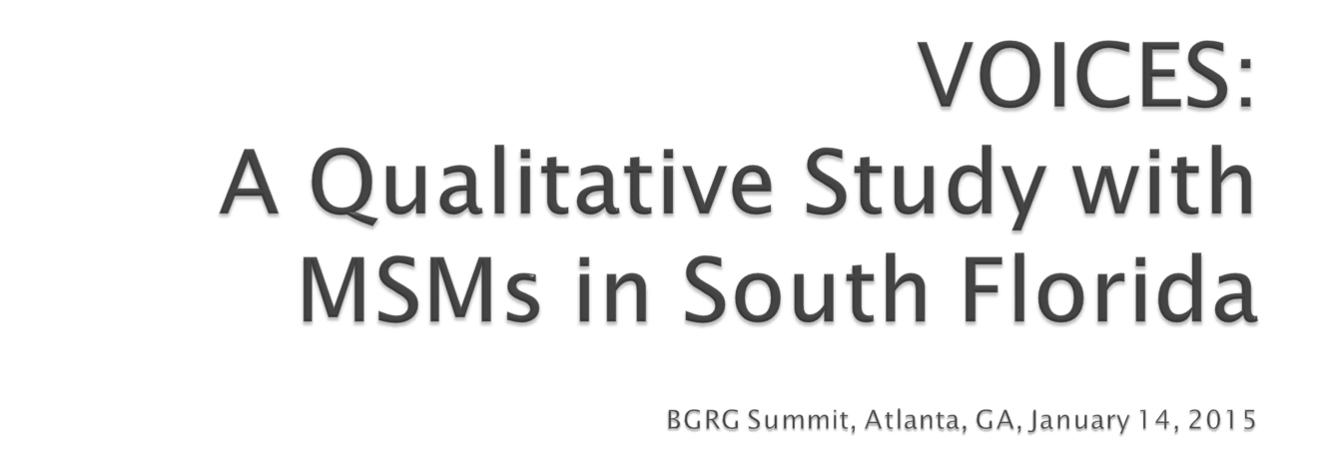

Slide 2

Gregory W. Edwards, Flowers Heritage Foundation, Oakland, CA
William Green, Broward, Health Care Services Section, Broward County, FL
Marsha A. Martin, Get Screened Oakland, Office of the Mayor, Oakland, CA and Urban Coalition for HIV/AIDS Prevention Services, Washington, DC-
Lead Consultant
William DiStefano, Get Screened Oakland, Oakland, CA
Leonard Jones, Human Services Section-Ryan White Part A, Broward County, FL

Slide 3

A Portrait of 2011
In Broward County, Florida, 21,100 persons lived with HIV disease
3,334 (15.8%) were unaware,
the largest number resided in Ft. Lauderdale.
1000 new cases of HIV were reported, showed an increase of 25% from 2010.
new cases affected persons between the ages of 40 and 49.
MSMs make up approximately 70% of all infections.

Slide 4

A multifaceted approach assessed the epidemic among gay, bisexual, and other MSMs:
community advisory workgroup
review of the literature
25 key informant interviews
17 focus groups with men of known and unknown HIV sero-status
4 focus groups with transgender women
consumer surveys.

Slide 5

What are the socio-sexual-cultural circumstances that lead to increased risk and transmission of HIV among gay, bisexual men and transgender women?

Slide 6

Young and older MSMs report and experience social isolation, disaffiliation and limited choices for socialization and healthy relationships.
Most feel HIV infection is inevitable or 'just a matter of time.'
For some gay men who have been living with HIV for more than 15 years, HIV messages are not relevant to their experiences.
The availability and accessibility of venues and multi-day circuit parties that promote sexual play and risk-taking behaviors also contribute to the spread of HIV among gay and bisexual men, and transgender women.
Online 'hookups' that advertise 'bareback sex play' create the perception that it is no longer a socio-sexual cultural norm to use protective barriers during sexual intercourse.
Having very limited venues for positive self-expression and health promotion, many gay and bisexual MSMs living with HIV experience shame, low self-esteem and isolation .

Slide 7

The Broward County HIV epidemic is influenced by socio-sexual-cultural economic dynamics.
Anonymous sex, alcohol, and crystal meth ease hardships associated with a lack of social and communications skills.
Loneliness, isolation, and exhaustive vigilance create “the perfect storm” of HIV infection.

