Slide 1

BGRG SUMMIT 2015
Homosexuality in Ghana; the myths, misconceptions and miseries.
By
Francis Boakye (KAKRA),Executive Director
Of

Slide 2
GENERAL MYTH ‘a widely held but false belief or idea’ -
Homosexuals are un-Godly and a curse
Homosexuality is align to our culture
Homosexuals are filthy
Homosexuals spell doom for Ghana
Homosexuals wear pampers/diapers

Slide 3
General Misconceptions
‘conclusions that are wrong because they are based on faulty thinking or facts that are wrong’.
Homosexuality is an evil spirit
Homosexuals are possessed by demons
Homosexuality is an import from the west
Homosexuality is not our culture
Homosexuality is a mental deficiency
Homosexuality can be treated

Slide 4
MISERIES
‘a state or feeling of great distress or discomfort of mind or body’
High rate of blackmail cases against ‘perceived or actual’ homosexuals
High rates of stigma-related death
High rates of HIV/STI infections(17.5%) prevalence.
Low self-esteem , family rejection and neglect.
Rampant suicidal attempts
Police detention and un-warranted arrest

Slide 5
PRIORITIES ON RIGHTS AND SEXUAL HEALTH’S EFFORTS
Empowerment seminars
Referrals to friendly healthcare services
Provision of pro-bono legal services/advice
Peer education
Prison visits
General personal development sessions

Slide 6
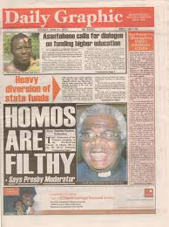

Slide 8
Notes:
Overall Population size
Ghana demographic data
Desk exercise
Using population estimates and estimated prevalence of MSM in populations in similar settings from the literature
Service multiplier
No service data available for Accra/Tema
Unique Object Multiplier
Outreach teams distributed beaded bracelets prior to data collection
Wisdom of the crowd
Median of the estimated number reported by participants in the MSM surveys in each study site
Mapping and Enumeration
Study teams mapped all MSM venues and conducted counts at selected venues during study period. Average counts applied to all venues.

Slide 9
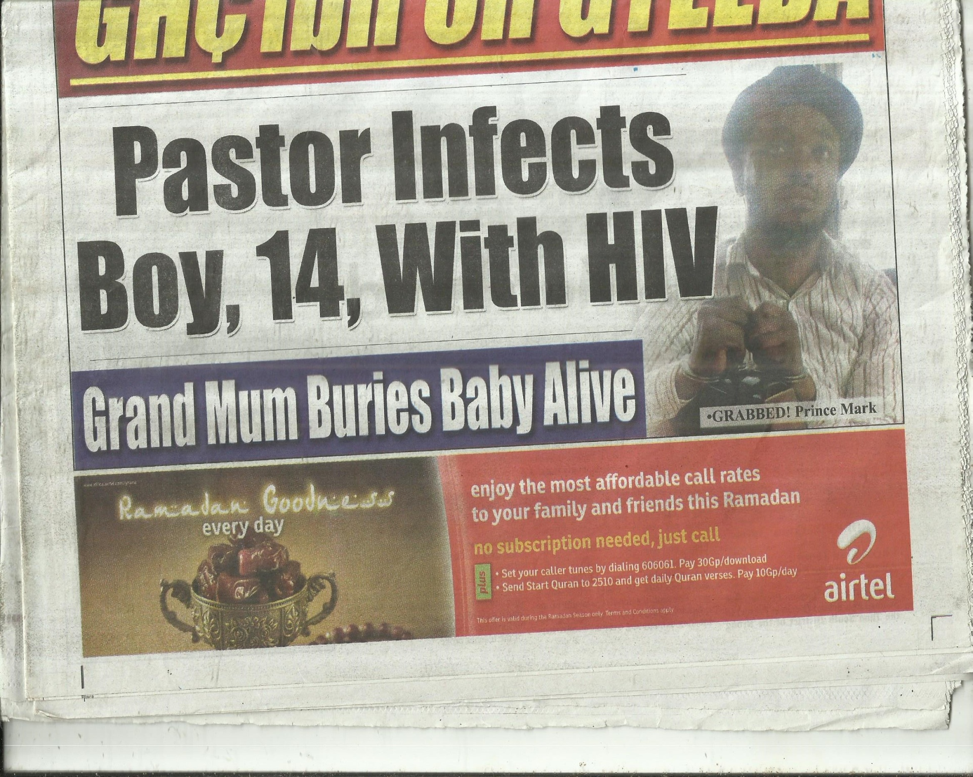

Slide 10
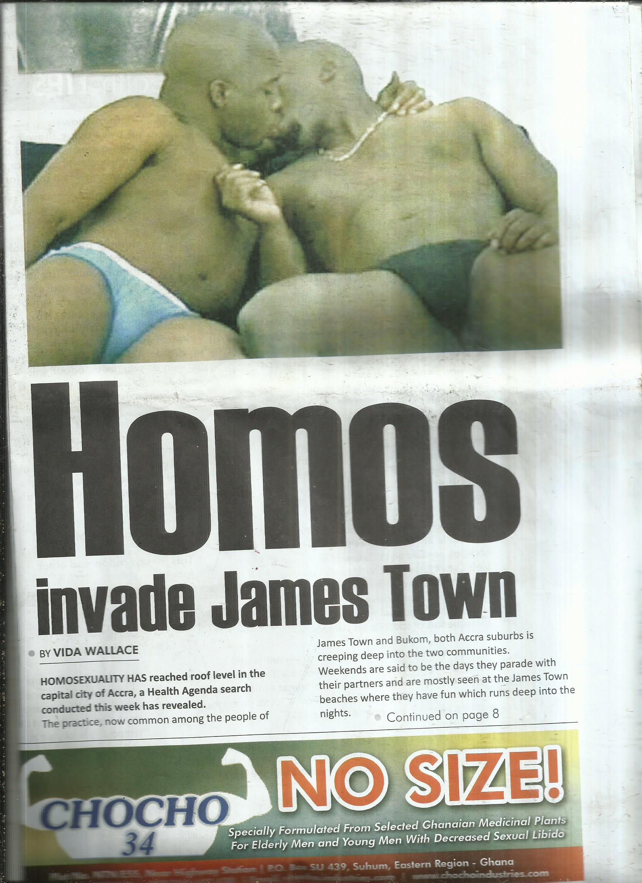

Slide 11
Thank You

