Slide 1
“Presenting yourself too ‘loud’ could get you killed”: Understanding Jamaican Masculinity and the Cultural Rejection of Effeminate Gay Men
Orlando O. Harris, PhD, RN, FNP
University of Rochester, School of Nursing
January 14th, 2015

Slide 2
Funding Sources & Support
United States Department of State, Institute for International Education (IIE)
    Fulbright Scholars Program
    US Embassy- Kingston, Jamaica
Center for AIDS Research (CFAR)
    University of Rochester Medical Center
University of the West Indies, Mona Campus
  Institute for Gender Development Studies

Slide 3
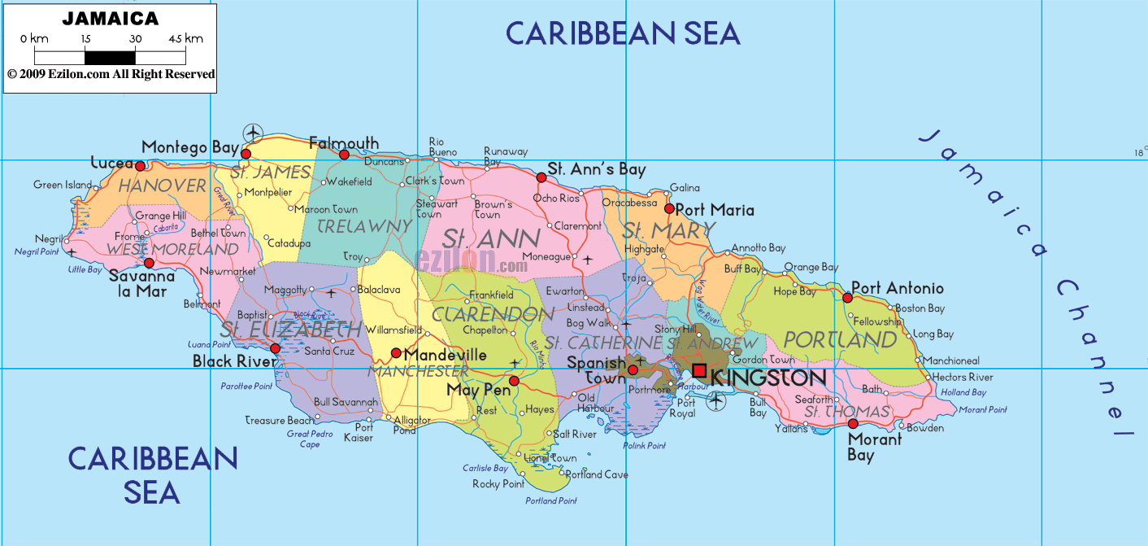
Map of Jamaica

Slide 4
Overview of HIV in Jamaica
Jamaican population = 2.8 million
    Adult HIV prevalence rate is 1.8%
HIV prevalence rate for JMSM is 38% (up from 32% in 2010)
    2/3 are unaware of their (HIV+) status
Approx. 32,000 people living with HIV
    Majority of the cases are among men
HIV infections cluster in two urban areas: Kingston/ St. Andrew & Montego Bay (St. James)
JMSM accounted for 53% of all new HIV infections in 2012
(Ministry of Health, 2010; UNAIDS, 2012)
Notes:
This speaks to HIV vulnerability for JMSM

Slide 5
Jamaican Masculinity
  Colonial Jamaica
  Masculinity in Jamaica is centered around biological and social indicators
    Gender, class, economic status, and cultural
  Afro-Jamaican male sexuality was perceived as animalist
    Male slaves were not given the opportunity to love
  Marriage or fatherhood was not considered to be a part of the colonizer’s plan for the Afro-Jamaican male
  Even though British colonial occupation ended in 1965, these views around masculinity persist today
(Chevannes, 1999; & Tafari-Ama, 2006)

Slide 6
Jamaican Masculinity
Post-Colonialism
  Men are perceived as sexually irresponsible, uneducated, proponents of violence, and dodgers of fatherhood
  Economic hardships allow for girls to attend school while boys are required to provide income for the family
    Boys “make life”, “juggle”, or “hustle” the streets
  Masculinity is synonymous with violence in the inner-city
    Rise of the “hyper-heterosexual” male or “rude boy”
  Violence against women and homosexuals, and sometimes male-on-male violence provide legitimate evidence of masculinity
  Homosexuality is seen as “un-Jamaican”
(Chevannes, 1999; & Tafari-Ama, 2006)
Notes:
“The passion therefore to which (dignified by the name of love) is ascribed the power of softening all the miseries of slavery, is mere animal desire, implanted by the great Author of all things for the preservation of all species. This the Negroes, without doubt, posses in common with the rest of the animal creation, and they indulge it, as inclination prompts, in an almost promiscuous intercourse with the other sex; or at least in temporary connection, which they form without ceremony, and dissolve without reluctance...”(Edwards 1793, reprinted in LaFont, 2001).

Slide 7
Enforcement of Jamaican Masculinity
Dancehall Culture
  Disrespectful to towards women and violent towards homosexuals
  The gun and the penis are synonymous
  Vulgar sexually explicit lyrics contribute to the hetero-normative discourse
Community
Mostly artists from poor inner-city communities
The definition of a “real man” in popular culture is a man from the ghetto
    “Dons” (gang leaders) are expected to have many women
    Any male (i.e., homosexuals) who does not fit in this category should be terminated
(Hope, 2010, & Stanley-Niah, 2006)

Slide 8
Jamaican Masculinity
Violent Homophobia
Homophobic violence is common
  Violent mob attacks are often preferred way to project fear
  Societal and Cultural condemnation of homosexuality has created a hostile living environment
Discrimination towards JMSM is sanctioned by law
  The “buggery” (sodomy) law punishes homosexual sexual behavior with imprisonment (maximum of 10 years)

Slide 9
Research Purpose
The purpose of this inquiry was to understand the circumstances that place JMSM at risk for HIV
Explore how they navigate their environment to enhance their personal safety

Slide 10
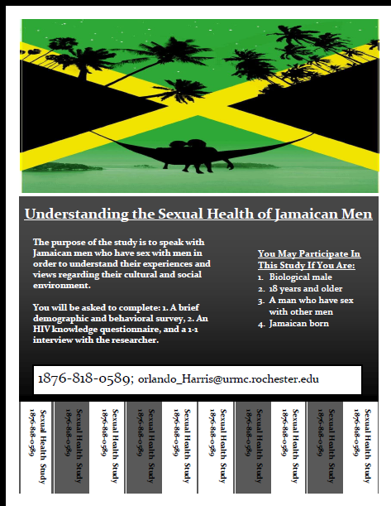
Methods: Design & Recruitment
Qualitative Description
  Individual semi-structured interviews
  Focus group discussion
Participants were recruited from
  A local university
  One community-based organization
Interviews and focus group discussions were recorded, transcribed, and analyzed using thematic content analysis

Slide 11
Sample
Participants self-identified as
  Gay (60%)
  Bisexual (40%)
Age of first sexual experience ranged from 7-24 years
 | n | %
Parish of Residency
St. James | 1 | 3
St. Catherine | 7 | 23
St. Andrew | 5 | 17
St. Thomas | 1 | 3
Kingston | 16 | 53
Age
18-20 | 8 | 27
21-24 | 16 | 53
25-29 | 6 | 20

Slide 12
Sample
 | n | %
Religion/Spirituality
Christian | 26 | 87
“Spiritual” | 1 | 3
Atheist | 2 | 7
None | 1 | 3
Levels of Education Completed
Grade School | 1 | 3
Some High School | 8 | 27
High School Diploma/GED | 4 | 13
Some College | 9 | 30
Associates Degree | 3 | 10
Bachelor’s Degree | 5 | 17

Slide 13
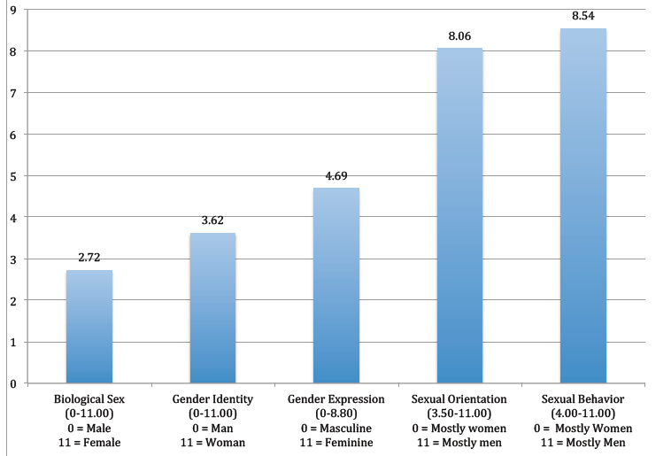
Gender Expression and Behavior

Slide 14
The Cultural Rejection of Effeminate Gay Men

Slide 15
Community-Level Acceptance
This level of homophobia common in inner-city areas
If you can pass or have family in the community…You stay
    Gender nonconforming behaviors are overlooked
    This privilege only applies to men who were born and raised within the space
If you were born and grew up in that community, they not going to trouble you… but if you are new there, and they see you move certain way, they might tease you and probably try to mob you. Sean (age 20)

Slide 16
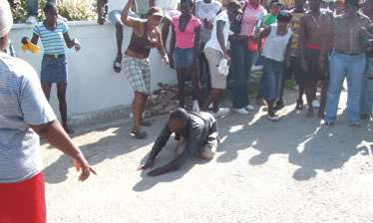
Community-Level Acceptance
With limitations:
If a group of men are hanging out in the community… and you know when they hangout, they drink and smoke. As feminine as I am, I can’t go there and drink with them…I don’t want them to kill me...I can’t go there and drink with them because they would say ‘battyman fi dead.’ I know my place so I won’t really go there to hang out. You understand? I would probably hang out more with the girls, so if the girls are drinking, me and them will drink and smoke. Zack (age 21)

Slide 17
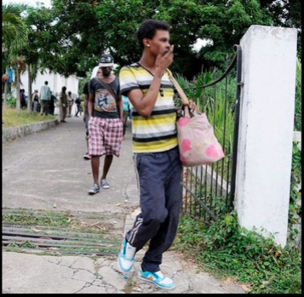
Rejection of Effeminate Gay Men
Gay men and trans women who refuse to conform to Jamaica’s explicit gender expectations have this heightened awareness of their environment
Gender bending or gender nonconforming presentation increases homophobia and HIV vulnerability in this context
We are aware and cognizant of our surroundings, so we are not going to present ourselves so ‘loud’ because it could get us killed. I remember when I was in primary school there was one guy in our community who people found out was gay because they caught him with another guy…. They stoned him… so he had to leave the community… So it was then that I realized that you have to know your surroundings. Mark (age 23)

Slide 18
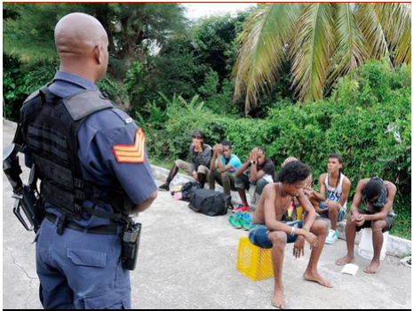
Rejection of Effeminate Gay Men
Gay youth are not exempt from community-level homophobia
I left the country and came to Kingston to live with my mother. I couldn't tolerate teasing coming from community members so I decide to run away after I was attacked. I guess I was too feminine to live there… so then my mother and siblings told me to cut down on my femininity and man-up. I love my make-up you know… so someone sent word to my mother saying that our safety was in jeopardy… so because I didn't want anything to happen to them or have the house destroyed... I left… I was 15 years old. Arron (age 24)
Notes:
Gender expressions that are incongruent with socially and culturally acceptable norms are rejected.
Feminine men from inner-city communities faced frequent acts of discrimination.

Slide 19
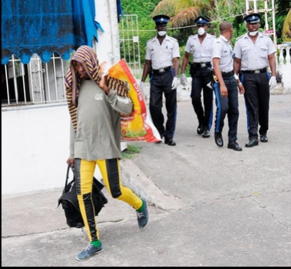
Always on the Move
Those who were forced to leave their communities found refuge in abandon homes
Engage in this “cat and mouse” relationship with law enforcement
Only to be forced out again by middle class people who do not want deviants in their upscale neighborhoods

Slide 20
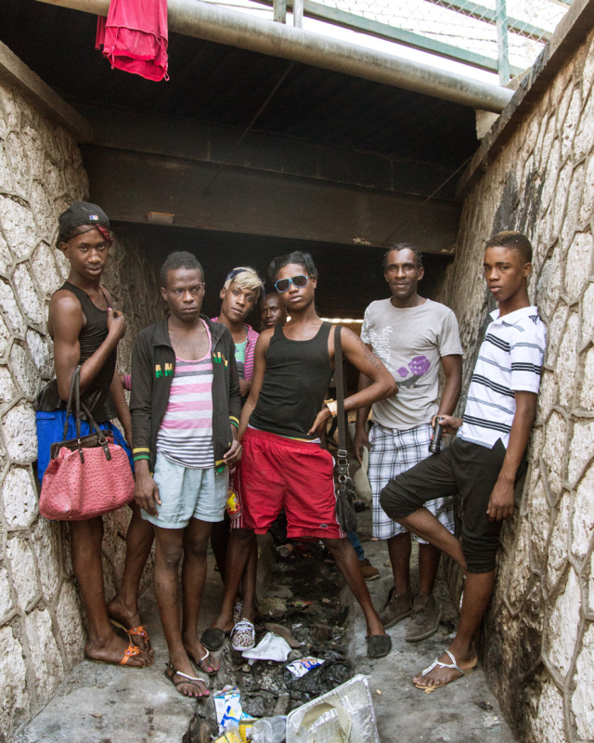
Building Community
Many of those men/youth find each other through word of mouth
Have created agency for themselves through building of a strong support network
Many found a home in the sewer system after being chased out of derelict buildings
These networks also provide protection and financial support

Slide 21
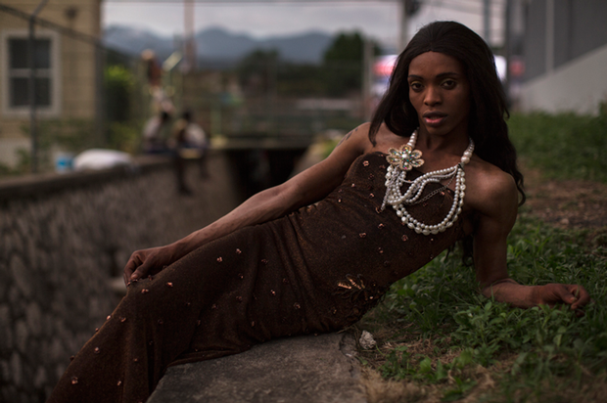
Beauty, Safety, and Survival
Providing for each other often includes participation in
  Commercial sex work
    Often older gay youth would engage in this activity to provide for the younger MSM
  Criminality (scamming, theft, etc.

Slide 22
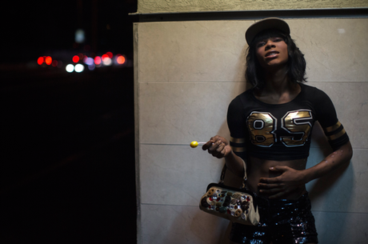
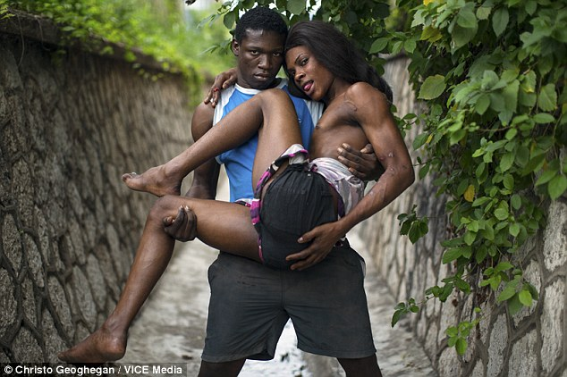
Resilience, Love, and Companionship

Slide 23
Survival Trumped HIV Concerns
Potential HIV infection was measured through a distal and proximal risk assessment.
  Proximal risk involved not being immediately concerned with HIV infection during intimate contact with their partners
  Distal risk involved the possibility of being caught in a “compromising situation” with their partners, or any other circumstances that might affect their personal safety.
Notes:
Reword bullet points

Slide 24
Protection In Public Spaces
Changing your appearance or dressing more masculine
“I try to act masculine in public to create an edgy version of myself around others who I know are against homosexuals.”
Avoiding being in the presence of more feminine JMSM in public
In most cases I would just try to act masculine in public. I create a edgy version of myself in public and around others who I know are strictly safe or who are against homosexuals… so basically just act rough or toughen up myself more than the real me… I’m never real unless I’m around good friends…I dress more clean, nothing that draws too much attention to anyone, just average. Kevin (age 21)

Slide 25
Implications: Clinical Practice
Advocate for the removal of structural barriers, including legal barriers, that inhibit access to prevention services
Sensitization and education of more culturally competent health care providers around issues related to
  Gender, gender identity, gender expression, sexuality, and sexual orientation
Improve public healthcare facilities so that they are accessible and welcoming
Screen for childhood sexual abuse and mental health disorders
Notes:
Privacy/ confidentiality issues when accessing health care services

