Slide 1

The Role of Women and MSMs in each other’s lives
Gail Wyatt, Ph.D.
UCLA Health, Hope, & Healing (H³)/BGRG Summit
January 14, 2015
Atlanta, GA

Slide 2
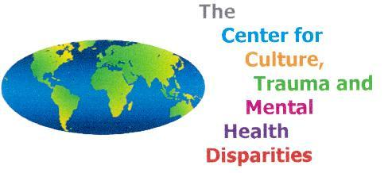
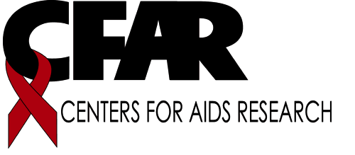
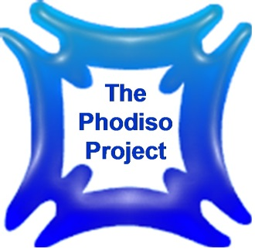
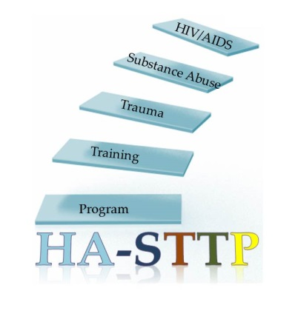

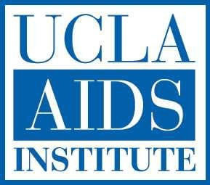

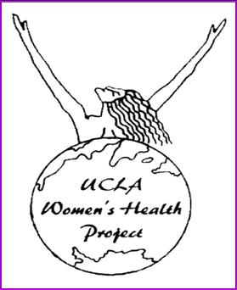
Eban II

Slide 3
Being Stolen For almost 400 years & their descendents were not allowed to:
Behaviors | Consequences
Control their sexuality | Externalized Control (someone made decisions for you)
Avoid sexual abuse | Normalization & Depersonalization (1 in 3 HIV-negative women, 1 in 4 HIV-negative men)
Avoid physical abuse/corporal punishment | Normalized as a sign of strength
Protect each other | Helplessness (observe and not act)
Talk to each other directly & have eye contact | Indirect/Poor communication (Secretism)

Slide 4
Being Stolen For almost 400 years & their descendents were not allowed to:
Behaviors | Consequences
Express anger, or break rules | Punishment, Torture, Isolation (over 40% incarcerated populations are Black)
Marry without permission | Tolerance for non-marital unions (51% Black women non-married)
Select sexual partners | Breeders, baby daddies and mamas
Learn to read and write | 50% of Black men are high school dropouts, 40% of unemployed Black men are 16-24 years old
Have control over health (Slave & Surgeon) | African Americans do not know their HIV status, get less care and die sooner than Whites

Slide 5



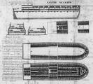

Stolen

Slide 6

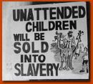
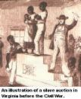
Splitting

Slide 7
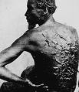
Punishment

Slide 8


Helplessness

Slide 9
Today Behaviors are the best HIV prevention strategies

Slide 10
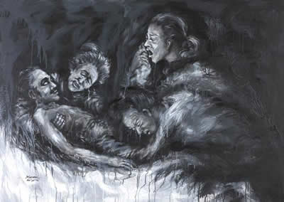
Unresolved grief, depression and trauma was overlooked
“Mary Don’t You Weep…”
“I Been Rebuked and I Been Scorned”

Slide 11
Examples of Coping
Their survival was enhanced by Religiosity and Spirituality
“Didn’t My Lord Deliver Daniel?”
Communication through Religion
“Steal Away…”
“Swing Low, Sweet Chariot”

Slide 12
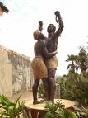
Examples of Coping
Interconnectedness
Valuing relationships over self

Slide 13
What is the Aftermath?
Segregated, inner-city housing and social networks breed sexual risk-taking
Black men with high school education – 30% chance of incarceration versus Black men without high school education – 60% chance of incarceration
Mate unavailability for women – Power/Prestige imbalance in relationship
Depression/Trauma/Grief
Teen Pregnancy – Baby mama/daddy
Secrecy/Poor communication about sex – Homophobia
MSMs still have a vital role to play in families, work, and communities

Slide 14
Sexual Health Model
Risky Sexual Practices
History of Sexually Transmitted Diseases
Sexual Ownership
Body Awareness
Religious / Spiritual Beliefs
Interconnectedness
Substance Abuse
Cultural Beliefs

Slide 15
The Sexual Health Model is a conceptual framework to acknowledge these values and to reframe them within an HIV prevention context.
Interconnectedness addresses the common belief that being in a relationship with one’s group or having a family defines and enhances personal value. However, personal health along with family ties and social networks is promoted, regardless of relationship status.*
*Wyatt, GE (2009). Enhancing cultural and contextual intervention strategies to reduce HIV/AIDS among African Americans. American Journal of Public Health, In press.

Slide 16
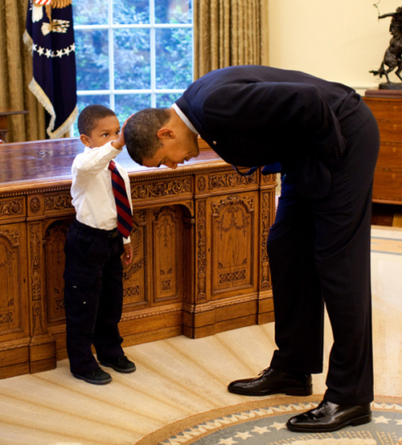
Change is Real Now.
Just as most of us still can't believe our eyes, just think how every young black boy in America now sees himself, for the rest of his life, with the election of someone who's hair looks like his...brings tears to your eyes. That's why we have to save them now from destroying themselves.
This a recent photo of a little boy visiting the White House. He wanted to feel Obama's hair because he wanted to know if the President's hair felt just like his. Obama obliged. Priceless.

Slide 17
Example of Interconnectedness
Principle | Women | Men
If you can’t love the one you want, love the one you’re with. | Love the one you want. | Love the one you’re with.

Slide 18
Body awareness…
… addresses cultural and religious prohibitions about body touching, condom and contraceptive use and some sexual practices. Knowledge about how the body works, diet and exercise for a healthy body image, mind-body health, and skills to identify and articulate problems that require treatment are provided.*
*Wyatt, GE (2009). Enhancing cultural and contextual intervention strategies to reduce HIV/AIDS among African Americans. American Journal of Public Health, In press.

Slide 19
Sexual ownership…
… addresses historical and personal patterns of externalized control and promotes skills to prevent these experiences by assessing risky people, risky behaviors and risky circumstances that can limit self protection. Personal responsibility for sexual and physical health and communication about sexual orientation is emphasized.*
*Wyatt, GE (2009). Enhancing cultural and contextual intervention strategies to reduce HIV/AIDS among African Americans. American Journal of Public Health, In press.

Slide 20
Conflicts that Women Encounter
The Nurturer
The Last to Know
The Hostage

Slide 21
Six Steps to where we go from here?
Redefine interconnectedness so that non sexual relationships can engender respect, trust and honesty.
The best practice of disclosing sexual orientation or behaviors to someone who does not know about their partner is to encourage the person with the secret to disclose themselves
Advocate for HIV prevention for women

Slide 22
Six Steps to where we go from here?
Women and men need to better understand their realities, accept them and get support for who they are
Retain anatomical descriptions and discussions of how men and women become HIV infected-you never know who may be listening and need to know
Understand what the personal, psychological and health related costs of secrecy and decide to advocate for HIV in our communities. Change needs to come from within

Slide 23
