Slide 1
Mentor Sessions
Batch I – START 29 February 2020

Slide 2
AIM
Get to understand how to start an (analytics) project
Work with simple models and approaches to understand the real thing
Gain insight in data and understand what you want to do
Time box and plan your work (just like in the real world… ;-) )

Slide 3
approach
Any topic in the field of analytics or data science
Should be doable in a period of 12 weeks
Mentoring on topic selection, and while working on the solution
Peer discussions to learn from each other
Additional help if required (but limited)
Weekly meetings to discuss progress and keep the deadlines
Providing additional resources for any

Slide 4
program
Date | Deliverable
Week 1 - 29 February 2020 | Introduction + kick-off
Week 2 – 7 March 2020 | Topic selection + plan
Week 3 - 14 March 2020 | Discussion
Week 4 - 21 March 2020 | Concept I
Week 5 - 28 March 2020 | Discussion
Week 6 – 4 April 2020 | Concept II
Week 7 - 11 April 2020 | Discussion
Week 8 - 18 April 2020 | Draft I
Week 9 - 25 April 2020 | Discussion
Week 10 – 2 May 2020 | Discussion
Week 11 - 9 May 2020 | Discussion on final approach
Week 12 – 16 May 2020 | End presentations and closure

Slide 5
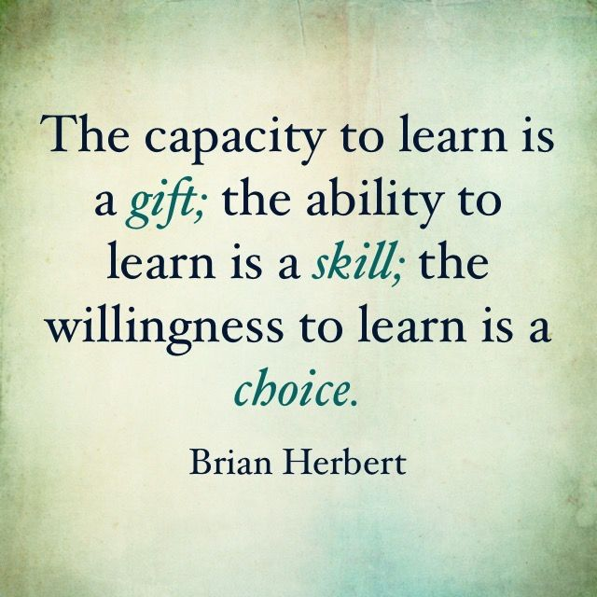
Expectations from you
Your dedicated time to work on your solution in the 12-week period
Feel free to fail, this is just for learning

Slide 6
What to Expect from me
mentoring on working on a solution
Help with selecting topic and creating plan
If required additional discussions on approach

Slide 7
Timings
Weekly meeting every Saturday 11:00 am IST (skype)
If any specific questions, please forward those before the meeting
5-10 minutes speaking time each
Whatsapp group to inform others about presence (in case you cannot make it to a meeting
I will be available during the week, but only limited

Slide 8
problem
Choose a topic or problem you would like to tackle (or choose from the list)
Make a 11-week plan to work on this

Slide 9
Data sets
Kaggle
Internet
Other?

