Slide 1

You Only Look Once:
Unified, Real-Time Object Detection
Joseph Redmon, Santosh Divvala, Ross Girshick, Ali Farhadi
Made by Maxewell
Notes:
YOLO：一种实时性较强的目标检测模型

Slide 2
Abstract
Frame object detection as a regression problem.
A single neural network.
End-to-end
Real-time at 45 frames per second
Makes more localization errors
Less likely to predict false positives on background
General representations
Notes:
YOLO：一种实时检测性较强的目标检测模型。
1.将目标检测问题转化为回归问题
2.是一个单一的神经网络
3.具有端到端的学习特性
4.具有实时性，每秒钟可检测45帧的图像信息
5.相对来说会产生更多定位的错误信息但对于背景的预测错误率较小
6.泛化性能较好

Slide 3
01
Part one
Introduction

Slide 4
Introduction
Current detection systems ：repurpose classifiers to perform detection
deformable parts
models (DPM)
sliding window
slow and hard
to optimize!
trained separately
Object detector
R-CNN series（fast R-CNN，faster R-CNN）
region proposal
Notes:
传统的目标检测系统一般由分类问题转化而来.
DPM使用滑动窗口，R-CNN系列使用建议区域；
但是这些系统检测速率相对较慢，且不易优化。
因为他们的组件是独立进行训练的。

Slide 5
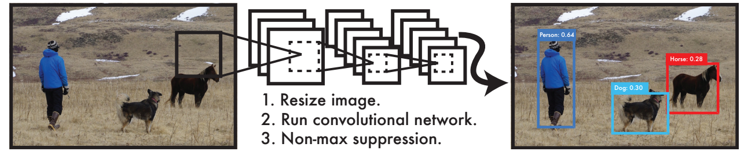
Introduction
a single regression problem
straight from image pixels
This paper :
YOLO!
bounding box coordinates and class probabilities
Trains on full images and directly optimizes detection performance
Notes:
本文中提出的YOLO算法，实现了一个简单的回归问题
仅对于像素进行处理
并对盒边界与分类概率进行预测

Slide 6
Introduction
Extremely fast
benefits
Reasons globally about the image when
making predictions.
Learns generalizable representations of objects
Still lags behind state-of-the-art detection systems in accuracy
While it can quickly identify objects
Notes:
三大优势：快速，全局思考，泛化性能；
在准确率上相对目前主流目标检测系统较差,但检测速度较快

Slide 7
02
Part two
Unified Detection

Slide 8
Unified Detection
Predicts B bounding boxes
input image
S × S grid
Confidence scores
（a object or not? Accuracy?）
predicts C conditional class probabilities
(x,y): the center of the box
w,h: predicted relative to the whole image
bounding boxes’predictions
Confidence: represents the IOU between the predicted box and any ground truth box
Notes:
系统将输入图像分为S * S 的网格，对于每个网格，预测B个边界盒，以及信心值，以及C个条件类概率
每个边界盒有5个参数：xy是边界盒的中心，wh是相对于整个图像的宽与高
以及边界盒与gt的IOU值

Slide 9
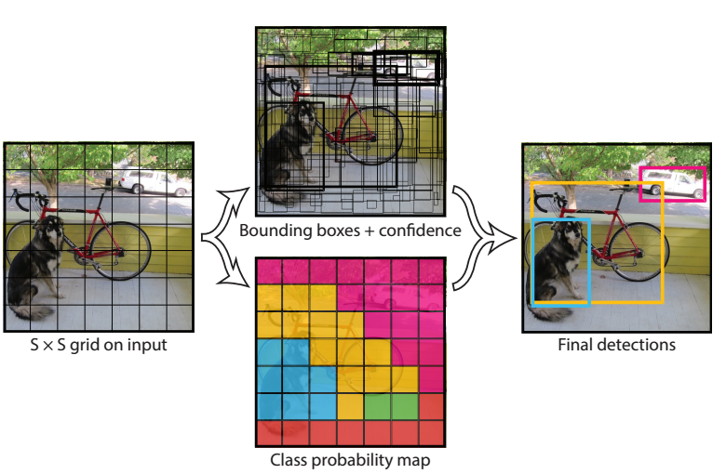
Unified Detection
Divides the image into an S × S grid and for each grid cell predicts B bounding boxes, confidence for those boxes, and C class probabilities. These predictions are encoded as an S × S × (B ∗ 5 + C) tensor.

Slide 10
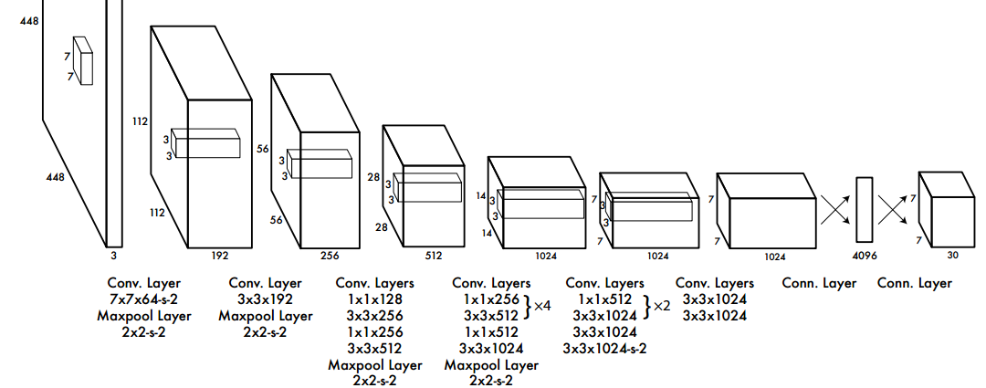
Unified Detection
2.1. Network Design
24 convolutional layers followed by 2 fully connected layers
simply use 1 × 1 reduction layers followed by 3 × 3 convolutional layers
pretrain the convolutional layers on the ImageNet
The final output ：7 × 7 × 30 tensor of predictions.
Notes:
此网络使用了24卷积层，2个全连接层，使用1*1的卷积核削减特征空间。使用ImageNet进行与训练；

Slide 11
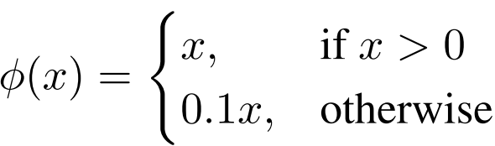
Unified Detection
2.2. Training
1.pretrain: ImageNet 1000-class competition dataset
2.Input resolution 448 × 448
3.Normalize the bounding box width and height by the image width and height
(they fall between 0 and 1. )
4.Parametrize the bounding box x and y coordinates to be offsets of a particular grid cell location (they are also bounded between 0 and 1)
5. Activation function: leaky ReLU
6. Batch size: 64; Momentum 0.9 ;Decay 0:0005.
Notes:
此网络使用了24卷积层，2个全连接层，使用1*1的卷积核削减特征空间。使用ImageNet进行与训练；

Slide 12
Unified Detection
2.3. Limitations
Spatial constraint limits the number of nearby objects that our model can predict.
Struggles to generalize to objects in new or unusual aspect ratios or configurations
Loss functions treats errors the same in small bounding boxes versus large bounding
boxes
Notes:
YOLO的局限性：
具有空间的局限性，限制了预测邻近目标的数量；
努力去将目标泛化为新的不同尺度或配置
损失函数在不同大小的边界盒中，对于误差处理的程度相同

Slide 13
03
Part THREE
Experiments

Slide 14
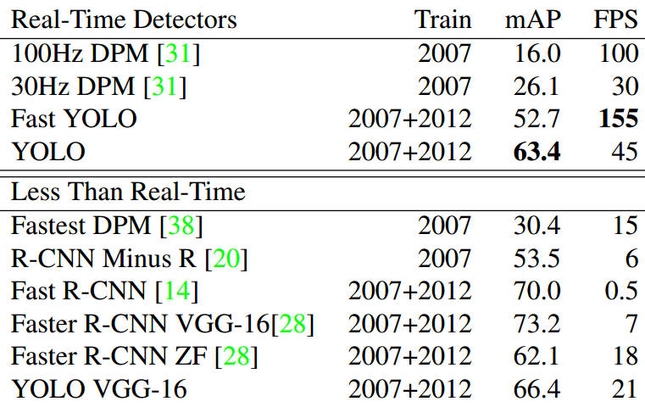
Experiments
3.1. Comparison to Other Real-Time Systems
Fast YOLO is the fastest detector on record for PASCAL VOC detection and is
still twice as accurate as any other real-time detector. YOLO is 10 mAP more accurate than the fast version while still well above real-time in speed.
Notes:
YOLO的局限性：
具有空间的局限性，限制了预测邻近目标的数量；
努力去将目标泛化为新的不同尺度或配置
损失函数在不同大小的边界盒中，对于误差处理的程度相同

Slide 15
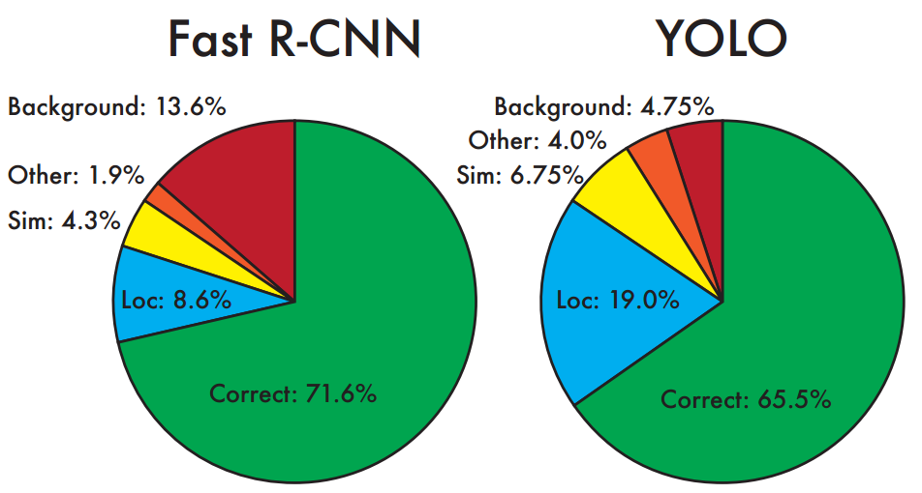
Experiments
3.2. VOC 2007 Error Analysis
Error Analysis: Fast R-CNN vs. YOLO These charts show the percentage of localization and background errors in the top N detections for various categories (N = # objects in that category).

Slide 16
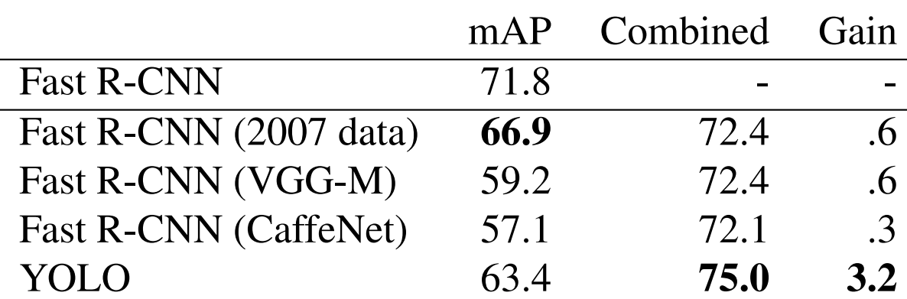
Experiments
3.3. Combining Fast R-CNN and YOLO
Other versions of Fast R-CNN provide only a small benefit while YOLO provides a significant performance boost.

Slide 17
Experiments
3.4. VOC 2012 Results
On the VOC 2012 test set, YOLO scores 57.9% mAP.
Lower than the current state of the art
Closer to the original R-CNN using VGG-16
Fast R-CNN + YOLO model is one of the
highest performing detection methods. Fast R-CNN gets a 2.3% improvement from the combination with YOLO

Slide 18
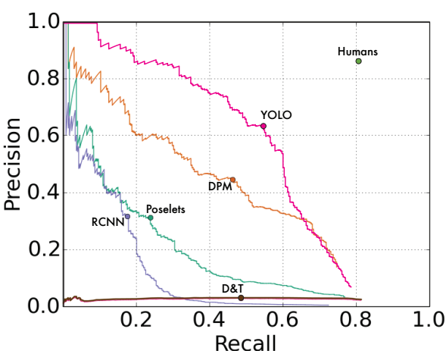
Experiments
3.5. Generalizability: Person Detection in Artwork
YOLO has good performance on VOC 2007 and its AP degrades less than other methods when applied to artwork
Notes:
使用YOLO进行泛化，识别人类艺术作品中的目标，YOLO表现良好

Slide 19
04
Part four
Conclusion

Slide 20
Conclusion
Our model is simple to construct and can be trained
directly on full images. Unlike classifier-based approaches,
YOLO is trained on a loss function that directly corresponds
to detection performance and the entire model is trained
Jointly.

