Slide 1

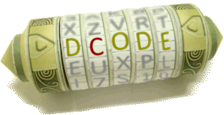

Ez crypto wins tools

