Slide 1

Nmap and reconnaissance

Slide 2

Course plan:
Basics you should know
Communication protocols
Let’s start with Nmap !

Slide 3
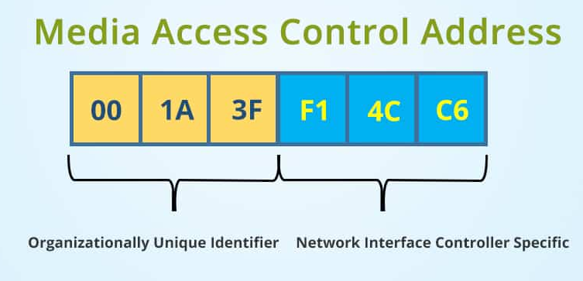
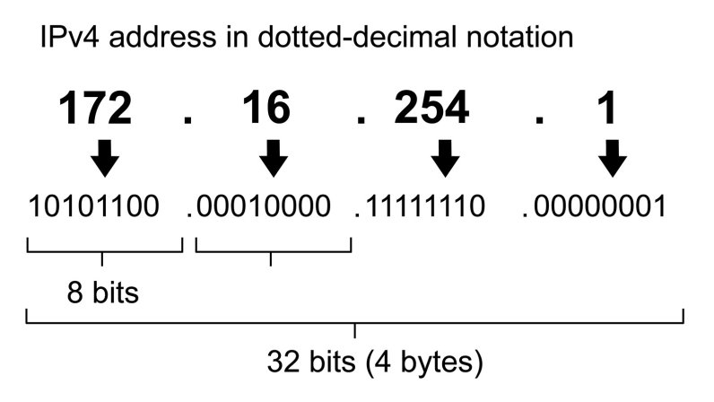
Basics you should know
MAC address (Media Access Control address): A unique identifier assigned to network interface controller. It’s represented by 6 groups of 2 hexadecimal digits.
IP address (Internet Protocol address): A numeric label that is connected to a computer network. It’s assigned with the DHCP (Dynamic Host Configuration Protocol) in a network. There are IPv4 on 32-bits and IPv6 on 64-bits.
Port: Communication endpoint

Slide 4
Communications protocols

Slide 5
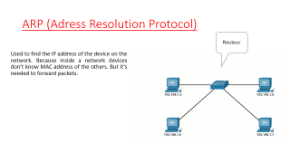
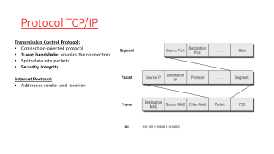
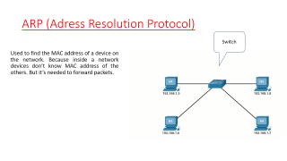
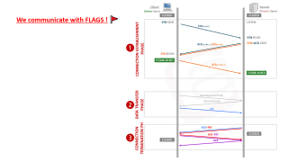
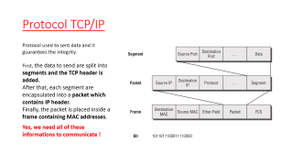
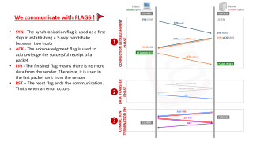
TCP/IP protocol
What is it ?
How do we know the MAC address ?
How it works ?

Slide 6
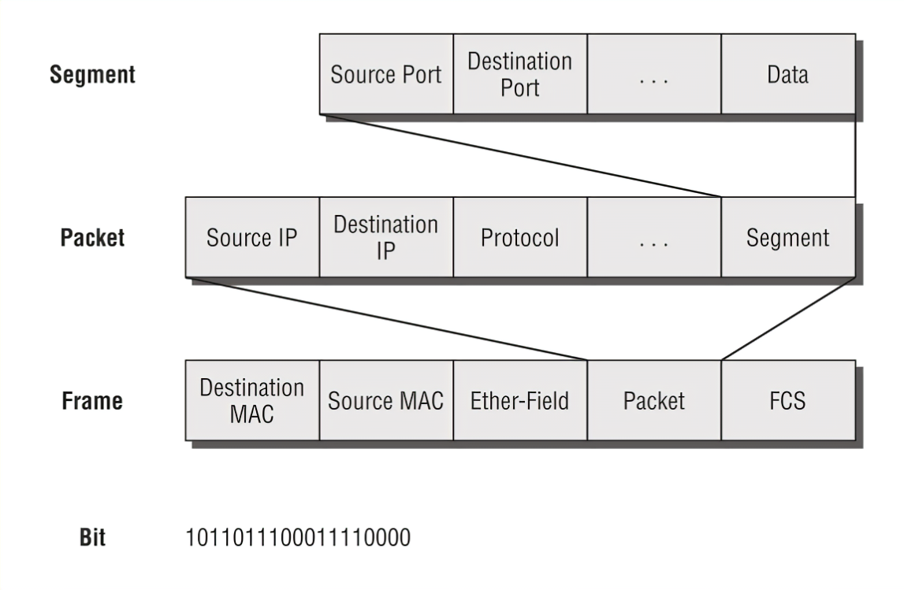
Protocol TCP/IP
Transmission Control Protocol:
Connection-oriented protocol
3-way handshake: enables the connection
Splits data into packets
Security, integrity
Internet Protocol:
Addresses sender and receiver

Slide 7
ARP (Adress Resolution Protocol)
Switch
Used to find the MAC address of a device on the network. Because inside a network devices don’t know MAC address of the others. But it’s needed to forward packets.

Slide 8
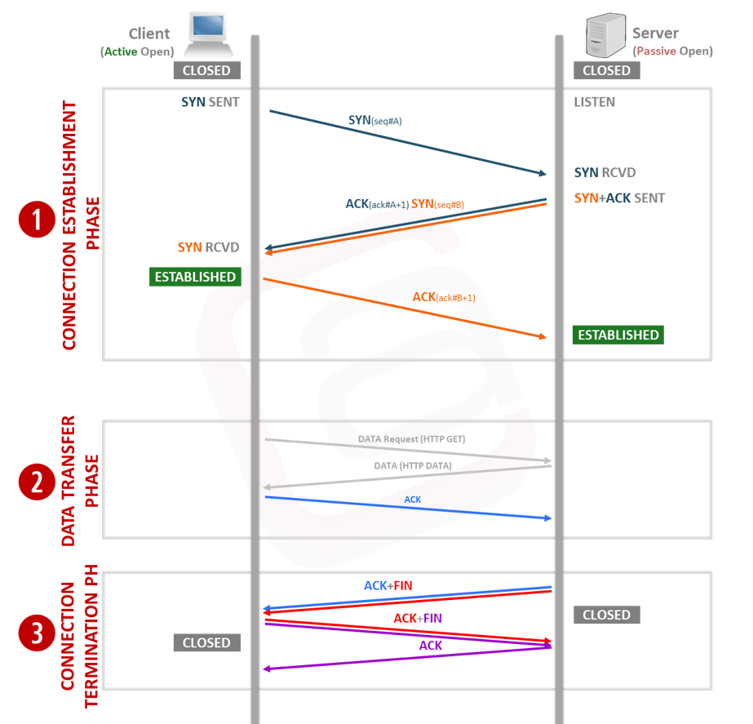
We communicate with FLAGS ! 🚩
SYN - The synchronization flag is used as a first step in establishing a 3-way handshake between two hosts
ACK - The acknowledgment flag is used to acknowledge the successful receipt of a packet
FIN - The finished flag means there is no more data from the sender. Therefore, it is used in the last packet sent from the sender
RST – The reset flag ends the communication. That’s when an error occurs

Slide 9

Reconnaissance with nmap ⚔

Slide 10
Be careful ⚠️
Do not scan an IP address if you are not authorized !
It’s used for both attack and defense
You can see Nessus software, which is a tool for scanning and discovering vulnerabilities on ports

Slide 11
Basic nmap commands and options:
Options | Description
-p | Selects the range of ports number
-T[1/2/3/4] | Selects the speed
-O | Detects the operating system
-sn | No port scanning
-vv | Displays more information
-sC | Use script on each port
Installation: sudo apt-get install nmap
Command: sudo nmap <IP> [OPTIONS]
Example command:
sudo nmap IP_ADDRESS –p [PORTS] [SCAN OPTIONS]
More information: man nmap or nmap –help for more informations
https://nmap.org/book/inst-linux.html

Slide 12
Host discovery: 🔎
Discover more host in a subnetworks
Examples:
Sudo nmap scanme.nmap.org/24 –PR –sn
Sudo nmap scanme.nmap.org/24 –PE –sn
Options | Description
-PR | Use ARP
-PE | USE ICMP echo
-PS | Use TCP SYN
Etc…

Slide 13
Port scanning:
Scan ports to get more information
Examples:
Scan with TCP from port 1 to 1000:
Sudo nmap scanme.nmap.org –sS –p1-1000
Scan all ports with UDP:
Sudo nmap scanme.nmap.org -sU –p-
Options | Description
-sT | TCP scan
-sS | TCP scan with RST at the end
-sU | Use UDP
-sV | Display version

Slide 14
Firewall detection: 🛡
In this case nmap can indicate several results:
Open/filtered: port is open or protected by a firewall
Close: port is closed
unfiltered: no firewall
“ If the connection does not exist (CLOSED) then a reset is sent in response to any incoming segment except another reset”
Consequently, if the port is open or filtered, we don’t get answer with sN, sF and sX. But if the port is open, we get an answer with sA.
Options | Description
-sN | No flag
-sF | TCP FIN flag
-sX | FIN, PSH, and URG flags simultaneously
-sA | TCP ACK flag

Slide 15
Spoofing, Decoys and zombies: do not use that
Spoofing consists to usurp it’s IP address by another one
Decoys consists to use several IP address, amount them there is ours
Zombie / idle host consists to use a remote system
Options | Description
-S <spoofed_ip> <target_ip> | Spoofing
-D <list of IP> <target_ip> | Decoys
-Si | Zombie scan

Slide 16
Thank you ! 😀

