Slide 1
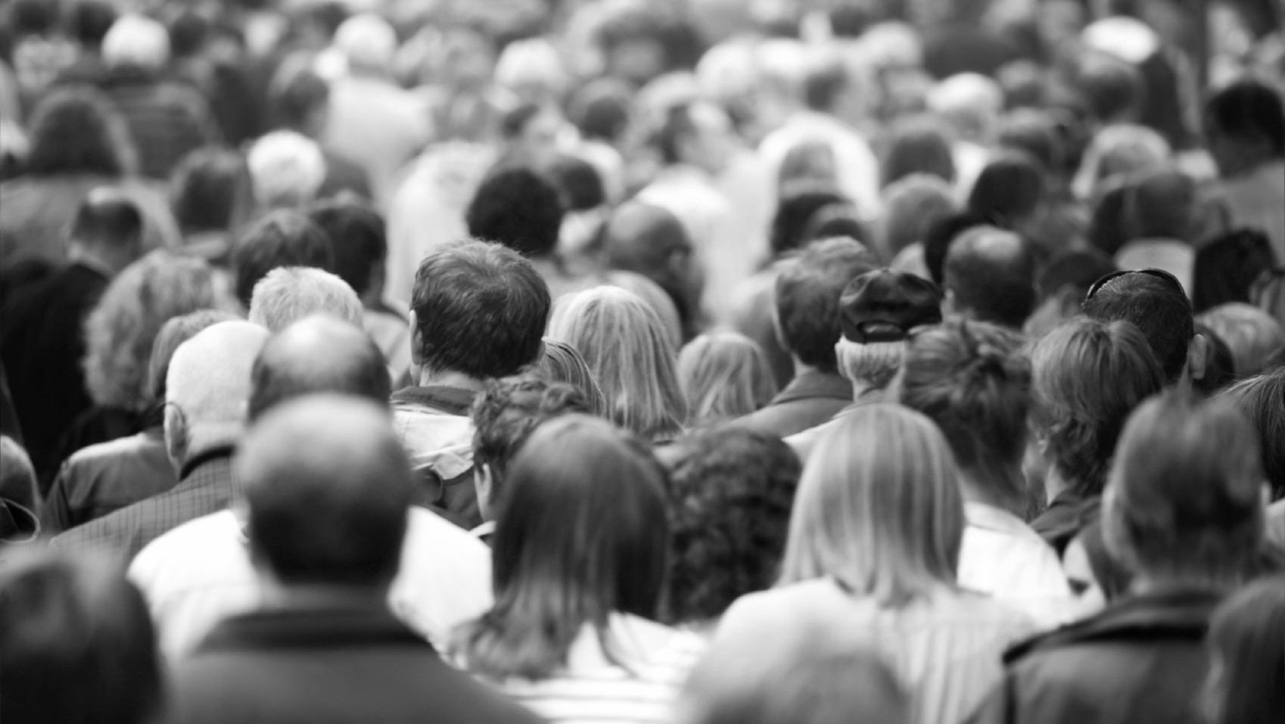
Heterogeneity of desired speed in crowd dynamics
Group 5: Daniel Vink, Frantisek Bartos, Abinash satapathy, Corien van kleij
Notes:
CORIEN

Slide 2
Table of Contents
Motivation
Research question
Method
Results
Conclusion
Q&A

Slide 3

Motivation
Crowd dynamics:
Complex system
Interesting practical applications: safe design for big events
Heterogeneity of desired speeds:
Example of different heterogeneity:
Only young people
Old and young people
Notes:
CORIEN
Our motivation to do research on the topic of crowd dynamics has two reasons. First, crowds pose an interesting example of a complex system in which emergent behavior is observed out of interaction of many individual agents. Besides that, modelling crowd dynamics does have interesting practical applications, think for example about the safe design for big sport or music event, especially in case of possible emergency situations.
In our research question we are especially interested in how the heterogeneity of desired speeds influences the crowd dynamics. Imagine a situation were a lot of people come together, like a big sport event, or a music event. One can image that the crowd behaviour is different dependent on the speed everyone wants to go. For example the behavior might be different for a more homogeneous group (like all young people) compared to a more mixed group with old and young people in it, with very different desired speeds (as old people walk more slowly compared to young people). It could be that the crowd dynamics of the first group are very different from the dynamics of the second group. If we want to learn how to make a good design for a big event, it might be interesting to see how obstacles effect the crowd behaviour as well. For example, one could potentially increase the flow of people with certain objects, or see that people are slowed down by certain specific placed objects.
Link afbeelding: Free Vector | Diverse crowd of people of different ages and races (freepik.com)

Slide 4
Research question
How does the heterogeneity in desired speeds influence the congestion and throughput?
Higher heterogeneity will lead to decreased outflow (defined as number of agents escaping the area per second) and more congestion.
Two types of heterogeneity:
Different variances in desired speed (remaining the same during the simulation)
Changing the desired speed of a few people during the simulation
Does the heterogeneity in desired speed influence interaction with different obstacles?
The effect might be slightly more pronounced for different obstacles, but we do not have any a priori predictions.
Notes:
CORIEN
Based on our ideas of the previous slide about our interest in heterogeneity of speed, we specified our questions into a research question.
We split our research question into two parts. The first question is: how does the heterogeneity in desired speeds influence the congestion and throughput? With ‘higher’ heterogeneity we mean that there is a bigger difference between the desired speeds of different people. We are expecting that higher heterogeneity will lead to a decreased outflow and more congestion. The reason why we are expecting this is that when all people want to go approximately at the same speed, people will be more in the same ‘flow” whereas people with different speeds have probably more interactions with each other, in other words slowing each other down. Think for example at a fast people behind a slow person, the fast person needs to slow down in that case.
As it is of course impossible to look at all cases of different heterogeneity, we will limit ourselves to two cases: first we will see what the influence is of different variances in the desired speed. That means that we will give people a certain desired speed based on a normal distribution with always the same mean but for different standarddeviations. Thus lower sd is lower heterogeneity. Because we kept the average the same, you would expect the throughput to remain the same, in case there were no interactions happening. So that means that we can be sure that the effect of different variances in speed must come from the interactions between persons.
The second situation we would like to investigate is what would happen if a certain person slows down very fast at a certain point (image for example someone looking at a window of a store).
Our second research question is: does the desired speed influence the interactions with different obstacles? We are expecting that the effect might be slily more pronounced for different obstacles, but we do no have any a priori predictions.
By answering these questions, we will get a better insight in what way the heterogeneity in the desired speeds influences the crowd dynamics. However, these answers are of course restricted to the specific settings we used, like the model we choose to use, and the type of obstacles we choose, as we will explain more about in the method part.

Slide 5
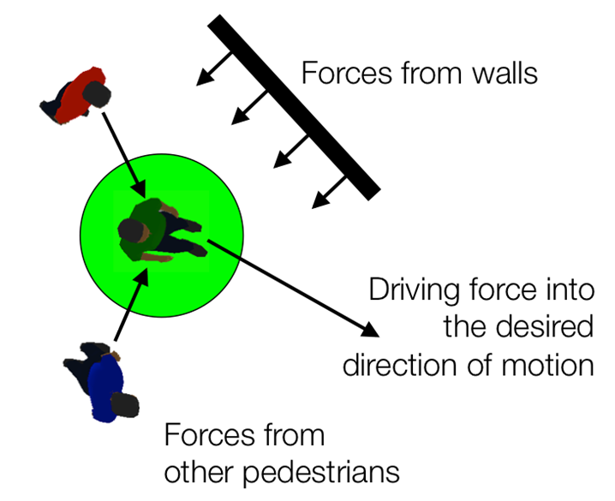
Method - model
- Crowd behavior modelled by a social force model
I.M. Sticco, G.A. Frank, C.O. Dorso, Social Force Model parameter testing and optimization using a high stress real-life situation, Physica A: Statistical Mechanics and its Applications, Volume 561, 2021, 125299, ISSN 0378-4371
Helbing, Dirk & Molnar, Peter. (1998). Social Force Model for Pedestrian Dynamics. Physical Review E. 51. 10.1103/PhysRevE.51.4282.
Notes:
CORIEN
The main assumption we made is that crowds behave as a social force model. Explain model by picture
Explain all parameter settings of the model:
Desired velocity → from paper mike lees
Radius by another paper based on empirical measurements
Mass: 80 kg (remaining parametervalues used from the paper of Helbing
Tau: time until a person is going back to his desired speed when disturbed by wall/people
Kappa: stiffness contstant to handle overlapping
Delta: to maintain a certain distance from a person
F: repulsion force between people
Fwall: repulstion force between people and the wall
Eta: friction coefficient

Slide 6
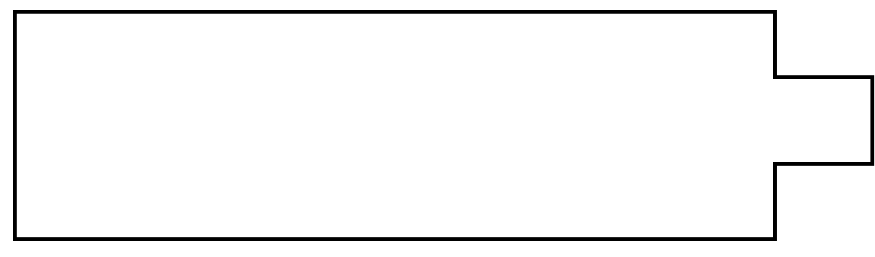
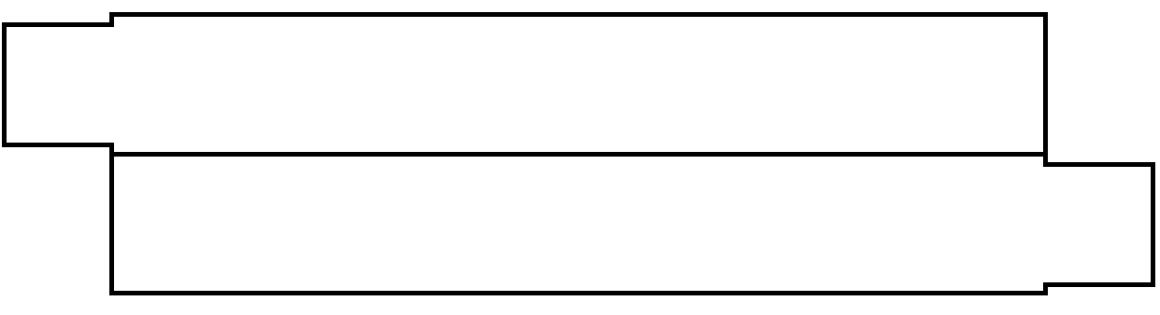
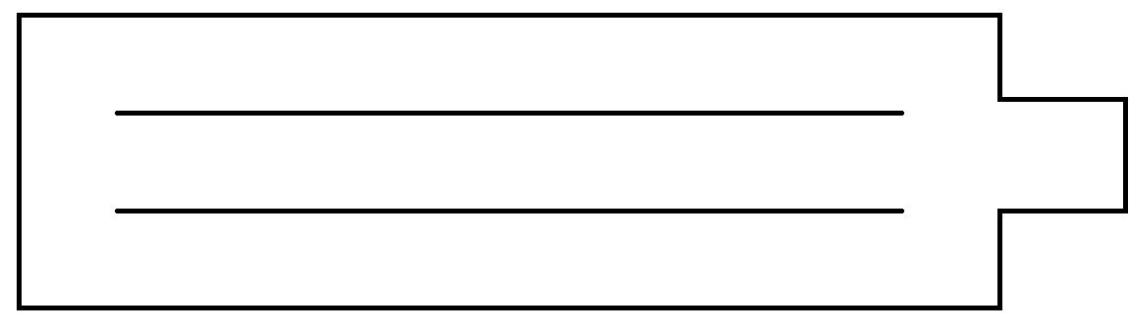
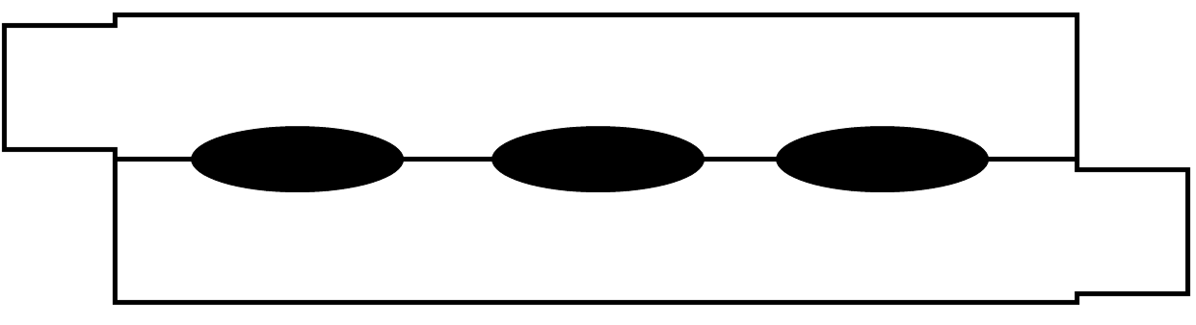
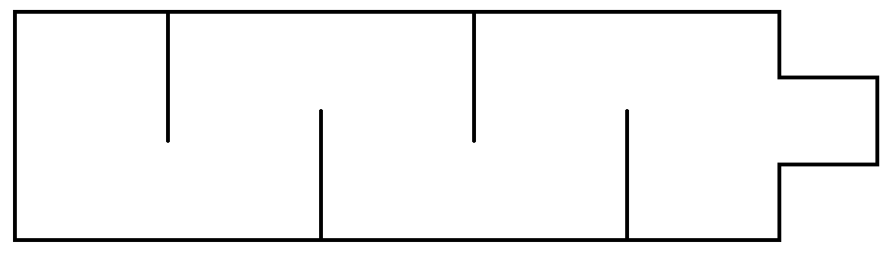
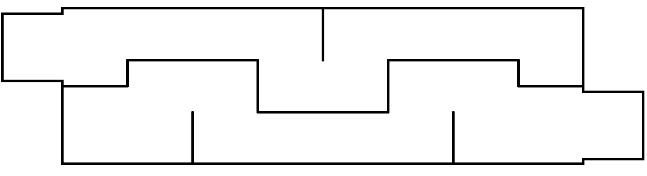
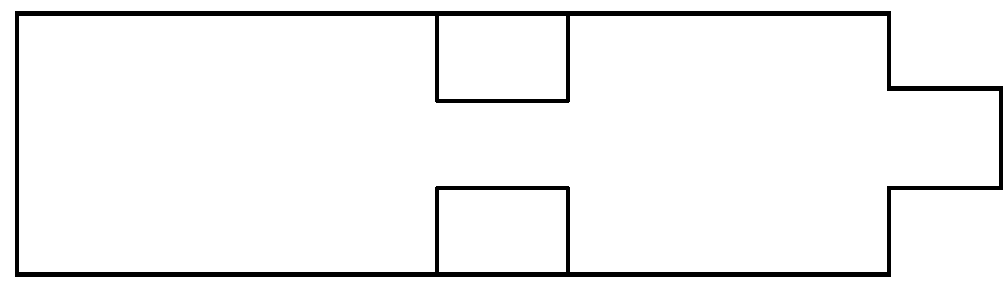
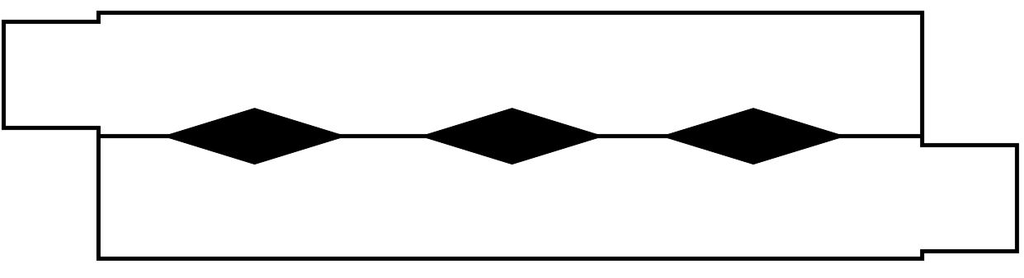
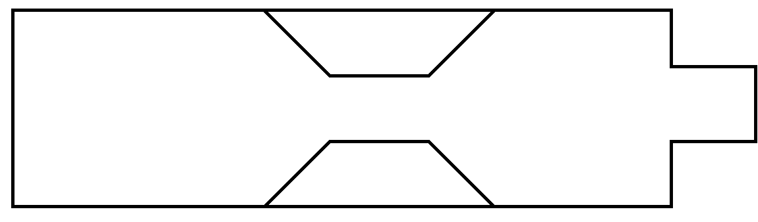
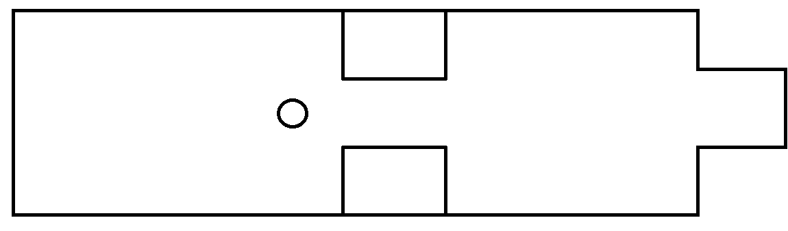
Method – maps
- different obstacles:
Unidirectional maps |  | Bidirectional maps
A0 |  | B0
A1 |  | B1
A2 |  | B2
A3 |  | B3
A4
A5
Karbovskii, Vladislav & Severiukhina, Oksana & Derevitskii, Ivan & Voloshin, Daniil & Presbitero, Alva & Lees, Michael. (2018). The Impact of Different Obstacles on Crowd Dynamics. Journal of Computational Science. 36. 10.1016/j.jocs.2018.06.010.
Notes:
CORIEN
Add reference to paper

Slide 7
Method – simulation settings
Manipulating standard deviation of the desired velocity distribution, Normal(1.6, sd)
Standard deviation 0.1, 0.15, 0.3, 0.45, 0.6
Slowing down (or not) agents
Select every 5 seconds randomly 2 people to slow down for 5 seconds to 20% of their original speed
Inflow of people:
unidirectional maps: 5 people added every 1 seconds
Bidirectional maps: 4 people added on each side every 1 seconds
Repeat 50 times for every sd ✖ slowing down combination

Slide 8
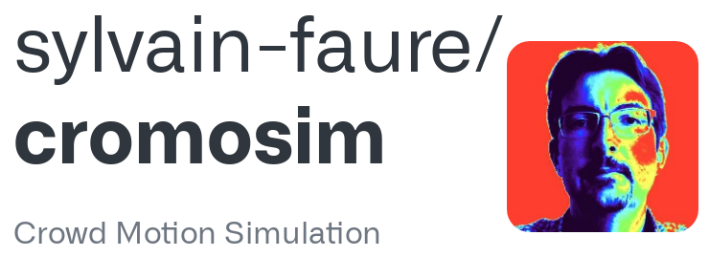
Method – Implementation
Package used: Cromosim – Sylvain Faure (2018)
Python based model for Crowd Motion Simulation
Cellular Automata and Agent-Based options
Incorporates the Social Force Model
Discrete time steps
Simple to use custom maps
Notes:
Base Model = Cromosim
Cromosim includes Cellullar Automata and ABM
Discrete time steps – time step provided as dt
JSON files for parameters – useful for single simulations, not for multiple
Documentation between well commented and odd data structures / variable names / functionality
Shortcomings of the model:
Simulation of a static environment
Data collection and figures are in-simulation
Expanded how?
Converting backgrounds to plots
Influx of new agents
Slowing down of agents
Extracting data
Difficulties?
Agents spawning on top of each other → marble effect
Geometrical objects
Speeding agents back up

Slide 9
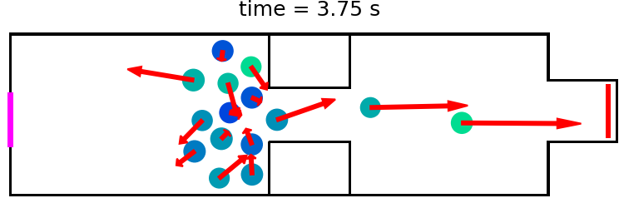
Method – Implementation
Shortcomings of the model:
Data collection and presentation is handled during the simulation.
Simulations are too simple: Initializes agents once, no spawn function.
JSON-file with model parameters not suitable for multiple simulations over small perturbations.
Documentation is almost good.
Solutions / Expansions:
Capture sensor data and export as CSV.
Add a continuous flow of spawned agents.
(Randomly) slow down groups of agents.
Parameterize model expansions.
Script to run multiple iterations.
Notes:
Base Model = Cromosim
Cromosim includes Cellullar Automata and ABM
Discrete time steps – time step provided as dt
JSON files for parameters – useful for single simulations, not for multiple
Documentation between well commented and odd data structures / variable names / functionality
Shortcomings of the model:
Simulation of a static environment
Data collection and figures are in-simulation
Expanded how?
Converting backgrounds to plots
Influx of new agents
Slowing down of agents
Extracting data
Difficulties?
Agents spawning on top of each other → marble effect
Geometrical objects
Speeding agents back up

Slide 10
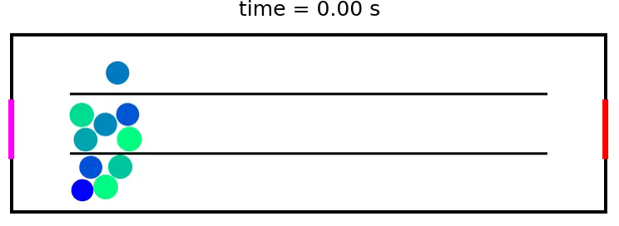
Method – Implementation
Difficulties:
Agents leaving the model
Agent collisions on spawn → Extreme Social Force → Marble effect
Notes:
Base Model = Cromosim
Cromosim includes Cellullar Automata and ABM
Discrete time steps – time step provided as dt
JSON files for parameters – useful for single simulations, not for multiple
Documentation between well commented and odd data structures / variable names / functionality
Shortcomings of the model:
Simulation of a static environment
Data collection and figures are in-simulation
Expanded how?
Converting backgrounds to plots
Influx of new agents
Slowing down of agents
Extracting data
Difficulties?
Agents spawning on top of each other → marble effect
Geometrical objects
Speeding agents back up

Slide 11
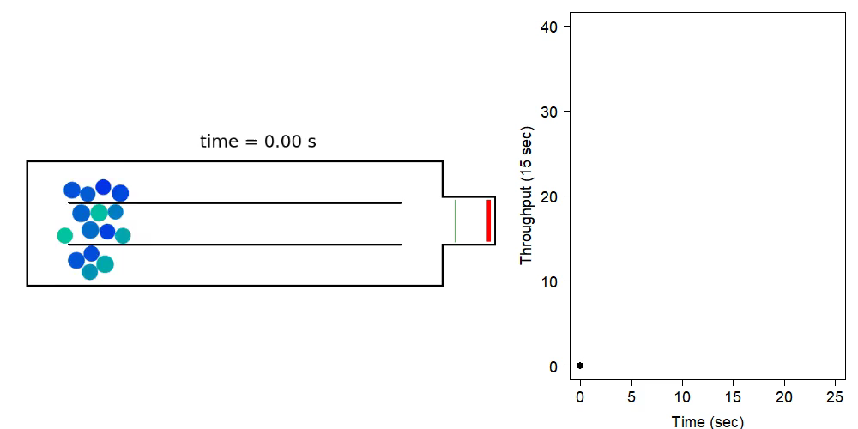
Results – Throughput by Condition
Notes:
FRANTISEK

Slide 12
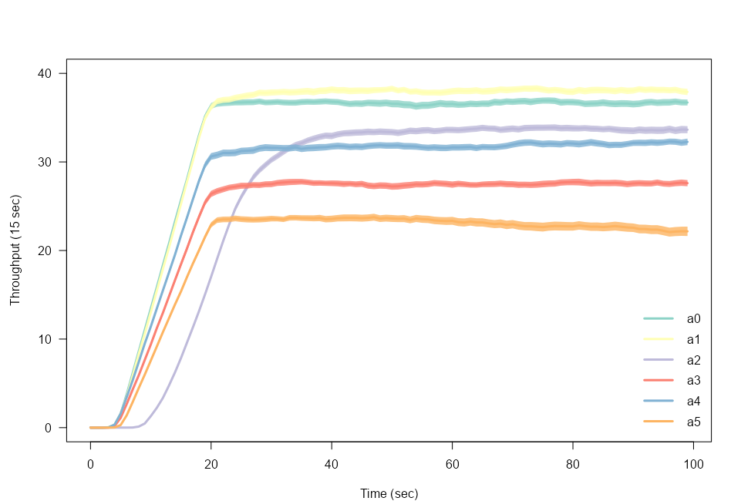
Results – Throughput by Condition
a1 a0 a2 a4 a3 a5
Notes:
FRANTISEK

Slide 13
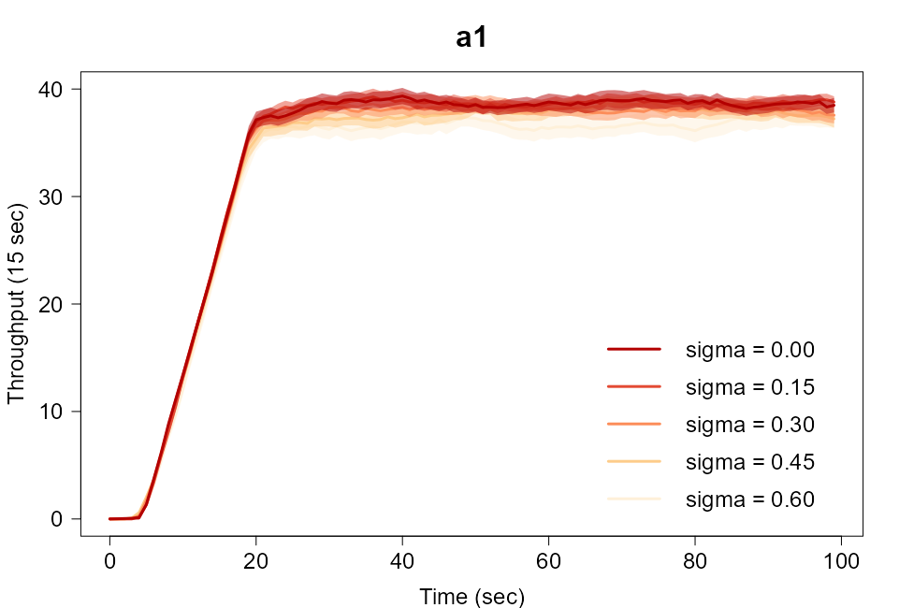
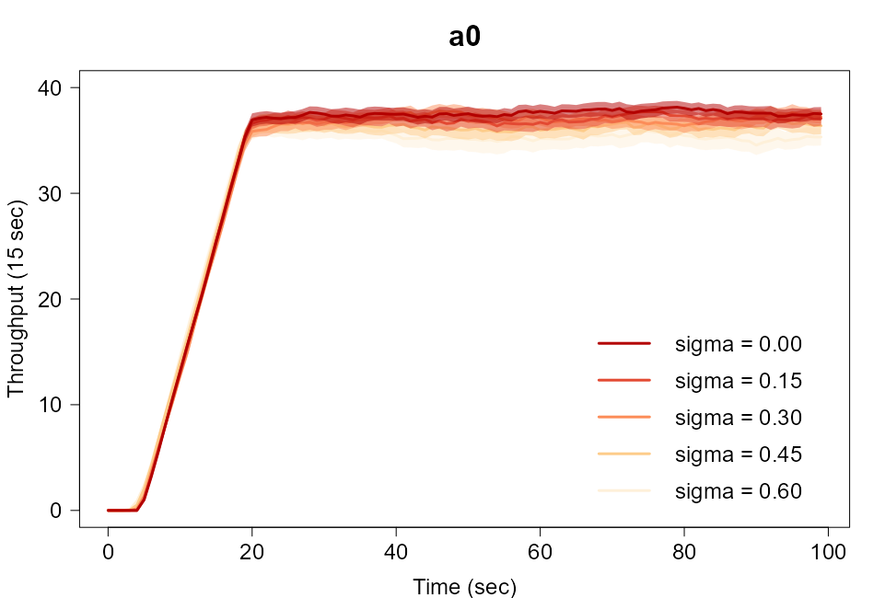
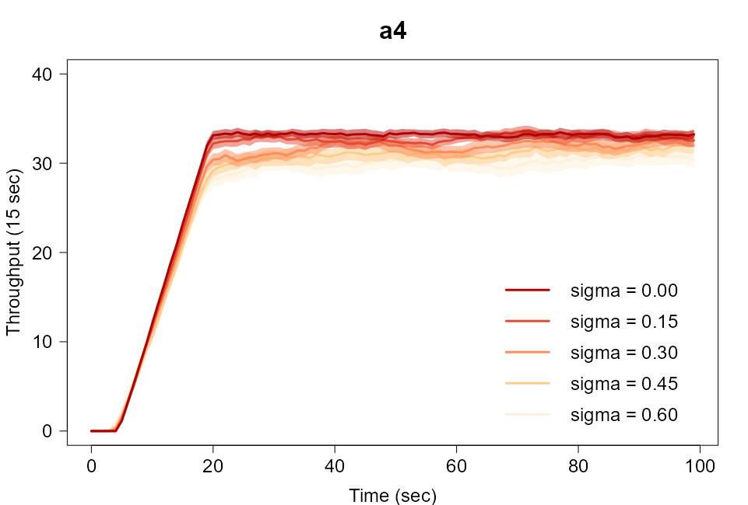
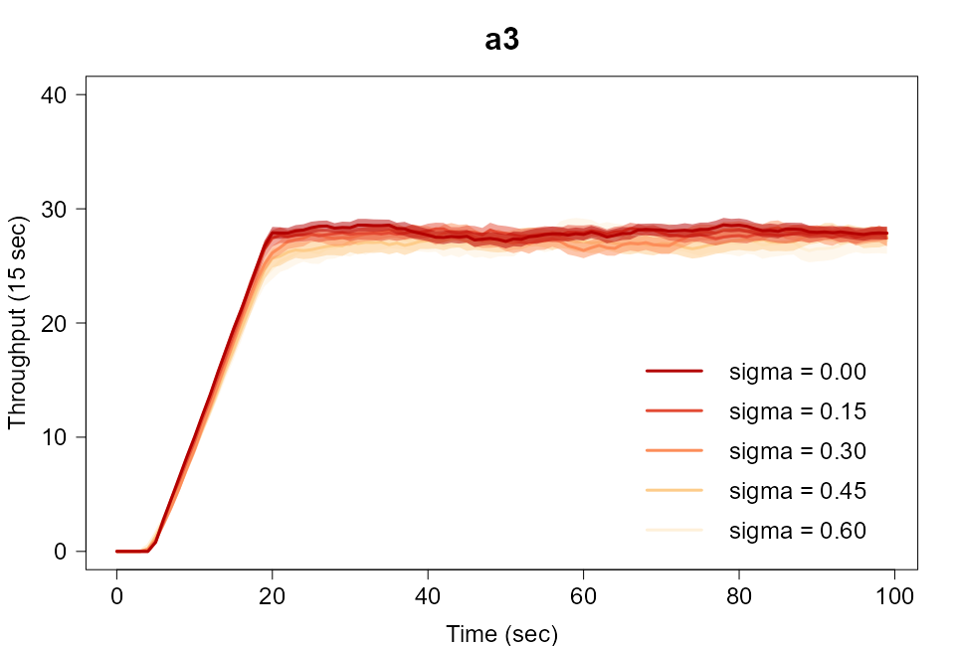
Results – Throughput by Heterogeneity
a1 a0 a2 a4 a3 a5
Notes:
FRANTISEK

Slide 14
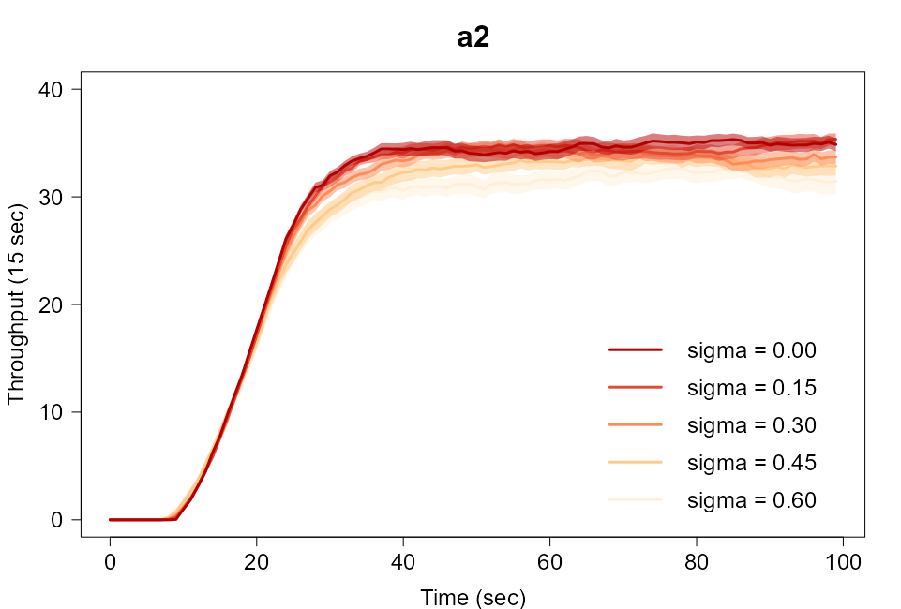
Results – Throughput by Heterogeneity
a1 a0 a2 a4 a3 a5
Notes:
FRANTISEK

Slide 15
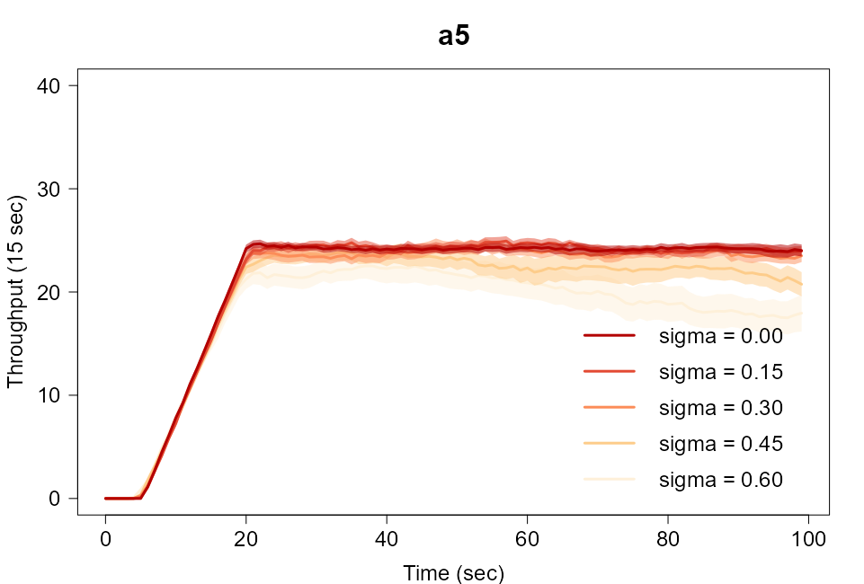
Results – Throughput by Heterogeneity
a1 a0 a2 a4 a3 a5
Notes:
FRANTISEK

Slide 16
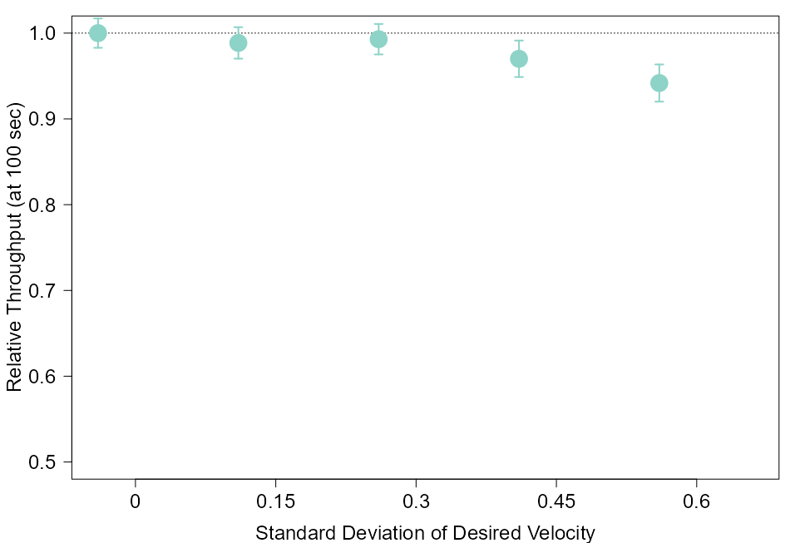
Results – Relative Decrease (Unidirectional)
a0
a0
relative decrease in throughput with increasing heterogeneity
Notes:
FRANTISEK

Slide 17
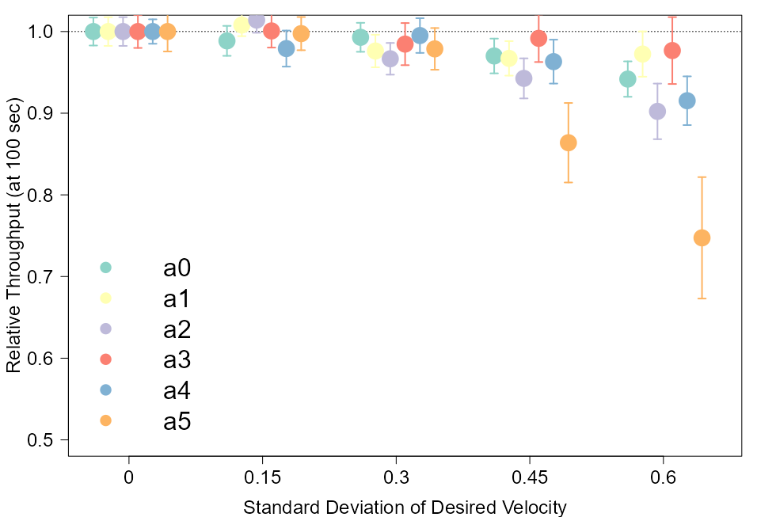
Results – Relative Decrease (Unidirectional)
a0 a1 a2 a3 a4 a5
Notes:
FRANTISEK

Slide 18
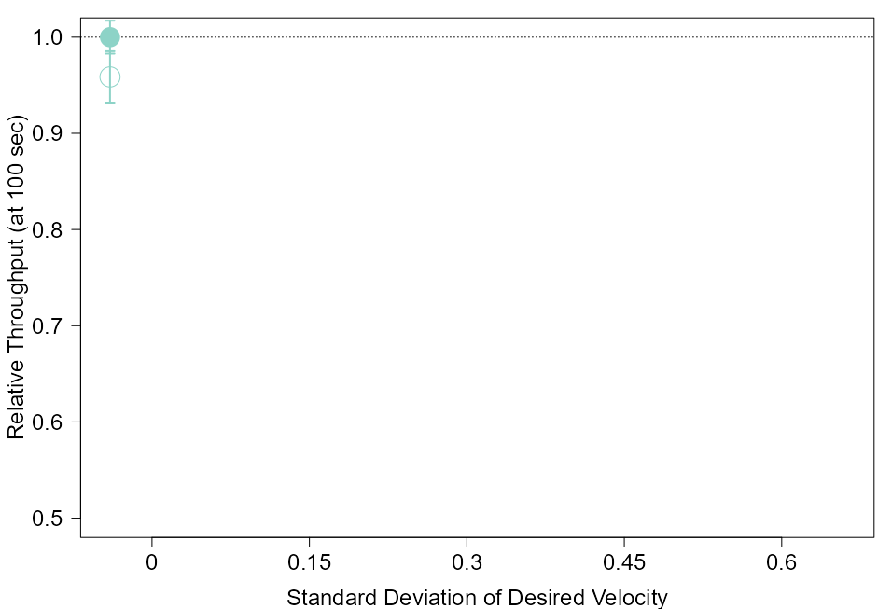
Results – Relative Decrease (Unidirectional)
relative decrease in throughput with addition of randomly slowed people
a0 a1 a2 a3 a4 a5
Notes:
FRANTISEK

Slide 19
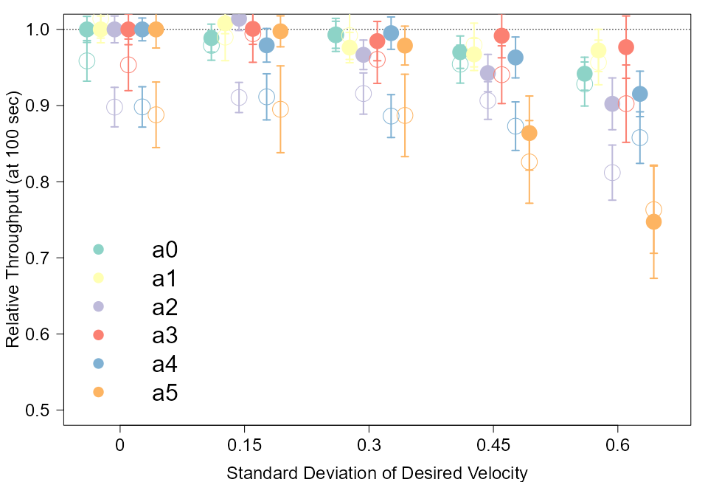
Results – Relative Decrease (Unidirectional)
a0 a1 a2 a3 a4 a5
Notes:
FRANTISEK

Slide 20
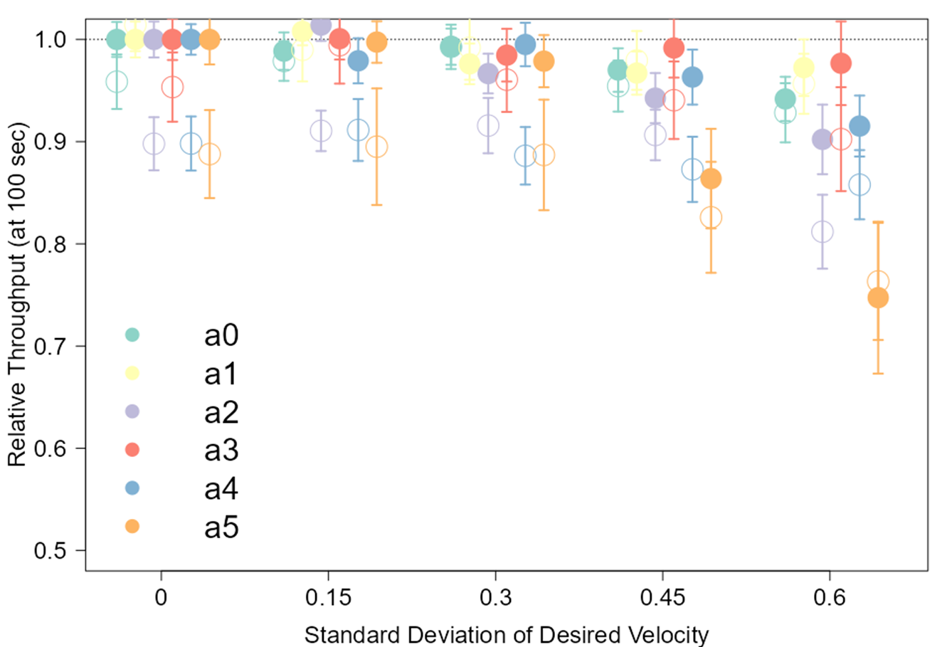
Results – Relative Decrease (Unidirectional)
a0 a1 a2 a3 a4 a5
Notes:
FRANTISEK

Slide 21
Results – Relative Decrease (Unidirectional)
a0 a1 a2 a3 a4 a5
Notes:
FRANTISEK

Slide 22
Results – Relative Decrease (Unidirectional)
a0 a1 a2 a3 a4 a5
Notes:
FRANTISEK

Slide 23
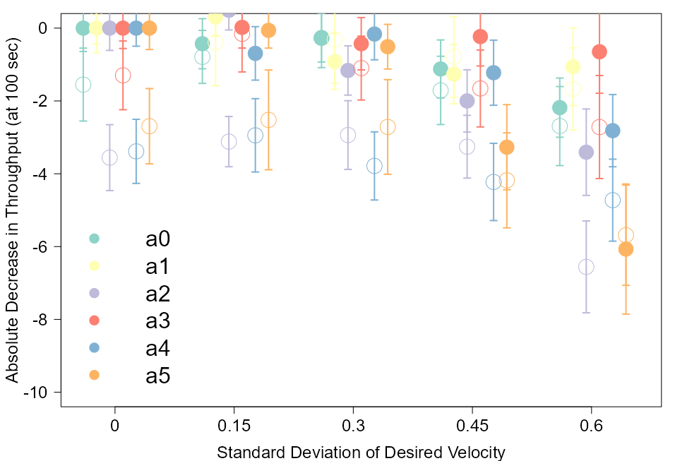
Results – Absolute Decrease (Unidirectional)
a0 a1 a2 a3 a4 a5
Notes:
FRANTISEK

Slide 24
Conclusion
The two primary hypotheses:
Greater heterogeneity leads to reduced outflow of people
Heterogeneity in desired speed influences interaction with various obstacles
Notes:
The 2 hypotheses that we have to finally prove. In this case, confirm the hypothesis and answer the research questions.

Slide 25

Heterogeneity vs Throughput
$Throughput∝\frac{1}{{Heterogeneity}_{velocity}}$
Decrease in speed of few agents during the simulation reduces the throughput of outflow
Notes:
Point 1
The greater variance we have of the speeds of agents, there is increase in congestion. The simulation shows that the slowest people in the crowd tend to slow down the people behind them. This is clearly in sync with real life scenario where the slow people affect the people behind them in a dense crowd.
Point 2
When we reduced the speeds of some agents during the simulation, it also affected the throughput negatively – decrease in throughput.
Point 3 – additional observation of simulation
When extra people were added within the map, they were introduced with varied speed distribution – thereby increasing both heterogeneity and congestion – further decrease in throughput.

Slide 26
Different speeds and obstacles
Notes:
With varying distribution of speeds, the obstacles play a major role in determining the trajectory of escape of the agents. When the obstacles are arranged in such a way that there is less distance between the agent and the walls, there is an increase in congestion of the agents. This influence reduces the throughput of escape.

Slide 27
Thank you for you attention

Slide 28
Appendix

Slide 29
Method - model
- Crowd behavior modelled by a social force model
- Parameter settings model:
Desired velocity: N(1.6,*)
Radius distribution: U(0.185, 0.215)
Mass: 80 kg
Tau: 0.5 s
Kappa: 120000 kg/s²
Delta: 0.08 m
Fwall: 2000 N
F: 2000 N
Eta: 240000 kg/(ms) ¹ ²
* Dependent on simulation
I.M. Sticco, G.A. Frank, C.O. Dorso, Social Force Model parameter testing and optimization using a high stress real-life situation, Physica A: Statistical Mechanics and its Applications, Volume 561, 2021, 125299, ISSN 0378-4371
Helbing, Dirk & Molnar, Peter. (1998). Social Force Model for Pedestrian Dynamics. Physical Review E. 51. 10.1103/PhysRevE.51.4282.
Notes:
CORIEN
The main assumption we made is that crowds behave as a social force model. Explain model by picture
Explain all parameter settings of the model:
Desired velocity → from paper mike lees
Radius by another paper based on empirical measurements
Mass: 80 kg (remaining parametervalues used from the paper of Helbing
Tau: time until a person is going back to his desired speed when disturbed by wall/people
Kappa: stiffness contstant to handle overlapping
Delta: to maintain a certain distance from a person
F: repulsion force between people
Fwall: repulstion force between people and the wall
Eta: friction coefficient

Slide 30
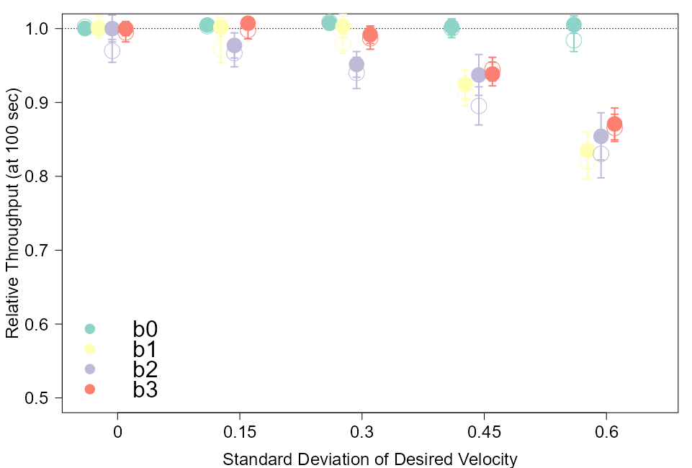
Results – simulations b

Slide 31
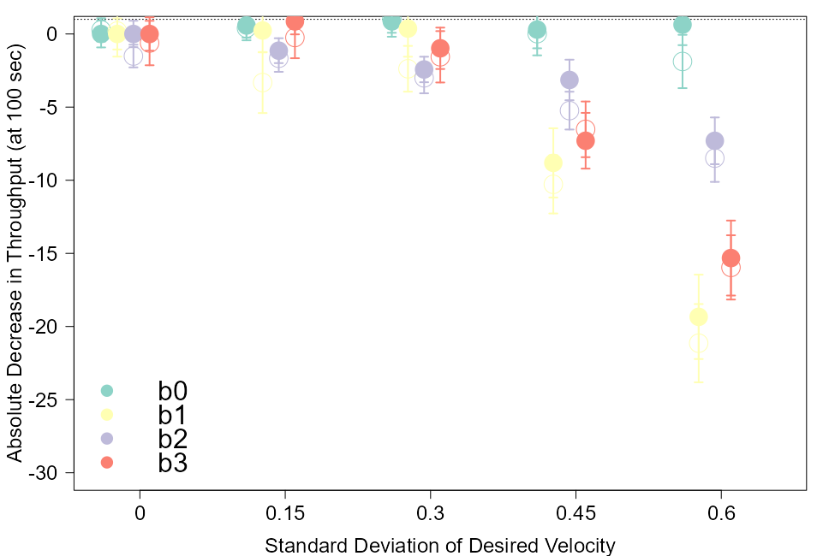
Results – simulations b

