Slide 1

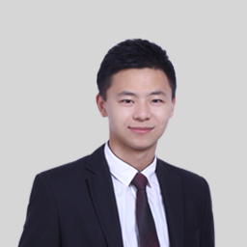

雅思口语
微博：杨帅-贵学
公众微信：Ielts-shuaige

Slide 2
词汇逆向推导
  物尽其用、绝不浪费
一篇P2满分答案详细讲解

Slide 3
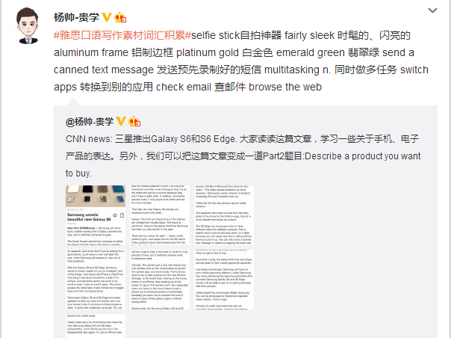

Slide 4
Describe something you would like to buy in the future
You should say
  What it is
  When you would buy it
  Where you would buy it
And explain why you would like to buy it.

Slide 5
I would like to buy a New Samsung phone in the near future. To be specific, it’s called Galaxy S6. Actually, Samsung just unveiled this phone not long ago, so I guess I would look pretty cool to have it.
To be honest with you, I’m not quite sure when I would be able to buy it cause I’m a little short of money at the moment and this Galaxy S6 is even more expensive than an Iphone 6. So, I guess I would have to scrimp and save for a couple of months in order to buy it. Oh, by the way, I would definitely buy this phone from JD.COM cause that’s where I buy everything. It’s kind of like the Chinese equivalent of Amazon.

Slide 6
Um, I would really love to own a Samsung S6 primarily because it looks super sleek. The frame is aluminum and it comes in four colors - black, white, platinum gold and emerald green. I would probably choose emerald green cause that’s my favorite color. Another reason why I wanna buy it is this phone makes it easier to multitask. For instance, you can watch a video while checking email or browsing the web simultaneously. Also, I’ve been an Iphone user for a long time and I really feel like a change. I guess this Galaxy S6 could be a good start of my Samsung using experience.

Slide 7
in the near future=in the not-too-distant future
unveil v.
a little short of money at the moment
scrimp and save
the Chinese equivalent of Amazon
sleek
it comes in four colors
feel like a change

Slide 8
in the near future=in the not-too-distant future
e.g. I would like to buy a pair of Jordan shoes in the not-too-distant future.
unveil v.
e.g. They just unveiled this series of shoes last month, so if I had them now, I would be among the first in the world to wear them.
a little short of money at the moment
e.g. However, I'm a little short of money at the moment, so I guess I would have to wait until the end of this semester before I can buy the shoes.
scrimp and save
e.g. Before then, I would scrimp and save in order to have enough money.

Slide 9
the Chinese equivalent of Amazon
e.g. I suppose I would buy them on JD.COM, the Chinese equivalent of Amazon.
it comes in four colors
e.g. This series of shoes comes in three colors - red, green and black.
feel like a change
e.g To be honest, I've never worn Jordan shoes before. I've been a huge fan of Nike Air Force One since middle school, but I just feel like a change now.

Slide 10
feel like a change
I wanna move to another city in the future, maybe somewhere in the south. It's because I've been living in my hometown since I was born and I really feel like a change. (hometown)
I major in engineering but I don't find it interesting at all. I really feel like a change and I will probably change a major next year. (study)
I'm a shopaholic but I'm a little short of money at the moment, so I've been trying to kill any thought of shopping for the past two weeks. (shopping)

Slide 11
a little short of money at the moment
I'm supposed to buy some new shoes this week, but I'm a little short of money at the moment, so I guess I will go shopping for shoes next month. (shoes)
Traveling is an essential part of my life and I planned to go somewhere next month, but I'm a little short of money at the moment, so I guess I will have to put off the plan. (travleing)
My plans for the near future? Well, I'm gonna start reading biographies. I've always read novels only and now I feel like a small change. (plans)

Slide 12
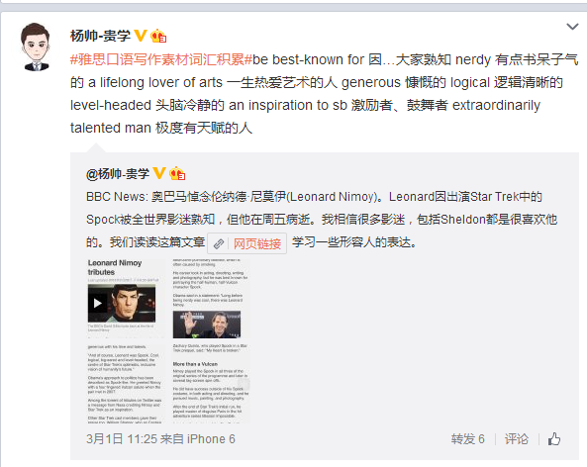

Slide 13
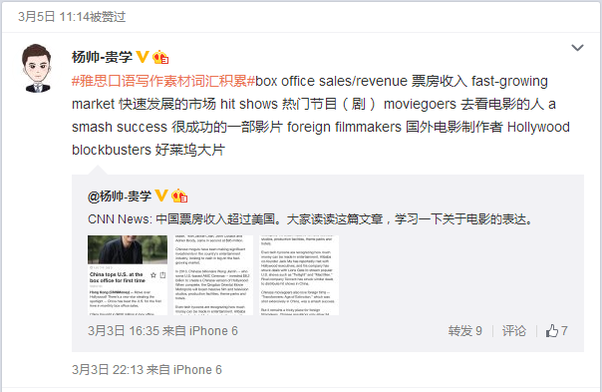

Slide 14


Slide 15
150句：提高语法、词汇、发音
逻辑扩展法：下句不再靠缘分，提高流利度、连贯性
所有题目素材
提高分数的最快方法是提高能力
走错路，你会越走越远

Slide 16
雅思口语
微博：杨帅-贵学
公众微信：Ielts-shuaige

