Slide 1
Criterion of the writing test
TR
CC
LR
GRA
Task Response
Coherence and cohesion
Lexical Resource
Grammatical range and accuracy

Slide 2
Grammatical Range and Accuracy（7分）
Use a variety of complex structures
Produces frequent error-free sentences
Has good control of grammar and punctuation but make a few errors

Slide 3
Grammatical Range and Accuracy（6分）
uses a mix of simple and complex sentence forms
makes some errors in grammar and punctuation but they rarely reduce communication

Slide 4
Grammatical Range and Accuracy（5分）
uses only a limited range of structures
attempts complex sentences but this tend to be less accurate than simple sentences
may make frequent grammatical errors and punctuation may be faculty; errors can cause some difficulty for the reader.

Slide 5
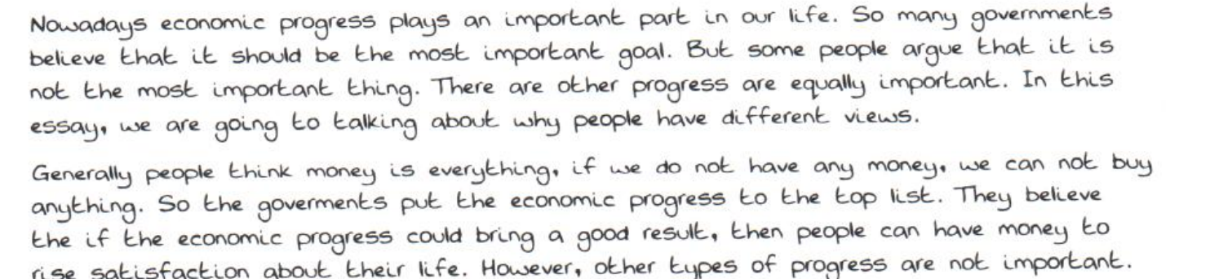

Slide 7
七个词性知识

Slide 8
① 主（名词/代词/动名词） 系（be） 表(名词/形容词/介词/不定式)
句子中翻译成“是” 的时候。
I am a student.
She is an employee.
Playing video games is a waste of time.
The number of girls is 500.
The consumption of beef is 5 million tonnes.
They are workers of the company.

Slide 9
① 主（名词/代词/动名词） 系（be） 表(名词/形容词/介词/不定式)
句子中翻译成“是” 的时候。
I am hungry.
Learning English is important.
Playing video games is detrimental to teenagers’ mental health.
Driving private cars is convenient.
Helping the orphans and the widows is significant.

Slide 10
flexible --inflexible
feasible--unfeasible
necessary--unnecessary
wise-unwise
realistic-unrealistic
appropriate-inappropriate
suitable-unsuitable
beneficial-detrimental/harmful

Slide 11
半系动词+adj
I become increasingly sensitive.
He becomes increasingly handsome./I keep clam.
Steven Jobs once said: stay hungry, stay foolish.
The breafast smells/tastes/looks good.
I feel comfortable./This idea sounds great.
From 1993 to 2003, the proportion of girls kept stable.
Between 2002 and 2012, the consumption of beef remained unchanged.
The sales stayed steady.

Slide 12
① 主（名词/代词/动名词） 系（be） 表(名词/形容词/介词/不定式)
From 1993 to 1998, the proportion of girls kept stable.
Between1993 and 1998, the figure remained unchanged.
The sales stayed steady.

Slide 13
① 主（名词/代词/动名词） 系（be） 表(名词/形容词/介词/不定式)
I am at school.They are with their parents.
The monkeys are on trees.
Learning English is of great importance.极具重要性
Driving private cars is of great convenience. 很方便
Maintaining old buildings is of great significance. 有意义
I am in favor of free college education. 我支持
I am against animal testing. 我反对
This is due to serious air pollution.

Slide 14
① 主（名词/代词/动名词） 系（be） 表(名词/形容词/介词/不定式)
The first step is to pick peaches from trees.
The main responsibility of teachers is to impart knowkledge.
The main responsibility of students is to acquire knowledge and job-related skills.

Slide 15
② 主（名词/代词/动名词） 谓（vt） 宾（adj+n）
Parents play an important role in my life.
I experienced an accident yesterday.
From 1998 to 2008, the proportion of girls saw a dramatic increase.
From 1995 to 2005, the proportion of boys witnessed a slow decrease.
The figure showed an initial growth/fall.

Slide 16
② 主（名词/代词/动名词） 谓（vt） 宾（adj+n）
大幅度的：dramatic; significant; sharp; substantial; considerable； remarkable； incredible
小幅度的：slight; slow; marginal
上升：increase; growth; rise
下降：decrease;decline; fall

Slide 17
② 主（名词/代词/动名词） 谓（vt） 宾（adj+n）
全职工作的夫妻的数量已经看见了一个大幅度的上升。
The number of couples both working full-time has seen a dramatic increase.
The number of wild animals living in Africa has seen a dramatic decrease.
The number of people writing letters has seen a dramatic decrease，which reduces the use of paper and promotes a green lifestyle.
The overuse of phones has seriously affected our life.
The violence in movies has seriously affected teenagers’ mental health.

Slide 18
③ 主+谓vi+adv
I walk slowly.
The proportion of girls increased dramatically.
The percentage of females decreased slowly.
The figure fluctuated slightly.
The figure soared/rocketed to the peak at 20%. 猛增
The figure plunged to the bottom at only 5 million tonnes.猛降
The figure plateaued/levelled off. 保持平稳

Slide 19
④并列句--两个句子并列在一起--姐妹关系-并列连词
表示并列：and; as well as
表示否则：or
表示转折：but; while; whereas
表示因此：so; and therefore
表示因为：for
表示然后：and then

Slide 20
辨析并列连词&副词
I like singing, while she likes dancing.
I like singing. However, she likes dancing.
I like reading, so I often buy books on the Internet.
I like reading. Therefore, I often buy books on the Internet.

Slide 21
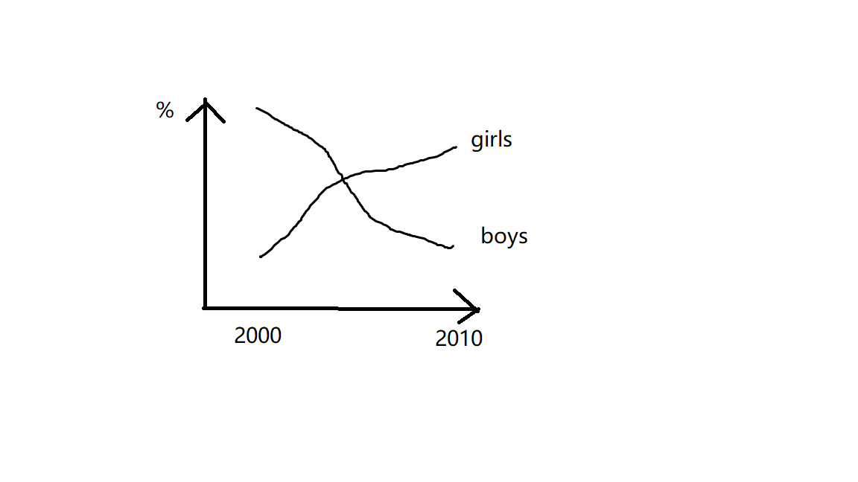
并列句在动态图中的运用
A. 趋势对比--并列句--while/whereas

Slide 22
It is clear that the proportion of girls saw a dramatic increase, whereas that of boys decreased sharply over the decade from 2000 to 2010.

Slide 23
It is clear that the proportion of girls saw a dramatic increase, while that of boys decreased sharply over the decade from 2000 to 2010.

Slide 24
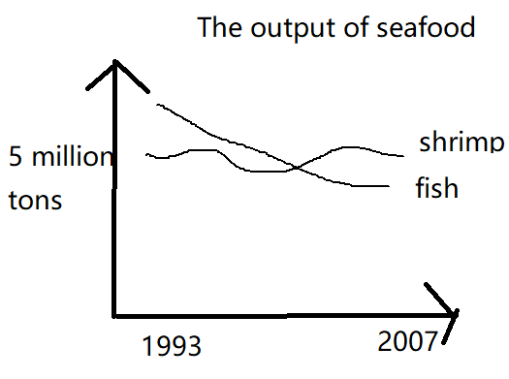
It is clear that the output of fish saw a slow decrease, while that of shrimp remained unchanged around 5 million tonnes from 1993 to 2007.

Slide 25
It is clear that the output of fish saw a dramatic decreace,whereas that of shrimp fluctuated slightly around 5 million tonnes from 1993 to 2007.

Slide 26
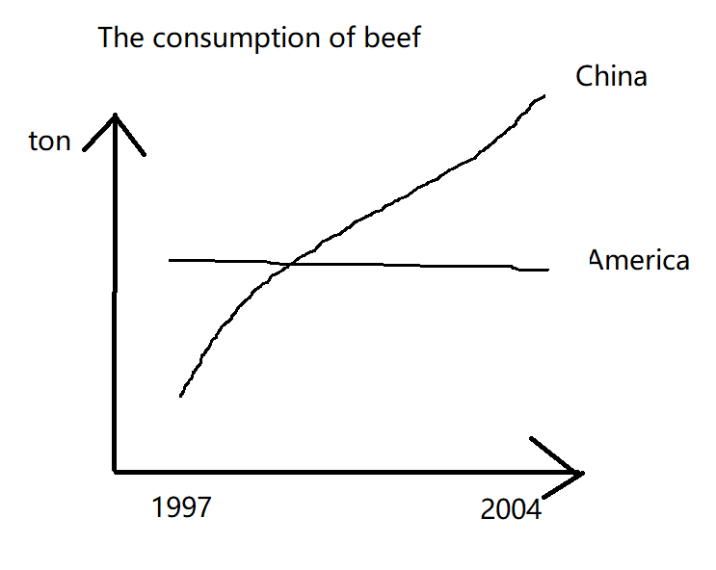
It is clear that the consumption of beef in China saw a dramatic increase, while that in America kept stable from 1997 to 2004.

Slide 27
It is clear that the consumption of beef in China saw a dramatic increase,whereas that in America kept stable between 1997 and 2004.

Slide 28
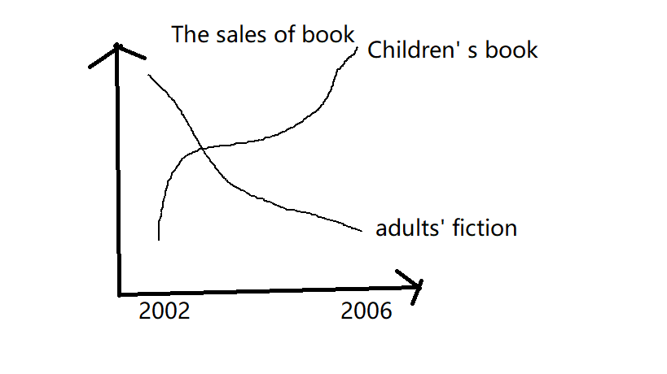
It is clear that the sales of children’s book saw a dramatic increase ,while those of adult’s fiction book decreased rapidly from 2002 to 2006.

Slide 29
It is clear that the sales of children’s book saw a dramatic increase,while those of adults’ fiction decreased sharply
from 2002 and 2006.

Slide 30
B. 表示拐点--并列句--and then

Slide 31
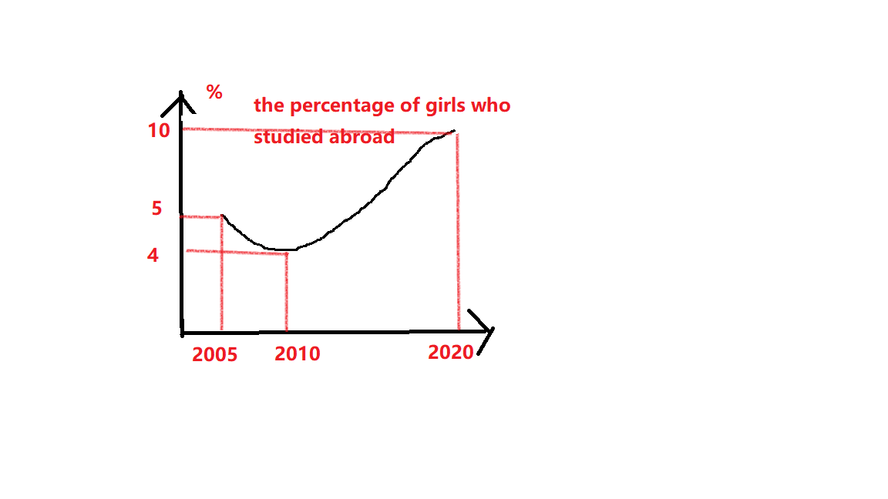
As is shown in the line chart, the proportion of girls firstly saw a temporary decrease between 2005 and 2010, and then it soared to the peak at 10% in the end.

Slide 32
As is shown in the graph, the proportion of girls studying abroad firstly saw a temporary decrease from 5% to 4%, and then it soared to the peak at 10% in the end.

Slide 33
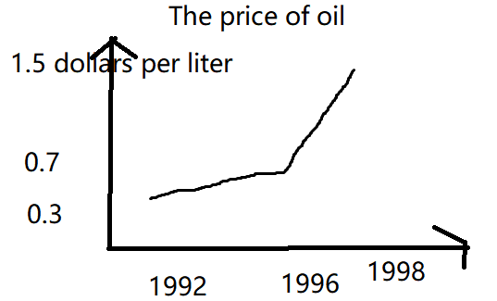
As is shown in the graph, the price of oil saw a slow increase from 0.3 to 0.7 dollar per liter in the first four years, and then it soared to the highest point at 1.5 in the end.

Slide 34
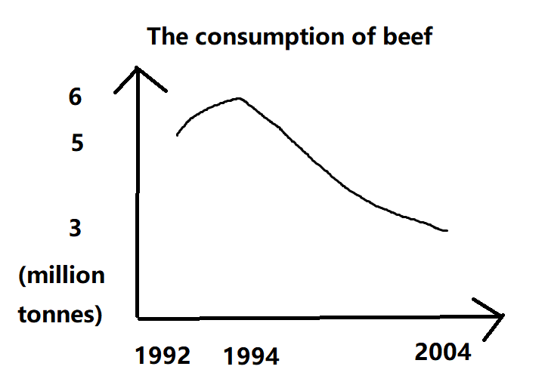
As is shown in the line chart,the consumption of beef firstly saw a slow increase between 1992 and 1994,and then it plunged to the bottom at only 3 million tonnes in the end.

Slide 35
As is shown in the graph，the consumption of beef firstly saw a temporary increase from 5 to 6 million tonnes, and then it plunged to the bottom at 3 million tonnes in the end.

Slide 36
C. 表示交点--并列句--and
超过： overtake; exceed; surpass

Slide 37
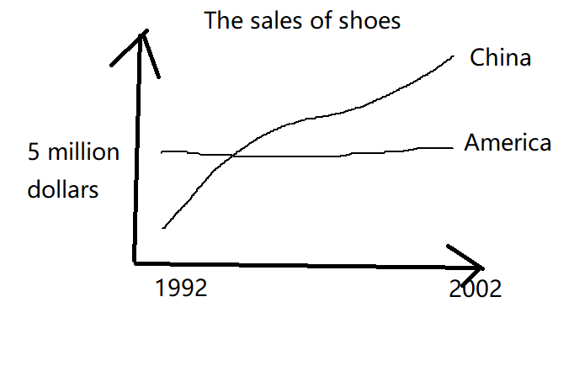
It is note-worthy that the sales of shoes in China overtook those in America, and it had become the largest market of shoes since 1994.

Slide 38
It is note-worthy that the sales of children’s book exceeded those of adults’ fiction, and it had become the most popular book since about 2003. about 2003.

Slide 39
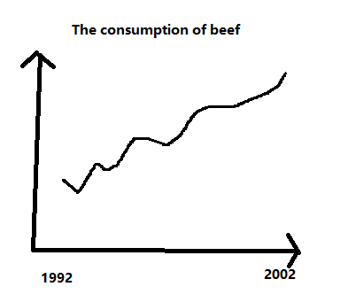
4 表示在波动中上升
The consumption of beef saw an increasing/upward trend in general, despite some fluctuation in the middle years.

Slide 40
5 对比起点
Beef was the most popular meat for European people at 220 grams per person person. The figure for chicken was relatively smaller at 180 grams. However, fish was the least popular food among three types, at only 50 grams.

Slide 41
Writing Task 1 C7T2T1
You should spend about 20 minutes on this task.
The graph below shows the consumption of fish and some different kinds of meat in a European country between 1979 and 2004.
Write at least 150 words.

Slide 42
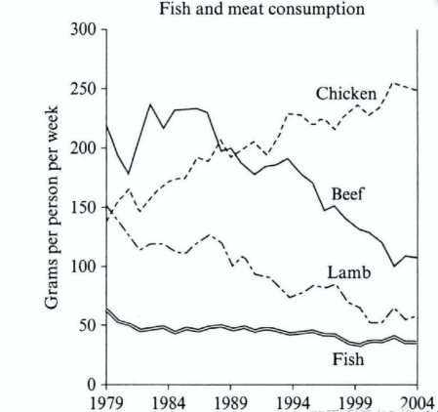

Slide 43
范文
The line chart illustrates the changes in the amounts of beef, lamb, chicken and fish consumed in a country of Europe from 1979 to 2004.
It is clear that the figure for chicken exceeded that of beef in nearly 1989, and it had become the best-seller since then, while the popularity of the other three food all decreased over the period.

Slide 44
范文
In 1979, beef was by far the most popular of these foods,with about 225 grams consumed person per week. Lamb and chicken were eaten in similar quantities(around 150 grams), while much less fish was consumed at just over 50 grams.

Slide 45
范文
However, during this 25-year period, the consumption of beef and lamb fell dramatically to approximately 100 grams and 55 grams respectively. The consumption of fish also declined, but much less significantly to just below 50 grams, so although it remained the least popular food, consumption levels were the most stable.
The consumption of chicken, on the other hand, showed an upward trend, overtaking that of lamb in 1980 and that of beef in 1989. By 2004 it had soared to almost 250 grams per person per week.

Slide 46
连词 并列连词
状语从句的连词
连词+完整句子

Slide 47
⑤状语从句--修饰动词或者限定句子--adv
时间状语从句：when; until; before; after; since; as; as soon as
条件状语从句：if; as long as; unless; once---主将/情从现
原因状语从句：because; since; as
目的/结果状语：so that
让步状语从句：although; though

Slide 48
⑥状语从句--修饰动词或者限定句子--adv
当毕业生找工作的时候，他们往往优先重视工资。look for; give top priority to; graduates
When graduates look for jobs, they often give top priority to salaries.
如果家长在使用电子设备方面树立一个榜样，孩子们的屏幕时间会看见一个大幅度的下降。electronic devices; screen time; set a good example
If parents can set a good example in using electronic devices, children’s screen time will see a dramatic decrease.

Slide 49
⑥状语从句--修饰动词或者限定句子--adv
很多人反对动物实验因为他是残忍的。be against
Many people are against animal testing because it is cruel.
Many people are against animal testing. Because it is cruel. ×（从句不能单独存在）
Many people are against animal testing. This is because it is cruel. √
手机的使用已经严重影响了我们的公用生活以至于一些人把它和吸烟作比较。
The use of phones has seriously affected our public life so that some people begin to compare it with smoking.

Slide 50
⑥状语从句--修饰动词或者限定句子--adv
微信已经逐渐成为中国青少年最受欢迎的软件之一，因为他们可以在通过它联系他们的朋友。
application; gradually
Wechat has gradually become one of the most popular applications for teenagers in China because they can contact their friends throught it.

Slide 51
虽然线上阅读很方便，我仍认为纸质书扮演了一个不可替代的角色。Indispensable
Although it is convenient to read online, I still believe that printed book plays an indispensable role.
虽然线上欣赏艺术品很方便，我仍认为博物馆和画廊扮演不可替代的角色。
Although it is convenient to appreciate artworks online, I still believe that museums and gallaries play an indispensable role.

Slide 52
虽然保护野生动物很重要，我仍认为钱应该先被花在公共服务上。
Although it is important to protect wild animals, I still believe that money should be spent on public services first.
Despite the importance of protecting wild animals,.....
在波动中上升
Despite some fluctuation, the proportion of girls saw an increasing trend in general.

Slide 53
⑥prep+n/doing/being done
After lunch, I often take a nap.
After having lunch, I often take a nap.
After being criticized, I often cry for a while.
After arriving at the destination, the fish will be frozen.
After being transported to the port, the fish will be frozen.

Slide 54
⑥prep+n/doing/being done
XXX before XXXX 然后
The proportion of girls firstly saw a dramatic increase, and then it plunged to the bottom at only 20% in the end.
The proportion of girls firstly saw a dramatic increase before plunging to the bottom at only 20% in the end.
I plan to watch movies first before having dinner.
苹果应该先洗再吃。
The apples should be washed before being eaten.

Slide 55
⑥prep+n/doing/being done
Despite 虽然--介词
Despite many advantages of watching TV, parents and teachers should still control children’s screen time.
Despite facing many difficulties, I still choose to stay positive.
Despite being underestimated, those musicians still composed many magnificant pieces.
Despite some fluctuation, the proportion of girls saw an increasing trend in general.

Slide 56
⑥辨析连词&介词
由于严重的空气污染，人们不得不戴口罩。
Because air pollution is serious, people have to wear a mask.
Due to serious air pollution, people have to wear a mask.
由于学英语很困难，一些同学不得不熬夜完成作业。
Because it is difficult to learn English, some students have to stay up late to finish their homework.
Due to many difficulties of learning English, some students have to stay up late to finish their homework.

Slide 57
⑥辨析连词&介词
由于开私家车很麻烦，我选择骑自行车。
Because it is troublesome to drive private cars, I choose to ride a bike.
Due to many troubles of driving private cars, I choose to ride a bike.
由于活着很艰难，我选择寻找一个支持团体。
Because it is hard to live, I choose to seek for help.
Due to the hardships of living, I choose to seek for help.

Slide 58
⑥辨析连词&介词
虽然线上阅读很方便，我仍认为纸质书扮演了一个不可替代的角色。
Although it is convenient to read online, I still believe that printed book plays an indispensable role.
Despite the convenience of reading online, I still believe that printed book plays an indispensable role.

Slide 59
⑥辨析连词&介词
虽然保护野生动物很重要，我仍认为钱应该先被花在公共服务上。
Although it is important to protect wild animals, I still believe that the money should be spent on public services first.
Despite the importance of protecting wild animals, I still believe the money should be spent on public services first

Slide 60
⑥辨析连词&介词
虽然看电视有一些好处，我仍认为家长和老师应该控制孩子的屏幕时长。
Although it is beneficial to watch TV for children, I still believe that parents and teachers should control children’s screen time.
Despite many benefits of watching TV, I still believe that parents and teachers should control children’s screen time.

Slide 61
⑥ with的使用 随着；有
With +n
随着电子设备的使用
With the wide use of various electronic devices,....
随着医疗技术的进步
With the progress of medical technology,...
随着泰勒斯威夫特的流行
With the popularity of Taylor Swift,....
随着油价的上升
With the increase of oil price,...

Slide 62
With+n+doing/done
介词---后面不能加句子--后面不能加谓语--只能加非谓语（分词）--with+n+doing/done
随着女人在职场扮演一个更加重要的角色, ...
With women playing a more important role in the workplace,....
随着更多的时间被花在作业上, ...
With more time spent on homework, ....

Slide 63
With+n+doing/done
随着三亚计划发展旅游业，很多酒店已经被建了。
With Sanya planning to develop tourism industry, many hotels have been established.
随着很多消费者被广告所影响，他们倾向于去买他们不需要的奢侈品。
With many consumers influenced by advertisements, they tend to buy some luxuries that they do not need.

Slide 64
With+n+doing/done
随着很多学生选择出国留学，国内的就业压力变小了。
With many students choosing to study abroad, the employment competition has become lesss fierce than before.
随着很多读者被媒体所操控，他们倾向于掉入商人和政客的全套。
With many readers manipulated by the media, they tend to fall into the trap of businessmen and politicians.

Slide 65
With+n+doing/done
这个村庄已经被发展地很好了，有很多路被添加在那里。
The village has been developed very well, with many roads added there.
这个公园非常凉爽，有一条河流包围着它。
The park is very cool during the summer vocations, with a river surrounding it.
China depends heavily on fossil fuels, with 50% of electricty produced by it.

Slide 66
⑦adv+adj
academically outstanding
socially active
economically independent
financially successful
physically strong
mentally healthy
environmentally friendly
morally wrong
nutritionally balanced
方面副词
incredibly beautiful
extremely dangerous
seriously polluted
particularly intelligent
especially worried
highly adaptable
strongly recommended
vitally important
程度副词

Slide 67
Be +adv+adj（系 表）
Students are often increadibly good-looking.
Animal testing is morally wrong in my opinion.
Those countries are financially successful.
Those athletes are physically strong.

Slide 68
adv+adj+n 做定语--修饰名词
Socially active students are often increadibly good-looking.
The government should promote the use of environmentally friendly packages and products.
Those financially successful countries should provide some aid to developing countries.
Physically strong athletes usually win.

Slide 69
标点符号的使用
John values his work, he usually gets to his office early in the morning.
逗号不能连接两个完整句子。
John values his work, and he usually gets to his office early in the morning.

Slide 70
加逗号的地方

Slide 71
加逗号的地方
①并列句
②状语从句
③非限制性定语从句（指代一件事，必须加）
④副词/介词/非谓语放句首
Generally/In addition/Feeling awkward, I..........
With+...., many hotels have been built.
⑤插入语/同位语
Jay Chou, I believe, is the most talented singer in China.
Jay Chou, a famous singer in China, has become role models of many young people.

Slide 72
判断对错
Because I like you.
I give an apple because I like you.
If the weather allows.
If the weather allows, we will go to the park.
Although I worked hard, but I still failed in the exam.
Although I worked hard, I still failed in the exam.
I love him, I will marry him.
I love him, and I will marry him.
She tried to tolerate him, but she failed.
While she likes red.
I like blue,while she likes red.
However/Therefore/Moreover, she likes him.

