Slide 1
补充语法点①状语从句的省略--分词做状语
When pears are compared with apples, pears are sweeter.
When compared with apples, pears are sweeter.
Compared with apples, pears are sweeter.
Compared with pears, bananas are sweeter.
Compared with bananas, watermelons are sweeter.
Compared with online courses, classroom-based learning is more effective.

Slide 2
补充语法点①状语从句的省略--分词做状语
Compared with traditional games, electronic games are more exciting.
When I compare those apples, I choose three.
Comparing those apples, I choose three.
Feeling a little tired, I plan to take a nap.
Many students are addicted to video games, causing them to be distracted from their study.

Slide 3
补充语法点②辨析that & those
The proportion of girls is larger than that of boys. 同类不同个--单数
The girls in SD are much taller than those in BJ. 同类不同个--复数
表示趋势对比
from 1993 to 2003, a slight decrease was seen in the output of seafood in America, while that in China increased steadily.

Slide 4
补充语法点②辨析that & those
表示趋势对比
from 1993 to 2003, a slight decrease was seen in the sales of clothes in America, while those in China increased steadily.
Between 1996 and 2006, a dramatic increase was seen the output of seafood in America, while that in Chinadecreased constantly.

Slide 5
补充语法点②辨析that & those
表示交点 exceed; overtake; surpass
It is note-worthy that the sales of children’s book exceeded those of adults’ fiction, and it had become the best-seller since 2003.
In 2030, the production of vegetables in America is expected to exceed that in Brazil, and it will become the largest exporter of vegetables.

Slide 6
补充语法点②辨析that & those
表示交点 exceed; overtake; surpass
In 2030, the production of vegetables in America is expected to exceed that in Brazil, and it will become the largest exporter of vegetables.
In 2050, the proportion of the elderly in China is expected to exceed that in Japan, and it will become the most serious aging country.

Slide 7
补充语法点③辨析it & they
I have a cat, it is lovely. ×逗号不能连接两个完整句子
I have a cat, which is lovely. 非限制性定从 √
I have a cat, and it is lovely. 并列句 √ 同一只
I have three cats, and they are lovely. 同一只--复数

Slide 8
补充语法点③辨析it & they
表示拐点
From 1993 to 1994, the time spent on phones firstly saw a temporary decrease, and then it soared to the peak at 21 hours.
Between 1995 and 1996, the money spent on clothes firstly saw a dramatic increase, and then it plunged to the bottom at 5 million dollars.

Slide 9
补充语法点③辨析it & they
表示拐点
From 1993 to 1994, the time spent on phones firstly saw a temporary decrease, and then it soared to the peak at 21 hours.
Between 1995 and 1996, the money spent on clothes firstly saw a dramatic increase, and then it plunged to the bottom at 5 million dollars.

Slide 10
补充语法点③辨析it & they
表示差值
The sales of children’s book in China saw an increasing trend in general, with a jump of 5 million dollars.
My weight increased to 60kg. 上升到
My weight increased by 5kg. 上升了
My weight saw an increasing trend in general, with a jump of 5 kg.

Slide 11
补充语法点③辨析it & they
表示极值点
soared to the peak at 20%.
plunged to the bottom at only 5%.

Slide 12
补充语法点③辨析it & they
表示：在波动中上升
The proportion of girls saw an increasing trend in general, despite some fluctuation in the middle years.

Slide 13
Lecture Three
定语-修饰名词
微博：学为贵-赵颖伦

Slide 14
定语
修饰名词的词。一般翻译为“……的”，表示事物的性质或状态，分为前置或后置。常做定语的有名词、形容词、介词短语、定语从句、分词结构、形容词短语等。

Slide 15
① n+n
leisure activities
career prospects
maternity leave
wealth gap
gap year
cheese cake
job opportunities
science fiction
lemon tree
love story
shoe store
English class
top students
chocolate ice cream
talk show
show business
Key opinion leader

Slide 16
② adj+n
a productive director
an effective way
a glamorous life
a devastating effect
名词所有格---指名词加上’s，如dog's, teachers'
单数名词+’s : the boy's dog; John's dream; that girl's bag
名词复数+ ’：my parents' friends; those girls' bags; employees’ salaries
特殊情况+’s：children’s; sheep’s; people’s; media’s

Slide 17
分词形容词
doing/done 主动关系（主谓关系）--doing
被动关系（谓宾关系）--done
rising sun; roaring lion; working classes
used cars; cleaned dishes; broken bottles

Slide 18
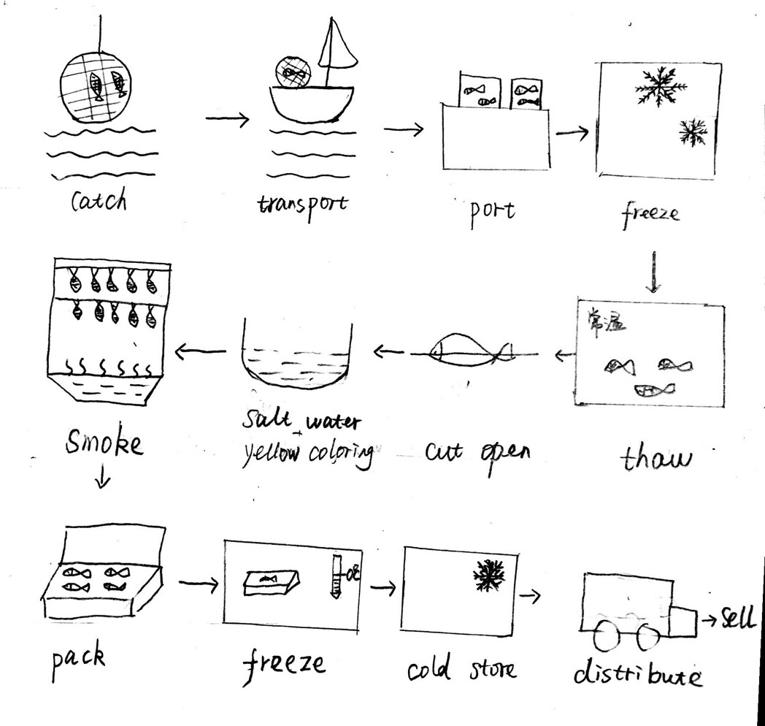
分词形容词在流程图中的使用
The fourth step is to freeze the fish in the freezer, and then the frozen fish are put into a container to thaw. (CC)
The most important stage is to hang and smoke the fish until ready for sale, after which the smoked fish are packed in boxes and frozen again. (CC)

Slide 19
③ n+prep
the people in extreme poverty.....
people in different age groups....
a research on global warming...
a paper on fungi
the people at the corner
the people at present
the reason for this problem....
the talent for
The figure for...
a gift for sb
the role of parents
the fun of watching TV
the drawbacks of playing video games
the convenience of driving private cars
a documentary about African wild animals
the suggestion of great value/importance..
the day of great significance
people in favor of animal experiments...
people against taking maternity leave....
couples with several children

Slide 20
④ n+定语从句
定义：在复合中修饰名词或代词的从句是定语从句
先行词：被定语从句修饰的名词或代词
定语从句一般放在先行词的后面，紧跟先行词。
引导词： 关系代词：that; which; who;+不完整成分
关系副词：when; where; why+完整成分

Slide 21
④ n+定语从句
我喜欢那个在工厂工作的女孩。
I like the girl who works in the factory.
I like the girl working in the factory.
被花在作业上的时间已经被延长了。
The time that is spent on homework has been extended.
The time spent on homework has been extended.

Slide 22
④ n+定语从句
选择出国留学的学生应该学英语。
The students who choose to study abroad should learn English.
The students choosing to study abroad should learn English.
沉浸在这部电影中的观众往往会哭泣。 be immersed in; the audience
The audience who are immersed in this film often cry.
The audience immersed in this film often cry.

Slide 23
④ n+定语从句
经常参观博物馆的青少年倾向于更加学术出色。academically outstanding; tend to be +adj
The teenagers who usually visit museums tend to be academically outstanding.
The teenagers usually visiting museums tend to be academically outstanding.

Slide 24
④ n+定语从句
被明星表演的广告往往会劝说消费者去买他们不需要的东西。 persuade sb to do sth; celebrities; perform
The advertisements which are performed by celebrities often persuade costomers to buy the things that they do not need.
The advertisements performed by celebrities often persuade costomers to buy buy the things they do not need.

Slide 25
④ n+定语从句
位于村庄南部的停车场已经被扩大了两倍。be located in/lie in-lay
The car park which was located in the south of village has been expanded twice.
The car park located in the south of village has been expanded twice
The car park which lay in the south of village has been expanded twice
The car park lying in the south of village has been expanded twice

Slide 26
④ n+定语从句
我喜欢你学英语的地方。
I like the place where you learn English.
我怀念我准备考试的那些天。
I miss those days when I prepared for my test.
我喜欢学英语的原因是我可以得到一种成就感。
The reason why I like learning English is that I can gain a sense of achievement.

Slide 27
④ n+定语从句
越来越多的青少年犯罪的主要原因是他们家长忙于工作以至于没有足够多的时间管教他们。
The reason why an increasing number of teenagers commit crimes is that their parents are engaged by busy work so that they have no sufficient time to discipline them.

Slide 28
⑤doing/done 分词做后置定语
The people living in the metropolis are usually busy.
The time spent on homework is enough.

Slide 29
辨析which&where
我喜欢那个提供免费咖啡的图书馆。
I like the library which provides free coffee.
我往往去那个我可以喝免费咖啡的图书馆学习。
I often study in the library where I can drink free coffee.

Slide 30
辨析which&where
政府应该投资在可以给大多数纳税人带来利润的领域。
The government should invest in the field which can bring profits to most taxpayers.
政府应该投资在大多数纳税人可以获益的领域。
The government should invest in the field where most taxpayers can reap the benefits.

Slide 31
辨析which&where
我喜欢那个让所有人都感到舒适的聊天。
I like the conversation which makes everyone feel comfortable.
我喜欢那个没有人觉得尴尬的聊天。
I like the conversation where nobody feels embarrassed.

Slide 32
where 可以修饰抽象的地点名词：
                profession；situation; field; case; job; conversation; industry; point；
毕业生应该找到他们可以充分发挥他们潜能的职业。
                Graduates should find the profession where they can fully develop their potential.
                我喜欢那种没有人觉得尴尬的聊天。
                I like the conversation where nobody feels embarrassed.
                政府应该投资在大多数纳税人可以收获利益的领域。
                The government should invest in the fields where most taxpayers can reap benefits.
                这儿有很多丈夫帮助他们妻子做家务的案例在上海。
                There are many cases where husbands help wives to do housework in SH.

Slide 33
That; which; who
I like the girl who works in the factory.
the girl= who
I could not ignore the dog that had been barking all night.
the dog=that
I would like to borrow the book which you recommended yesterday.
the book =which
that, which, who 引导定语从句指代前面的名词，后面+不完整句子，它们与后面的部分共同构成从句。

Slide 34
When Where Why
I cannot forget the day when I met you the first time.
The life cycle of the silkworm begins when the moth lays an egg.
时间名词+when---定语从句
The government should also make people willing to stay where they were born.
I like the place where you study English.
地点名词+where---定语从句
The reason why he left the company was unknown.
reason+why---定语从句

Slide 35
练习
政府应该投资在可以给大多数纳税人带来利润的领域。
The government should invest in the fields that can bring real benefits to most taxpayers.
全职工作的母亲们不能很好地照顾她们的孩子。
The mothers who work full-time cannot take good care of their children.
政府需要解决的主要问题是不断增大的贫富差距。
The main problem that the government needs to address is the constantly growing/increasing gap between the rich and the poor.
很多学生选择去那个他们可以喝免费咖啡的图书馆学习。
Many students choose to study in the library where they can have free coffee.

Slide 36
练习
我怀念我在英国度假的那些天。
I miss those days when I spent my holidays in Britain.
暴力新闻越来越多的原因是很多媒体急切地想要吸引人的眼球。（be desperate to; catch one’s eyeballs）
The reason why violent news becomes more and more is that many media are desperate to catch people’s eyeballs.
可以鼓励年轻人建立积极的世界观的运动员应该代言知名品牌。（endorse）
The athletes who can encourage young people to build positive worldviews should endorse famous brands.
大多数年轻人想居住在有更多就业机会的城市。
Most young people prefer to live in the cities which have more job opportunities.
Most young poeple prefer to live in the cities where there are more job opportunities.

Slide 37
练习
司机师傅违反交通规则的情况有时会发生当他们被乘客催促的时候。（rush）
The situation where drivers violate traffic rules sometimes happens when they are rushed by passengers.
家长所需要解决的问题是现在很多青少年把网红当偶像。
The main problem that the government needs to solve is that many teenagers regard online celebrities as role models.
牛肉的消耗量在1992年到到达最高点5吨，那时鸡肉的消耗量只有1吨。
The consumption of beef reached the peak at 5 tons in 1992 when that of chicken was only 1 ton.
很多人反对禁止吸烟的主要原因是这个政策会打击烟草业。
The reason why many people are against banning smoking is that this policy will attack tobacco industry.

Slide 38
常用定语从句

Slide 39
常用定从（一）
Which引导非限制性定语从句，指代前面一件事， 后面的谓语动词用单数。
The movie industry has boomed in recent years, which greatly promotes the domestic economic development.
People tend to check their phones when hanging with their friends, which is detrimental to enhancing their relationship.

Slide 40
一句话（一个现象），which | 表示递进关系，对前面现象的评论或者继续阐述
 | Enables/allows sb to do sth 使能够，使有机会
 | encourages sb to do sth
 | makes it possible/difficult for sb to do sth
 | makes it/sth/sb adj
 | means that +完整
 | contributes to/promotes….
 | is beneficial to +n/doing
 | leads to/results in +n
 | causes sb to do sth
 | prevents/deters sb from doing sth
 | discourages sb from doing sth
 | is detrimental to +n/doing
 | hinders +n /sb from doing sth 阻碍
 | has a devastating effect on
 | poses a threat to 对……造成威胁
 | poses pressure on 对……造成压力

Slide 41
常用定从（二）
Those who , 那些……样的人
Those students who...
Those elders who....
Those who cannot focus on class lack self-control.
Those who do not know the psychology of consumers cannot sell.

Slide 42
例句
选择出国留学的学生需要学英语
The students choosing to study abroad need to learn English.
计划发展旅游业的国家需要多收税。
The countries planning to develop tourism industry need to collect more taxes.
花大量时间在社交媒体上的学生可能在面对面交流的时候表现不活跃。
The students spending a great amount of time on social media may be inactive in face-to-face communication.

Slide 43
done 做后置定语
There are many children that are addicted to watching TV.
that = children
不喜欢重复
省略that
定语从句无主语---就不再是定语从句
are addicted to 这个谓语动词就要变成---非谓语
非谓语有三个选项：doing/done/to do
因为 children 和 addict 是被动关系，所以用done
There are many children addicted to watching TV.

Slide 44
例句
对游戏上瘾的学生不能集中精力在他们的学习上。
The students addicted to video games cannot focus on their study.
被广告影响的消费者不能理性购买。
The customers influenced by advertisements cannot buy things rationally.
被家长惯坏的孩子不能独立地做决定。
The children spoiled by their parents usually cannot make decisions independently.

Slide 45
⑥ 形容词短语做后置定语
能够伤害或杀害人类的危险动物（capable）
dangerous creatures capable of injuring or killing humans.
与海岸平行的网（parallel）
nets parallel to the shore
用于教育的钱（available）
the money avaiable for education

Slide 46
介词之间的辨析
in 在……的里面
play an important role in; engage in; join in; take part in; engage in; be involved in; in 1998; in January; stay in silence; in China; work in that place; be helpful in doing sth ; in my opinion; In conclusion; achieve success in doing sth; specialize in

Slide 47
介词之间的辨析
on 在……上
concentrate on; on Sunday; focus on; put huge pressure on; on foot; depend on; rely on; count on; a paper on African tigers; a research on global warming; on both sides of the road; move on; go on; on my house; on subway; be keen on sth

Slide 48
介词之间的辨析
to 对；于
be beneficial to doing; be detrimental to doing; contribute to; adapt to; be accustomed to; be used to doing; be faithful to; be loyal to; be addicted to; be devoted to

Slide 49
介词之间的辨析
of 极具
the suggestion of great importance
the tool of great convenience
the anniversary of great significance
the old buildings of great value

Slide 50
介词之间的辨析
of 所属关系; 对；由
the convenience of driving private cars; the benefits of watching TV; the importance of learning English;
be aware of sth； think of; remind sb of sth: it is so nice of you； be made of； die of ; be fond of

Slide 51
介词之间的辨析
for 为了;对于
the reason for; the figure for; have an innate talent for; a gift for you; buy sth for sb; look for; seek for; hunt for; be responsible for; be known for; be famous for;

Slide 52
介词之间的辨析
with 和；与；对
be obsessed with; fall in love with sb ; work with sb; the old buildings with historical value; get along with; chat with; communicate with sb; catch up with 赶上; along with 随着; provide sb with sth; be faced with; be confronted with; come up with 想到；

Slide 53
介词之间的辨析
at 在……地方
point at; look at; stare at; glare at; aim at; be good at; at corner; at present; at 7 a.m.; at that moment; at bus station; at school; at hospital

Slide 54
介词之间的辨析
at 在……地方
point at; look at; stare at; glare at; aim at; be good at; at corner; at present; at 7 a.m.; at that moment; at bus station; at school; at hospital

Slide 55
介词之间的辨析
by 被；通过
be fascinated by; by bus; by subway; the time goes by; By 2000 直到2000年；by the way;

Slide 56
介词之间的辨析
through 通过
get through many difficulties; think through; look through; go through the corridor;
across 从表面经过
come across 想到； across the street

Slide 57
介词之间的辨析
about 关于
be crazy about; know about; learn about; think about; be concerned about; care about

Slide 58
介词之间的辨析
from 从
come from; from my perspective; from 1993 to 1998; be completely different from; from then on; from time to time; be made from sth 看不出原材料； suffer from; die from 死于

