Slide 1
Lecture Five
名词性从句
微博：赵颖伦-学为贵

Slide 2
判断句子成分
The teacher is a young female.
I like the teacher.
His mother is a teacher.
My mother, one of the best teachers in local high school, is regarded as role model to many young females.

Slide 3
名词性从句
                主语从句
                表语从句
                宾语从句
                同位语从句

Slide 4
主语从句
从句在句子中做主语，引导词有that, whether, what, who,（whoever, whatever） how, when, where, why .
which ; whose

Slide 5
不定式做主语--改成It做形式主语
To learn English is difficult.
It is difficult to learn English.
It is effective for girls to lose weight by dieting.
It is possible for students to achieve Band 7 by working hard.
It is effective to improve air quality by decreasing car emissions.
It is ineffective for parents to improve their children’s academic performance by harsh punishment.

Slide 6
常用主语从句： that+完整句子
That dogs are loyal friends of human beings is a fact.
It is a fact that dogs are loyal friends of human beings.
It is a common phenomenon that women often take maternity leave after giving birth to a child in China.
It is a pity that we missed his wedding.
It is such an honor that I am invited to your wedding.

Slide 7
It is vitally important that parents should set a good example for their children.
It is clear that the proportion of girls saw a dramatic increase.
It is true that many old buildings cannot meet the safety standard.
It is admitted that females are more adept in nurturing babies.
It is believed by some people that museums are for entertainments.

Slide 8
常用主语从句： that+完整句子
It is of great importance that the government should take responsibility for the local environment.
It is of great significance that couples often celebrite their anniversaries.

Slide 9
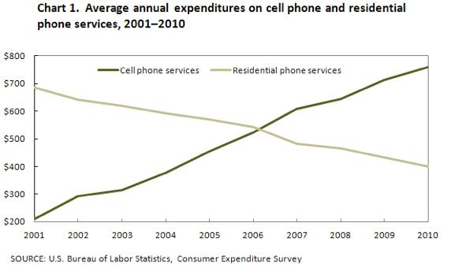

Slide 10
It is clear that spending on landline phones fell steadily over the 10-year period, while mobile phone expenditure rose quickly.

Slide 11
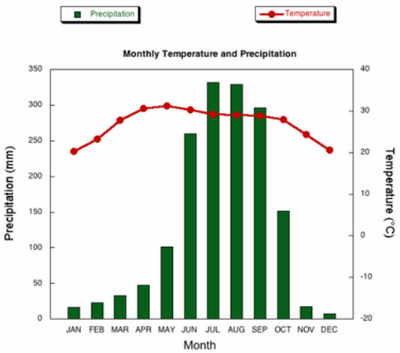

Slide 12
It is noticeable that monthly figures for precipitation in Kolkata vary considerably, whereas monthly temperatures remain relatively stable.

Slide 13
Whether +完整句子/to do
Whether men and women should share housework equally has triggered a heated debate.
It has triggered a heated debate whether men and women should share housework equally.
是否要维护老建筑取决于他们的历史文化价值。
Whether to maintain old buildings depends on their significance in culture and history.

Slide 14
Whether +完整句子/to do
在大城市盖房子还是种树取决于住房需求是否被满足。
Whether to build houses or plant trees in the metropolis depends on whether the housing needs have been met.
Building houses or planting trees in the metropolis depends on whether the housing needs have been met.

Slide 15
Whether +完整句子/to do
一个员工的工作质量和穿着是否都很重要取决于他在哪工作。
Whether an employee’s work quality and dressing are both important depends on where they work.
是否应该雇佣年轻人担任政府的重要职业吸引了我们的关注
Whether to employ young people to undertake important positions of the government has attracted our great attention.

Slide 16
What+不完整句子 指代事/物
What the government should do is......
What the government and parents should be concerned about is.....
What makes XX and XX especially worried is ......
政府和家长应该共同关心的是现在青少年把网红当偶像而不是科学家和艺术家。
What the government and parents should be concerned about is that nowadays teenagers regard celebrities online as role models rather than scientists and artists.

Slide 17
What+不完整句子 指代事/物
让我妈妈尤其担心的是我选择去以色列旅游。
What makes my mother especially worried is that I choose to travel to Israel.
国家和公众应该共同努力去做的是维护政府和居民之间的和平。
What the country and the public should make joint efforts to do is to maintain peace between the authority and citizens.

Slide 18
Who+不完整句子 指代人
Who will hold the conference has not been decided yet.
Who will be invited to my party is my business.
Who I will invite to my party is my business, not yours.
谁应该为当地环境负责已经引发了我们极大的讨论。
Who should be responsible for the local environment has triggered a heated discussion.
谁更适合做政府部门的领导，老年人还是年轻人，已经引发了一个热烈的讨论。
Who are more suitable to be leaders of the government, the elderly or the young, has triggered a heated discussion.

Slide 19
How/when/where/why+完整句子
How/when/where/why I hold the party is my business.

Slide 20
宾语从句
从句在句子中做宾语，that可以省略，引导词同上。放在谓语动词和介词之后。
I think he is handsome.
I think he is not handsome.
I do not think he is handsome.

Slide 21
常用宾语从句
I believe/think/hold/argue that......
一句话，which means that.......
This means that......
However, this does not necessarily mean that.....（转折段）
In spite of above arguments, I still believe that.....
Some people have different views about....
The line chart illustrates how the proportion of girls changed from 1993 to 2003.
The flow chart illustrates how the peach cans are produced.
The two maps compare how the village has been rebuilt in the past thirty years.

Slide 22
练习
我们的动机塑造了我们如何看待这个世界。
Our motives shape how we see the world.
这个曲线图展示了牛肉的消耗量是如何变化的从1993年到1998年。
The line chart illustrates how the consumption of beef changed from 1993 to 1998.
这个流程图展示了桃子罐头是如何制作的主要分三步分别包括采摘、加工和售卖。
The diagram illustrates how peach cans are produced mainly divided into three steps including picking, processing and selling respectively.
这些地图对比了村庄在过去的三十年是如何改造的。
The maps compare how the village has been rebuilt in the past 30 years.

Slide 23
People have different views about+辩论话题
人们有不同的观点关于老年人还是年轻人更适合做政府领导。
People have different views about whether the young or the elderly are more suitable for important positions of the government.
人们有不同的观点关于是否大学生应该有自由选择他们偏爱的专业。
People have different views about whether college students have the freedom to choose their preferred subjects

Slide 24
表语从句
从句在句子中做表语，引导词同上，放在系动词之后。

Slide 25
常用表语从句
The argument in favour of XXX would be that......
The argument in favor of animal experiments would be that some side effects of new medicines can be found and avoided to a large extent by examining the response of tested animals.
The argument against XXX would be that......
The argument against smoking would be that it is one of the preventable causes of cancer.

Slide 26
常用表语从句
报告类--reasons& solutions
reasons & effects
problems &solutions

Slide 27
常用表语从句
The main reason why an increasing number of people prefer to buy famous brands is that their living standard has been improved dramatically.
Another reason for this problem is that there have been more advanced marketing strategies and advertisements everywhere that can persuade customers to buy luxurious brands.

Slide 28
常用表语从句
The main reason why an increasing number of teenagers commit crimes is that their parents are engaged by busy work and they have no sufficient time to discipline their children.
Another reason for this problem is that there is too much inappropriate information online such as violence and pornography so that many teenagers begin to imitate.

Slide 29
常用表语从句
The main reason why .... is that .......
Another reason for this problem is that ......
The problem caused by this trend is that ...
The effect brought by this trend is that.....
This is because....
This is why....

Slide 30
同位语从句
解释说明一个抽象名词：idea; news; report; fact; trend; suggestion; order; fear; hope; advice; promise; memory; the story; faith; belief; rumor; lie;
引导词：that +完整句子

Slide 31
辨析定语从句&同位语从句
从美国西部传来的消息是千真万确的。
滴滴乘客失踪的消息令我们震惊。
大家已经接受了John 和Lucy谈恋爱的事实。
五十年前发生在杭州的故事被写成了一首歌。
学生应该通过反复翻译句子来提高其英语成绩的建议非常实用。

Slide 32
同位语从句 | 定语从句
解释说明一个抽象名词，从句就是这个抽象名词的内容。可以翻译成“这一” | 修饰一个名词，翻译成“……的”
that引导同位语从句+完整句子 | that+不完整句子
被解释的名词必须是抽象的：idea; news; report | 被修饰的名词可以是任何名词

Slide 33
常用同位语从句句型
Due to the fact that......, ........
Despite the fact that......, .......
There is a trend that........
I agree with the view that.......
This will lead to the result that.....

Slide 34
常用同位语从句句型
一句话，which will lead to the result that.....
An increasing number of graduates choose to settle down in the major cities of a country, which will lead to the result that housing, traffic, medical and educational resources there will face huge pressure.

Slide 35


Slide 36
保6争7

Slide 37
2015-8-8/2018-7-28
Some people who have been in prison become good citizens later, and it is often argued that these are the best people to talk to teenagers about the dangers of committing a crime.
To what extent do you agree or disagree?

Slide 38
第二段
On the one hand, 改造好的前科犯的演讲确实更有说服力。
This is because 这些人真实经历过他们如何卷入一场犯罪活动中、监狱的悲惨生活和出狱之后找工作的困难。
Therefore/So, 相比于老师家长或者警官的说教，罪犯基于事实的演讲更加生动并可以消除青少年心中关于罪犯都在过光鲜生活的错误观点。
As a result, 学生更倾向于听从那些按照经验讲话的人。

Slide 39
deliver a speech
Reformed ex-offender 改造好的前科犯
convincing & persuasive 令人信服的
go through 经历
Be involved in 卷入、涉嫌
miserable life 悲惨的生活
Serve the sentence 服刑
secure a job 找工作
Release a prisoner 释放一个囚犯
Compared to...... 与……相比
monotonous talk 乏味的讲话
be based on 基于
vivid 生动的
Dispel 消除
Lead a glamorous life 过一个光鲜的生活
Be likely to/be inclined to/tend to 倾向于
take advice 听从意见
those who
speak from their experience 从经验讲话

Slide 40
On the one hand, it is true that lectures delivered by reformed criminals are more convincing. This is because they have truly gone through how to be involved in a crime, miserable life when serving the sentence and the difficulties of securing a job after being released. So compared with monotonous talk of parents and teachers, their stories based on the fact can be more vivid and dispel teenagers’ wrong idea that criminals are leading a glamorous life. As a result, teenagers are more likely to take advice from those reformed ex-prisoners who speak from their experience.

