Slide 1
雅思写作Task-1
新浪微博：@杜仕明-学为贵

Slide 2
G 类 – 书信写作
A 类 – 图表作文
150词 + 大约20分钟 + 占到总分值1/3

Slide 3
对于参加General Training(移民类)雅思考试的考生来说，Task1的写作任务是完成一封书信。题目中给出一个背景话题，然后要求考生完成题目中给出的三个要求。书信写作的高分关键在于：
1. 编故事的能力要出色，能写出一个连贯合理的故事；
2. 文字表达不需要过于学术，但是要偏向地道表达；
3. 注意书信写作的时态，有可能在一篇文章里使用超过5种时态。

Slide 4
书信内容介绍
书信写作的内容包括很宽的范围：
1. 道歉；
2. 感谢；
3. 投诉；
4. 建议；
5. 申请；
6. 邀请；
7. 介绍；
8. 寻求帮助

Slide 5
下面这封邮件来自于铁路公司官方。
虽然和考试的内容不是完全一样，但是结构和用语都很恰当。

Slide 6


Slide 7
书信格式介绍
1). 最好是左边对齐，每段之间空一整行；
2). 称呼—Dear 名字/头衔/Sir or Madam；
3). 结尾部分一定需要比较礼貌的收尾：
kind regards-sincerely/faithfully-lots of love

Slide 8
书信内容风格
1). 第一段通常简单开头—I am writing this letter to 介绍写信的目的；
2). 正文的分段没有固定要求—一般来说题目会给出一件事的大概介绍，然后要求完成三个具体的任务。
3). 结尾部分一般需要表示感谢或者提出要求
I would be grateful if you could …….
My request is that ……
I will be looking forward to your reply.

Slide 9
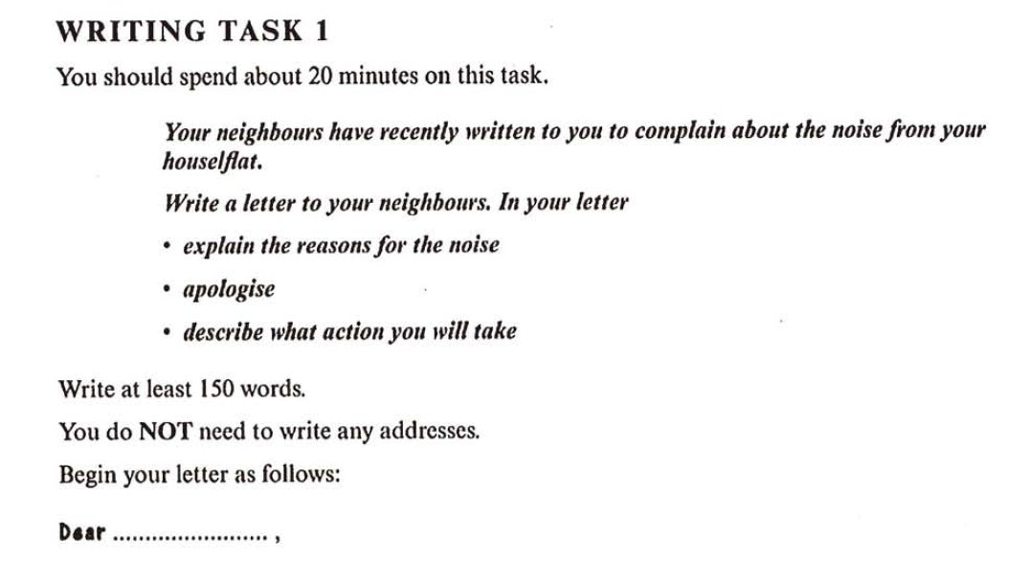

Slide 10
Dear Jason,
I am writing this letter to apologize for what have happened these days. I am really sorry about the noise from my dog.
Last week, my sister sent her dog, Frank, to us asking me to be a puppy-sitter for two weeks while she was in China for honeymoon. I was told that Frank had been doing well and barely made trouble for my sister. Unfortunately, it is clear that the dog does not like his temporary home possibly because it is the first time that he lives in a place that is unfamiliar to him.
I know that you must have been annoyed by the barking of the dog all day long, so I am going to fix it. Sending Frank to the pet house in the community may be a good solution. There, he can do whatever he wants while leaving others in peace.
I would be grateful if you could understand my situation and accept my apology.
Sincerely yours
Jeremy Lin

Slide 11
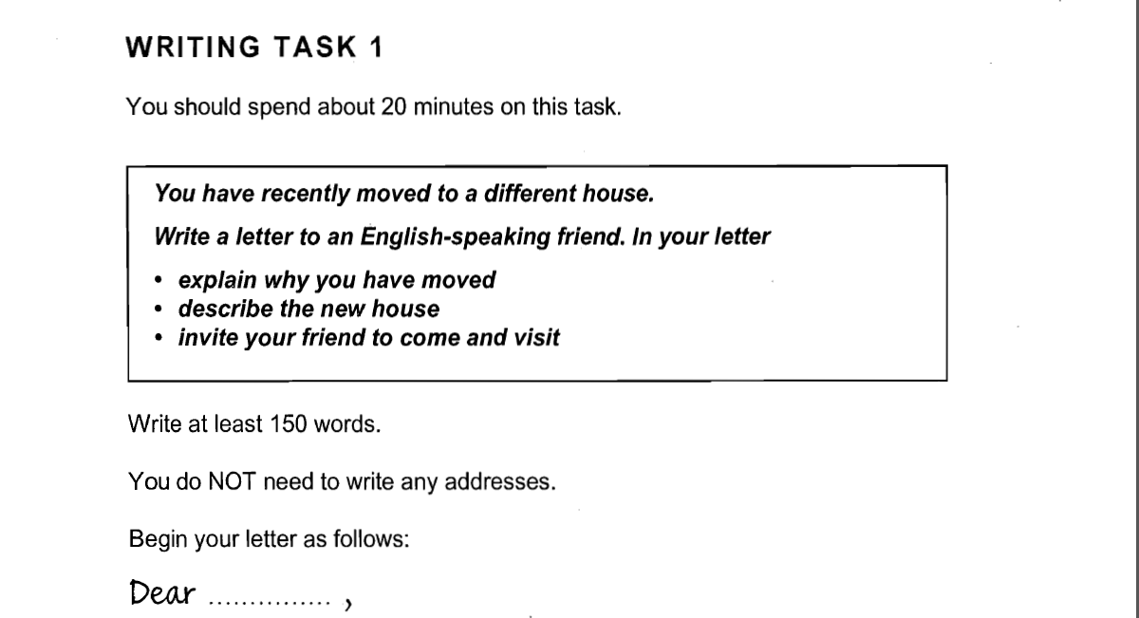

Slide 12
Dear Dave,
I am writing to let you know that at last we have moved to a bigger house! We just couldn't go on living in the two-bedroom bungalow now that the twins are growing up and the new baby has arrived. So we started looking—and one thing led to another and finally here we are in our new home.
I am sure you will like it. We have three bedrooms now, and a very modern bathroom and kitchen. The kids are happy because there is much more space with the big living room and the garden outside. But Michel is the happiest of all because he doesn't need to do much decorating.
Why don't you come round this weekend and see what you think of our new place? We would all love to see you and if the weather is good we can have a barbecue in the garden.
Our new address and phone number are below, so give us a call and let us know when to expect you.
Lots of love
Francoise

Slide 13
图表作文得高分来自于两个能力
精准的句子表达和词汇选择(理解和模仿翻译练习的句子)
宏观看图表的能力，而不是数据流水账的描述
(无论任何图表，在overall段落写出2-3个宏观特征，有了这个段落保你7分)

Slide 14
Task1--图表作文的句子也满足4+3基本原则
1. 主谓宾
2. 主系表
3. There be 名词
4. It is……(图表作文里很少用到)

Slide 15
用介词短语来扩展句子
(介词短语) 主句 (介词短语)
There is a substantial difference between the UK and the US in terms of their consumption of beef.
As for the smoking rate of females, there was a substantial growth during the 20-year period, rising from 8% in 1990 to 20% in 2010.
Despite some initial fluctuation, from 1995 there was a steady increase.
The US will continue to rely on fossil fuels, with sustainable and nuclear energy sources remaining relatively insignificant.
The population of Singapore is about 4 million, with Chinese accounting for 3 quarters.

Slide 16
用让步状语从句来增加对比能力
(状语从句) 主句 (状语从句)
Although the proportion of people buying classical music was 17%, it was just half of the figures for the other two types of music.
National and international fixed line calls grew steadily from 37 to 62, though the growth slowed over the last two years.

Slide 17
修饰名词的能力能避免重复
基础句型里的名词被充分修饰
1. There was a significant increase in the amount of money spent on books and furniture.
2. The percentage of males who buy pop and rock music is higher than that of females.
3. Those families consisting of one parent or a single adult were most likely to live in poverty.
4. The chart shows the time spent by UK residents on different types of telephone calls between 1995 and 2002.

Slide 18
在句尾用分词短语来进行跟进一步的内容描述
主句, doing .....(分词用来详细说明)
变化：The proportion of population aged over 60 saw an upward trend, rising from 11% in 1990 to 30% in 2005.
对比：Chinese tourists spent the largest amount of money on shopping, accounting for 74% of their total spending.

Slide 19
对于参加A类考试的同学，你们被要求在Task1完成对一个图表的描述。
Line graph 线图
Bar chart 柱状图
Pie chart 饼图
Table 表格图
Diagram 地图或者流程

Slide 20
重要的事情说三遍
请不要按照图形分类，因为图表之间是interchangeable的！！！
1. 100% 完全对比图(没有时间变化)
2. 20%对比+80%变化图(有时间变化)

Slide 21
简单对比图—只出现在混合图表里，机会很小
不靠分析，靠句型，写流水账。
（这部分可以先跳过，往后看复杂的对比图表，从33页开始）

Slide 22
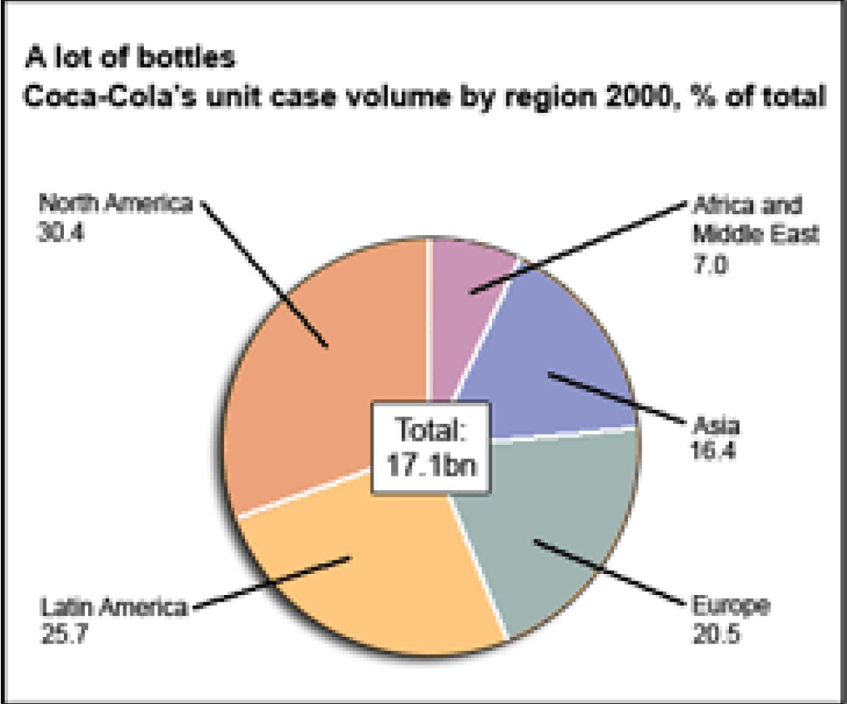

Slide 23
Coke的全球销量达到了17.1 billion, 其中北美洲有最大的比率，是30.4%， 而非洲和中东地区只有7%。 在其他三个地区中，拉丁美洲有相对较高的销售比率，达到25.7%， 然后是欧洲20.5%和亚洲16.4%。

Slide 24
The total sales of Coke was 17.1 billion bottles in 2000, with North America having the largest proportion at 34%, compared to only 7% in Africa and Middle East. In the other three regions, Latin America had a relatively higher percentage(25.7%), followed by Europe (20.5%) and Asia (16.4%).

Slide 25
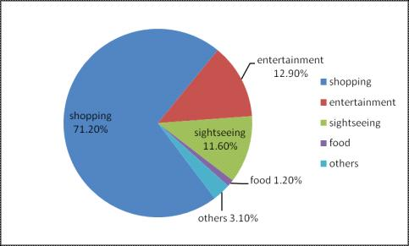

Slide 26
很明显，中国游客的钱主要花在了购物上，占到71.2%， 而食物的花费才只有1.2%。花在娱乐和观光方面的钱很相近，分别占到12.9%和11.6%。其他方面的花费占到3.1%。

Slide 27
It is obvious that Chinese tourists spent most of their money on shopping accounting for as much as 71.2%, compared to only 1.2% on food. The amount spent on entertainment and sightseeing varied slightly, with 12.9% and 11.6% respectively. The remaining 3.1% was spent on other items.

Slide 28
简单对比图一般出现在混合图表中。混合图表里的两个图一般都是分开描述，如果有一些内在的联系，只需要在结尾段点出来就好了。

Slide 29
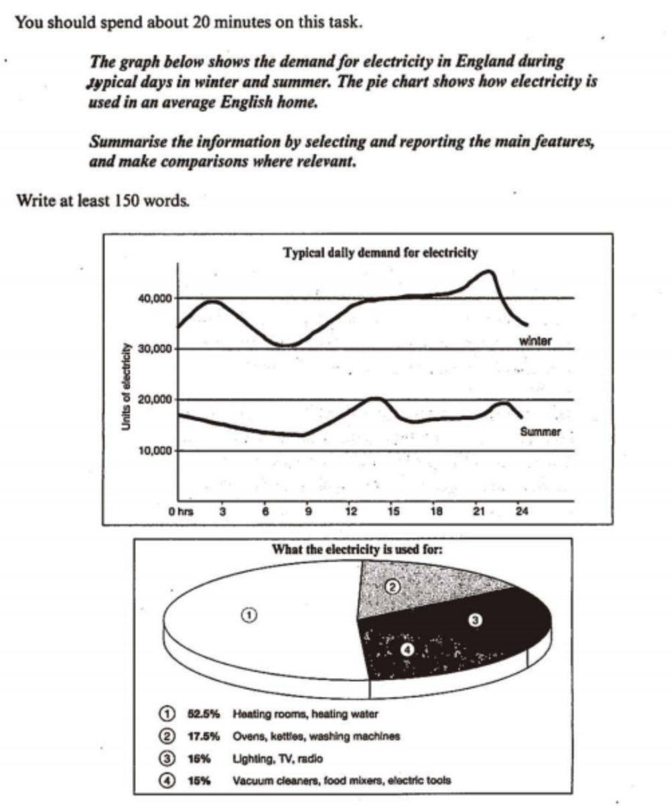

Slide 30
复杂对比图—这才是考试的重点
在这种图表里，你没有机会使用任何一个变化相关的词汇和句子。
不论对比图表里出现了多少个数据，你的任务总是从中提炼出2-3个宏观特征。这些特征包括：哪一组最高，哪一组最低，两组之间是相似还是相差的关系，最大差值/最小差值（特殊图表的情况下）。

Slide 31
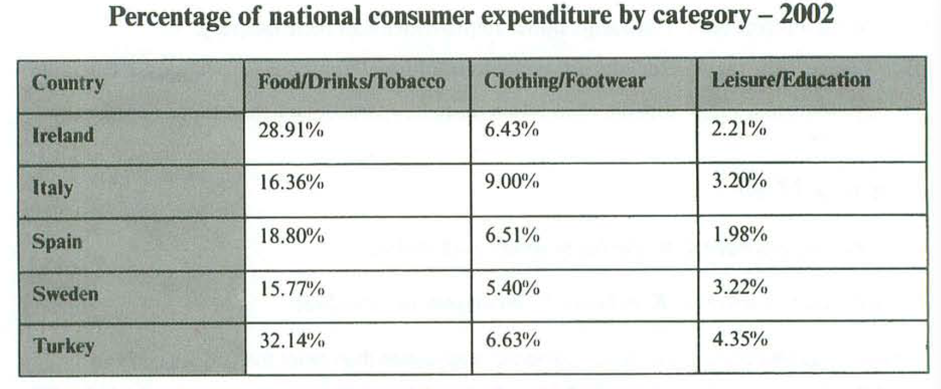
The table below gives information on consumer spending on different items in five different countries in 2002.

Slide 32
The table illustrates the proportion of national expenditure in Ireland, Italy, Spain, Sweden and Turkey on three types of consumer items in 2002.
Overall, the category of consumer goods that all countries spent most on was food, drinks and tobacco, which was considerably more than the expenditure on the other types of goods. The lowest spending could be seen in the category of leisure and education in all five countries.
In terms of food, drinks and tobacco, Turkey spent the most at 32.14%. The expenditure of Ireland was also high (28.91%) compared to Sweden which spent the least (15.77%). Spain and Italy spent 18.80% and 16.36% respectively. On the other hand, the lowest expenditure was on leisure and education which accounted for under 5% in all countries. Turkey spent most on these items at just 4.35% of their national expenditure which is around double that of Spain (1.98%).
Clothing and footwear was the third category of consumer goods and outlays for those items were between 9% in Italy and 5.40% in Sweden. The national spending in this area for the remaining countries averaged around 6.5%.

Slide 33
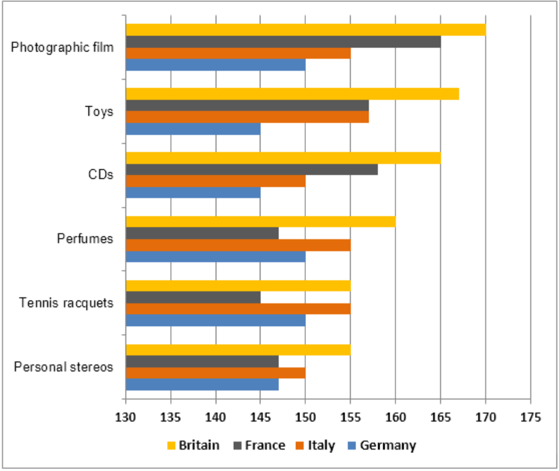
The chart below shows the amount spent on six consumer goods in four European countries.

Slide 34
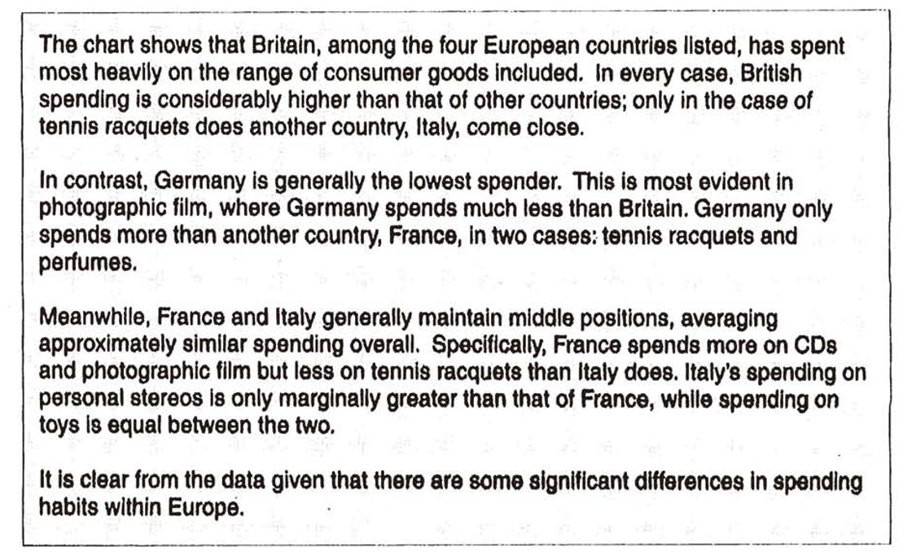

Slide 35
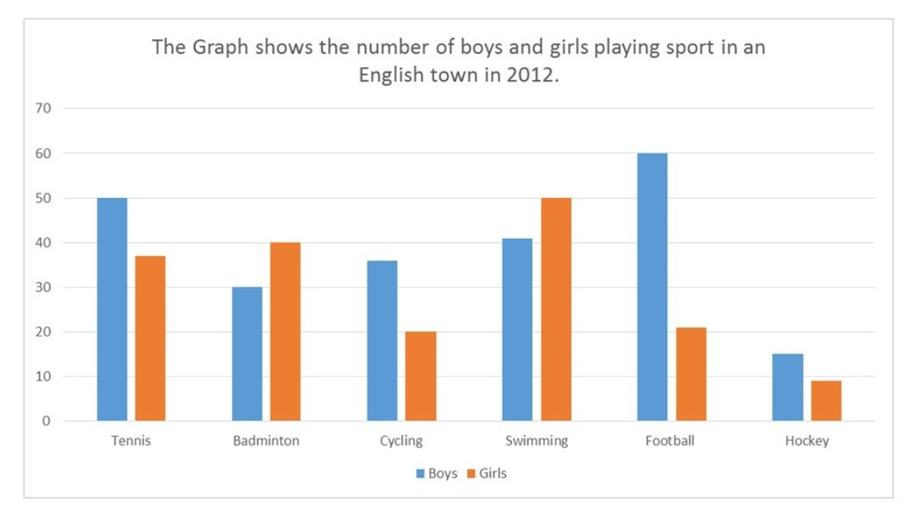
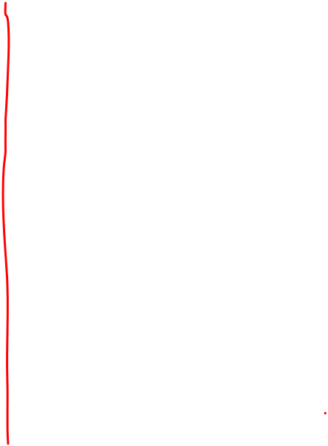

Slide 36
The bar chart illustrates how many children, divided by gender, played six kinds of sports (tennis, badminton, cycling, swimming, football and hockey) in a town in England in 2012.
Overall, the number of boys playing sport exceeded that of girls in the given period and the sport with the most significant difference between the genders was football. Football was also the most popular sport for boys while the majority of girls preferred swimming. Furthermore, both males and females least preferred playing hockey.
There were four sports in which boys participated more than girls. While 60 boys played football, the number of girls playing that sport was considerably lower (around 20). With regards to tennis, the figure for boys who played that sport was 50 as opposed to just under 40 for girls. Similarly, more boys cycled than girls (approximately 35and 20 respectively). The difference, in terms of hockey, was minimal with only about 5 more boys playing that sport than girls.
On the other hand, more girls took part in the two remaining sports which both showed a difference of about 10 between the genders. As many as 50 girls preferred swimming in comparison to 40 girls for badminton.

Slide 37
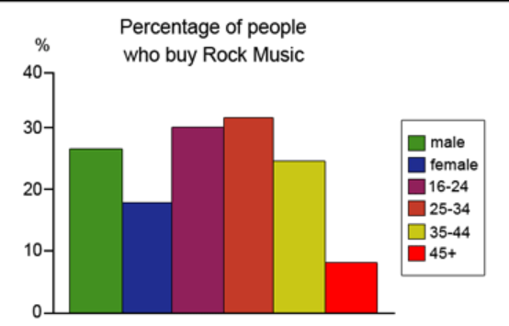
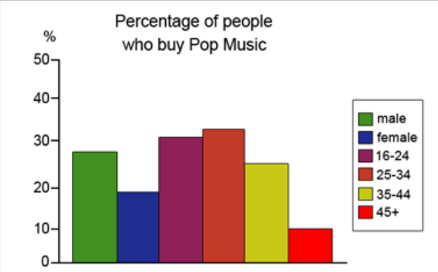
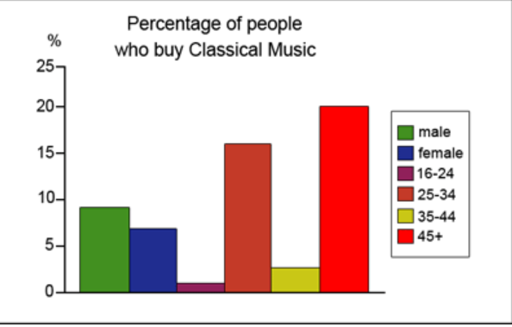
The graphs below show the types of music albums purchased by people in Britain according to s3x and age.
新浪微博：@杜仕明-学为贵

Slide 38
These charts make comparisons among three kinds of music about their popularity between males and females and among four different age groups.
Overall, it is clear that males are more willing to buy music albums than females. Modern types of music are more popular among people under 45, while classical music is mainly purchased by those over 45.
In terms of the percentage of male and female buyers, we can see that the proportion of the former is higher than that of the latter in all kinds of music. To be more specific, the figures for buyers of pop and rock music are similar with 28% of males and 18% of females. Classical music is purchased by only 9% of men and 7% of women.
When it comes to the music preference of different age groups, it can be noticed that pop and rock music have extremely similar patterns of purchasing and are much more popular among younger buyers. Specifically, the proportion of music buyers aged 25-34 is the highest (32%), followed by that of people between 16 and 24 (30%) and that of buyers aged 35-44 (26%). By contrast, classical music is generally the least popular choice, mainly purchased by people over 45 with approximately 20%. The percentages of people aged 16-24 and 35-44 are minimal, at about 1% and 3% respectively.

Slide 39
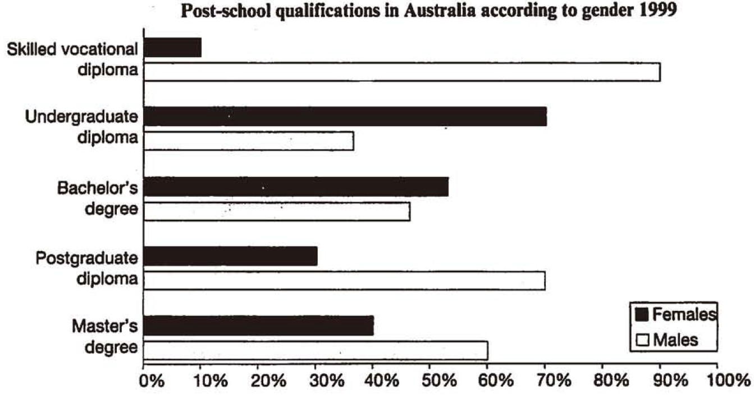
The chart below shows the different levels of post-school qualification in Australia and the proportion of men and women who held them in 1999.

Slide 40
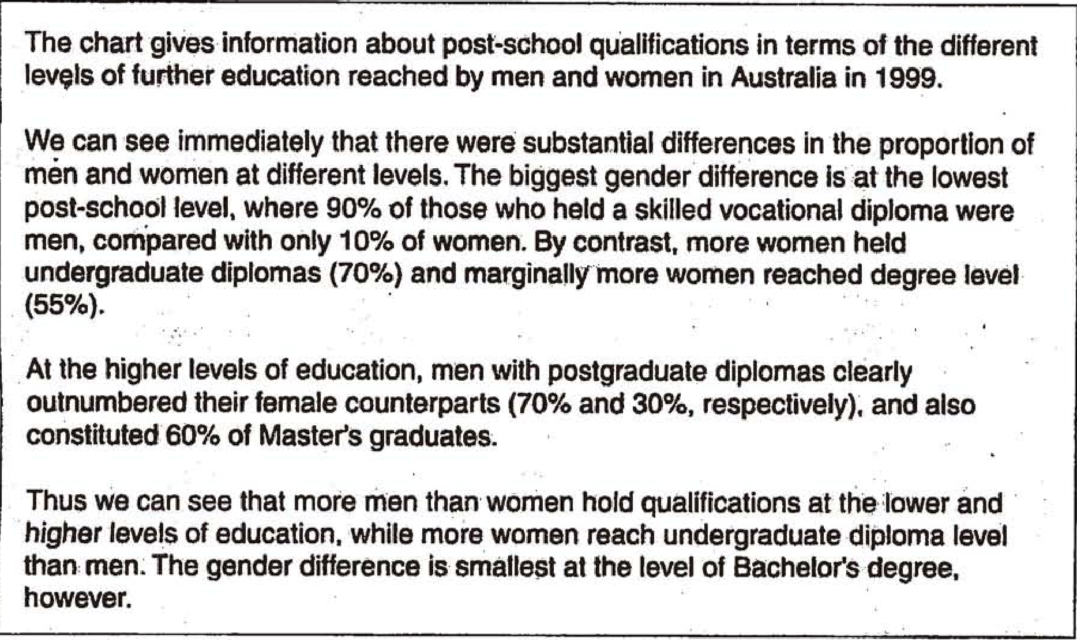

Slide 41
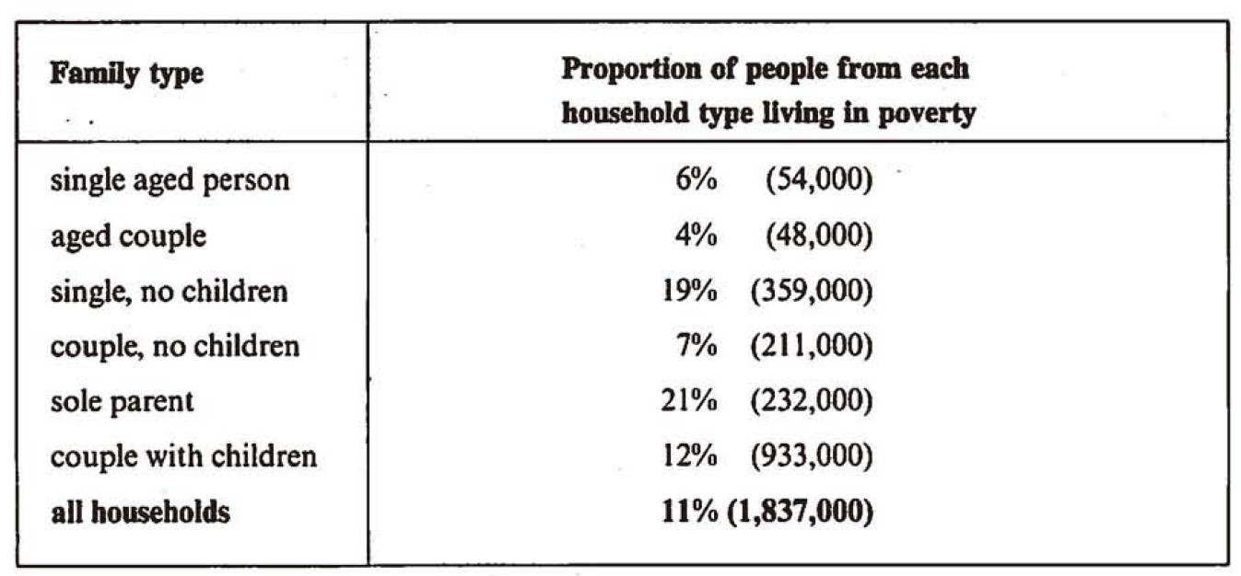
The table below the proportion of different categories of families living in poverty in Australia in1999.
新浪微博：@杜仕明-学为贵

Slide 42
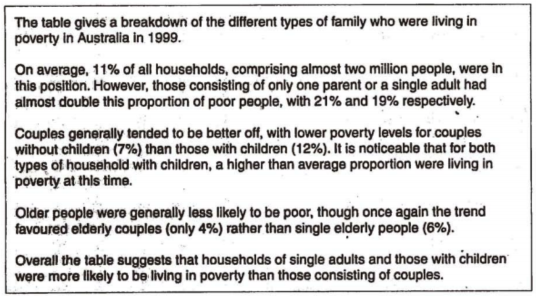

Slide 43
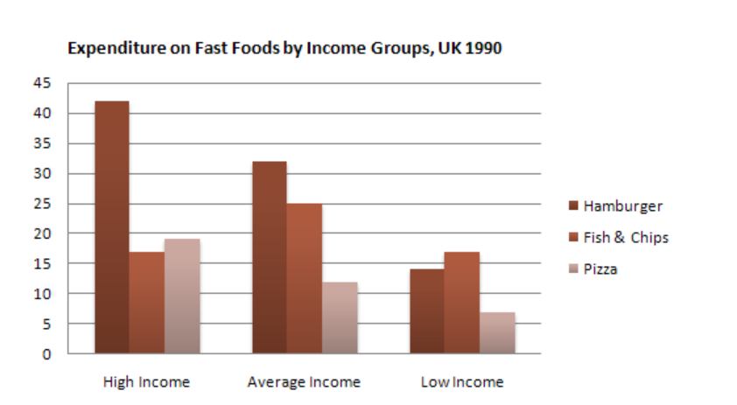
The chart below shows the amount of money per week spent on fast foods in Britain. The graph shows the trends in consumption of fast foods.

Slide 44
变化趋势图
变化图表相对简单，整个过程的核心一定是变化的内容。每个元素单独描述或者按相似/相反的方法分组。
变化趋势图一定要按照时间描述，不要跳跃或者从后往前写
变化图表的overall段落里一般20%的对比特征和80%的变化特征。
上升组 – 下降组 – 起伏波动组 – 很少变化组 – 最大/最小组

Slide 45
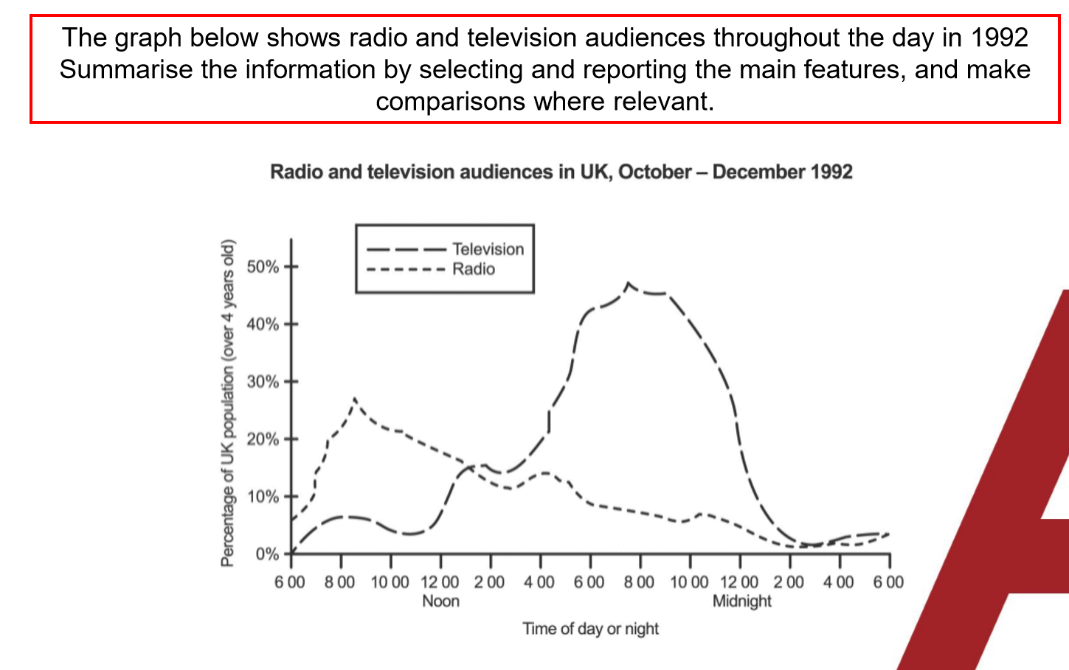

Slide 46
变化趋势图
The graph illustrates the changes in the proportions of radio listeners and TV viewers throughout the average day from October to December 1992 in the UK.
Overall, more people tended to listen to radio in the morning, while the popularity of watching TV was significantly greater in the afternoon and evening. People tended to do neither in the night and early morning.
Looking first at the radio audience, it was considerably higher before noon. Specifically, 7% of the British were listening to radio at 6 a.m. This radio audience increased dramatically in the next 3 hours and peaked at nearly 30% at around 9 a.m. After that, there was a steady decrease until 2 a.m. of the next day when it reached a minimal level which remained constant for the next four hours.
As for TV viewers, after starting at around zero viewers at 6 am, the percentage of TV viewers in the UK was less than 7% until noon. After that, TV viewing began to gain popularity and it was at 1 p.m. that the percentage of TV audiences overtook that of radio listeners. The greatest growth can be seen between 3 p.m. and 8 p.m., during which time the audience more than tripled. After peaking at roughly 50%, it witnessed a rapid decline until 2 a.m. of the next day. Over the last four hours, very few people watched TV.

Slide 47
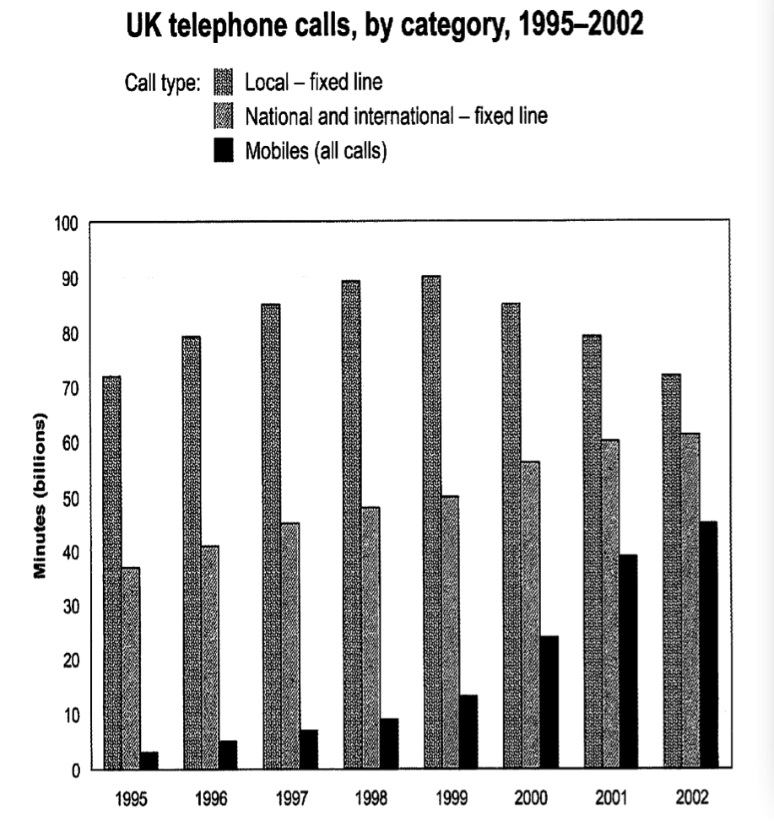
The chart shows the total number of minutes (in billions) of telephone calls in the UK, divided into three categories, from 1995-2002

Slide 48
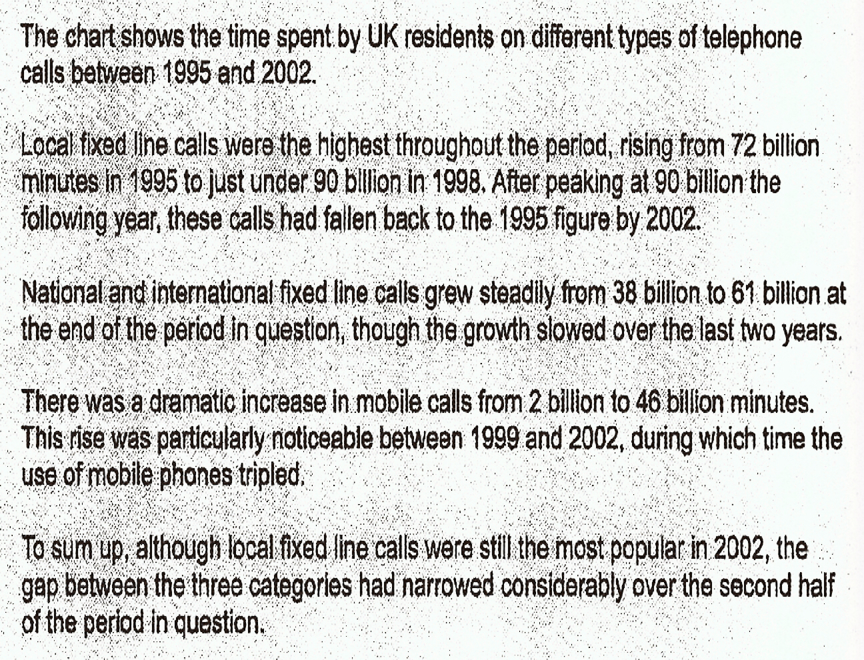

Slide 49
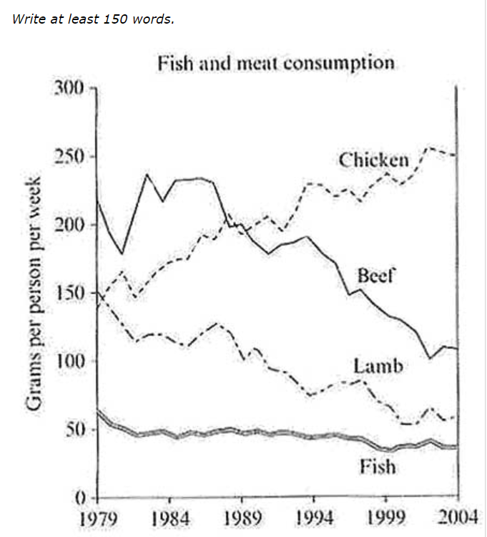
The graph below shows the consumption of fish and different kinds of meat in a European country between 1979 and 2004.

Slide 50
The graph shows how much fish and meat (chicken, beef, and lamb) were consumed by the average person in a particular European country from 1979 to 2004 in grams per week (gpw).
Overall, consumption of all types of meat declined with the exception of chicken, which showed a steady increase in popularity. Chicken replaced beef as the most popular meat, while fish remained the least consumed throughout the period.
At the start of the period, beef was the most popular meat, with over 200 gpw being consumed by the average person. At the same time, consumption of chicken and lamb stood at about 150 gpw, while that of fish was much lower, at 60 gpw. Thereafter, individual chicken consumption rose steadily, finishing the period at 250 gpw, while in contrast, personal demand for beef and lamb saw consistent declines, despite beef peaking at around 240 gpw in 1984. By the end of the period, their respective levels of consumption had fallen to around 100 and 60 gpw.
With regard to fish, it was the least popular at all times, falling from 60 gpw eaten by a typical person in this country in 1979, to 40 gpw in 2004.

Slide 51
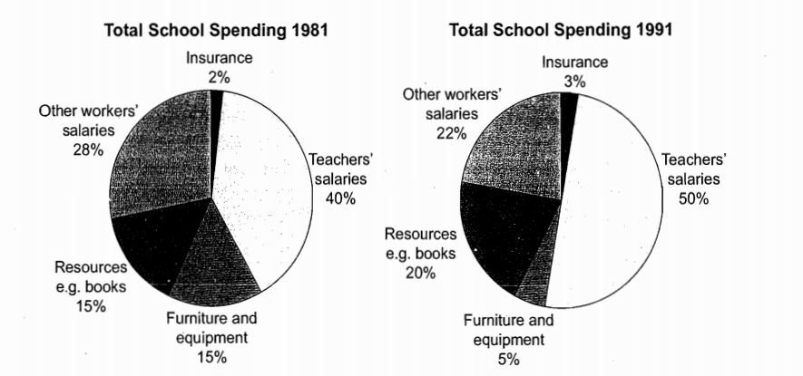
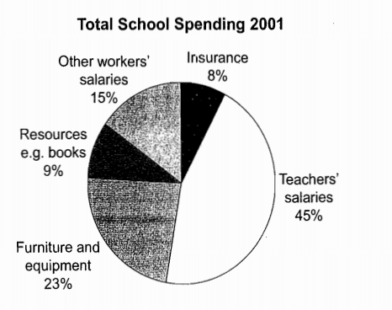
The three pie charts below show the changes in annual spending by a particular UK school in 1981,1991,and 2001.

Slide 52
The charts show how much a UK school spent on different running costs in three separate years:1981, 1991 and 2001.
In all three years, the greatest expenditure was on staff salaries. But while other workers' salaries saw a fall from 28% in 1981 to only 15% of spending in 2001, teachers' pay remained the biggest cost, reaching 50% of total spending in 1991 and ending at 45% in 2001.

Slide 53
Expenditure on resources such as books had increased to 20% by 1991 before decreasing to only 9% by the end of the period. In contrast, the cost of furniture and equipment saw an opposite trend. This cost decreased to only 5% of total expenditure in 1991 but rose dramatically in 2001 when it represented 23% of the school budget. Similarly, the cost of insurance saw a rising trend, growing from only 2% to 8% by 2001.
Overall, teachers' salaries constituted the largest cost to the school, and while spending increased dramatically for equipment and insurance, there were corresponding drops in expenditure on things such as books and on other workers' salaries.

Slide 54
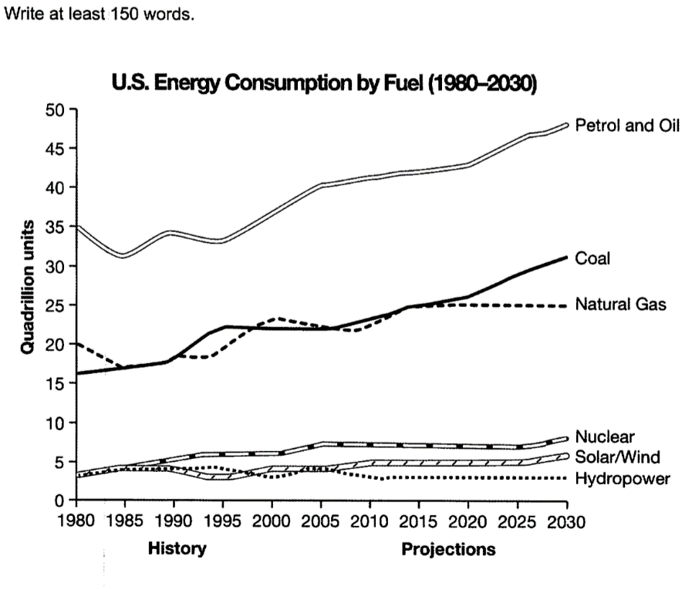
The graph below gives information from a 2008 report about consumption of energy in the USA since 1980 with projections until 2030.

Slide 55
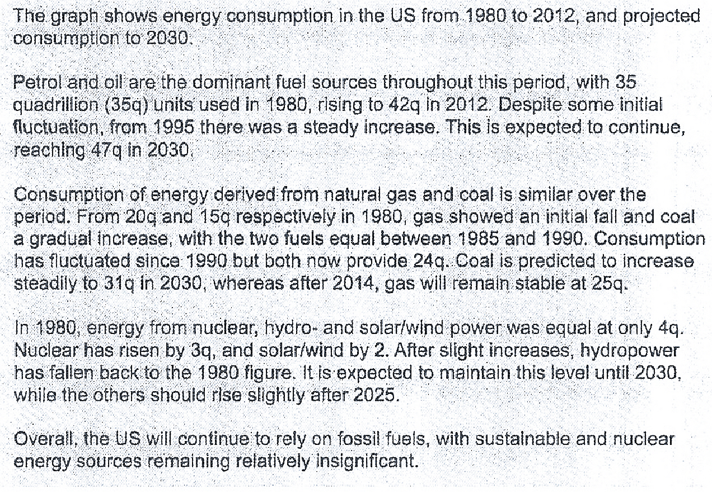

Slide 56
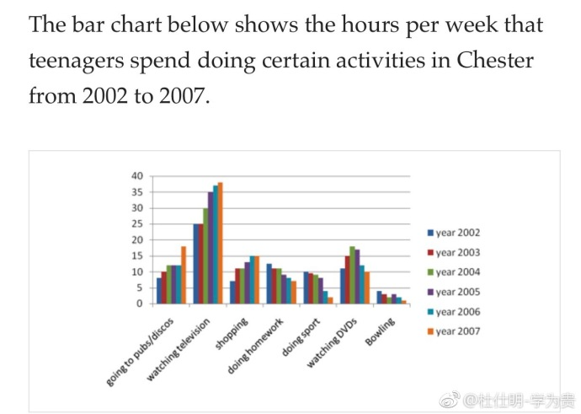

Slide 57
The bar chart illustrates how many hours adolescents in Chester spent on seven activities each week between 2002 and 2007.
Overall, the most popular activity over the period given was watching TV, whereas bowling was the least favourite. Going to pubs and discos, watching TV and shopping all showed an increase in the number of hours teenagers spent on these activities. The other pursuits showed a decrease in hours, except watching DVD’s which fluctuated.

Slide 58
Teenagers spent 25 hours on watching television in 2002 which increased to almost 40 hours in the final year. Both going to pubs and discos, and shopping more than doubled in hours from over 5 to over 15 and from over 5 to exactly 15 respectively.
While teenagers occupied 10 hours doing homework in 2002, this figure dropped to just over 5 in 2007. Playing sport fell more dramatically from 10 hours to around 3 hours. Bowling was under 5 hours throughout the entire period declining by about 4 hours in total. The number of hours teenagers dedicated to watching DVD’s was only 10 hours in first and final years, but reached a peak of over 15 hours in 2004 and 2005.

Slide 59
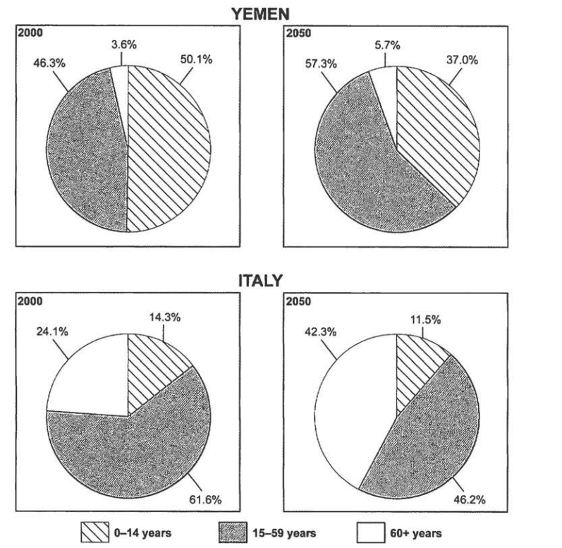
The charts below give information on the ages of the populations of Yemen and Italy In 2000 and projections for 2050.

Slide 60
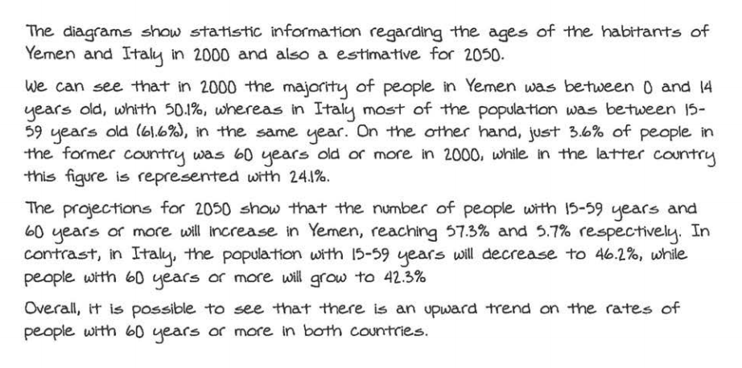
6分的范文

Slide 61
混合图表题
1. 两个图表分开写；
2. 同样需要overall；

Slide 62
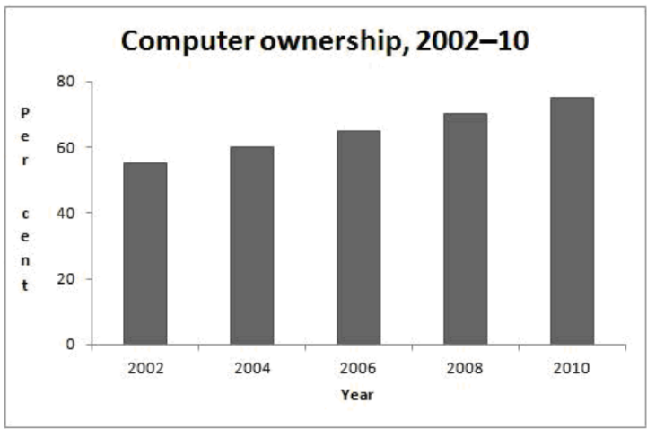
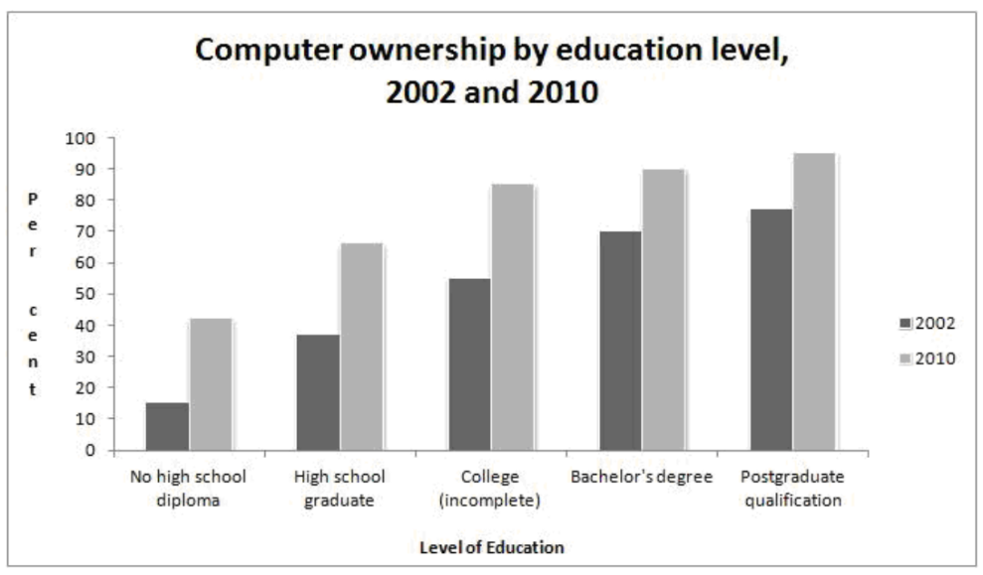
The graphs below give information about computer ownership as a percentage of the population between 2002 and 2010，and by level of education for the years 2002 and 2010.

Slide 63
The bar charts show data about computer ownership, with a further classification by level of education, from 2002 to 2010.
A steady but significant rise can be seen in the percentage of the population that owned a computer over the period. Just over half the population owned computers in 2002, whereas by 2010 three out of four people had a home computer.
An analysis of the data by level of education shows that higher levels of education correspond to higher levels of computer ownership in both of those years. In 2002, only around 15% of those who did not finish high school had a computer but this figure had trebled by 2010. There were also considerable increases, of approximately 30 percentage points, for those with a high school diploma or an unfinished college education (reaching 65% and 85% respectively in 2010). However, graduates and postgraduates proved to have the greatest level of ownership in 2010, at 90% and 95% respectively, 20 percentage points higher than in 2002.
The last decade has seen a substantial growth in computer ownership in general, and across all educational levels.

Slide 64
The graph below shows the demand for electricity in England during typical days in winter and summer. The pie chart shows how electricity is used in average England home.

Slide 65
The line graph gives information about the consumption of electricity during a typical day in winter and summer respectively in England and the pie chart shows how the power is consumed.
Overall, the amount of electricity consumed during a day in winter is considerably larger than in summer. The peak demand for electricity in winter occurs at night, while in winter it appears at noon. Half of the electricity is used for heating.
In winter, the demand for electricity witnesses remarkable changes throughout 24 hours. Specifically, from midnight to about 1 p.m., the figure starts from 35,000 units and fluctuates widely ranging between 30,000 and 40,000 units. After reaching a plateau at 1 p.m., the amount of electricity consumed remains stable for 6 hours at 40, 000 before rising again and peaking at 10 p.m. The last two hours sees a remarkable fall in power demand. By contrast, the amount for summer changes much less significantly. With approximately 17,000 units consumed at midnight, it slightly decreases to about 12,000 at 9 a.m., after which it rises to 20, 000 at 1 p.m., reaching the peak of a day. Slight fluctuation can be seen in the demand for electricity during the rest time of a summer day.
The pie chart shows that over 50% of electricity is used to heat rooms and water, compared with only 17.5% for ovens, kettles and washing machines. The remaining 30% of power is equally consumed by lighting, TV and radio and vacuum cleansers, food mixers and electric tools.

