Slide 1
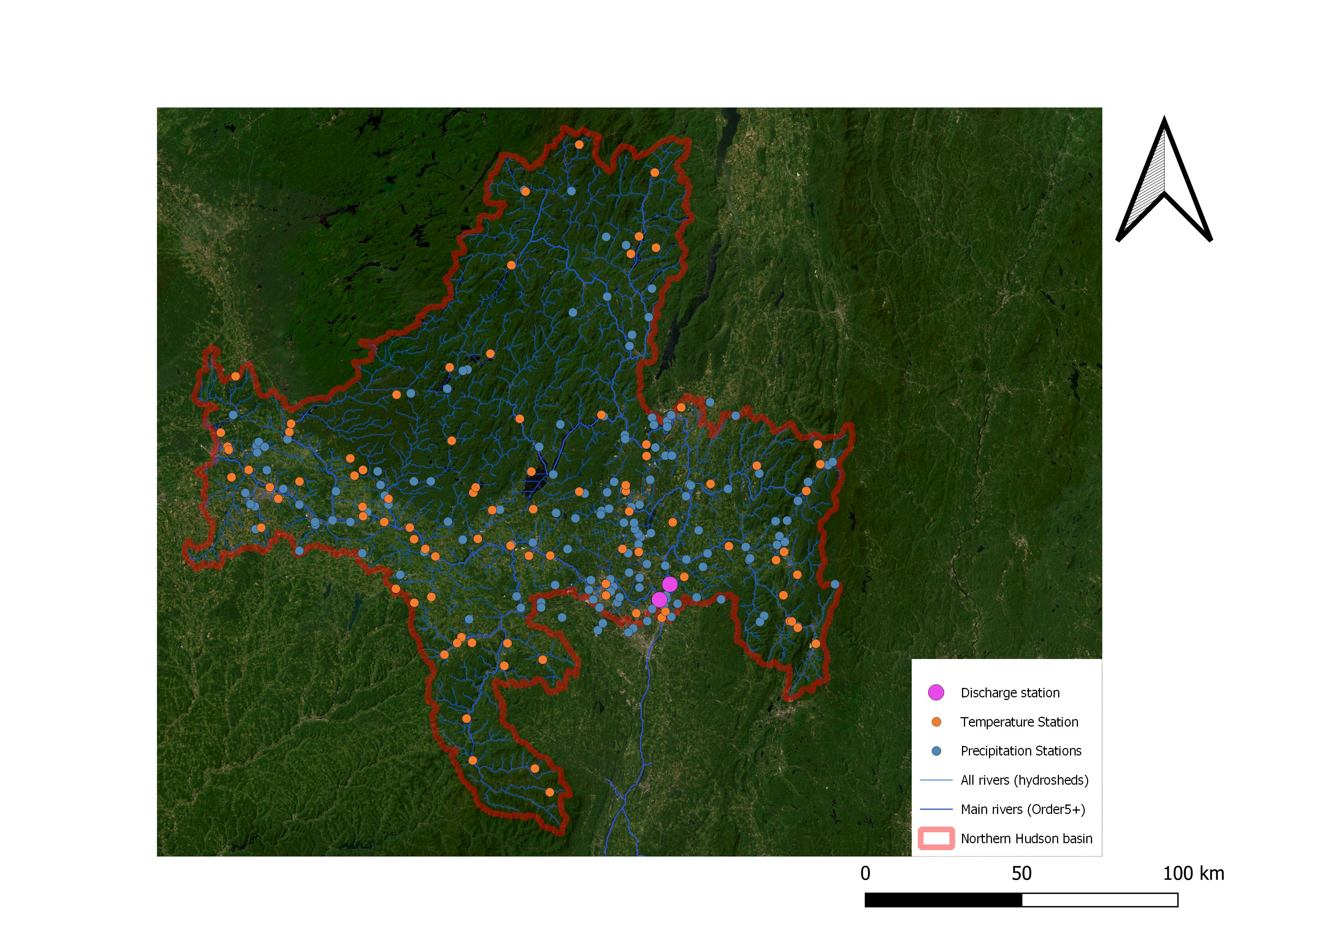
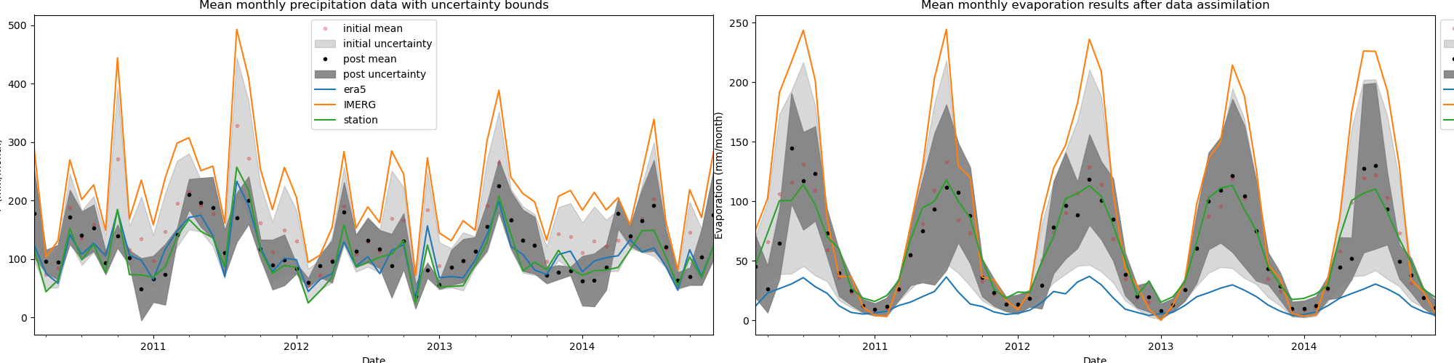
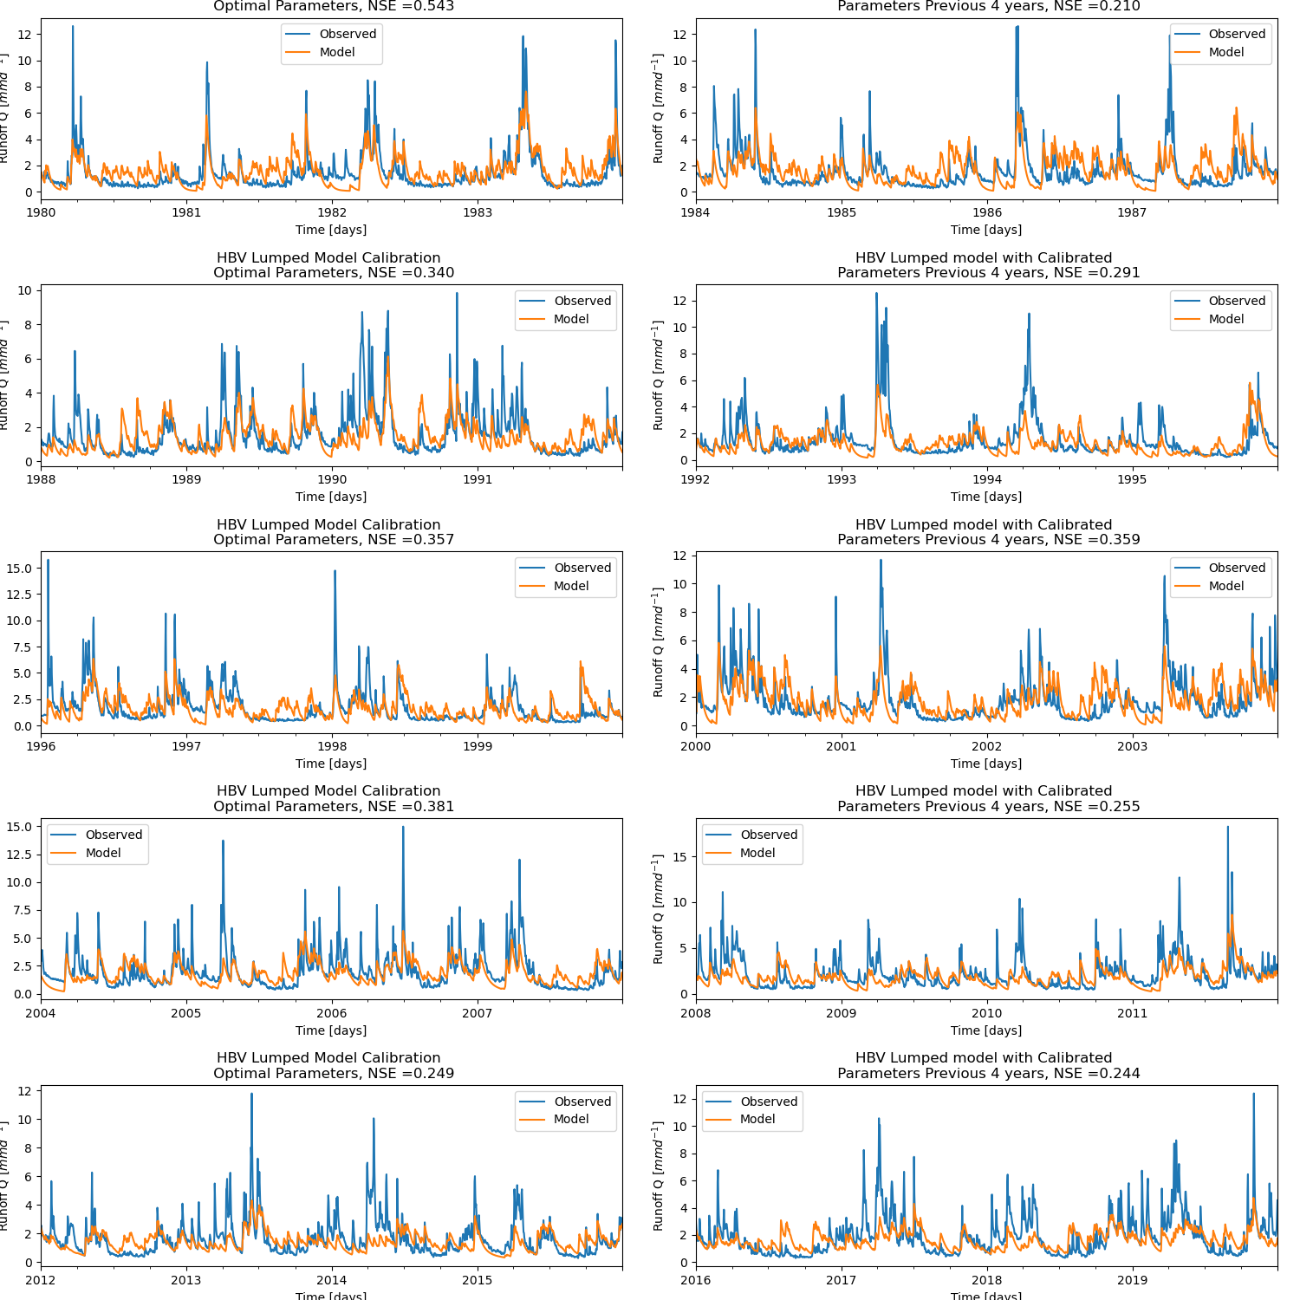
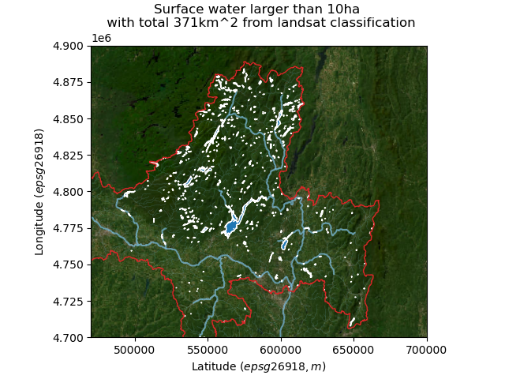
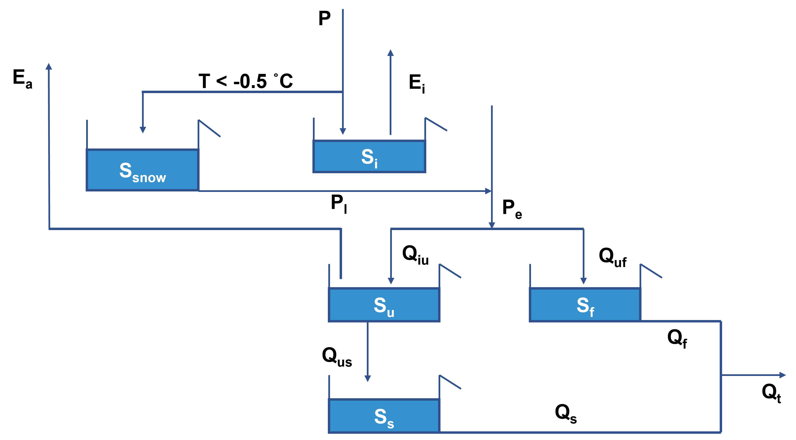

Hudson basin modelled HBV upper
David Haasnoot and Anne Versleijen
River Basin Hydrology and Water Management
Introduction
Data
Conclusion
The Hudson River Basin is located in the North East of the United States, which is around 35,000 km². The lower part of the basin is an estuary. As the river in the lower part is influenced by the sea, only the Northern region is taken into account with an area of 20,000 km². The region is showed in Figure 1. The area consists of forest, cropland and urban areas.
For the precipitation data, station data is used which matches ERA5 well. The station data is averaged over the area by using Thiessen polygons. For evaporation data obtain from Global Land Evaporation Amsterdam Model (GLEAM) is used. Discharge station data is retrieved from USGS, the discharge of two stations in the lower part are added together.
The HBV model overestimates the discharge during summer. An explanation for this could be the occurrence of reservoirs in the basin. (put figure of reservoirs?)
Next to this, the distributed model under estimates the discharge during snowfall. The data is taken as average throughout the basin, but in practice it is a heterogenic area. (plot where you can see this?)
Furthermore, both models have better outcome when same parameter range is chosen for the first 20 years based on the NSE. When run several times, the model of the past 20 years score always lower than data used from 1980 till 2000.
Uncertainty is large, but it is remarkable.
Data assimilation part + plot
Conclusion
Reservoirs in basin → higher modelled outflow summer
Used factor to compensate
Distributed model: under estimates discharge during snowfall
Heterogenity
Average
Both lumped and distributed parameter range better outcome first 20 years, or last 20 years
Comment on what we could do to improve the peaks:
compare to more data,
-equifinality
Figure 3. Data assimilation of precipitation (left) and evaporation (right) data.
Results
The lumped HBV model is calibrated for 8 different parameters. The data is divided into sets of 4 years, each time the parameters are calibrated and than tested over the 4 following years. Each time the , the Nash–Sutcliffe model efficiency coefficient (NSE) is calculated, the closer to 1, the higher the predictive skill. For each calibration the same range of parameters is used. As can be seen in Figure 3, the NSE is decreasing over the years.
Figure 1. Considered upperpart of the Hudson River Basin. With dots, the different stations are depicted.
Objective
Different data sets (data assimilation) voor evap. Uncertainty reduced
Results
HVB model (splitted in training (spinoff 1 year) and test)
Map with reservoirs
Sumax based on vegetation exercise
The aim is to describe the different elements of the water cycle within this region. To do so, data and information obtained from remote sensing techniques are used to develop a model.
HBV model
To model the water cycle in the basin, the HBV model is used. It is used both as lumped and distributed model. In the lumped model, the area is taken as homogenous. In the distributed model, the area is divided into wetland, hillslope and plateau areas.
The HBV model consists of various elements which describe different processes in the water cycle. If the air temperature is below 0.5 °C, the precipitation will be stored as snow. Otherwise it will intercept on vegetation until the storage capacity is reached. The excess (P_{e}) will flow into either the unsaturated rootzone or the fast reservoir. In case of melting snow, this flow will be added to P_{e}. From the unsaturated rootzone storage, water will leave as transpiration or percolate into the soil.
Figure 2. HBV model which is used to model the water cycle in the Hudson River Basin.

