Slide 1
Drought in Burkina Faso

Slide 2
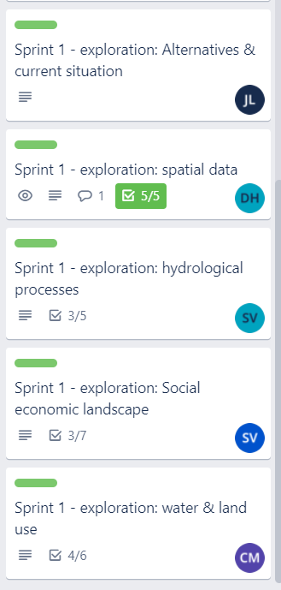
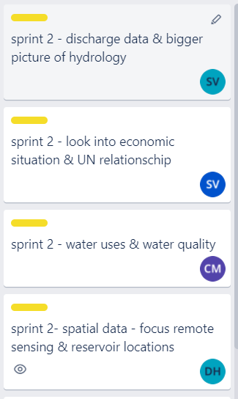
Sprint 1
Sprint 2

Slide 3
Our Goal:
"Build a future proof drought mitigation system of reservoirs"

Slide 4
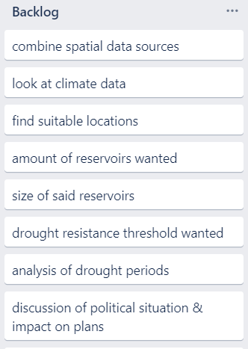
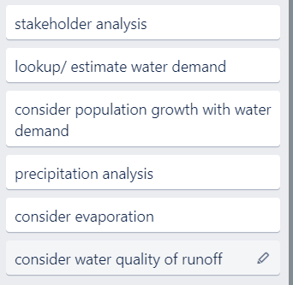
Backlog

Slide 5
Some initial pictures

Slide 6
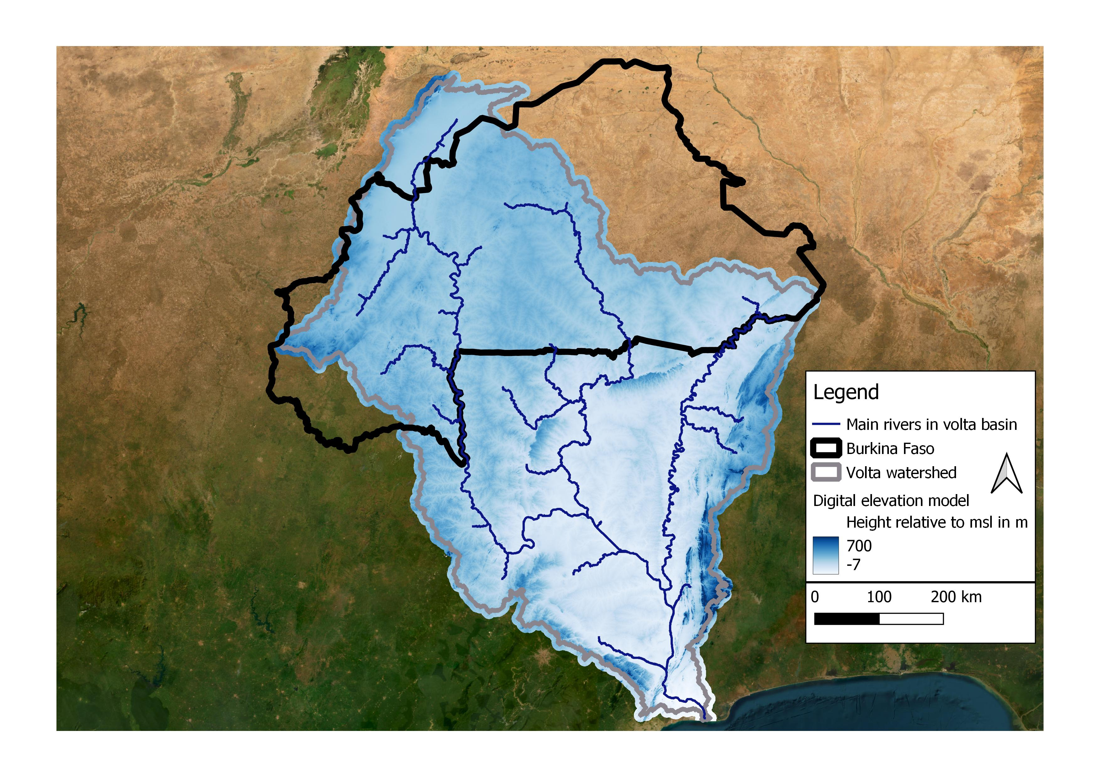

Slide 7
