Slide 1
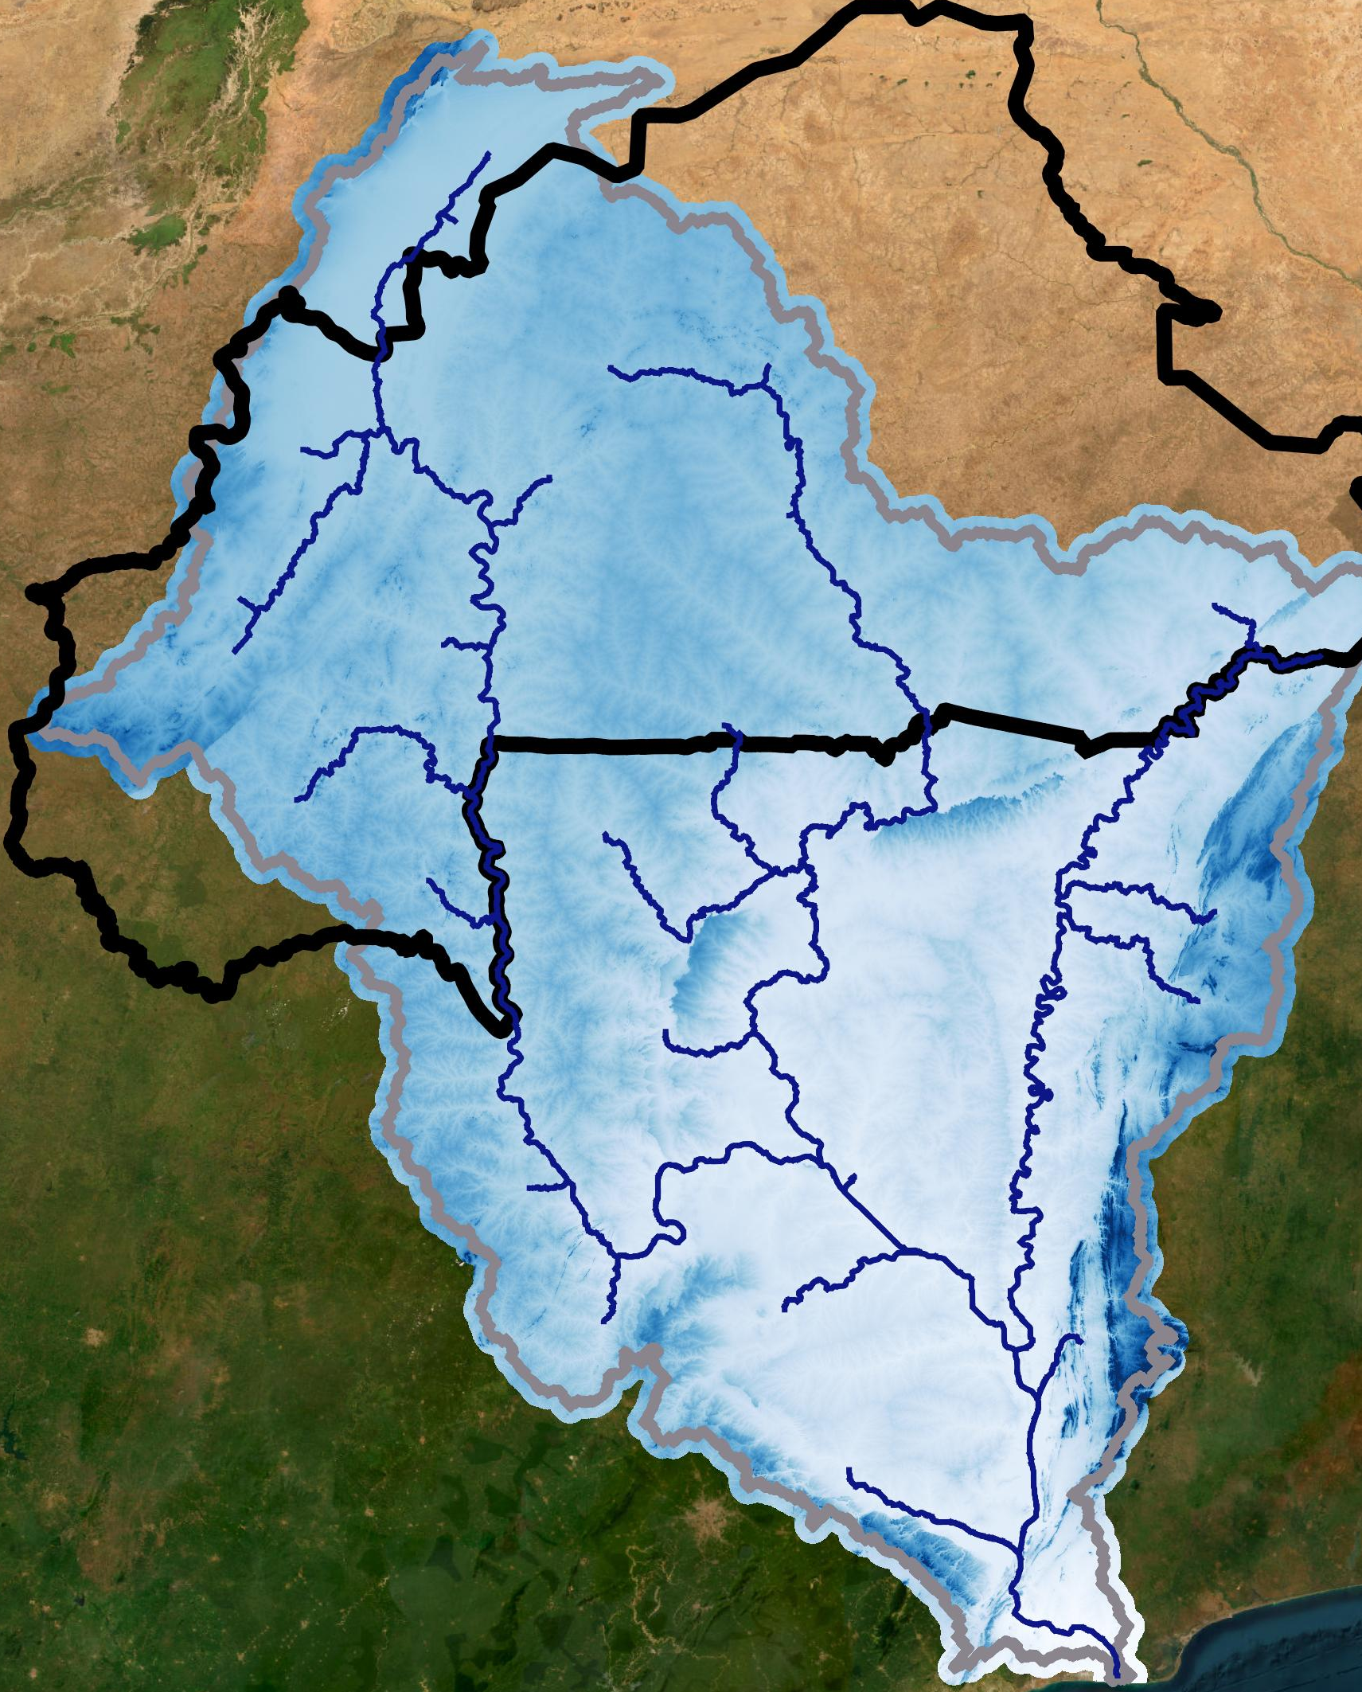
Water scarcity in Burkina Faso
Jonathan Linnebach – Product Owner David Haasnoot – Scrum master Sophie Verheugd - Developer Sophie van Velzen - Developer Christine Martin - Developer Jesse van Leeuwen – Developer

Slide 2
Problem: water scarcity in Burkina Faso
09-10-2020

Slide 3
(Client)
09-10-2020

Slide 4
Last week analysis:
Socio-economic, demographic and political situation
Stakeholders
Spatial analysis
Drought analysis
Water demand
Evaporation
Climate
….

Slide 5
Socio-economic, demographic and political situation

Slide 7
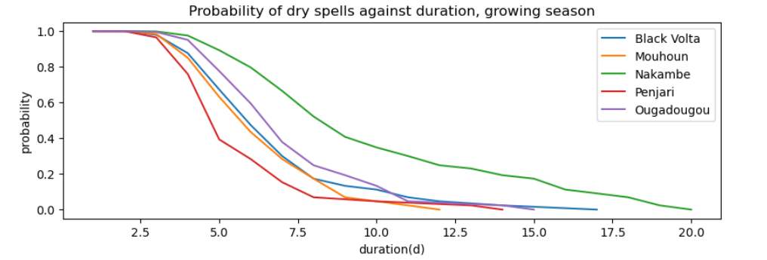
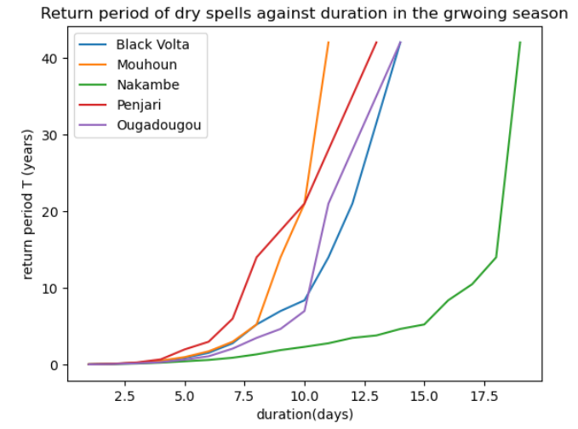
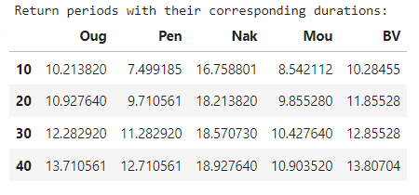
Drought analysis
Observations/conclusions:
……

Slide 8
Product goal

Slide 9
Thank you for tour attention

