Slide 1
Aquifer Storage Recharge David Haasnoot (4897900) & Justin van Beek (4480783)

Slide 2
Situation
40 000 [m^3] in August & July
10 < k < 40 [m/d]
0.25 < φ < 0.5 [-]
0.5 < α < 2 [m]
20 [m]
Salt = 30 [g/l]

Slide 3
Methodology and rules of thumb

Slide 4
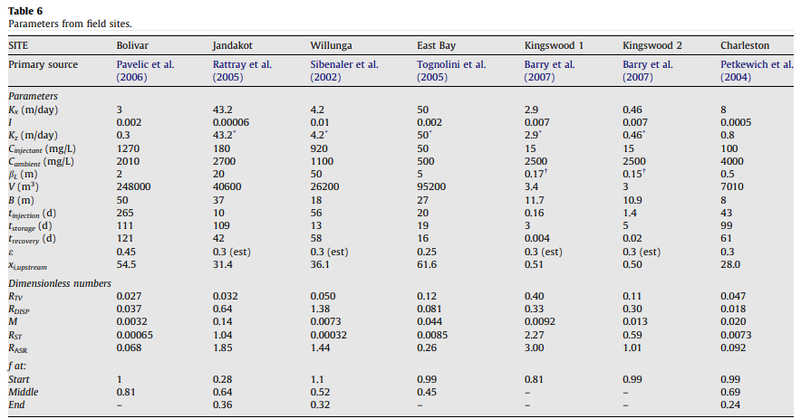
Comparable systems
Notes:
What is important to see on this figure is:

Slide 5
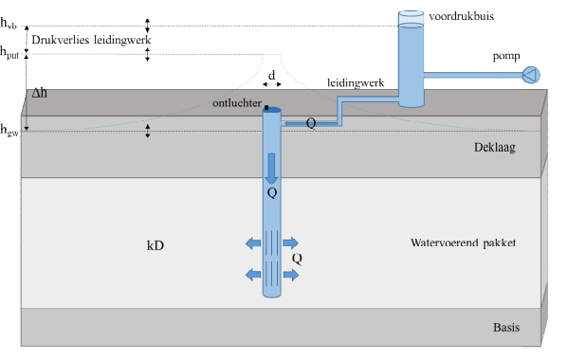

Maximum infiltration rate
(De Glee)
k = hydraulic conducitivity of aquifer (m/d)
D = thickness of aquifer (m)
c = hydraulic resistance of confining layer (d)
r_{well} = well radius (m)
h_{in} = infiltration head (m + land surface)
h₀ = natural hydraulic head in aquifer (m + land surface)
$$Q_{in}=\frac{2πkD\left(h_{in}−h_{o}\right)}{\ln\left(\frac{\sqrt{kDc}}{r_{well}}\right)}$$
h_{in}
h₀
Van Dooren et al. (2020): https://library.kwrwater.nl/publication/61802381/

Slide 6

Particle mobilization
$qmax =\frac{\sqrt{k}}{30}$ (Huisman, empirical)
$Q_{max}=q_{max}∗2Lπr_{well}$
L = screen length (m)
r_{well} = well radius (m)
k = hydraulic conductivity (in m/s)
Van der Schans & Meerkerk (2019): https://library.kwrwater.nl/publication/60518580/
Olsthoorn (1976): https://edepot.wur.nl/403280
Notes:
Maximum allowed specific discharge on the borehole (q_{max} in m/s)

Slide 7
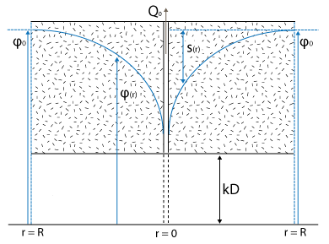

Soil compaction
Koppejan: $Z=d\left(\frac{1}{C_{p}}+\frac{log\left(t\right)}{C_{s}}\right)ln\left(\frac{φ+\frac{1}{2}dφ}{φ}\right)$
Z = soil compaction (m)
d = thickness of confining layer (m)
C_{p} = primary compaction constant (-)
C_{s} = secular compaction constant (-)
Φ = pore pressure (kN/m²)
dΦ = change of pore pressure (kN/m²)
t = time (days)
Notes:
The primary soil compaction is varying from ... to ...
The secular soil compaction is varying from ... to ...

Slide 8
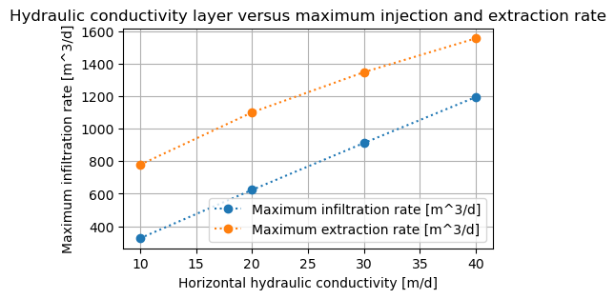
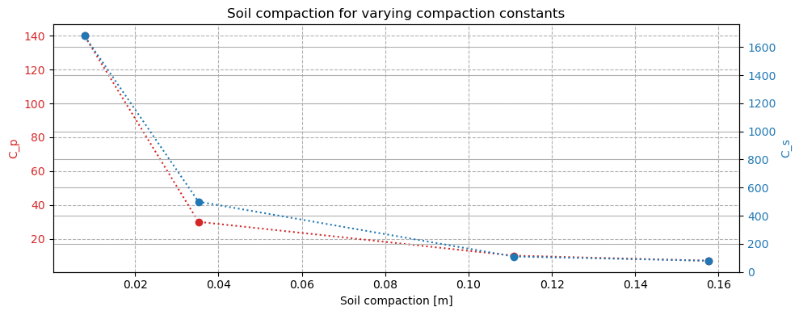
Results for analysis rules of thumb
Notes:
In this figures one can see:
For the worst case the extraction rate is
For the worst case the injection rate is
The soil compaction will be in the worst case and this can be higher if and if

Slide 9
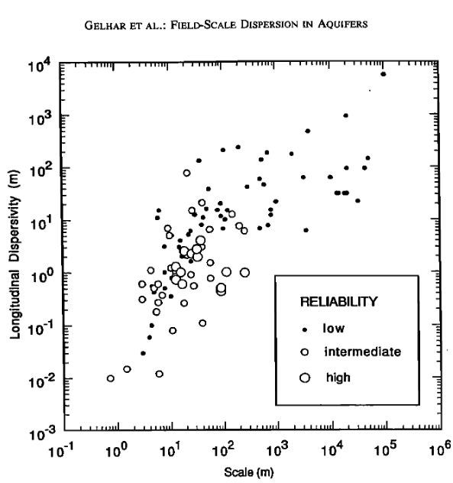
Dispersivity
0.2 < α_{L} < 95
0.5 < α_{L} < 2.0
Notes:
Dispersivity is determined based on this graph using the scale we are working in .

Slide 10
Design ASR system

Slide 11
Schedule for injection, extraction and storage

Slide 12
Results

Slide 14
Conclusion and take-aways

Slide 16
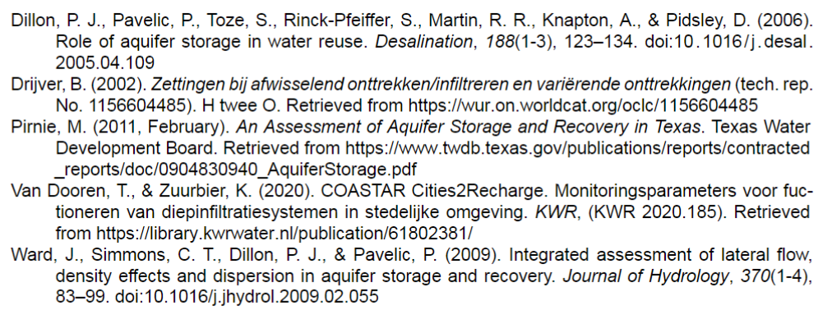
References

