Slide 1
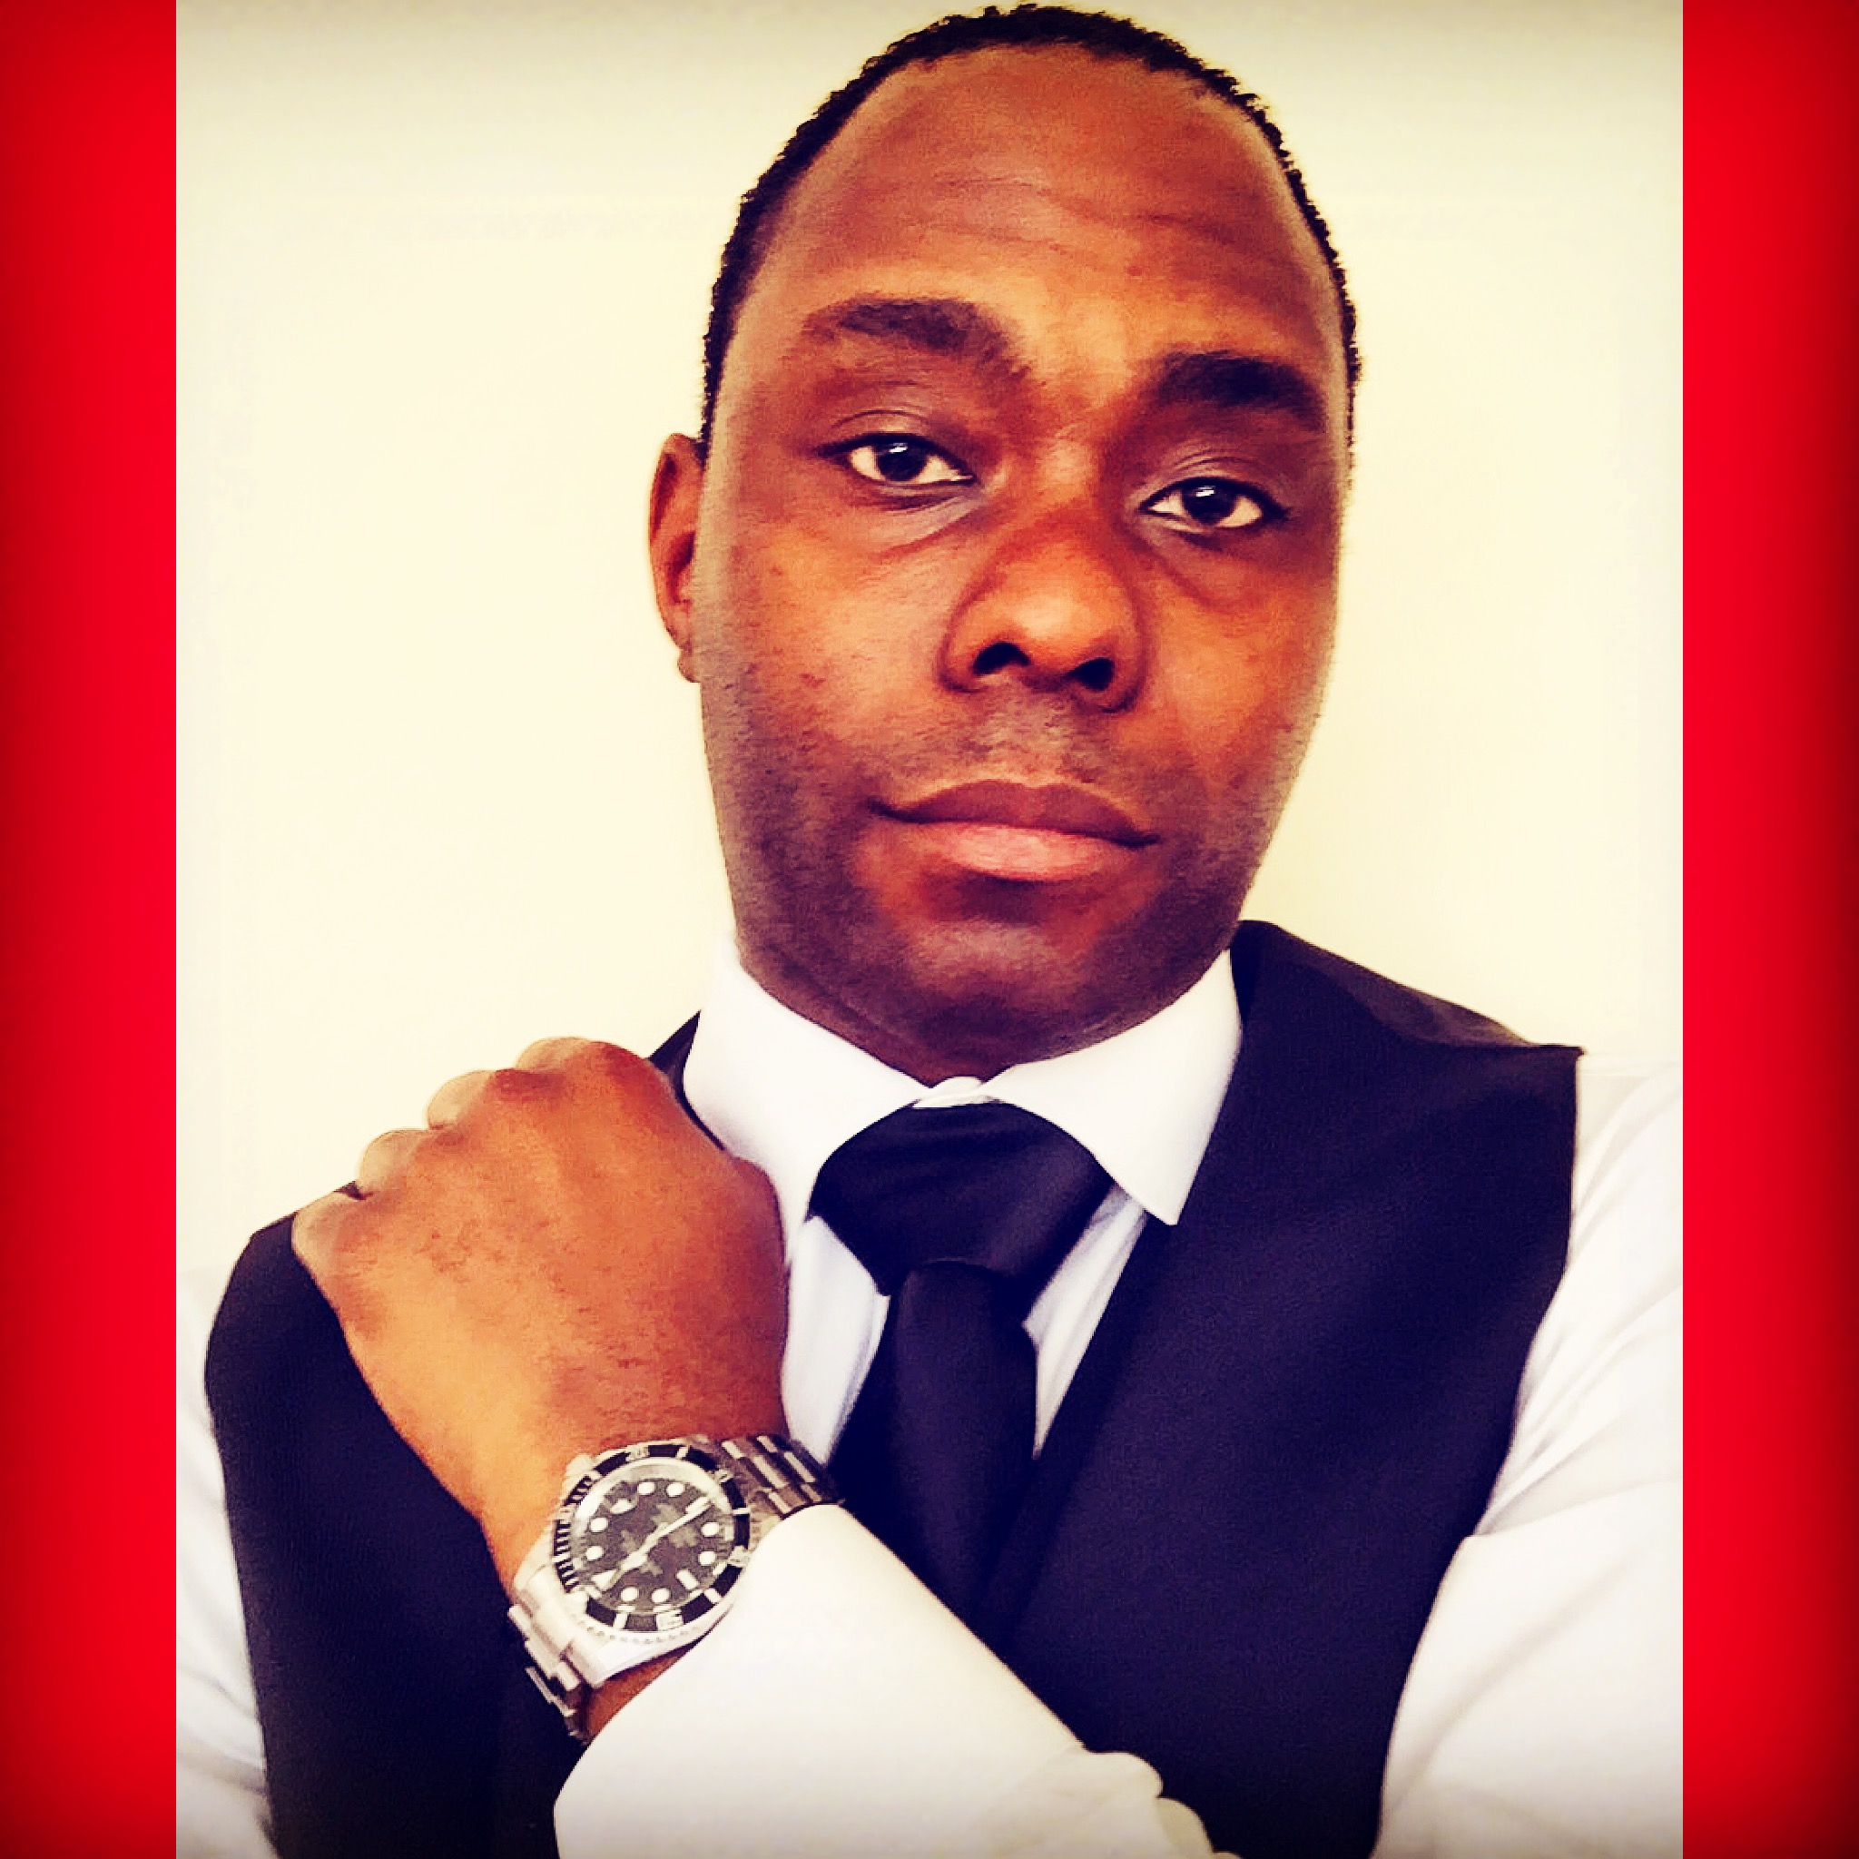
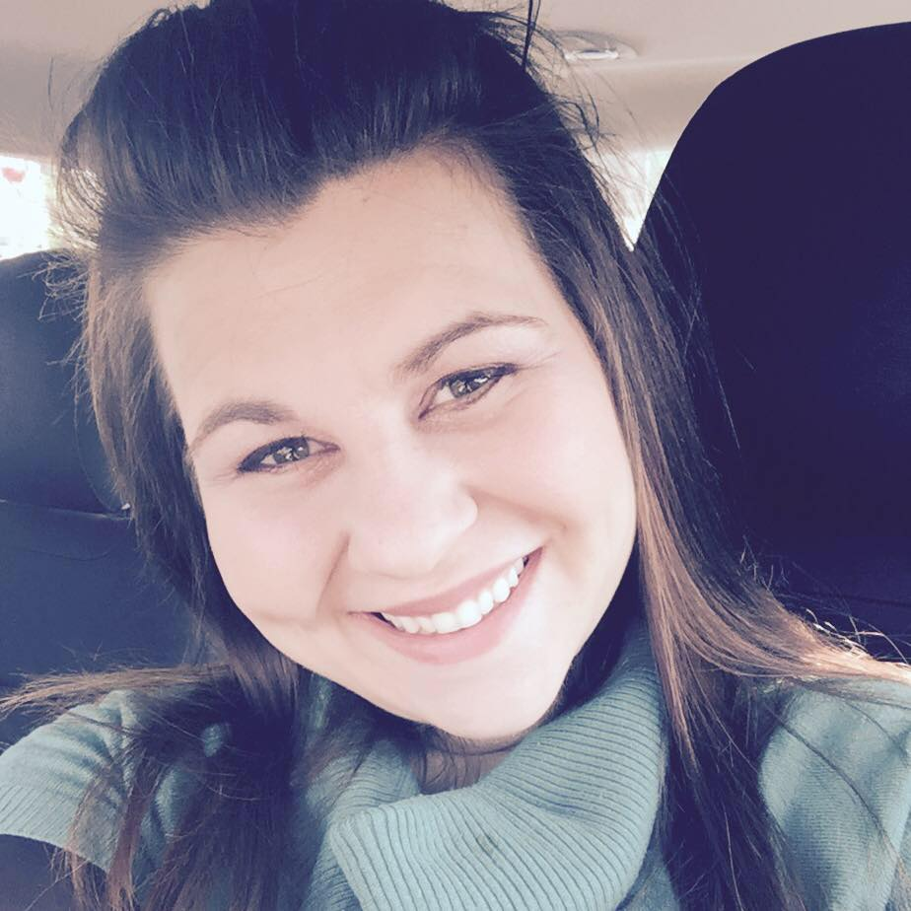
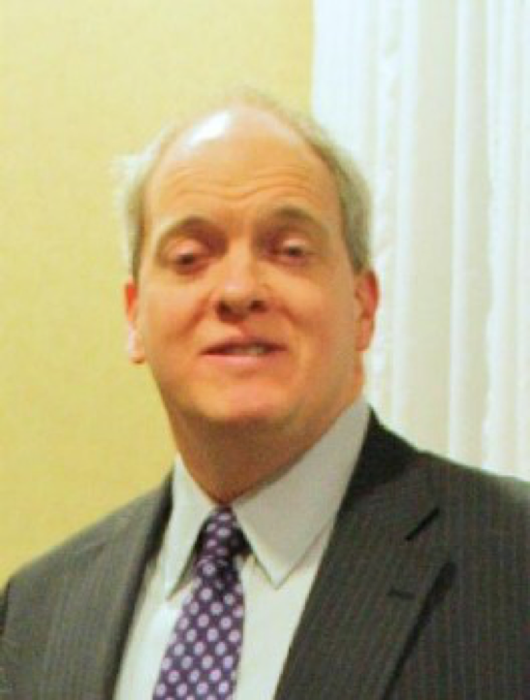
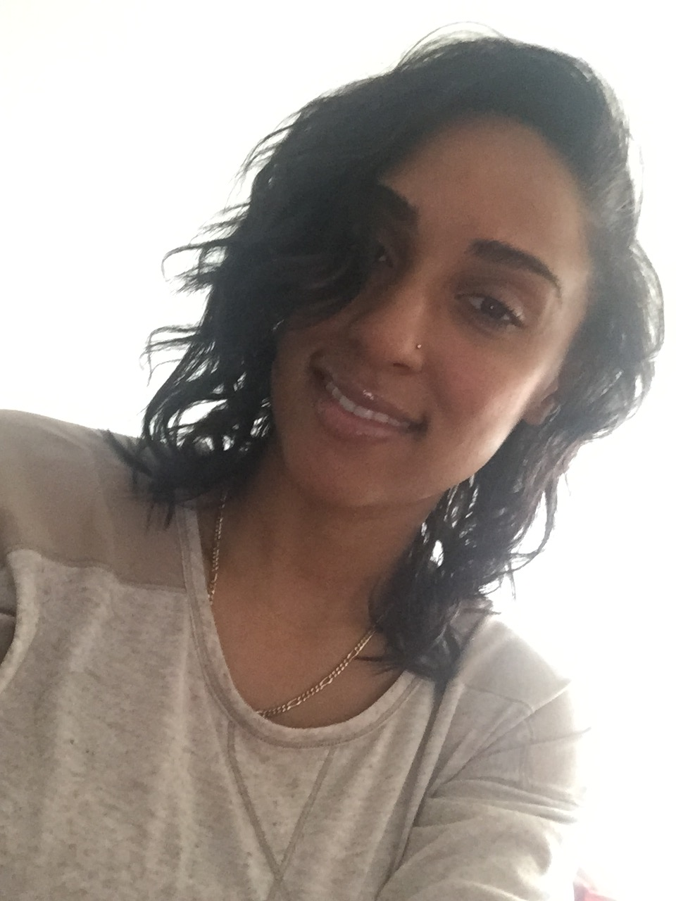
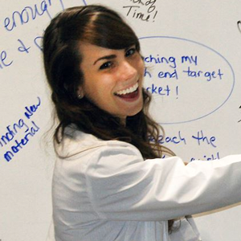
Your Logo
Here
Chris Weathers,
Founder, CEO
Melissa Martin,
CFO
David Robson,
V.P. Marketing
Erin Thompson, Communications Director
Anna Wiesler
Director of Social Media
Angela Arizpe
Director of Business Growth
Notes:
Rapportbook a geo based social network that connects businesses and individuals in the same local area. We are past BETA but in a long term vision, this is still our MVP because an app is never done. There are always new products to add, redesigns and code to refactor to improve performance.
But our team is what makes all this happen.
Melissa as our CFO has prior experience in fund raising for non profits.
David has extensive experience has a business owner and within marketing.
Erin is a communications major at Lindenwood, so her formal education gives her the skill set to be the face of the company.
Anna has tons of experience in crafting social media content relative to a company and industry and increasing engagement across all platforms.
And Kathy uses many social media platforms professionally so she knows better than anyone, what other establish companies are doing design wise and what constitutes as a good user experience.

Slide 2

Market Opportunity
543,000 businesses are started each month according to Forbes.
Problem
80% of businesses fail in the first 18 months.
Solution
Rapportbook provides a platform for businesses to engage with their local area.
1.47 Billion people use social networks.
Notes:
So what we do is canvass small businesses in the area about what we offer. When they learn that they can post content in a real time feed without any algorithms or unknown metrics affecting their visibility, they get ecstatic.

Slide 3


Our Competitors
Businesses create profiles but everyone on there is a recruiter trying to get the business to spend money on employees.
Not make money
Businesses make profile pages then fight visibility algorithms to be seen.
What makes us Unique?
We are a Social Yellow Pages for business.
Notes:
Our biggest advantage is that we are a geo based app. So this allows businesses to be seen by consumers in their community every time they post something, for free! Regardless if they have followers or not.

Slide 4



Business Model
Members produce content in our Connection Feed.
Members engage with other members content through likes, comments and messages.
Premium Post to appear first in feed.
Display BBB Status & Angie’s List Rating
Content Creation Support
Notes:
As businesses post content, our Connection Feed grows and the amount of content becomes overwhelming, granted it’s all good content. But the race to be seen organically increases drastically. This is where our business model flourishes. If there are 100 posts in a category in a city, owners want their product to be seen first. So through promoted posts, we will make sure of that.

Slide 5
Forecast

Slide 6

Strategy & Exit
Increase MAU & Market Share
Add More Experience to our Management Team
Develop more Revenue Streams
I.P.O in 5-6 Years
info@rapportbook.com
twitter.com/rapportbook
facebook.com/rapportbook
Notes:
We fill this company and product can grow large enough and produce enough revenue to the point we won’t need to be acquired. So our vision is to IPO.

Slide 7


Milestones
Eclipsed over 500 messages exchanged in over 2 months.
Over 100 photos uploaded.
Notes:
Usage increases every day for us. We find that owners prefer to do a lot of direct message to network. Also, we have given the ability to attach any combination of photos, video and documents, Which makes our messaging app more appealing than leaving our app to go to email. Videos can also be up to 10 minutes long, which is very appealing to members as well.

Slide 8
Capital Funding Requested: $50,000
Hardware 10% (Virtual)
30% Advertising (MAU)
(Direct Mail, Online Marketing)
Fund Distribution
Engineering 50%
10% Reserve
Notes:
Naturally, by our company being a tecnnology company, most of our revenue will go to engineering. But being a virtual environment save us a lot of money from a hardware perspective.

Slide 9
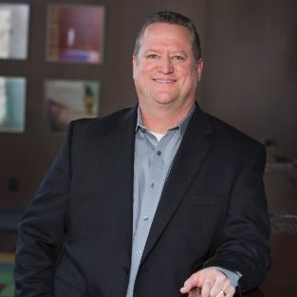
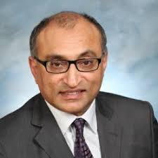
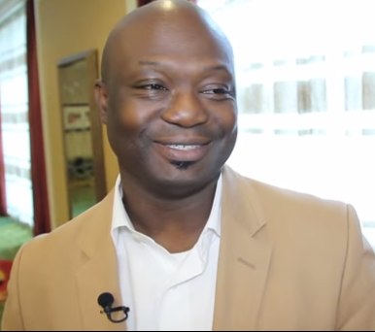
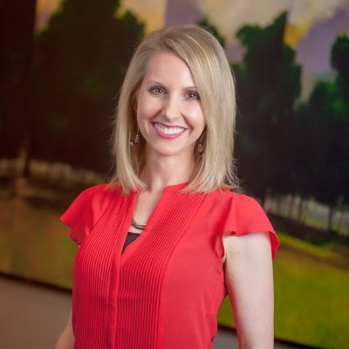
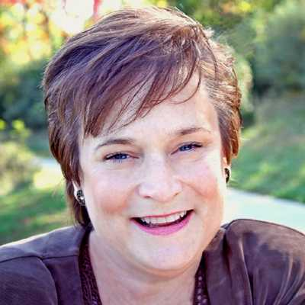
Advisors
Dave Sellers
CEO, Evtron
Aditya Eachempati
Principal, Everest Analytics
Vernon Ross,
Social Media Strategist
Angela LaRocca,
Brand Manager, Unidev
Kathy Bernard
Career Coach
Notes:
Our advisor team is rich is business and marketing experience is acts as a crutch for us when we need to understand what are the needs of our members and what can we do to entice new members to sign up.

