Slide 1
ODOO BACKUP & RECOVERY LAB
Odoo Backup & Recovery
Restored Odoo and quotation S00001 in a separate Compose project.
Germain Daakpo Amouzou
github.com/Daakpo
Project repository: publication pending
Business data synthetic. Passwords and cookies redacted.
01
Notes:
Manual application recovery is verified. GitHub repository creation and upload have not completed. Use the verified GitHub profile link until publication. Scope: Docker deployment, manual recovery, Veeam Agent integration and engineering lessons.

Slide 2
Scope and outcomes
Area | Status | What the evidence establishes
Odoo deployment | Verified | Odoo runs and PostgreSQL is healthy.
Manual backup | Verified | 7.5 MB bundle. Four checksums pass.
Manual restore | Verified | Separate instance serves S00001.
Veeam SMB access | Verified | Dedicated account uploads a test file.
Veeam recovery | Open | Final success session and recovered hashes needed.
Bare metal / RTO | Open | Recovery media and measured timing unverified.
Business data synthetic. Passwords and cookies redacted.
02
Notes:
Evidence: E032, E062, E065, E070, E085, E117 and E118. I completed the Veeam follow-up steps after these captures. I still need to add the final successful backup-session and recovered-file screenshots. My manual Odoo recovery is documented separately.

Slide 3
Lab architecture and recovery boundaries
Windows host with VirtualBox
Ubuntu 22.04 guest
E:\Enterprise-Lab-Backups
Odoo 18
Loopback :8069
PostgreSQL 16
Internal service
Source and backup destinations
share the same physical host.
odoo-data volume
postgres-data volume
Recovery bundle 7.5 MB
Dump + filestore + config
SHA256SUMS
Odoo directory
VirtualBox shared folder
vboxsf
Isolated restore project
Separate volumes and network
S00001 verified
Veeam Agent
File scope
Veeam directory
SMB: VeeamBackups
configured
Business data synthetic. Passwords and cookies redacted.
03
Notes:
Logical architecture based on the actual lab. The bundle exists on the Windows VirtualBox shared folder and as a verified local Ubuntu staging copy. The restore uses that manual bundle. The dashed Veeam connection represents configured SMB access, not proof of a successful backup. SMB observed path: //192.168.2.90/VeeamBackups. No independent-host or offsite copy is established.

Slide 4
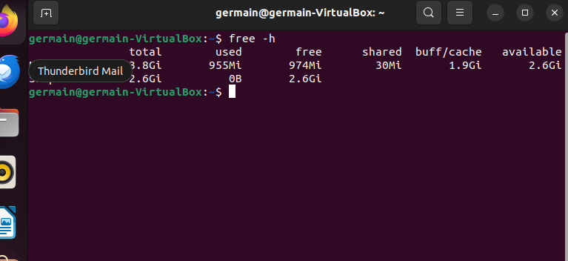
Ubuntu lab environment
4 GB guest RAM
Windows host with VirtualBox.
Ubuntu 22.04, amd64.
A 24 GB root filesystem constrains backup workspace.
E022 VM memory increased to 4 GB
A 24 GB guest root must hold the OS, containers and temporary backup workspace.
Business data synthetic. Passwords and cookies redacted.
04
Notes:
Evidence: docs/screenshots/022-20261031-211050.png
Memory screenshot after increasing the VM allocation. Guest storage figures come from the disk captures in gallery-01-platform.md.

Slide 5
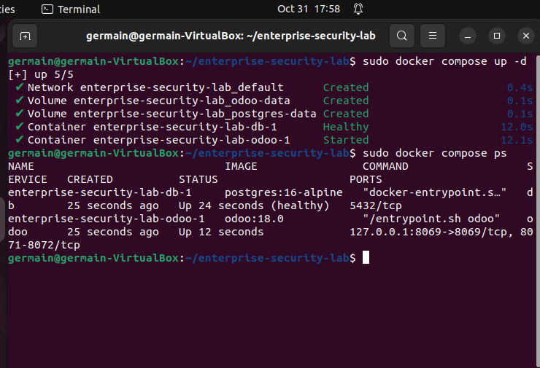
Container deployment
Database healthy
Odoo 18 and PostgreSQL 16 use separate named volumes.
Odoo publishes on Ubuntu loopback port 8069.
E032 Healthy PostgreSQL and running Odoo
The original stack publishes Odoo only on Ubuntu loopback. PostgreSQL has no host port.
Business data synthetic. Passwords and cookies redacted.
05
Notes:
Evidence: docs/screenshots/032-20261031-215827.png
Compose reference: compose.yaml. Separate volumes provide persistence, not independent backups. No database port is published.

Slide 6
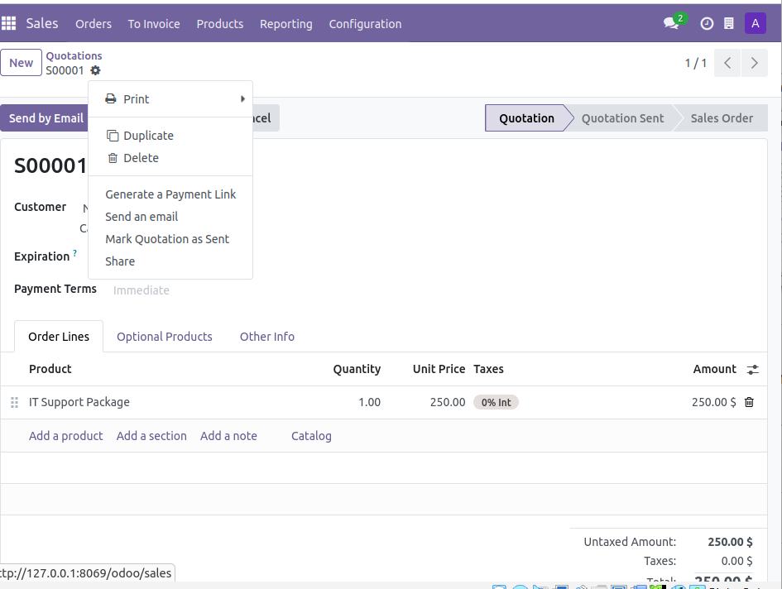
Business record baseline
Quotation S00001
Northstart Demo Ltd
IT Support Package
1 service at $250
Final tax: 0%
E043 Saved quotation S00001
Baseline: S00001, draft quotation, $250 total, with a PDF and recovery-test.txt attachment.
Business data synthetic. Passwords and cookies redacted.
06
Notes:
Evidence: docs/screenshots/043-20261031-224610.png
The spelling Northstart matches the stored customer. This record and its text/PDF attachments establish the recovery baseline.

Slide 7
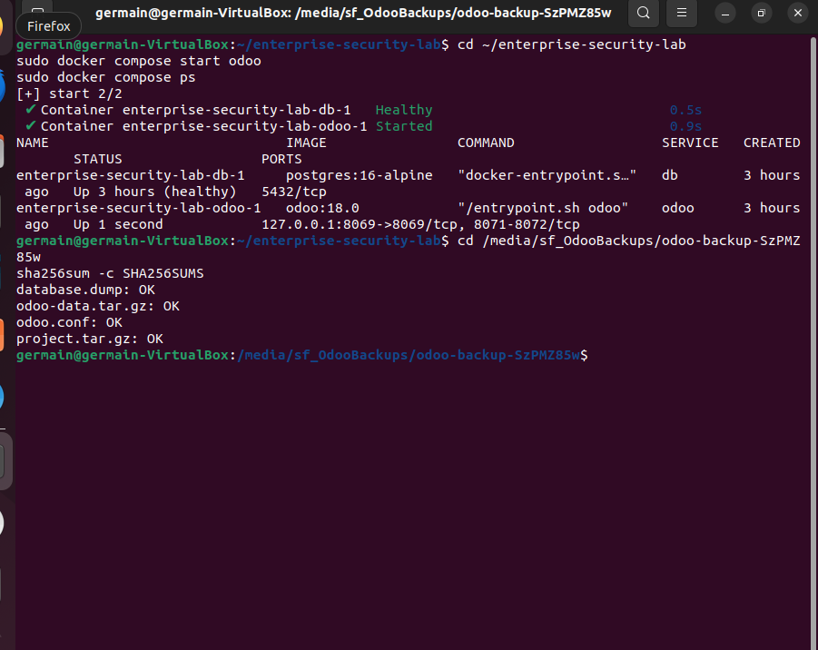
Manual recovery bundle
Four integrity checks pass
Custom database dump.
Odoo data and filestore.
Configuration and project archive.
E062 Original service restarted and four checksums passed
Verification: sha256sum -c SHA256SUMS
All four primary recovery-bundle files pass.
Business data synthetic. Passwords and cookies redacted.
07
Notes:
Evidence: docs/screenshots/062-20261101-004249.png
Odoo paused during export. PostgreSQL remained online. The original Compose service restarted after correcting the working-directory issue. The 7.5 MB bundle includes private configuration and is not published.

Slide 8
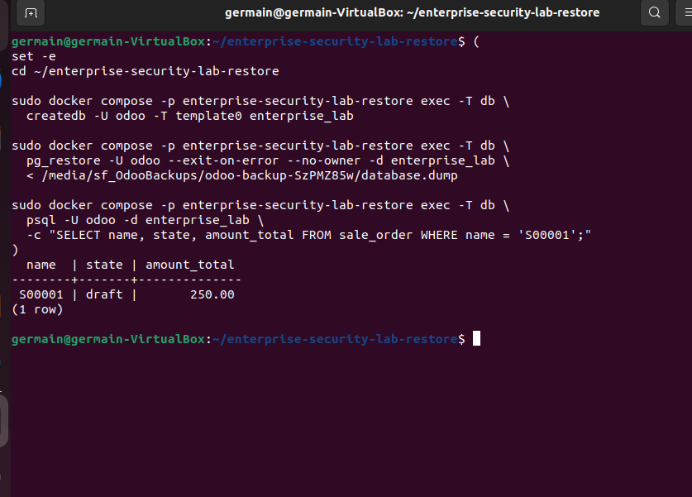
Database restoration
S00001 restored
A separate Compose project uses new data volumes.
The restored database query returns draft state and total 250.00.
E065 Restored database query confirms S00001
The restored SQL record returns S00001, draft state and total 250.00.
Business data synthetic. Passwords and cookies redacted.
08
Notes:
Evidence: docs/screenshots/065-20261101-004927.png
Recovery project: enterprise-security-lab-restore. Created enterprise_lab from template0 and imported with pg_restore --exit-on-error --no-owner.

Slide 9
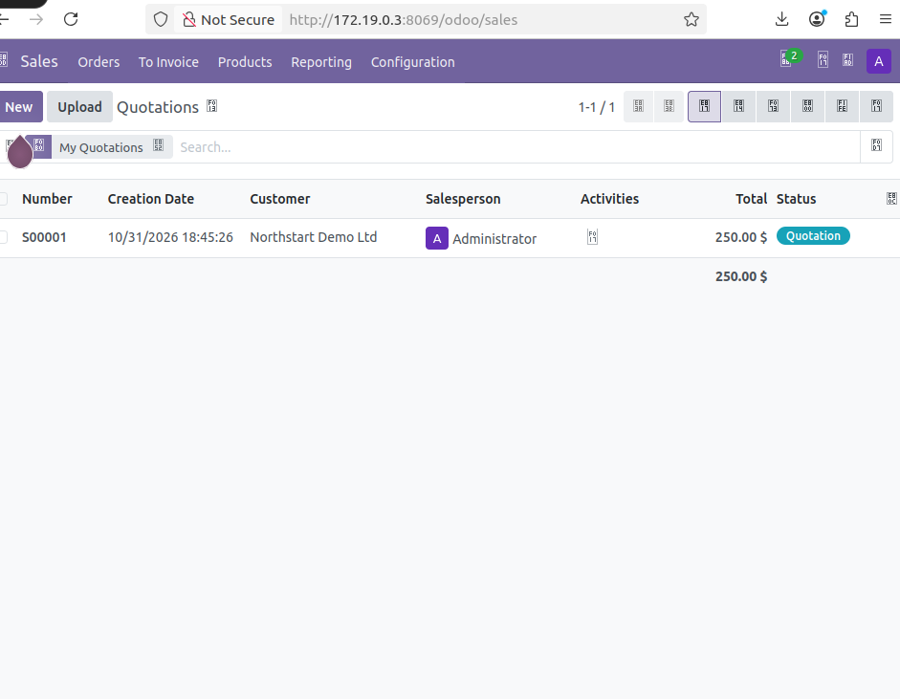
Restored application
Recovered quotation S00001
Recovery Odoo instance reachable from Ubuntu.
The original application remains separate.
E070 Restored Odoo quotation list at container IP
Separate project, volumes and network preserve the original application during recovery.
Business data synthetic. Passwords and cookies redacted.
09
Notes:
Evidence: docs/screenshots/070-20261101-005827.png
The observed recovery address is 172.19.0.3, subject to change. The intended host loopback mapping on 8070 did not respond in the internal-network configuration. Later attachment views have mixed provenance and are described separately in docs/RECOVERY.md.

Slide 10
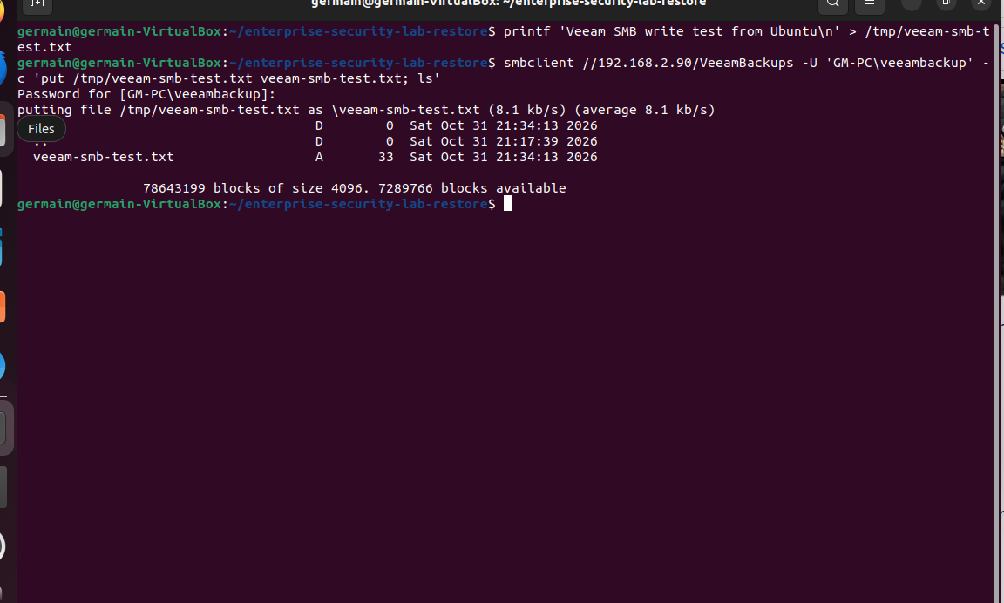
Windows SMB destination
Ubuntu upload succeeds
A dedicated Windows account writes to VeeamBackups.
Share and NTFS permissions control access.
E085 SMB upload test succeeds
GM-PC\veeambackup authenticates through a private password prompt. No password appears in E085.
Business data synthetic. Passwords and cookies redacted.
10
Notes:
Evidence: docs/screenshots/085-20261101-013449.png
UNC: //192.168.2.90/VeeamBackups. Account: GM-PC\veeambackup. Share Change and NTFS Modify. A scoped TCP 445 rule allows the lab network path. Destination is on the same host, with no offsite-copy claim.

Slide 11
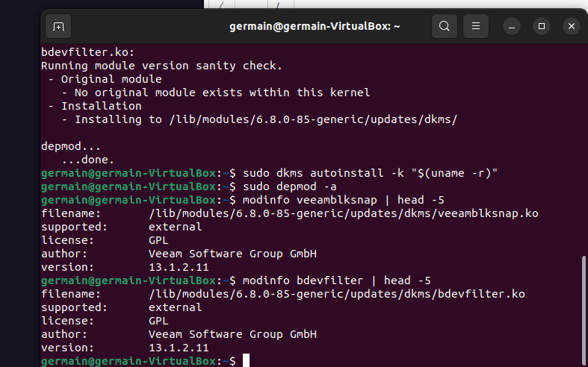
Veeam Agent and DKMS rebuild
Kernel modules rebuilt
Cleanup crossed mounted kernel paths.
Reinstalled kernel packages and headers.
A DKMS rebuild restored both modules.
E102 Veeam modules rebuilt successfully
Both veeamblksnap.ko and bdevfilter.ko rebuilt against kernel 6.8.0-85-generic.
modinfo confirms version 13.1.2.11.
Business data synthetic. Passwords and cookies redacted.
11
Notes:
Evidence: docs/screenshots/102-20261101-023147.png
These results follow a cleanup incident affecting firmware/module paths. Details in docs/TROUBLESHOOTING.md. No reboot verification is claimed.
Context: unsafe recursive cleanup traversed same-filesystem bind mounts and affected kernel-module paths. Reinstallation of kernel packages and current headers, followed by DKMS rebuild, restored both Veeam modules. This was a troubleshooting repair, not a Veeam compatibility claim.

Slide 12
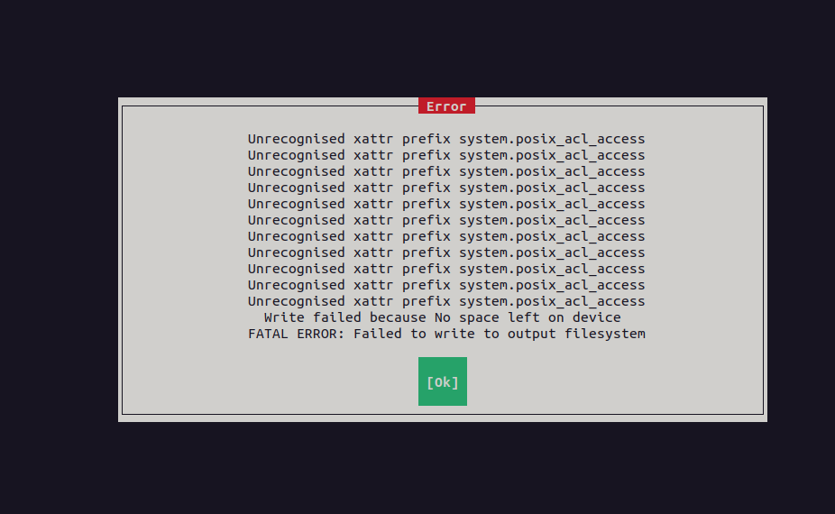
Recovery media storage failure
ISO creation runs out of space
Recovery-media creation stops with a space error.
Bootable recovery media remains unverified.
E094 Recovery ISO creation fails for lack of space
Cause: a ~4.8 GB workspace exhausted free space on the 24 GB root filesystem.
Remedy: provision workspace capacity before retrying, then store finished recovery media externally.
Business data synthetic. Passwords and cookies redacted.
12
Notes:
Evidence: docs/screenshots/094-20261101-021207.png
The initial downloaded ISO was i386 although the guest is amd64. The later download-and-patch attempt failed. This slide documents troubleshooting, not a completed bare-metal recovery capability.

Slide 13
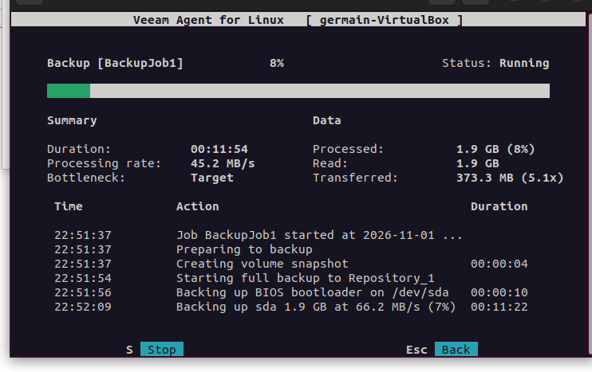
Full-machine backup attempt
Progress remains at 8%
1.9 GB processed.
373.3 MB transferred.
The stopped session ends in Failed.
E113 Backup remains at 8 percent
Root cause: snapshot storage growth exhausted root headroom. Root usage reached 99%.
Forced stop restored ~2.7 GB free. Provision snapshot capacity before retrying.
Business data synthetic. Passwords and cookies redacted.
13
Notes:
Evidence: docs/screenshots/113-20261101-030344.png
The full-machine job remained All System. A Target bottleneck alone did not prove cause. Snapshot low-free-space logs and df output support the storage diagnosis. Forced stop recovered root free space to about 2.7 GB.

Slide 14
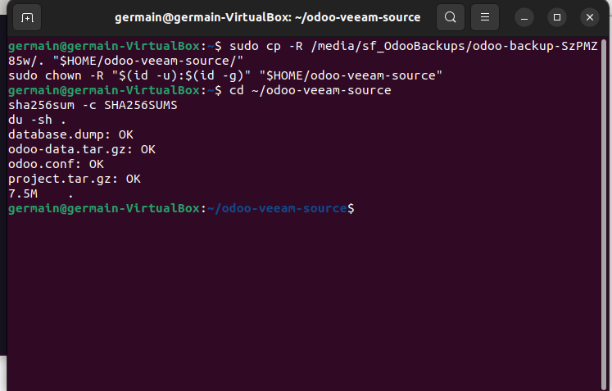
7.5 MB static recovery bundle
Four staged hashes pass
Verified with:
sha256sum -c SHA256SUMS
Intended Veeam mode:
file level, snapshot disabled.
E117 Local recovery bundle four checksums pass
Static copy of the manual recovery point, not a new export of live data.
Business data synthetic. Passwords and cookies redacted.
14
Notes:
Evidence: docs/screenshots/117-20261101-032032.png
Source: /home/germain/odoo-veeam-source. It preserves the earlier manual backup point, not a fresh Odoo export. Official reference: https://helpcenter.veeam.com/docs/agentforlinux/userguide/file_backup_snapshotless.html

Slide 15
Lessons learned
Application checks
SQL and Odoo UI validate usability.
Hashes validate integrity.
Workspace capacity
Budget temporary workspace and snapshot growth.
Mount topology
Inspect bind mounts before recursive cleanup.
Failure domains
Keep another copy outside the Windows host.
Business data synthetic. Passwords and cookies redacted.
15
Notes:
See docs/RECOVERY.md and docs/TROUBLESHOOTING.md. I ran a cleanup command without fully checking the bind mounts. It affected firmware and module paths, which I repaired afterward. I kept the incident in my notes because it changed how I check temporary mount points before cleanup.

Slide 16
Findings and risks
Finding | Risk | Engineering response
24 GB guest root | ISO and snapshot space exhaustion | Provision workspace and snapshot capacity.
Backups on the host | Host loss affects source and copies | Add independent storage and an offsite copy.
Recovery ISO incomplete | Machine recovery remains untested | Create compatible amd64 media and boot-test it.
Veeam closeout open | Restore-point usability unverified | Capture Success and recovered-bundle hashes.
No measured RTO/RPO | Recovery objectives remain unknown | Time a repeatable end-to-end recovery test.
Business data synthetic. Passwords and cookies redacted.
16
Notes:
Findings summarize the captured lab limitations. Risks describe possible consequences rather than additional observed failures. No numerical RTO/RPO or production recovery guarantee is inferred.

Slide 17
What I would do next
01 Close Veeam evidence
Successful file backup and recovery to a separate folder.
Exit check: all four recovered-file hashes pass.
02 Expand recovery capacity
Allocate workspace and create amd64 recovery media.
Exit check: media boots and the next test has headroom.
03 Separate backup storage
Add a copy outside the Windows host failure domain.
Exit check: restore from that independent copy.
04 Measure repeatability
Time recovery and record the exact backup timestamp.
Exit check: measured RTO/RPO with a repeatable runbook.
Business data synthetic. Passwords and cookies redacted.
17
Notes:
Proposed next work, not completed results. A successful backup is insufficient without recovery validation. External output media alone does not provide the guest temporary workspace needed by ISO generation.

Slide 18
Skills demonstrated
Linux operations
Disk diagnosis, mount inspection and DKMS repair
Container infrastructure
Compose services, health checks and separate volumes
Data recovery
PostgreSQL logical restore and Odoo filestore recovery
Backup integration
Veeam Agent setup and Windows SMB access controls
Engineering judgment
Integrity checks, failure analysis and honest evidence scope
Business data synthetic. Passwords and cookies redacted.
18
Notes:
Supported by the deployment and recovery guides, SMB screenshots, module rebuild capture and incident record. These are hands-on lab skills, not a production deployment or certification claim.

Slide 19
Project materials and contact
Manual application recovery verified
Odoo 18, PostgreSQL 16, Ubuntu and Veeam Agent
GitHub portfolio: github.com/Daakpo
Repository: Odoo-Backup-Recovery-Lab
Publication pending GitHub sign-in.
Report: docs/Enterprise_Security_Lab_Report.docx
README, technical guides and all 118 screenshots accompany this deck.
LinkedIn: linkedin.com/in/gdamouzou
Business data synthetic. Passwords and cookies redacted.
19
Notes:
Author: Germain Daakpo Amouzou. The final package contains the report, presentation, public-safe reference configuration and complete stage galleries. GitHub publication has not completed. Do not present the planned repository as a live link.

