Slide 1
Project NLP | Business Case:
Automated Customer Reviews
Daan Booy
01/09/2025 Ironhack Bootcamp

Slide 2

INDEX
1
Project Overview
2
Data Preparation
3
Review Classification
4
4
???
Product Category Clustering
5
5
Deployment
Review Summarization
6
Model Deployment

Slide 3




Develop a product review system. That can classify review sentiment to Positive/Neutral/Negative, cluster the reviews by product categories and write product summaries into recommendation articles.
1 Project overview
Project tasks
Create a model that classify reviews on sentiment Negative/Neutral/Positive
Simplify dataset into product category clusters
Summarize reviews into articles using generative AI
Deploy the results of the project
Review data from Amazon, collected between 1996 to 2023, was used for this project.
More specifically the Video Games category.
‹#›
Notes:
“Robyn es una herramienta de código abierto creada por Meta. ¿Por qué es relevante?
Porque automatiza y moderniza el proceso del MMM.
Porque permite atribuir el efecto de canales como TV, search, social media, etc.
Porque facilita optimizar el presupuesto y simular escenarios futuros.
Modelo Robyn - Flujo de trabajo
1. Ingesta de datos
Variables independientes: medios pagos, orgánicos, datos de Prophet y variables contextuales.
Parámetros del modelo: iteraciones de adstock, ventana de datos, hiperparámetros y calibración.
Comprobaciones de condiciones antes del procesamiento.
2. Core del modelo(robyn_run)
Transformación de adstock y saturación.
Regresión Ridge y calibración opcional.
Descomposición de efectos y generación de reportes individuales.
Uso de Nevergrad para la optimización multiobjetivo y paralelización.
3. OPTIMIZADOR DEL PRESUPUESTO(robyn_allocator)
Uso de un solucionador no lineal basado en gradientes.
Restricciones de igualdad y visualización de resultados.
5. Actualización del modelo (robyn_refresh)
Ajuste de la ventana de datos y adaptación de hiperparámetros.
Selección del modelo con menor error combinado.
Generación de reportes con gráficos y tablas.
6. Resultados finales
Salida del modelo con reportes visuales y tabulares para la toma de decisiones estratégicas en marketing.

Slide 4
INDEX
1
Project Overview
2
Data Preparation
3
Review Classification
4
4
???
Product Category Clustering
5
5
Deployment
Review Summarization
6
Model Deployment

Slide 5
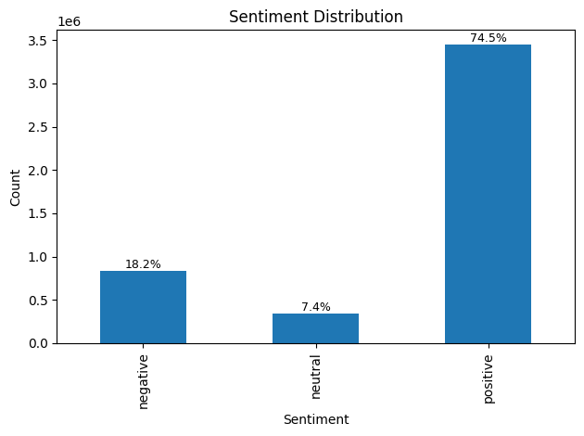
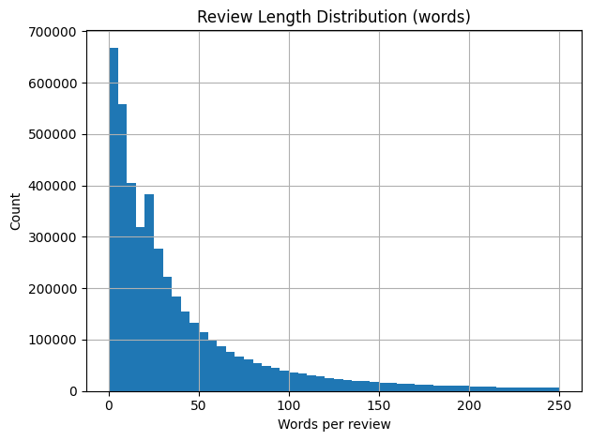
2 Data preparation
1
2
3
Add sentiment ratings to dataset
Inspecting data to make decisions
Data cleaning
Changed the 1 to 5 star ratings that Amazon uses for review to Negative/Neutral/Positive.
1 - 2 = Negative
3 = Neutral
4 - 5 = Positive
Used very minimal data cleaning to keep it useable for multiple models.
Cleaned the review text by:
Normalizing unicode
Removing HTML tags
Normalizing spaces
4.6M reviews
Negative 839397 18.15%
Neutral 340086 7.35%
Positive 3445132 74.50%
Checked review word length
50% 24
75% 57
90% 127
95% 209
‹#›

Slide 6
INDEX
1
Project Overview
2
Data Preparation
3
3
Review classification
Review Classification
4
4
???
Product Category Clustering
5
5
Deployment
Review Summarization
6
Model Deployment

Slide 7
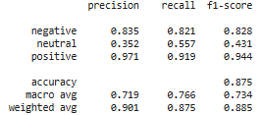
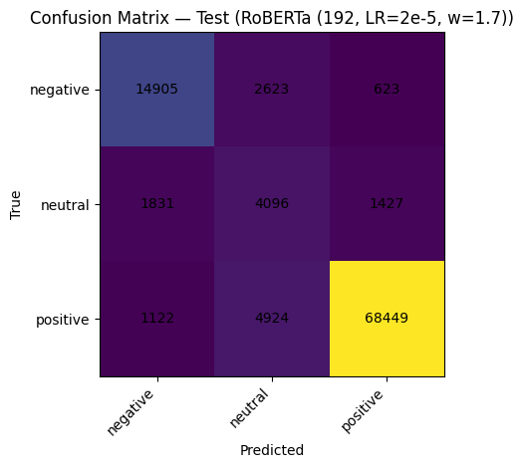
3 Review Classification
RoBERTA-base
Splitting data
Train 70 / validation 15 / test 15
Tokenizing
Used 3 different model for the tokenizing:
- Distilbert-base-uncased
- Bert-base-uncased
- Roberta-base
Model Training
Learning rate
Epochs
Weights for Neutral
‹#›

Slide 8
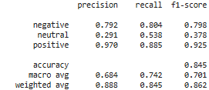
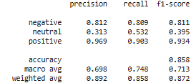
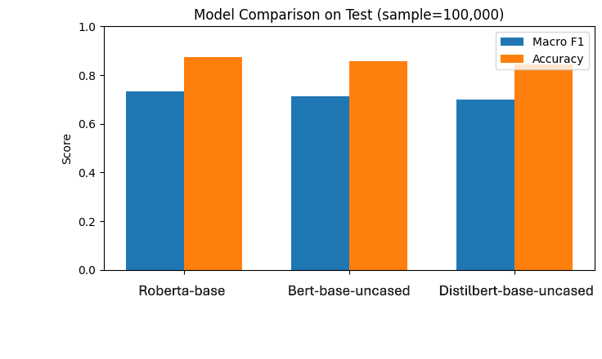
3.2 Review classification
Distilbert-base-uncased
Bert-base-uncased
‹#›
‹#›

Slide 9
INDEX
4
1
???
Project Overview
2
Data Preparation
3
Review Classification
4
4
4
Product Category Clustering
???
Product Category Clustering
5
5
Deployment
Review Summarization
6
Model Deployment

Slide 10
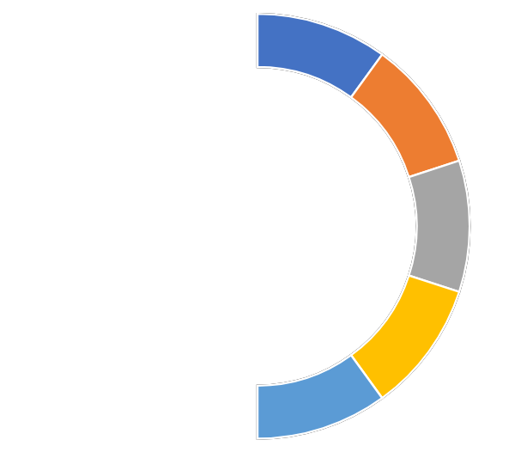
4 Product Category Clustering
1
Embedding
Turned reviews into vectors with sentence transformer all-MiniLM-L6-v2
2
Dimensionality reduction
Used PCA to reduce dimensionality from the embedding to improve processing speed
3
Clustering with KMeans
Clustered the reviews with MiniBatchKMeans.
Using K = 6
4
Cluster labeling
Used TF-IDF to label the clusters with top terms to find which categories the clusters belong to.
5
Merging Clusters
2 out of 6 cluster were not categorical, so merged these 2 clusters to nearest cluster.
Games
Headset and Audio
Cluster | Size | %
Games | 1.618.488 | 35.01%
Headset and Audio | 1.185.858 | 25.65%
Keyboard and Mice | 913.087 | 19.75%
Controllers | 907.182 | 19.63%
Keyboard and Mice
Controllers
‹#›
Notes:
Esta plantilla fue insertada desde Power-user, el complemento de productividad para PowerPoint, Excel y Word. Instala Power-user para acceder a miles de plantillas, íconos, mapas, diagramas y gráficos con Power-user.
Visita https://www.powerusersoftwares.com/
©Power-user SAS, términos de licencia: https://www.powerusersoftwares.com/terms

Slide 11
INDEX
5
1
Deployment
Project Overview
2
Data Preparation
3
Review Classification
4
4
???
Product Category Clustering
5
Review Summarization
6
Model Deployment

Slide 12
5 Review Summarization
Prompt, zero shots with clear instructions:
You are a product reviewer writing a short blog-style article for shoppers.
Write ~200 words with clear sections:
- Intro to this category
- Compare the top 3 products (strengths, differences, who they’re for)
- Summarize key complaints buyers should consider
- Explain the worst product and why to avoid it
Constraints:
- Neutral and factual tone
- Markdown formatting with headings
- Avoid exaggeration or making up numbers
Preparations:
- Search for top 3 products and worst per category
- Find their complaints
- Filter noise
- Set review limit
Models used
gpt-4o-mini:
Full coherent articles
facebook/bart-large-cnn:
Repeats instructions, off topic sentences
google/flan-t5-large:
Does not write article, incoherent
Notes:
Esta plantilla fue insertada desde Power-user, el complemento de productividad para PowerPoint, Excel y Word. Instala Power-user para acceder a miles de plantillas, íconos, mapas, diagramas y gráficos con Power-user.
Visita https://www.powerusersoftwares.com/
©Power-user SAS, términos de licencia: https://www.powerusersoftwares.com/terms

Slide 13
INDEX
5
1
Deployment
Project Overview
2
Data Preparation
3
Review Classification
4
4
???
Product Category Clustering
5
5
Deployment
Review summarization
6
6
Model deployment
Model Deployment

Slide 14
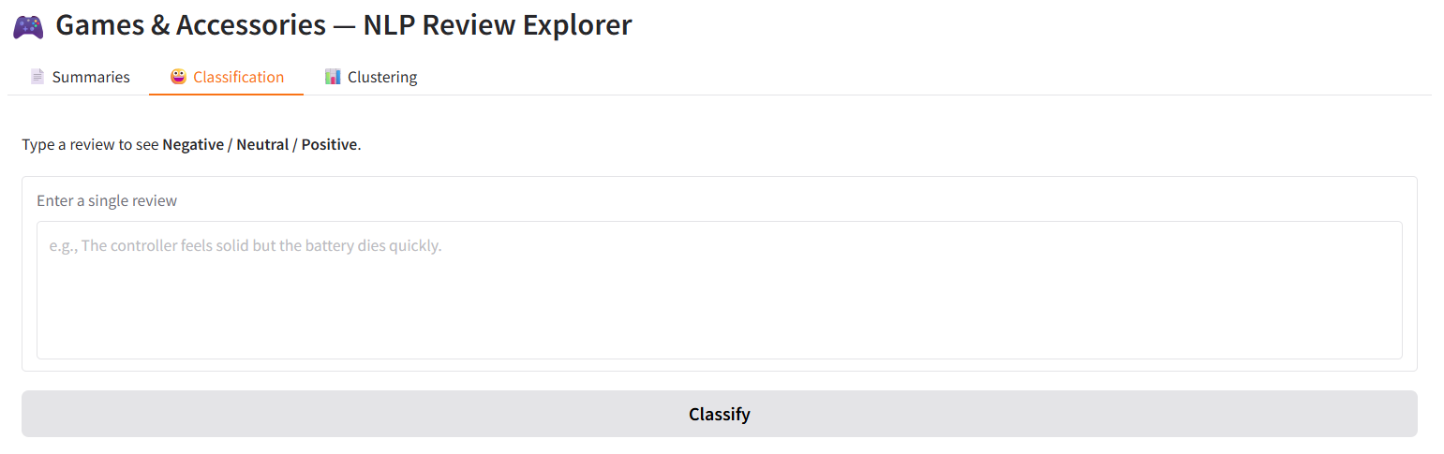
6 Model Deployment
Used HuggingFace Spaces for the deployment.
Classification: Upload a review and see its sentiment classification (RoBERTa-base).
Clustering: Explore product category clusters.
Summaries: Read AI-generated articles highlighting top products, main complaints, and the worst product per category.
https://huggingface.co/spaces/DaanBooy/games_and_accessories_reviews
‹#›

