Slide 1

The Impact of
AO Generation Methods on Real-Time Rendering
by Daan Demacker

Slide 2



AO METHODS
SCREEN SPACE
HORIZON BASED
GROUND TRUTH

Slide 3
AMBIENT
OCCLUSION?
| It’s when objects that are close together block
some of the surrounding light that bounces around in the scene.
_{ex:} Creases between fingers Book fold
Wrinkles in fabric

Slide 4
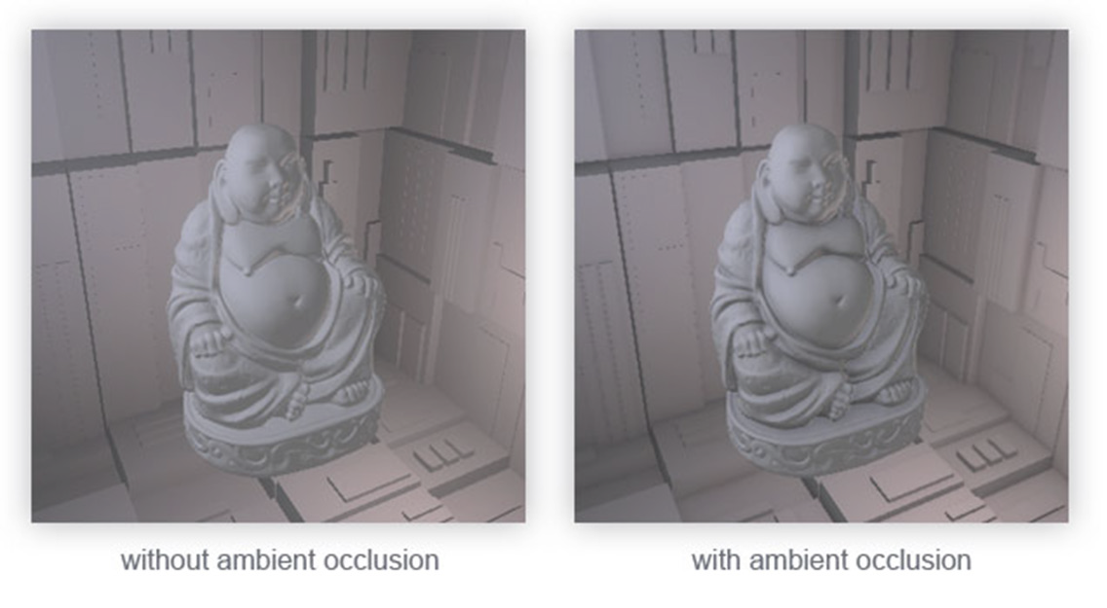
AO IN GRAPHICS
Non-real-time rendering, using precise ray tracing, makes the image look more realistic.

Slide 5
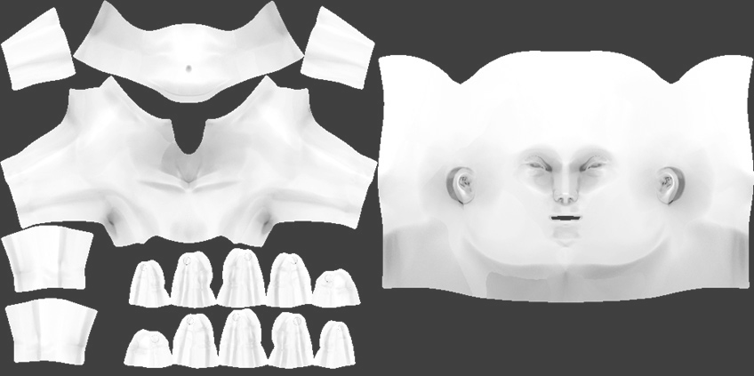
STATIC SCENES
For static scenes, AO can be baked into textures
This means AO is calculated and stored as a texture.
The resulting texture can then be multiplied with the diffuse texture.

Slide 6
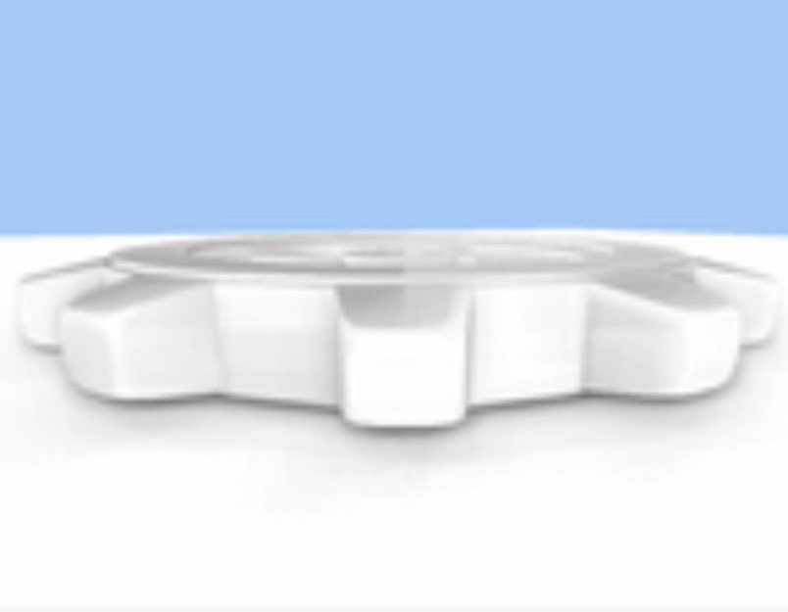
DYNAMIC SCENES
The scene changes every frame.
AO must be recalculated for each frame.

Slide 7
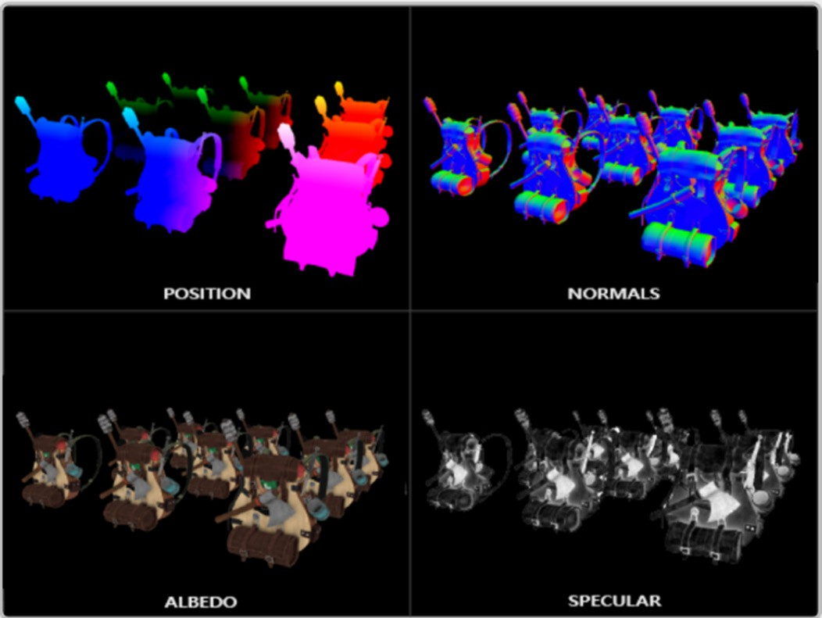
SCREEN SPACE AO
Deferred rendering
G-Buffer
Everything in space

Slide 8
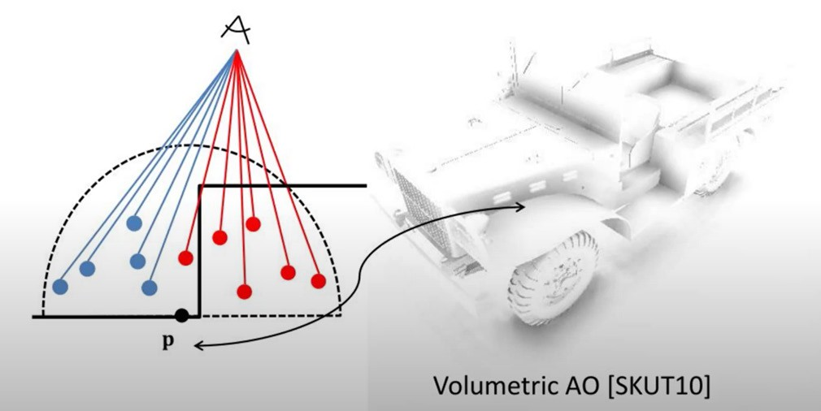
SCREEN SPACE AO
Project dome in direction of normal
Project a number of sample points
Calculate percentage of occlusion

Slide 9
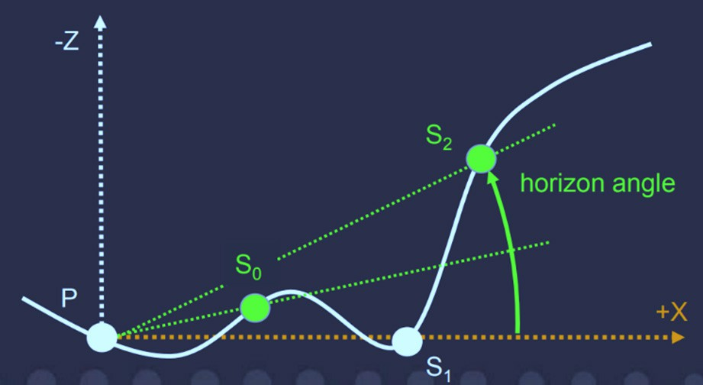
HORIZON BASED AO
Sample in random direction
1D depthfield
March the depthfield
Calculate highest horizon angle

Slide 10
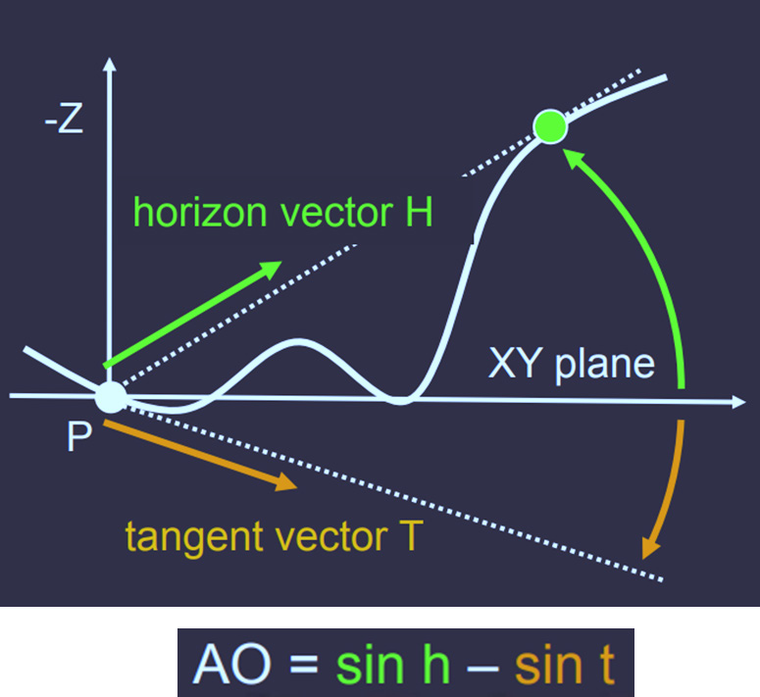
HORIZON BASED AO
Calculate tangent
Subtract sin tangent from sin horizon
Do this in multiple directions
Take average

Slide 11
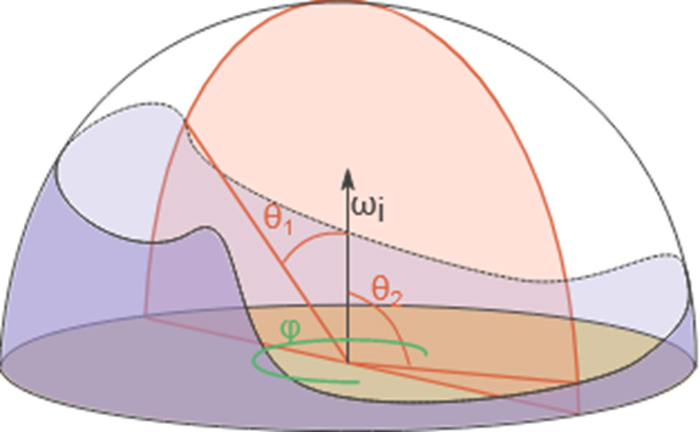
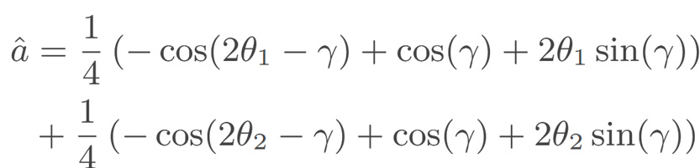
GROUND TRUTH AO
Calculate view vector
Divide dome into slices around view vector
Calculate horizon angles
Calculate equation for directions
Take average

Slide 12
RESULTS
SCREEN SPACE
HORIZON BASED
GROUND TRUTH

Slide 13
MEASUREMENTS
Framerate
CPU usage
VRAM usage
Visuals

Slide 14
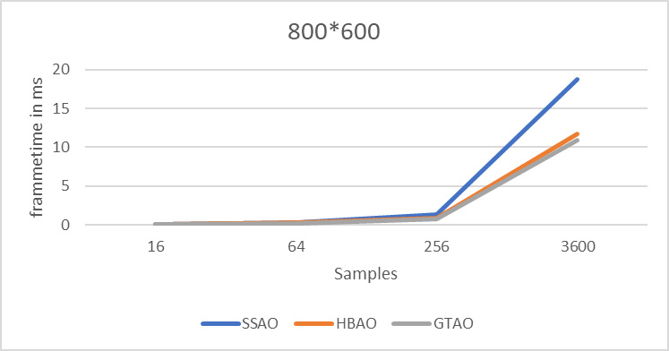
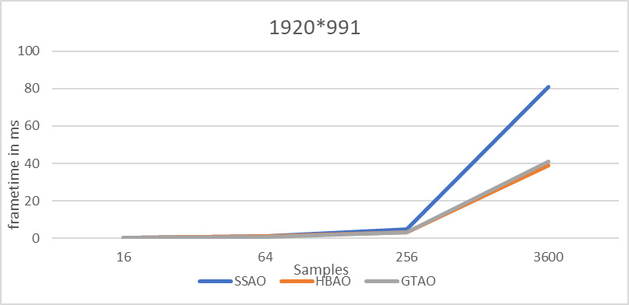
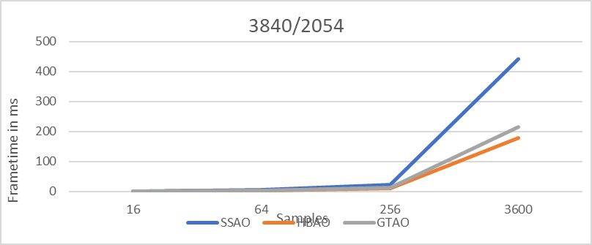
FRAMERATE

Slide 15
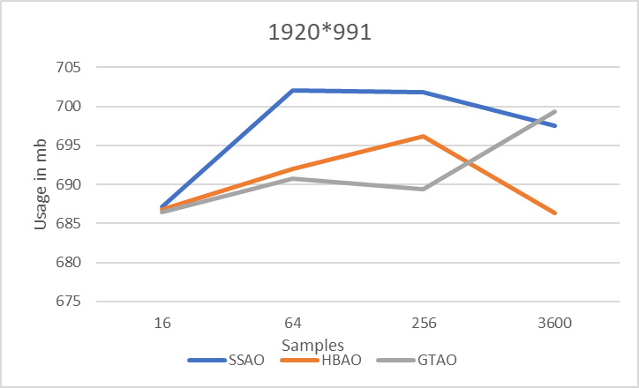
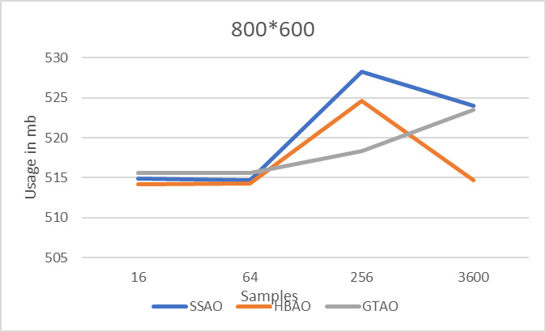

CPU USAGE

Slide 16
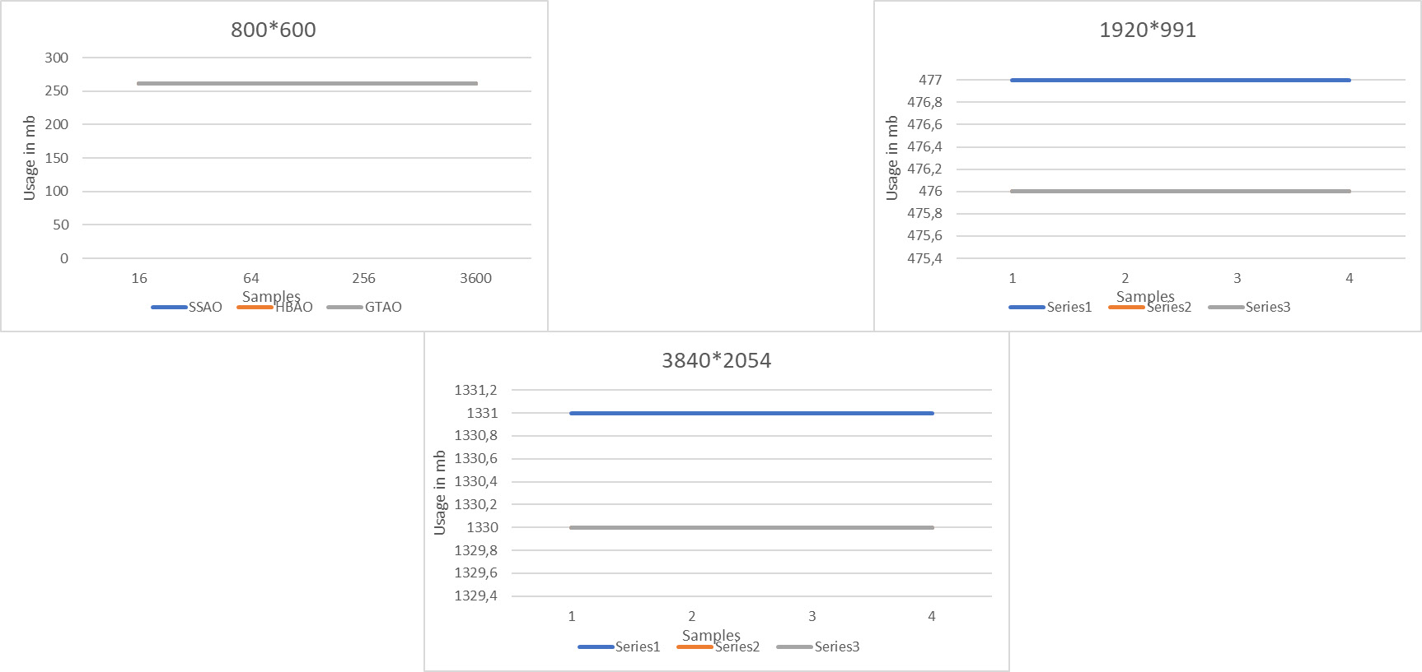
VRAM USAGE

Slide 17
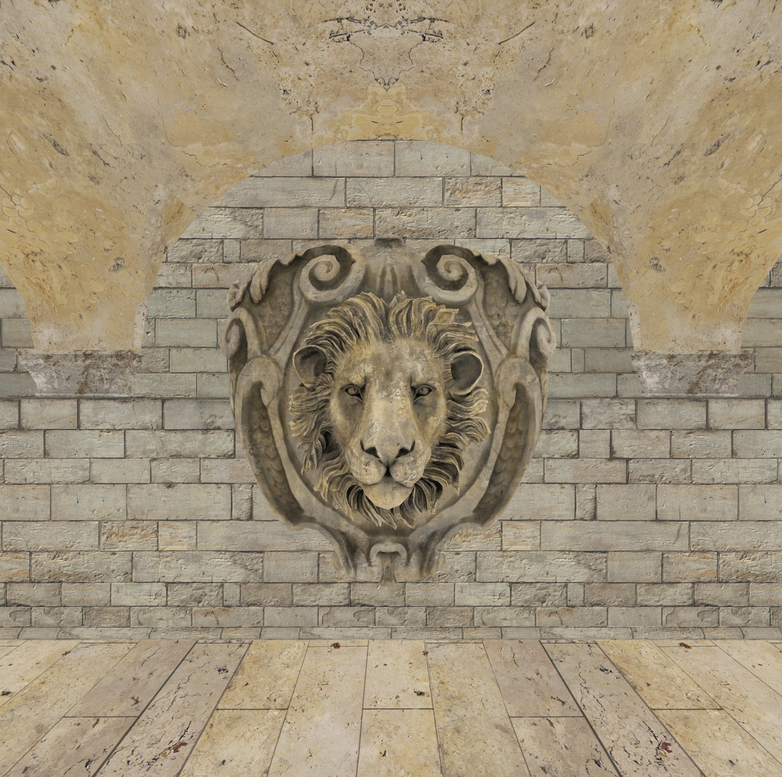
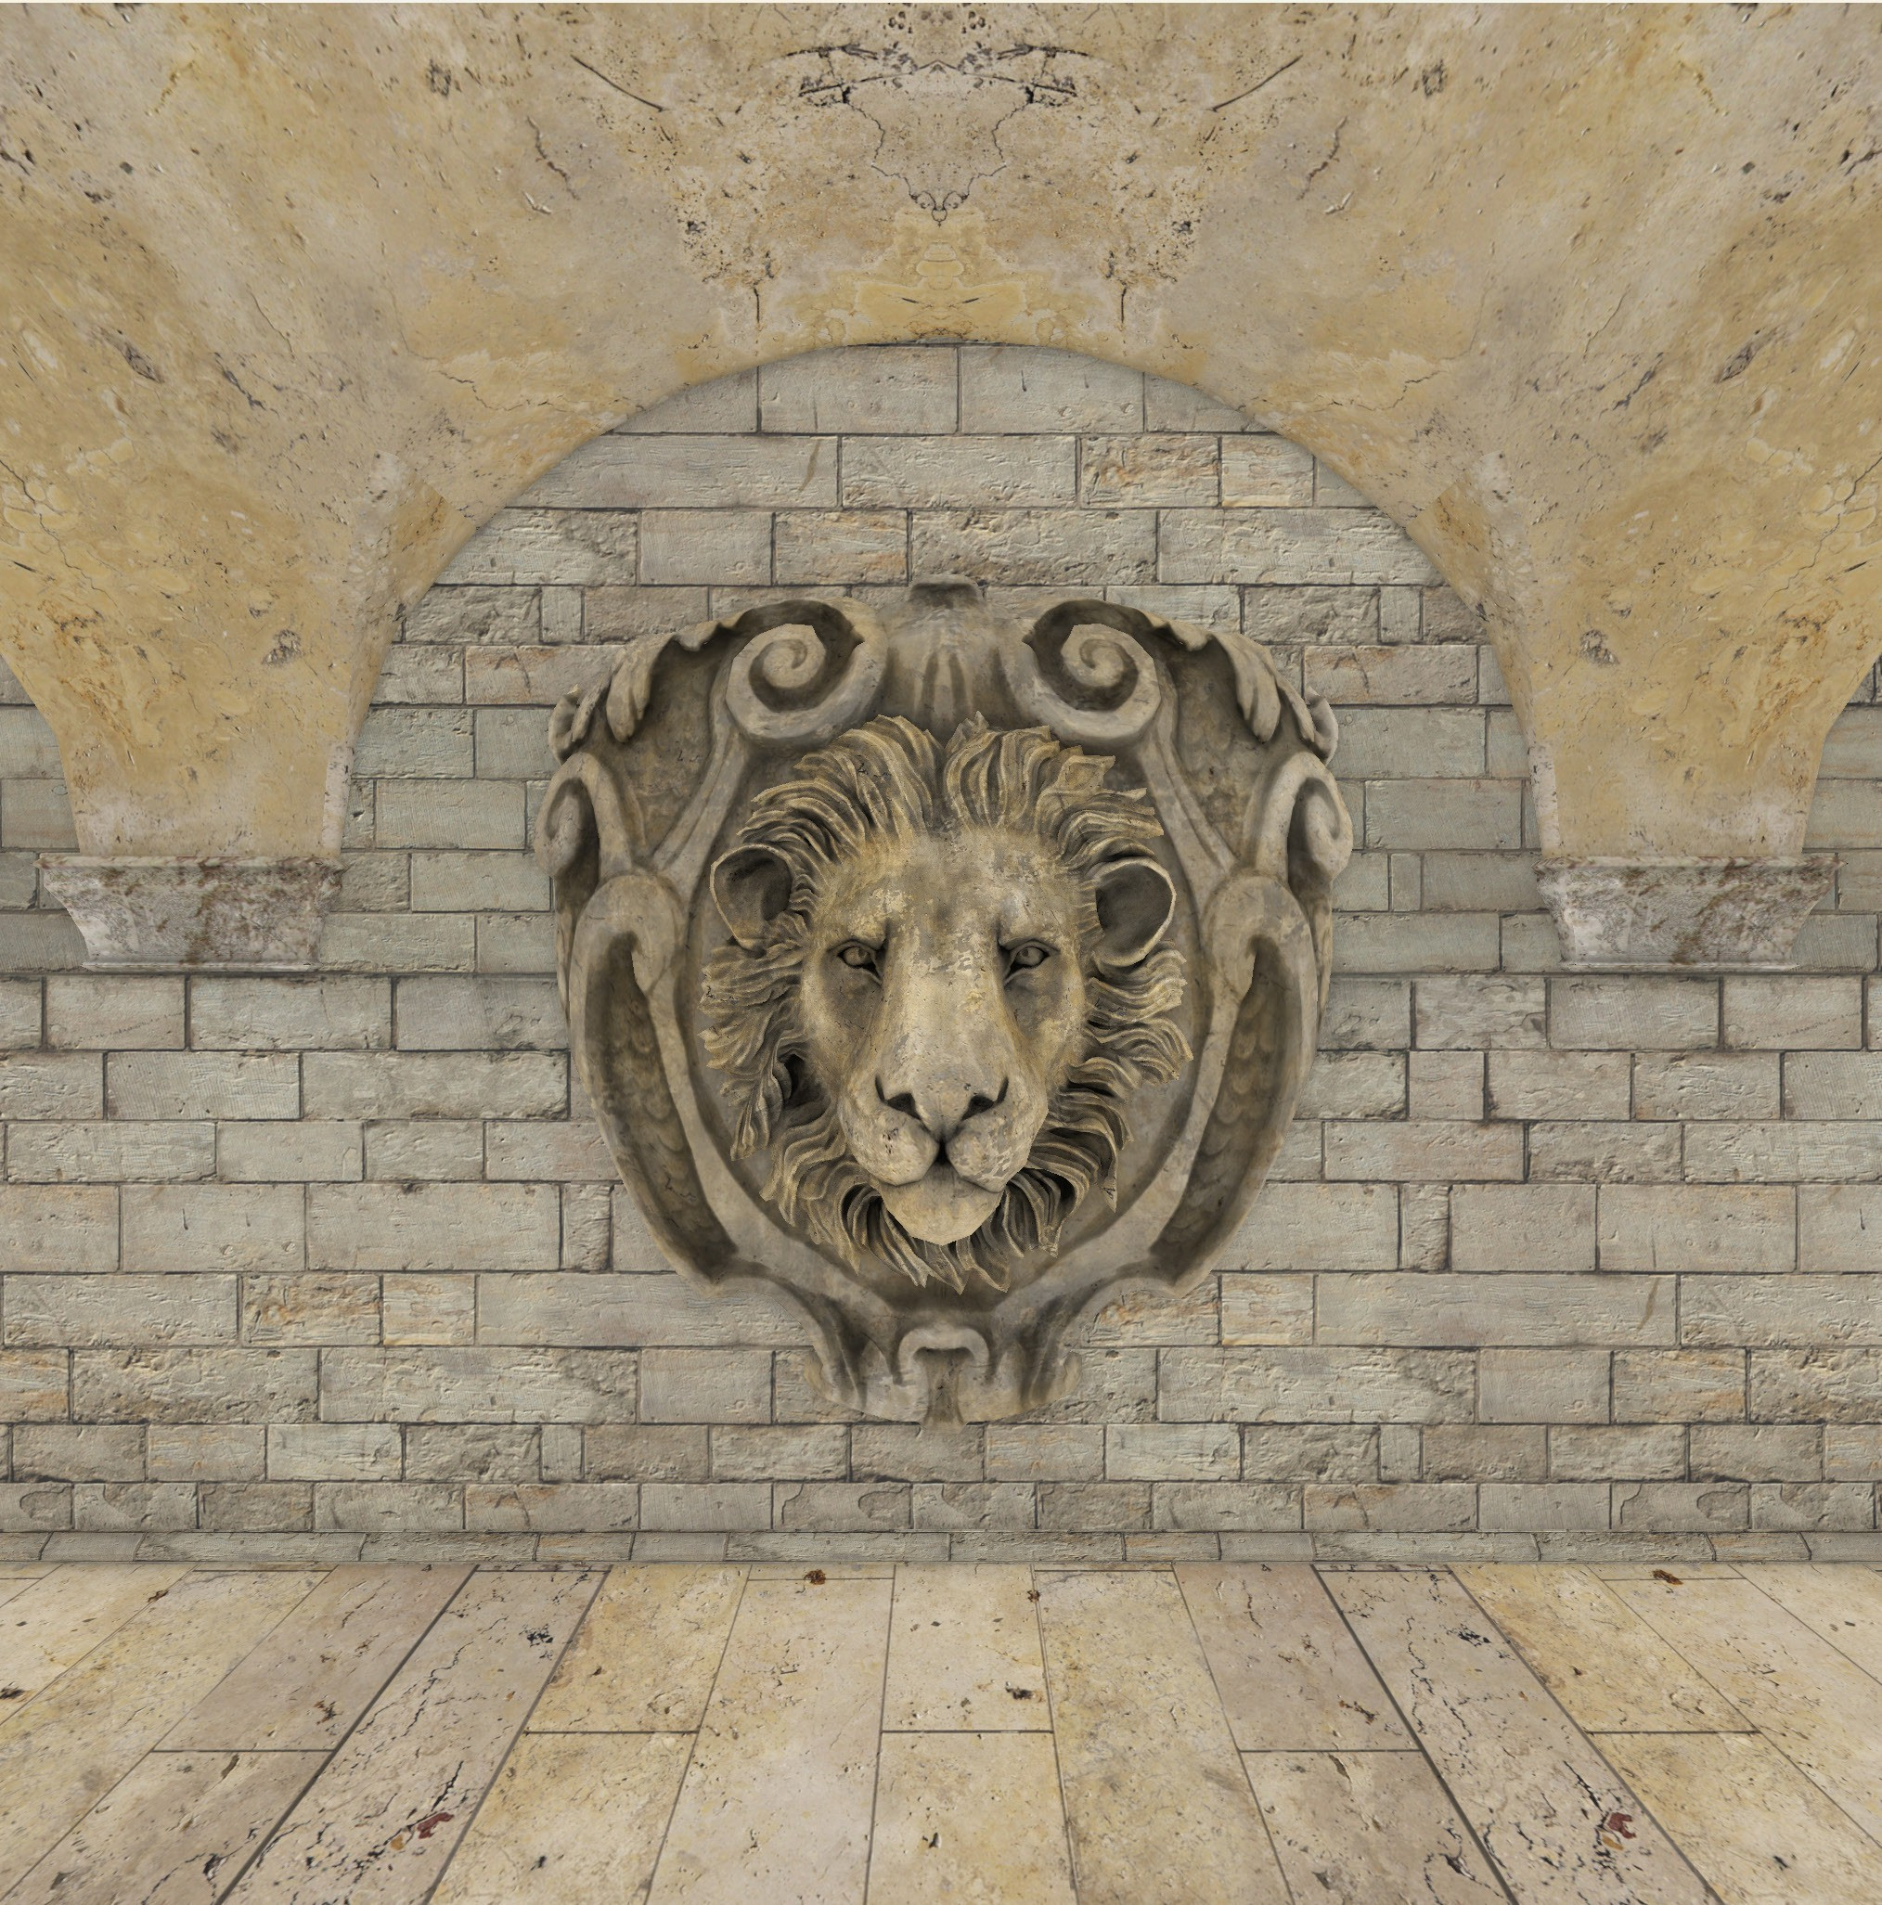
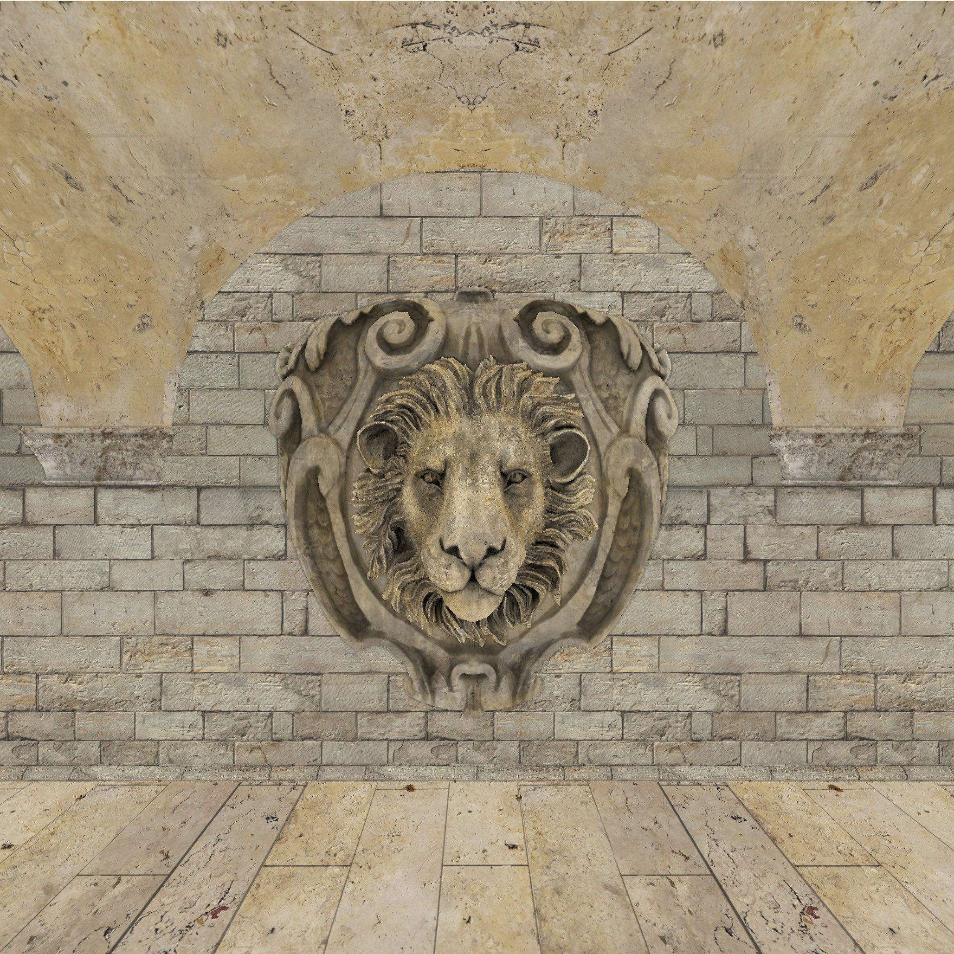
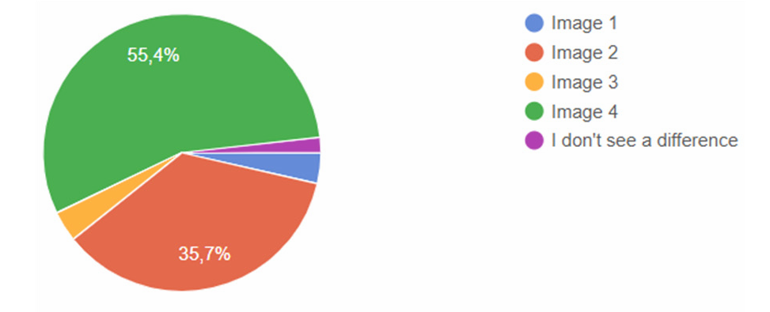
VISUALS
Notes:
Questionnaire
56 people
No expertise needed, anyone can fill in

Slide 18
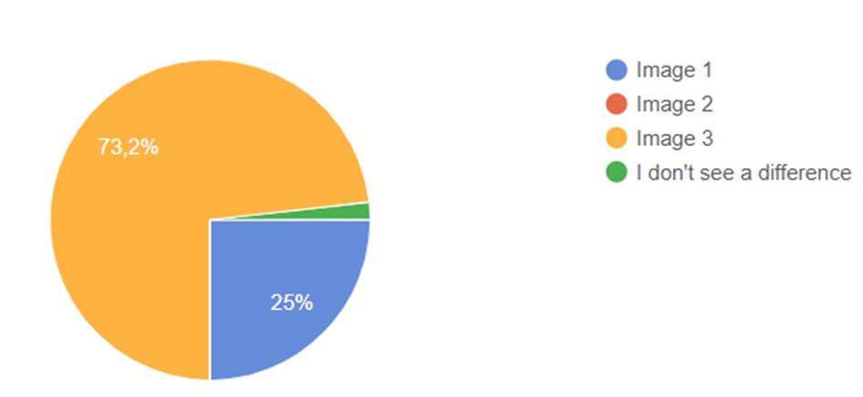
VISUALS

Slide 19
CONCLUSION
CPU and VRAM are not factors
Framerate: HBAO and GTAO
Visuals: GTAO first, SSAO second

Slide 20
FUTURE WORK
More AO methods
More optimization for shorter frametime
Notes:
Screen space directional occlusion
Horizon based ambient occlusion+
Alchemy ambient occlusion
Ray traced ambient occlusion

Slide 21

THANK YOU
FOR YOUR
ATTENTION!

