Slide 1
DATA ANALYTICS PROJECT
Customer Shopping Behavior Analysis
Python · SQL · Power BI — turning 3,900 transactions into business insight
Mohammad Ali Jauhar
University
Group No. 5 (BCA 3rd Year)
Daaniya khan (Roll No. 2405000005)
Mohd Amaan (Roll No. 2405000009)
Mohd Arsalan
Mohd Shaqib

Slide 2
OVERVIEW
Project Overview
This project analyzes customer shopping behavior using transactional data from 3,900 purchases across multiple product categories. The goal is to uncover spending patterns, customer segments, product preferences, and subscription behavior to guide strategic business decisions.
3,900
18
PostgreSQL
Power BI
transactions analyzed
data fields
for SQL analysis
for the dashboard

Slide 3
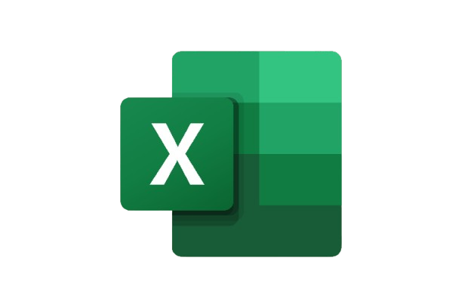
THE DATA
Dataset Summary
3,900 rows · 18 columns
Demographics
Age, Gender, Location, Subscription Status
Purchase Details
Item Purchased, Category, Purchase Amount, Season, Size, Color
Shopping Behavior
Discount Applied, Promo Code Used, Previous Purchases, Frequency of Purchases, Review Rating, Shipping Type
Data quality note: 37 missing values found in Review Rating — imputed using the median rating per product category.

Slide 4

STEP 1
Data Preparation in Python
1
Loaded the dataset with pandas; used df.info() and .describe() for initial structure and summary statistics
2
Handled missing values — imputed Review Rating nulls using the median rating per product category
3
Standardized all column names to snake_case for readability and consistency
4
Engineered new features: age_group (binned ages) and purchase_frequency_days
5
Checked for redundancy between discount_applied and promo_code_used; dropped the redundant column
6
Connected the cleaned DataFrame to PostgreSQL for structured SQL analysis

Slide 5

STEP 2
SQL Analysis — Key Findings
Revenue by Gender
Subscribers vs Non-Subscribers
Male $157,890 vs Female $75,191
Non-subscribers drive $170,436 vs $62,645
Customer Segmentation
Repeat Buyers & Subscriptions
Loyal 3,116 · Returning 701 · New 83
958 subscribed vs 2,518 did not, among repeat buyers
Top-Rated Products
Most Discount-Dependent Product
Gloves (3.86), Sandals (3.84), Boots (3.82)
Hat — 50% of purchases used a discount

Slide 6

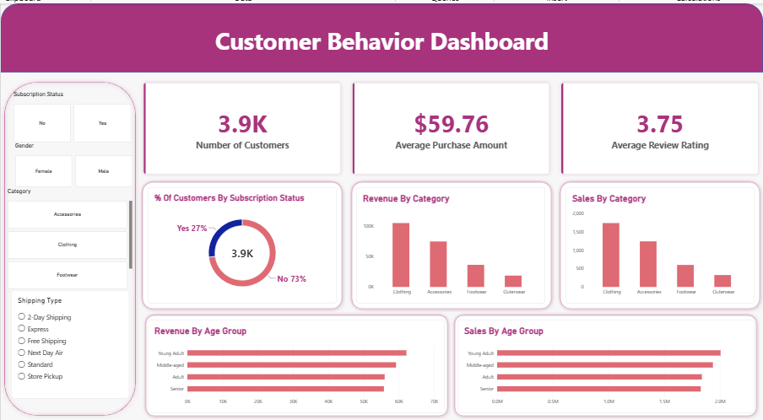
STEP 3
Power BI Dashboard

Slide 7
OUTCOME
Business Recommendations
Boost Subscriptions
Promote exclusive benefits to convert more of the 73% non-subscriber base.
Customer Loyalty Programs
Reward repeat buyers to help move Returning customers into the Loyal segment.
Review Discount Policy
Balance sales lift from discounts (e.g. Hats at 50%) against margin impact.
Product Positioning
Highlight top-rated and best-selling items — Gloves, Sandals, Jackets — in campaigns.
Targeted Marketing
Focus spend on high-revenue segments: Young Adults and Express-shipping users.

Slide 8

THANK YOU!

