Slide 1
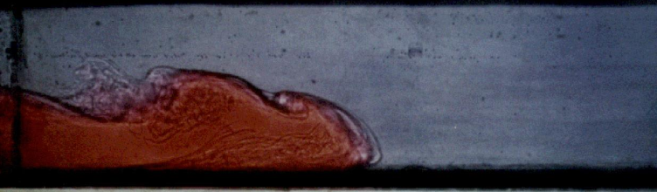
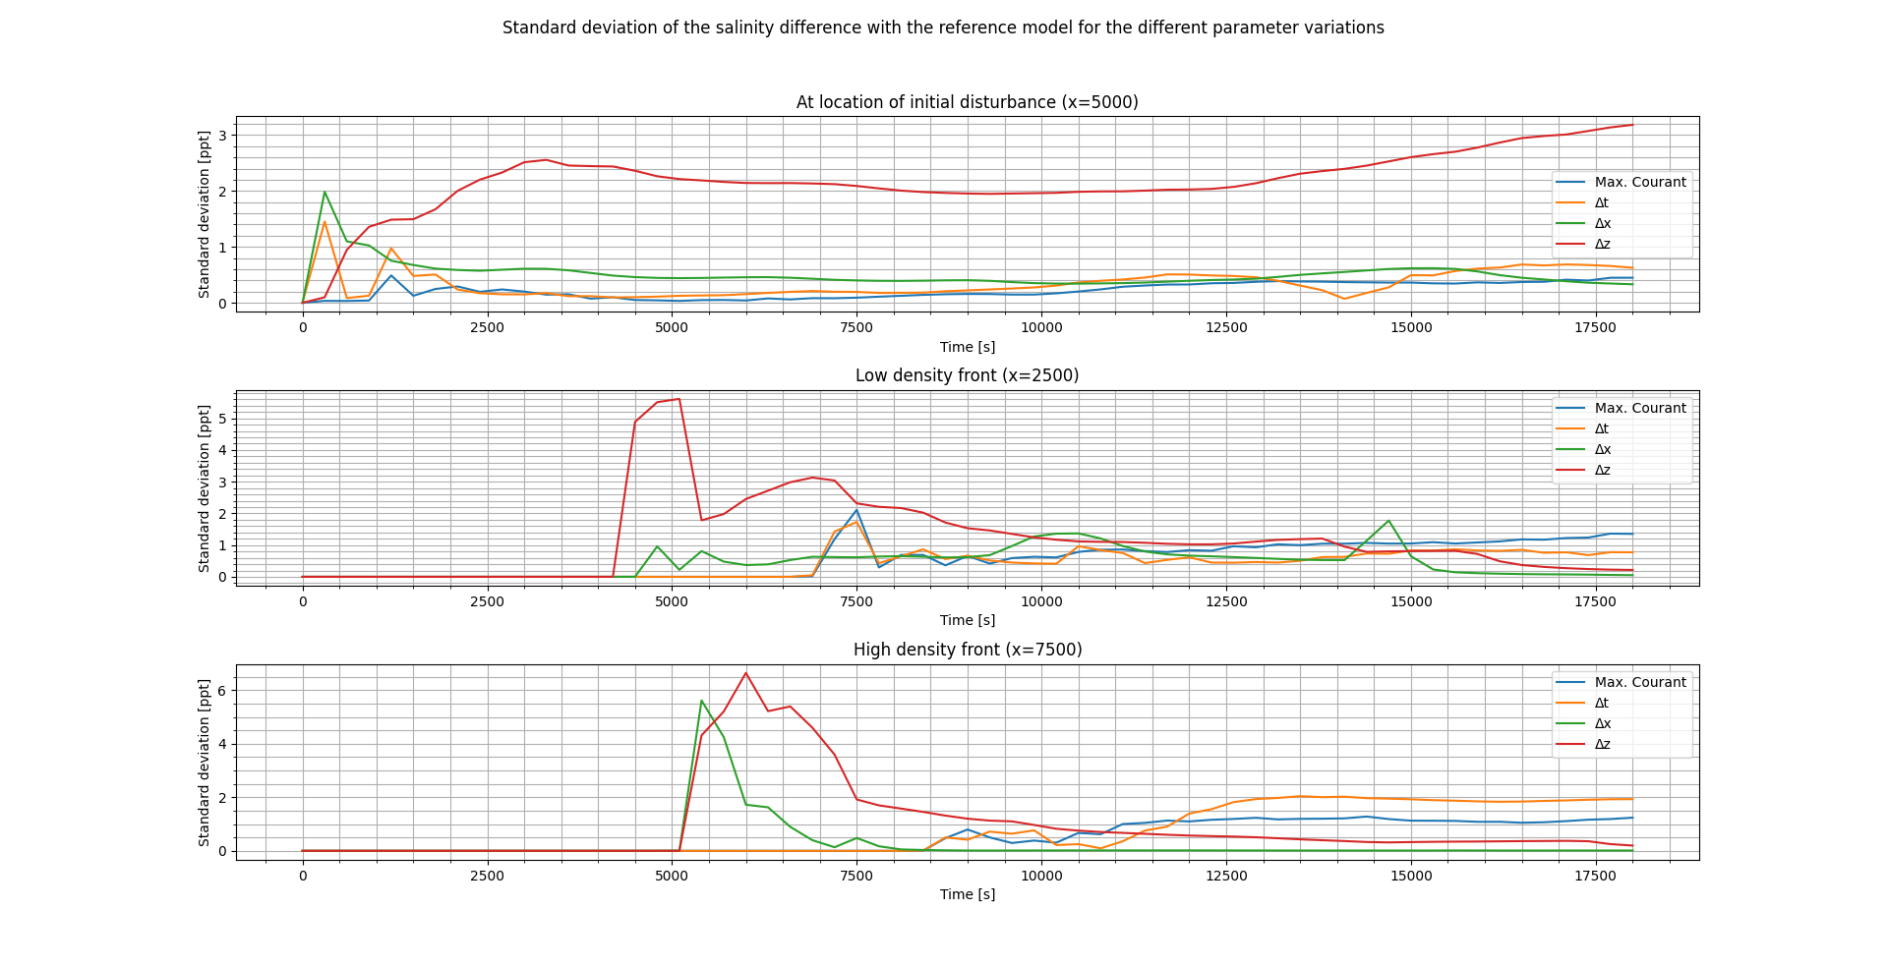
Approximation errors D-Flow FM in modelling salinity driven flow
Notes:
Salinity differences have great effect on important water systems in the Netherlands. If such density driven flows are numerically modelled steep gradients at the current front are a common cause for errors. In this research the sensitivity of numerical errors produced by D-Flow FM was quantified by changing four different parameters over a range of input values.

