Slide 1

Gotta predict ‘m all

Slide 2
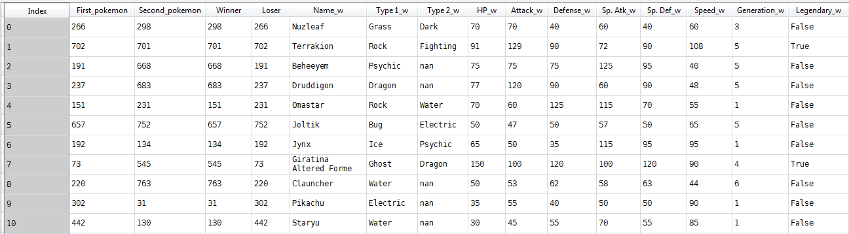
Data
A lot of features

Slide 3
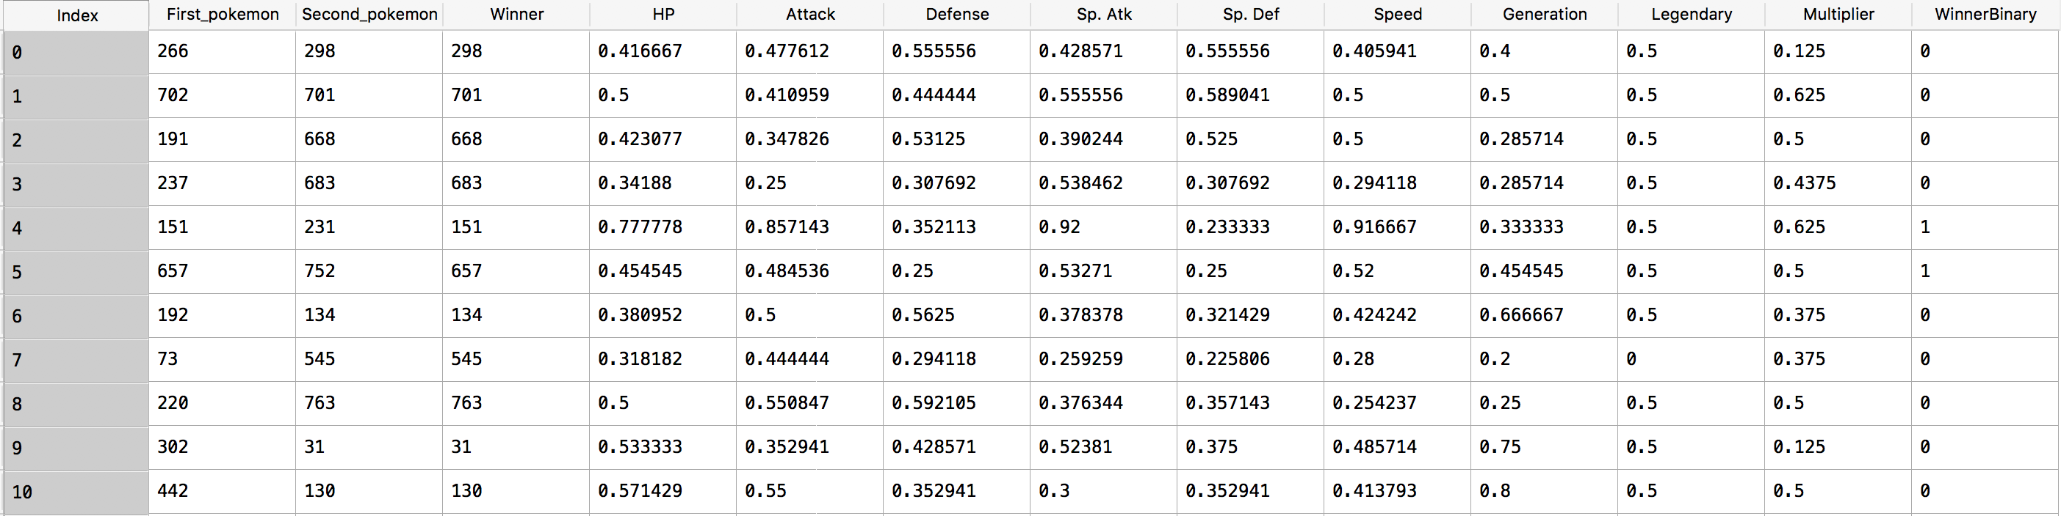
normalization
Formula of the normalization: x1/(x1+x2)

Slide 4
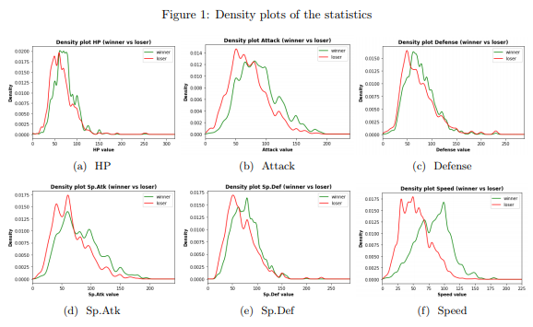
Data analysis

Slide 5
Naïve bayes
80%
Basic model

Slide 6
Logistic regression
90%
C varies

Slide 7

svm
Accuracy of 86%
Gridsearch for c
Maybe a kernel

Slide 8

Random forest
Accuracy of 97%
Variating amount of trees
Amount of features used for each tree

Slide 9
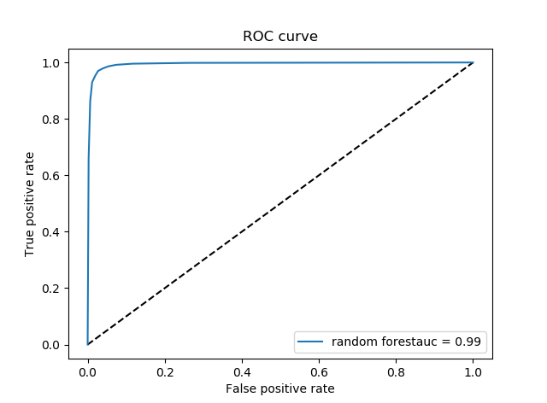
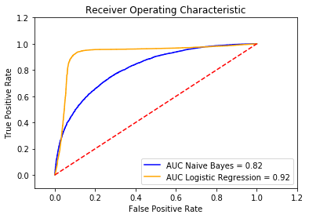
Roc curve

Slide 10
Furthermore
Expanding features
Take the sum of features

Slide 11

Questions / feedback

