Slide 1


Maintenance and evolution of the ESPD EDM
Publications Office – C.3
ESPD Meeting OP-GROW with Open User Community (OUC)
30th June 2021

Slide 2
Table of contents
Summary of last meeting on 31st March 2021
Reorganisation of GitHub
Revision of issues
Data model
AOB
Next meetings

Slide 3
1. Summary of last meeting on 31st March 2021
Meeting minutes: https://github.com/ESPD/ESPD-EDM/blob/wgm-reports/ESPD_Minutes_OUC_Meetings_20210331_v1.0.pdf
Main topics:
ESPD-EDM v3.0.0 release status
Release distribution
Maven Central Repository
Interoperability testbed usage for ESPD

Slide 4
2. Reorganization of GitHub
Harmonised GitHub repositories
Current and new approaches to GitHub usage:
 | Present | Future
Organisation | Master branch + one version per branch | Master branch + one version per tag
Access a released version | Specific (released) version branch | Specific version release tag
Access a developing version | Specific (upcoming) version branch | Master branch (or a feature/xxx branch)
Bug-fixing | Possible for any version branch | Possible for any version tag
Evolution | Possible for any version branch (past, current or upcoming) | Possible for upcoming versions only

Slide 5
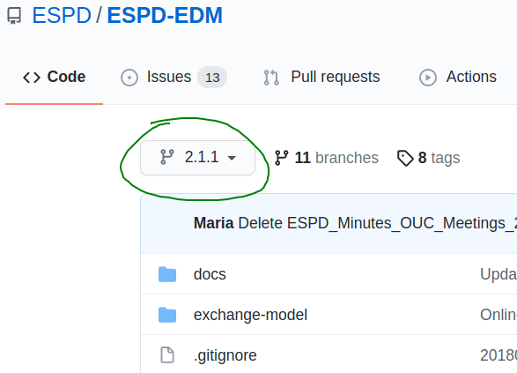
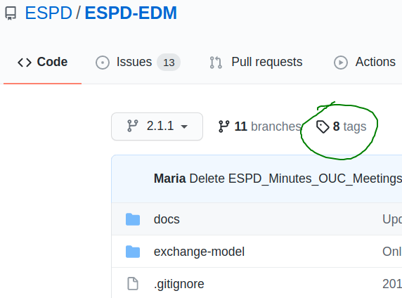
2. Reorganization of GitHub
Example: Access a released version

Slide 6
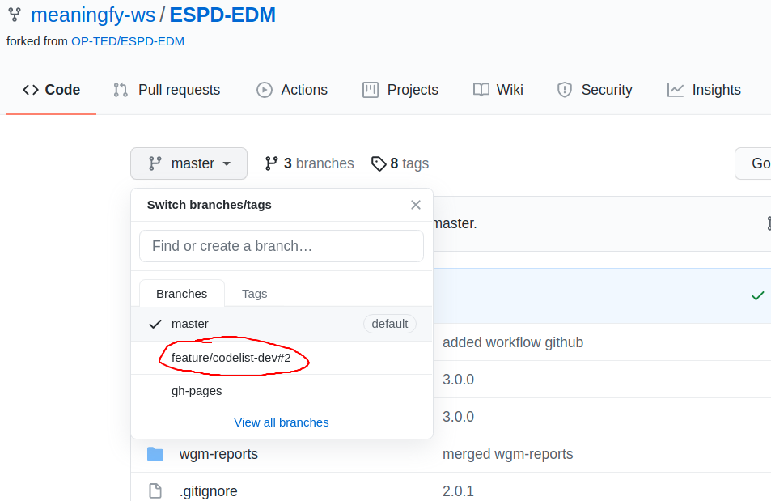
2. Reorganization of GitHub
Example: Access a new development

Slide 7
3. Revision of issues
Issues closed with the go-live of ESPD-EDM v3.0.0 release (16 issues)
Issue | Link
94 | https://github.com/ESPD/ESPD-EDM/issues/94
124 | https://github.com/ESPD/ESPD-EDM/issues/124
140 | https://github.com/ESPD/ESPD-EDM/issues/140
156 | https://github.com/ESPD/ESPD-EDM/issues/156
158 | https://github.com/ESPD/ESPD-EDM/issues/158
202 | https://github.com/ESPD/ESPD-EDM/issues/202
220 | https://github.com/ESPD/ESPD-EDM/issues/220
235 | https://github.com/ESPD/ESPD-EDM/issues/235
243 | https://github.com/ESPD/ESPD-EDM/issues/243
249 | https://github.com/ESPD/ESPD-EDM/issues/249
250 | https://github.com/ESPD/ESPD-EDM/issues/250
253 | https://github.com/ESPD/ESPD-EDM/issues/253
266 | https://github.com/ESPD/ESPD-EDM/issues/266
270 | https://github.com/ESPD/ESPD-EDM/issues/270
273 | https://github.com/ESPD/ESPD-EDM/issues/273
275 | https://github.com/ESPD/ESPD-EDM/issues/275

Slide 8
3. Revision of issues
Issues related to code lists (17 issues)
Issue | Link
294 | https://github.com/ESPD/ESPD-EDM/issues/294
295 | https://github.com/ESPD/ESPD-EDM/issues/295
296 | https://github.com/ESPD/ESPD-EDM/issues/296
297 | https://github.com/ESPD/ESPD-EDM/issues/297
298 | https://github.com/ESPD/ESPD-EDM/issues/298
299 | https://github.com/ESPD/ESPD-EDM/issues/299
300 | https://github.com/ESPD/ESPD-EDM/issues/300
301 | https://github.com/ESPD/ESPD-EDM/issues/301
302 | https://github.com/ESPD/ESPD-EDM/issues/302
303 | https://github.com/ESPD/ESPD-EDM/issues/303
304 | https://github.com/ESPD/ESPD-EDM/issues/304
305 | https://github.com/ESPD/ESPD-EDM/issues/305
306 | https://github.com/ESPD/ESPD-EDM/issues/306
307⁽¹⁾ | https://github.com/ESPD/ESPD-EDM/issues/307
308 | https://github.com/ESPD/ESPD-EDM/issues/308
309 | https://github.com/ESPD/ESPD-EDM/issues/309
310 | https://github.com/ESPD/ESPD-EDM/issues/310
⁽¹⁾ Issue 307 has been reopened in order to provide information on conducting validation using the API from ESCO

Slide 9
3. Revision of issues
New issues (4 issues)
Issue | Title of the issue
313 | Replacing #Criterion 62 Lots the EO tenders to
Description and proposed solution
Description: One ESPD Response per Lot vs One ESPD Response per group of Lots with same requirements. Proposed solution: The logic in the current ESPD v 3.0.0 is as follows, with 2 scenarios: • CA defines group of lots: If the CA defines a group of lots with the same requirements, there will be one ESPD response catering for this group of lots. In this case, only one signature is necessary. • CA defines no group of lots: The EO must provide an individual ESPD Response for each lot. In this case, each ESPD Response has to be signed individually.

Slide 10
3. Revision of issues
New issues (4 issues)
Issue | Title of the issue
314 | ESPD V.3 and multidomain: is the order of the Criteria in an ESPD request Relevant?
Description and proposed solution
Description: A clarification is required regarding relevancy of the order in which the criteria are presented in an ESPD Request. Proposed solution: The current order comes from the ESPD regulation and is as such as well depicted in the eCertis scenario. It makes sense to have a specific order as this will make it easier for suppliers to fill it out - at least in a country. If all solutions in one country would shuffle them, suppliers would need more time to fill it out manually or even to check. However, the more data comes from national databases, it could probably make sense to change the order. To adjust the order, it should always be thought of, if this helps the supplier to provide the information.

Slide 11
3. Revision of issues
New issues (4 issues)
Issue | Title of the issue
311 | Question on UUIDs for REQUIREMENT(s) and QUESTION(s)
312 | Question on UUID for Repeatable Question Sub Group
Description and proposed solution
Description: Both issues require clarifications on the assignment of UUID in QUESTION and REQUIREMENT in the RESPONSE document. Proposed solution: At criteria level, a UUID is created for each criterion. Within a criterion, a specific amount of elements can be provided by the EO and a hash value could be created for each one of these elements with information from the EO, the UUID of the criterion and with specific elements of the content itself. Therefore, the hash value would be unique and not arbitrary, it would respect the once-only principle and would facilitate a better reuse of information. This solution would be a major change from current version 3.0.0 of ESPD-EDM.

Slide 12
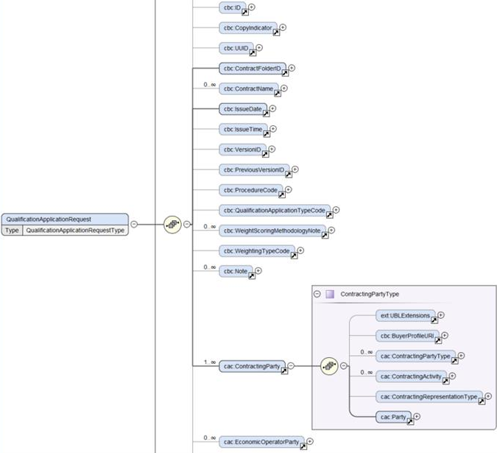
4. Data model
A data model will be prepared during summer
Currently, the UBL schema and an excel sheet are used
The data model aims at simplifying and facilitating the understanding of the model and its components, as well as its relationship with eForms

Slide 13
5. Next meetings
Last Thursday of every month:
August 26th / September 2nd, 10:00 – 11:30
September 30th, 10:00 – 11:30
October 28th , 10:00 – 11:30
November 25th , 10:00 – 11:30
Seminar date to be confirmed (October / November)

Slide 14

Questions

