Slide 1


Maintenance and evolution of the ESPD EDM
Publications Office – C.3
ESPD Meeting OP-GROW with Open User Community (OUC)
3rd February 2021

Slide 2
Table of contents
Summary of last meeting on 29th October 2020
ESPD-EDM v3.0.0 Release Process
Code List Cleansing and Harmonization
Code List Register Type
Next meetings

Slide 3
1. Summary of last meeting on 29th October 2020
Meeting minutes: https://github.com/ESPD/ESPD-EDM/blob/wgm-reports/ESPD_Minutes_OUC_Meetings_20201029_v1.0.pdf
GitHub issues :
#223: No need for Criterion 51 – Subcontracted proportion
#273: Criteria #25, 26 - extended - (trade and commercial registers) – continuation of the discussion
#277: TOOP extension to describe evidence metadata within the ESPD-EDM
#280: Specific yearly turnover and Specific average turnover
#285: ESPD 2.1.1. Schema & other discrepancies
BASIC and EXTENDED ESPD model

Slide 4
2. ESPD-EDM v3.0.0 Release Process
Phase | Status | Description
Set-up | DONE | Create new Branch Update from UBL2.2 to UBL2.3
Implementation | IN PROGRESS | Code List harmonization eForms harmonization Issue implementation Testbed update
Documentation | IN PROGRESS | New Business Handbook New Technical Handbook Wiki update

Slide 5
3. Code List Cleansing and Harmonization
Code List | Status
BidType | REMOVED
ConfidentialityLevel | UPDATED
CountryCodeIdentifier | UPDATED
CPVCodes | REMOVED
CriteriaTaxonomy | UPDATED
CurrencyCode | ALIGNED
DocRefContentType | UPDATED
EOIndustryClassificationCode | ALIGNED
EORoleType | UPDATED
EvaluationMethodType | REMOVED
LanguageCodeEU | ALIGNED
LegislationType | REMOVED
ProcedureType | REMOVED
ProjectType | REMOVED
ServiceProjectSubType | REMOVED
RegisterType (name TBD) | NEW

Slide 6
3. Code List Cleansing and Harmonization
BidType REMOVED
Defines type of submission possible for tenderer.
Used in CRITERIA.
2.1.1 status:
Code List maintained in ESPD.
3.0.0 update:
Code List is no longer required and is therefore removed.

Slide 7
3. Code List Cleansing and Harmonization
ConfidentialityLevel CODELIST NAME CHANGED: access-right
Identifies the confidentiality level of the given response for this criterion.
Used in the ESPD Response for EVIDENCEs.
2.1.1 status:
Code List maintained by ESPD.
All labels in English.
Possible values: CONFIDENTIAL, PUBLIC
CONFIDENTIAL code not present in EU Vocabulary.
3.0.0 update:
Change name to access-right, following EU Vocabulary.
English and Estonian labels in March. Other languages in June.
Code List maintained by ESPD (will be maintained by EU Vocabulary from mid-2021)
EU Vocabulary will adopt code CONFIDENTIAL for ESPD to use (mid-2021)

Slide 8
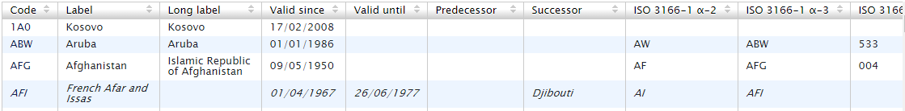
3. Code List Cleansing and Harmonization
CountryCodeIdentifier EFORMS ALIGNMENT: FROM 2-CHAR CODE TO 3-CHAR CODE
CODELIST NAME CHANGED: country
Identifies the country.
Used in CRITERIA for ESPD Request and Response
2.1.1 status:
Code List maintained by ESPD.
Code pattern: 2-character code.
All labels in English.
3.0.0 update:
Change name to country, following EU Vocabulary.
Code List maintained by EU Vocabulary (country).
Code pattern: 3-character code in alignment with eForms.
Labels translated according to EU Vocabulary.
Aligned with eForms.

Slide 9
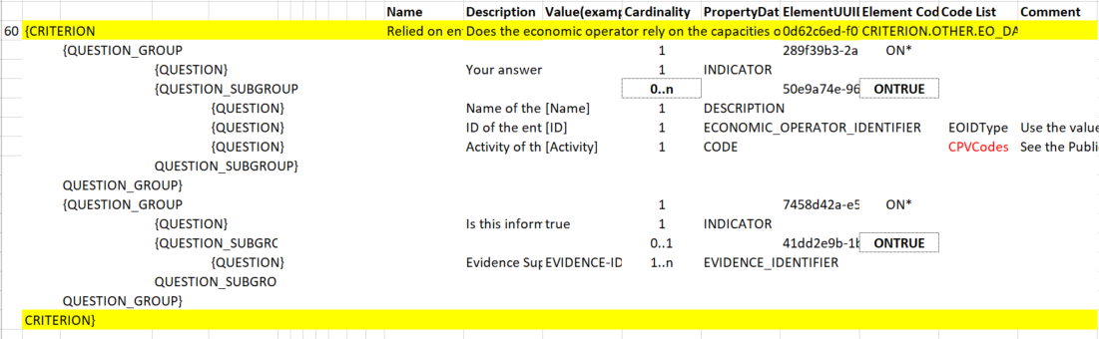
3. Code List Cleansing and Harmonization
CPVCodes REMOVED
Defines the subject of the contract, and a supplementary vocabulary to add further qualitative information.
Used in CRITERIA for ESPD Request and Response
2.1.1 status:
Code List maintained by ESPD.
3.0.0 update:
Aligned with eForms.
We propose to remove it as codes can be extracted from eForms, due to the alignment between the lots in ESPD and eForms.
As can be seen in the image, it is used for the EPSD response to specify the type of activity of the relied entity or the subcontractor. Pending discussion of its future usage.

Slide 10
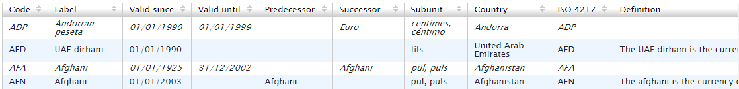
3. Code List Cleansing and Harmonization
CurrencyCode CODELIST NAME CHANGED: currency
Defines currency of the numeric value as an amount in the expected response.
Used in CRITERIA for the ESPD Response
2.1.1 status:
Code List maintained by ESPD.
3.0.0 update:
Change name to currency, following EU Vocabulary.
Code List maintained by EU Vocabulary (currency).
Aligned with eForms.

Slide 11
3. Code List Cleansing and Harmonization
DocRefContentType CODELIST NAME CHANGED: docref-content-type
Identifies the type of document being referenced.
Used in the ESPD Request
2.1.1 status:
Code List maintained by ESPD.
All labels in English.
3.0.0 update:
Change name to docref-content-type, following EU Vocabulary.
English labels in March. Other languages mid-2021.
Code List maintained by ESPD (will be maintained in EU Vocabulary mid-2021)

Slide 12
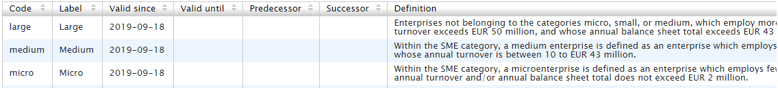
3. Code List Cleansing and Harmonization
EOIndustryClassificationCode CODELIST NAME CHANGED: economic-operator-size
Identifies whether the EO is a micro, small, medium or large company (or simply an SME)
Used in the ESPD Response
2.1.1 status:
Code List maintained by ESPD.
3.0.0 update:
Change name to economic-operator-size, following EU Vocabulary.
Code List maintained by EU Vocabulary (economic-operator-size).
Aligned with eForms.

Slide 13
3. Code List Cleansing and Harmonization
EORoleType CODELIST NAME CHANGED: eo-role-type
CODES CHANGED
Identifies the role of the economic operator in the bid.
Used in CRITERIA for the ESPD Response.
2.1.1 status:
Code List maintained by ESPD.
All labels in English.
Possible values: GM, OERON, OENRON, SC, LE
3.0.0 update:
Change name to eo-role-type.
English labels in March.
Code List maintained by ESPD.
Code changes (agreed on Issue #250)
OENRON (Other entity (not relied upon)) to subcont(Subcontractor)
SC(Sole contractor) to sole-tenderer (Sole tenderer)
LE(Lead Entity) to group-lead (Group leader)
GM to group-mem (Group member)

Slide 14
3. Code List Cleansing and Harmonization
EvaluationMethodType REMOVED
A code to inform about the type of Evaluation.
Used in CRITERIA for the ESPD Request.
2.1.1 status:
Code List maintained by ESPD.
3.0.0 update:
Code List is no longer required as agreed at 19th May 2020 OUC.

Slide 15
3. Code List Cleansing and Harmonization
LanguageCodeEU CODELIST NAME CHANGED: language
EFORMS ALIGNMENT: FROM 2-CHAR CODE TO 3-CHAR CODE
Identifies available languages.
Used in ESPD Request and Response
2.1.1 status:
Code List maintained by ESPD.
Code pattern: 2-character code.
24 available languages.
3.0.0 update:
Change name to language, following EU Vocabulary.
Code List maintained by EU Vocabulary (language).
Code pattern: 3-character code in alignment with eForms.
Aligned with eForms.
Same languages as eForms use context (55).

Slide 16
3. Code List Cleansing and Harmonization
LegislationType REMOVED
Identifies jurisdictional level of a particular legislation.
Used in ESPD Request.
2.1.1 status:
Code List maintained by ESPD.
Marked as unused.
3.0.0 update:
Code List is no longer required and is therefore removed.

Slide 17
3. Code List Cleansing and Harmonization
ProcedureType REMOVED
Identifies type of the procurement administrative procedure according to the EU Directives.
Used in ESPD Request
2.1.1 status:
Code List maintained by ESPD.
3.0.0 update:
The information related to the object of the contract will be defined by eForms, this information is no longer required.
Therefore, this Code List is no longer required because it is linked to eForms and we propose to remove it.

Slide 18
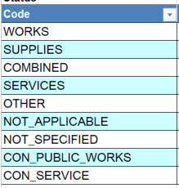
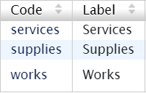
3. Code List Cleansing and Harmonization
ProjectType REMOVED
Identifies object of the project.
Used in ESPD Request
2.1.1 status:
Code List maintained by ESPD.
All labels in English.
3.0.0 update:
Code List is no longer required because the data is provided in eForms (contract-nature)
ESPD v2.1.1
ESPD 3.0.0 (eForms alignment)

Slide 19
3. Code List Cleansing and Harmonization
ServiceProjectSubType REMOVED
Identifies project subtype.
Used in ESPD Request
2.1.1 status:
Code List maintained by ESPD.
3.0.0 update:
The information related to the object of the contract will be defined by eForms, this information is no longer required.
Therefore, this Code List is no longer required because it is linked to eForms and we propose to remove it.

Slide 20
3. Code List Cleansing and Harmonization
CriteriaTaxonomy CODELIST NAME CHANGED: criterion (proposal)
CODES CHANGED – (proposed codes)
Identifies a group of requirements uniquely.
Used for CRITERIA in both ESPD Request and Response
2.1.1 status:
Code List maintained by ESPD.
All labels in English.
Repeated definitions.
3.0.0 update:
Change name to criterion (proposed name).
Code list maintained by ESPD.
Code list to be maintained by EU Vocabularies (mid-2021)
English labels in March.
New definitions.
New concepts.
Code Change to define non specific domain criteria (final code changes to be provided in March).

Slide 21
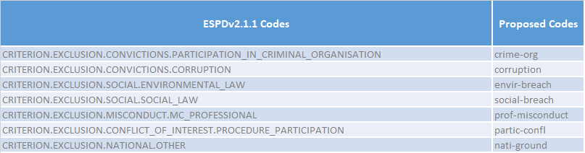
3. Code List Cleansing and Harmonization
CriteriaTaxonomy CODELIST NAME CHANGED: criterion (proposal)
CODES CHANGED – (proposed codes)

Slide 22
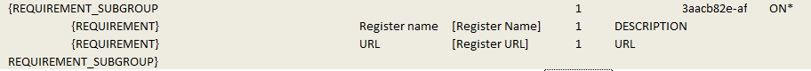
4. Code List Register Type New code list
Issue #273: Criteria #25, 26 - extended - (trade and commercial registers): logical error
Summary:
The issue reports a logical error on how the criteria #25 (professional register) and #26 (trade register) require information about the EO Registered in Trade Registers and Professional Registers.
Currently the CA can include a requirement about in which professional and trade register an EO should be registered in. This fact does not make sense, CA can ask or require the registration but not a specific register to be registered in.
Proposed solution:
Take RegProf database as a model for the new Code List.
Reconsider A:Suitability question
Implications:
Additional maintenance for any new Code Lists would be required.

Slide 23

5. Next meetings
Next meeting: Wednesday 3rd March 2021
14:00-15:30
Questions

