Slide 1


Maintenance and evolution of the ESPD EDM
Publications Office – C.3
ESPD Meeting OP-GROW with Open User Community (OUC)
2nd September 2021

Slide 2
Table of contents
Summary of last meeting on 30th June 2021
Data model
Closed issues
Issues related to future versions
Next meetings
AOB

Slide 3
1. Summary of last meeting on 30th June 2021
Meeting minutes: https://github.com/ESPD/ESPD-EDM/blob/wgm-reports/ESPD_Minutes_OUC_Meetings_20210630_v4.0.pdf
Main topics:
Reorganisation of GitHub
Revision of issues
Data model

Slide 4
2. Data model
Aimed at simplifying and facilitating the understanding of the model and its components, as well as its relationship with eForms.
One file with 3 views of the data model based on ESPD-EDM v3.0.0:
Business-oriented view (BOV) of the data model, aimed at facilitating the understanding of the model and the business context, with references to the technical model;
Technically-orientated view (TOV), providing an UBL-based schema with references to business and aligned with the Procurement Ontology; and
Mixed view (TOV-BOV), providing both the business context and an UBL-based schema.

Slide 5
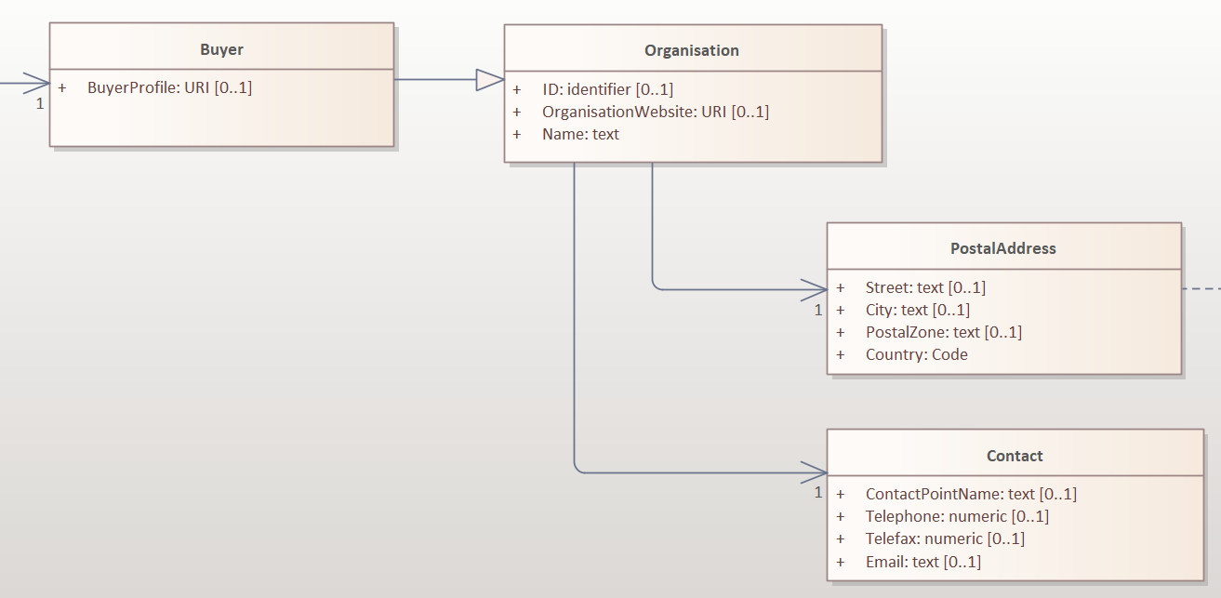
2. Data model
Business-oriented view (BOV):

Slide 6
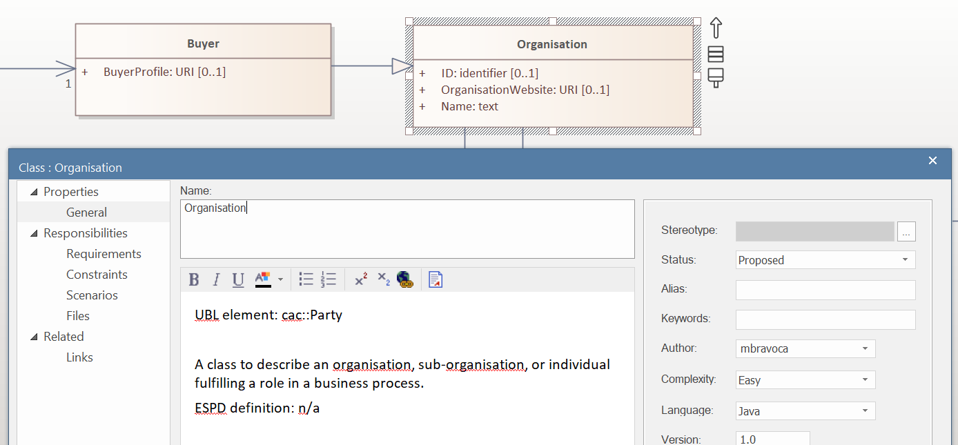
2. Data model
Business-oriented view (BOV) with reference to UBL element:

Slide 7
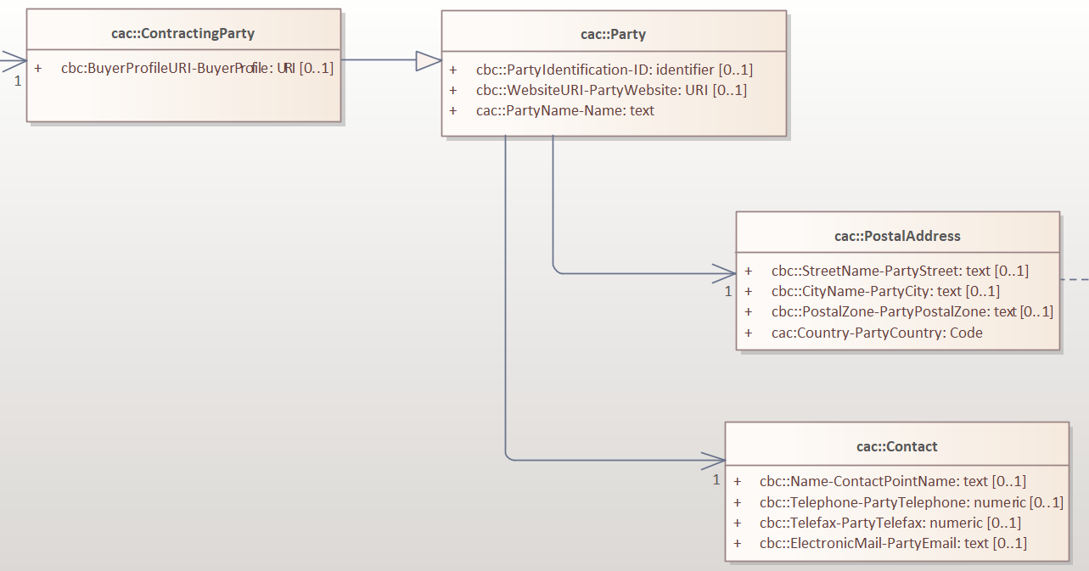
2. Data model
Technically-orientated view (TOV):

Slide 8
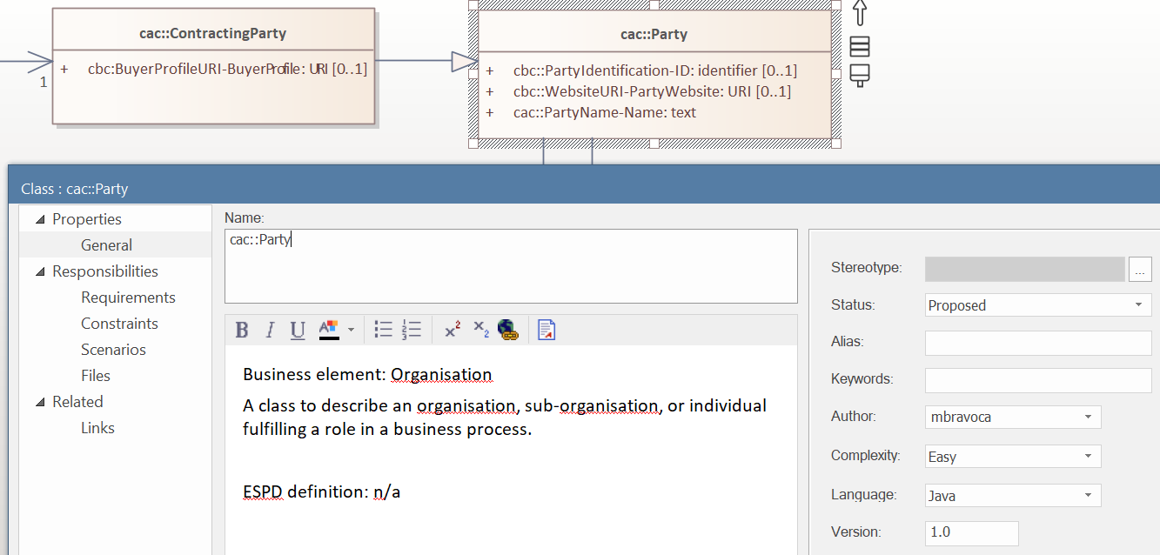
2. Data model
Technically-orientated view (TOV) with references to business:

Slide 9
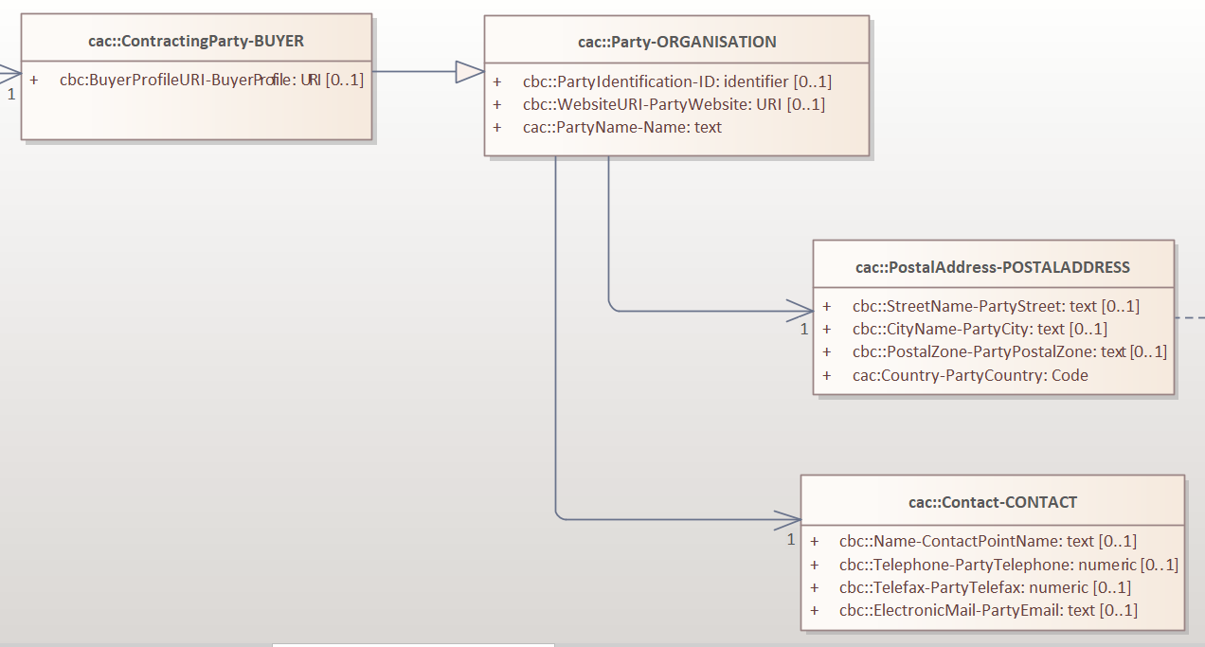
2. Data model
Mixed view (TOV-BOV), with information of both the business and the technical side:

Slide 10
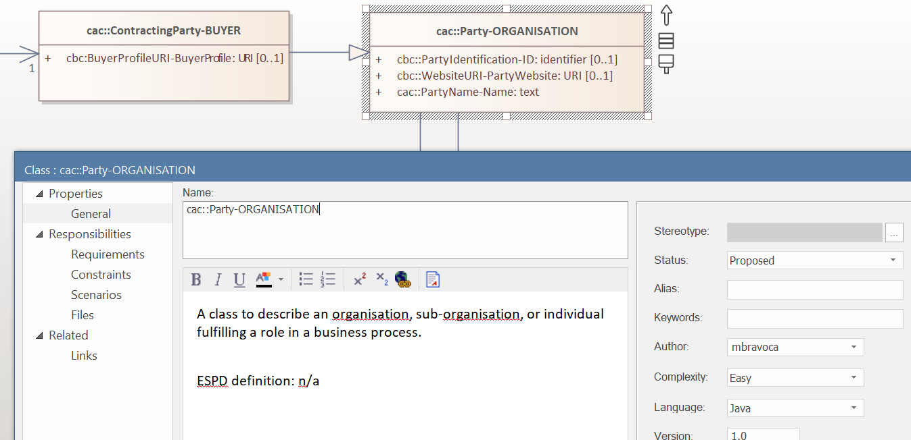
2. Data model
Mixed view (TOV-BOV) with descriptions:

Slide 11
3. Closed issues
Issues closed since last OUC meeting (7 issues)
Issue | Title of the issue
242 | Inconsistencies with Regulation and incorrect nesting @ Criteria #7 and #8
277 | TOOP extension to describe evidence metadata within the ESPD EDM
285 | ESPD 2.1.1. Schema & other discrepancies
313 | Replacing #Criterion 62 Lots the EO tenders to
314 | ESPD V.3 and multidomain: is the order of the Criteria in an ESPD request Relevant?
315 | Providing multiple answers for elements with cardinality 1
316 | WEIGHT_INDICATOR requirement with no response value in v2.1.1

Slide 12
4. Issues related to future versions
UUID
eCertis

Slide 13
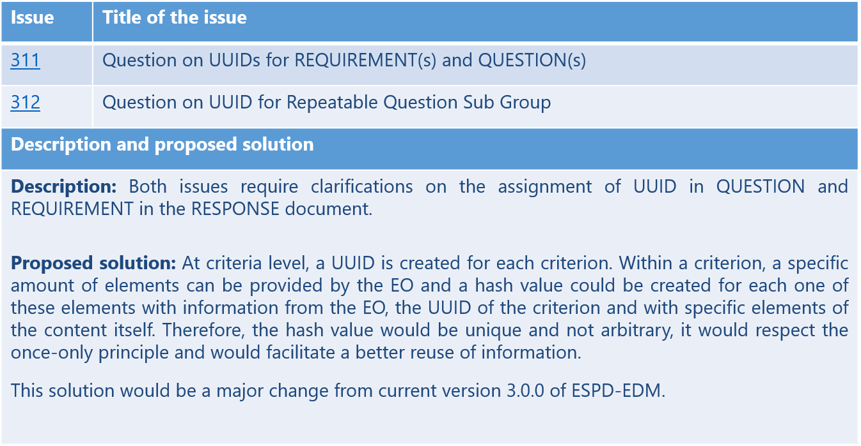
4. Issues related to future versions - UUID
Identification of a criterion and its elements – UUID vs Hash value (issues 311 & 312)

Slide 14
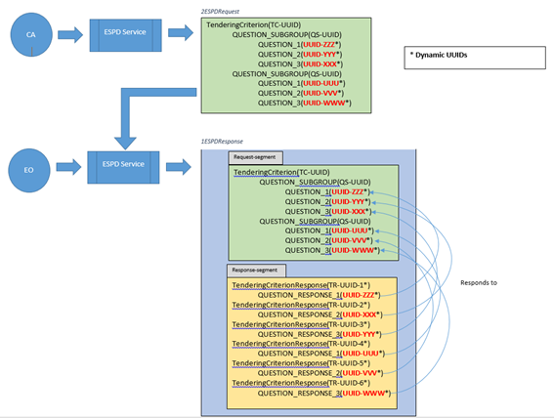
4. Issues related to future versions - UUID
UUID - Current identifier assignment

Slide 15
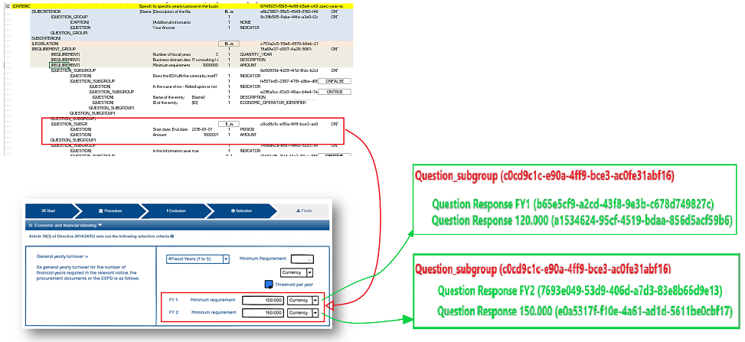
4. Issues related to future versions - UUID
UUID– Example of the current situation

Slide 16
4. Issues related to future versions - UUID
UUID reusable response code – Proposed new code
CCCCCCCC-XXXX-SSSS-EEEEEEEE-RRRRRRRR
[8] [4] [4] [56] [56]
CCCCCCCC (REQUEST): Criterion code as a CRC32 hash value.
XXXX (REQUEST): Fixed unique code. This value will be defined in the ESPD criteria to ensure identifiers are collision-safe.
SSSS (REQUEST): Sequence value needed to address multiple cardinality. This value is local to the group with multiple cardinality.
EEEEEEEE (RESPONSE): EO identifier + Country code as a SHA224 hash value.
RRRRRRRR (RESPONSE): Response value as a SHA224 hash value.
REQUEST example:
4908c6dc-a52d-0001
RESPONSE example:
4908c6dc-a52d-0001-
84113de743e6d6f4e09ed430576ee18ef5ff786524778ecf482c86b3-
cf655931d7b5dd0a2880633ab7be2f4395857f67edddd7f5ad6ede0c

Slide 17
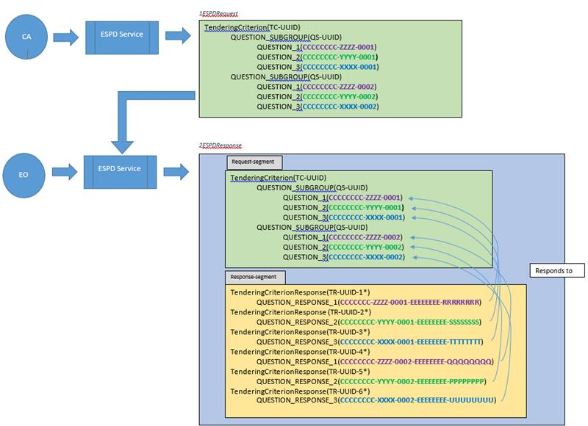
4. Issues related to future versions - UUID
UUID reusable response code – Proposed identifier assignment

Slide 18
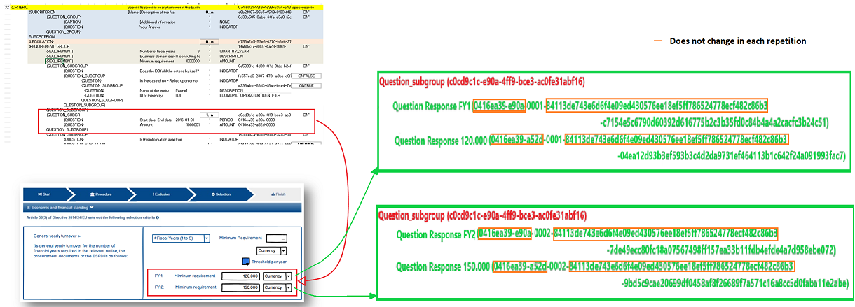
4. Issues related to future versions - UUID
UUID reusable response code – Example of the proposed situation

Slide 19
4. Issues related to future versions - eCertis
Issues related to eCertis
Issue | Title of the issue
199 | Alignment between ESPD and eCERTIS - Guideline how to detect the right eCERTIS scope
251 | Link eCertis and ESPD

Slide 20
5. Next meetings
Next OUC meetings:
October 7th, 10:00 – 11:30
October 28th , 10:00 – 11:30
November 25th , 10:00 – 11:30 (proposed cancellation due to EXEP meeting and seminar the previous week)
ESPD Seminar: November 17th, 14.00 – 17.00

Slide 21

6. AOB
Questions

Slide 22
Thank you!

