Slide 1
Fragmentomics:- Analysis of cfDNA
In this Presentation: WGS-Based Fragment Length and End Motif Profiling
Devansh Pancholi
Maher Lab
Washington University in St. Louis

Slide 2
Study Goal Current Progress
Successfully built end-to-end fragmentomics pipeline
Processed:
221 WGS samples (150 healthy, 71 cancer)
Completed:
Alignment (BWA-MEM)
Fragment size extraction
End motif extraction (5′ and 3′)
Generated:
Global fragment length distribution
Combined motif frequency profiles
Analyze cfDNA fragmentation patterns
Compare healthy vs cancer samples
Identify biomarkers from:
- Fragment length
- End motifs

Slide 3
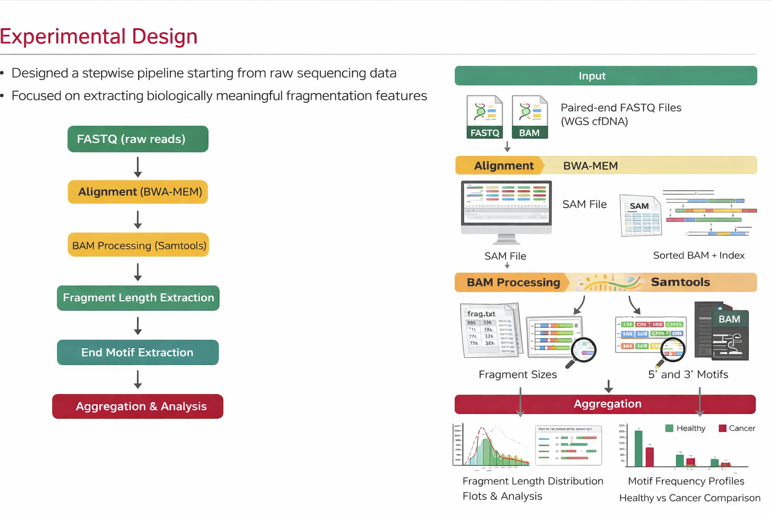
EXPERIMENTAL DESIGN
WGS-based data
Total samples: 221
Healthy: 150
Cancer: 71
Input: Paired-end FASTQ
Reference: GRCh38

Slide 4
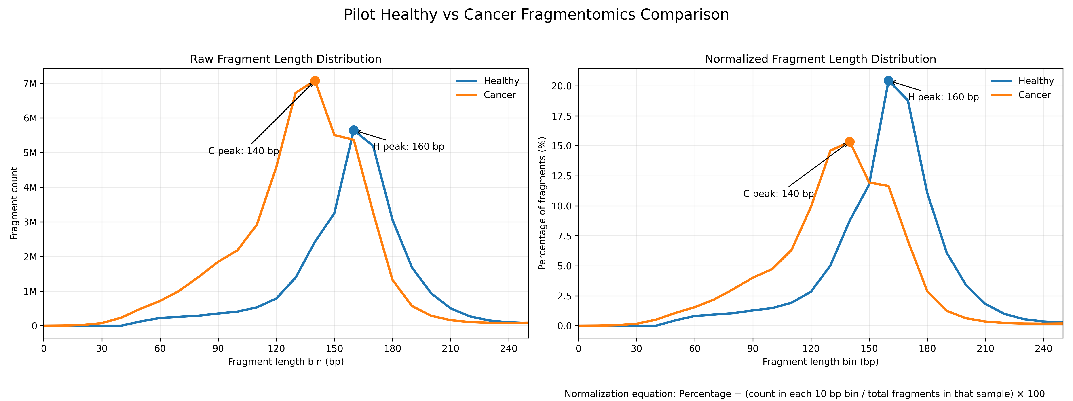
Analysis
Test sample: One Healthy and Cancer
Used as initial validation before scaling the pipeline
Extracted fragment size distribution from aligned reads
Observed dominant peak for healthy sample around 160–170 bp and for Cancer around 135 to 150 bp

Slide 5
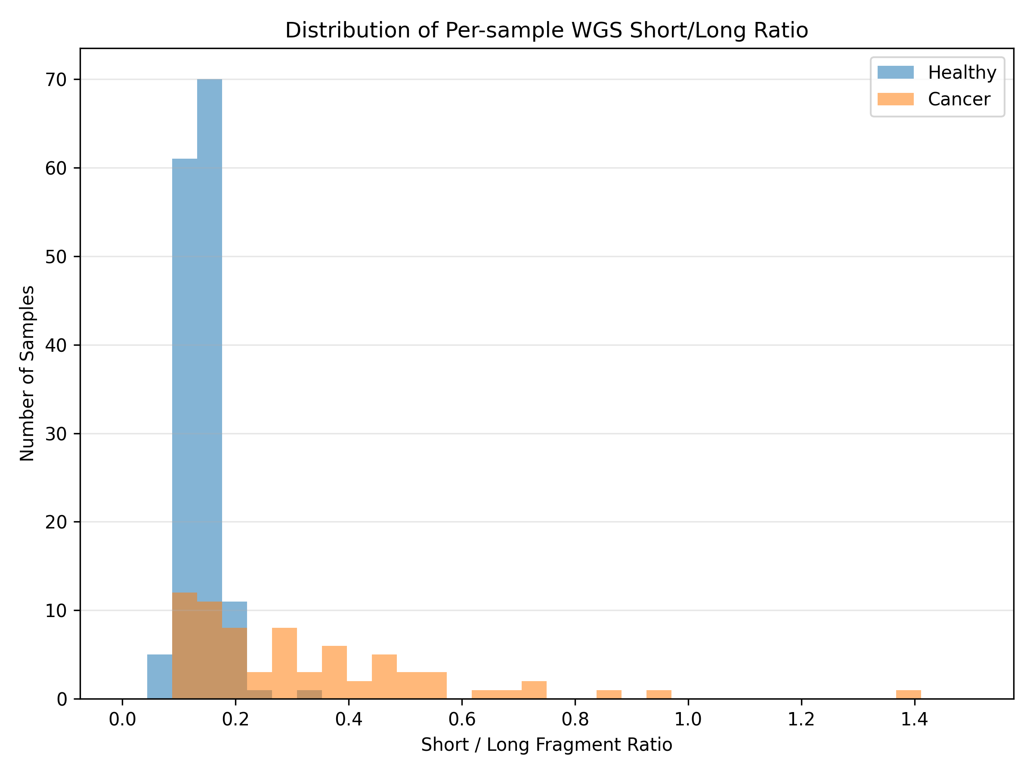
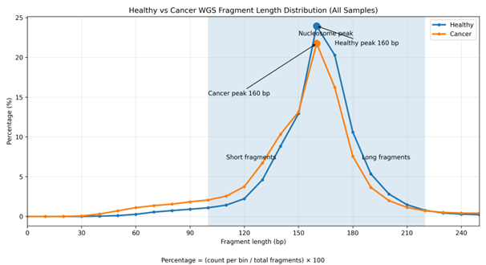
WGS_all sample_lenght
A clear rightward shift in cancer samples, with most healthy ratios clustered around 0.10–0.20, while cancer samples extend into higher ranges (0.20–0.50+)

Slide 6
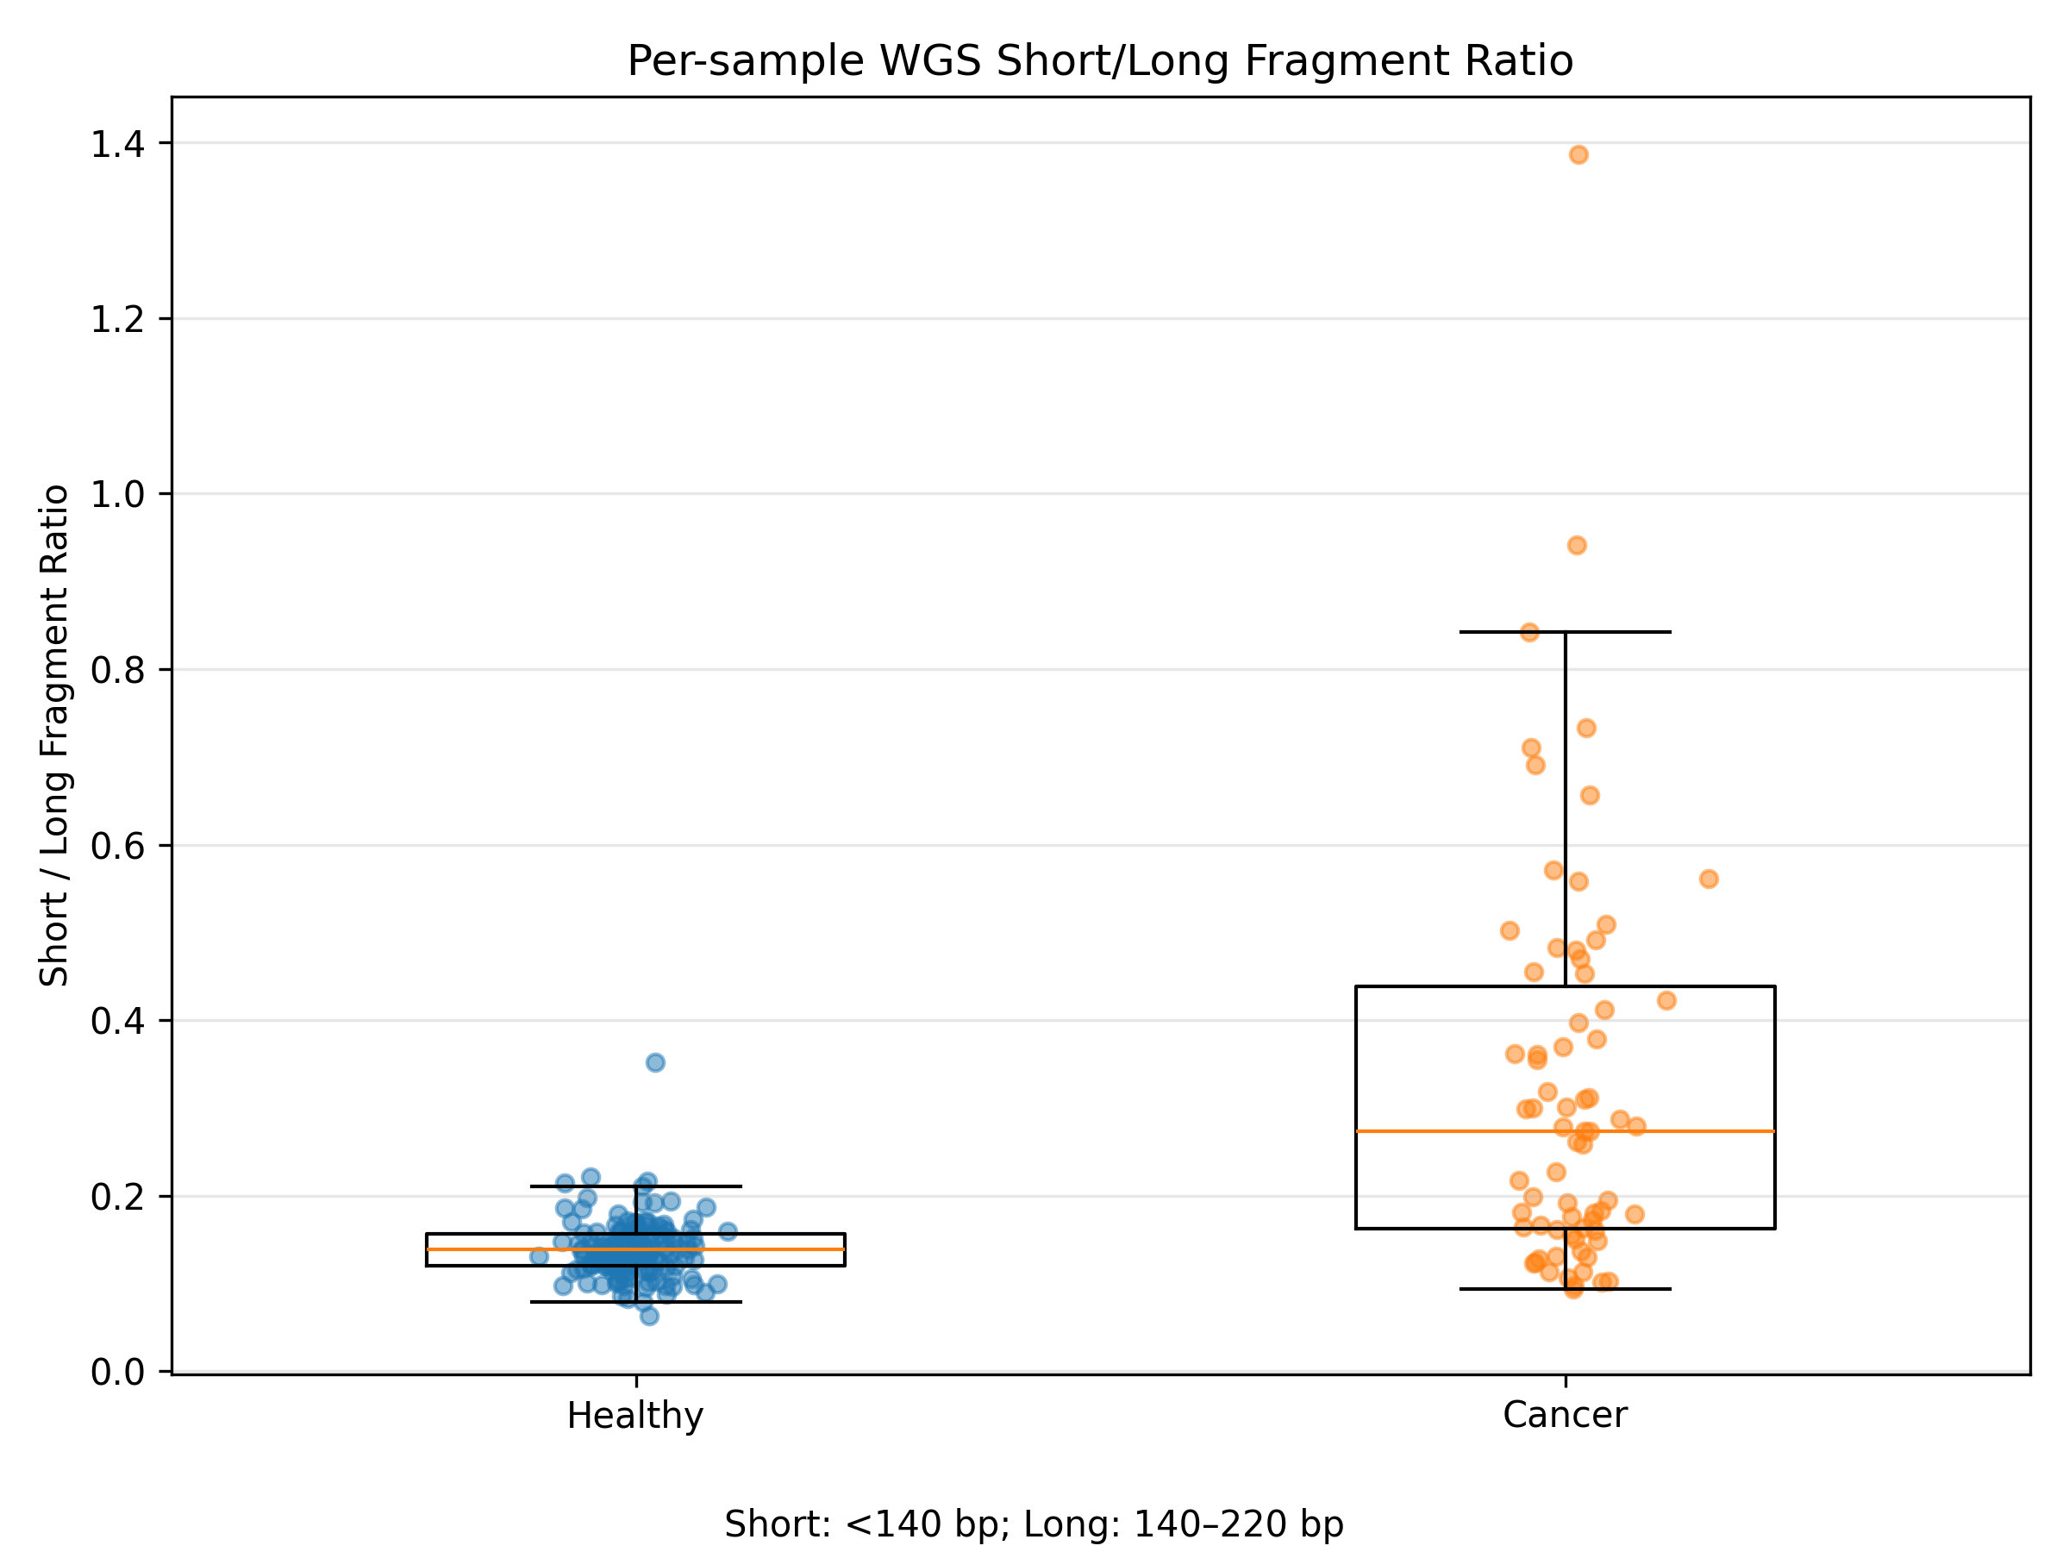
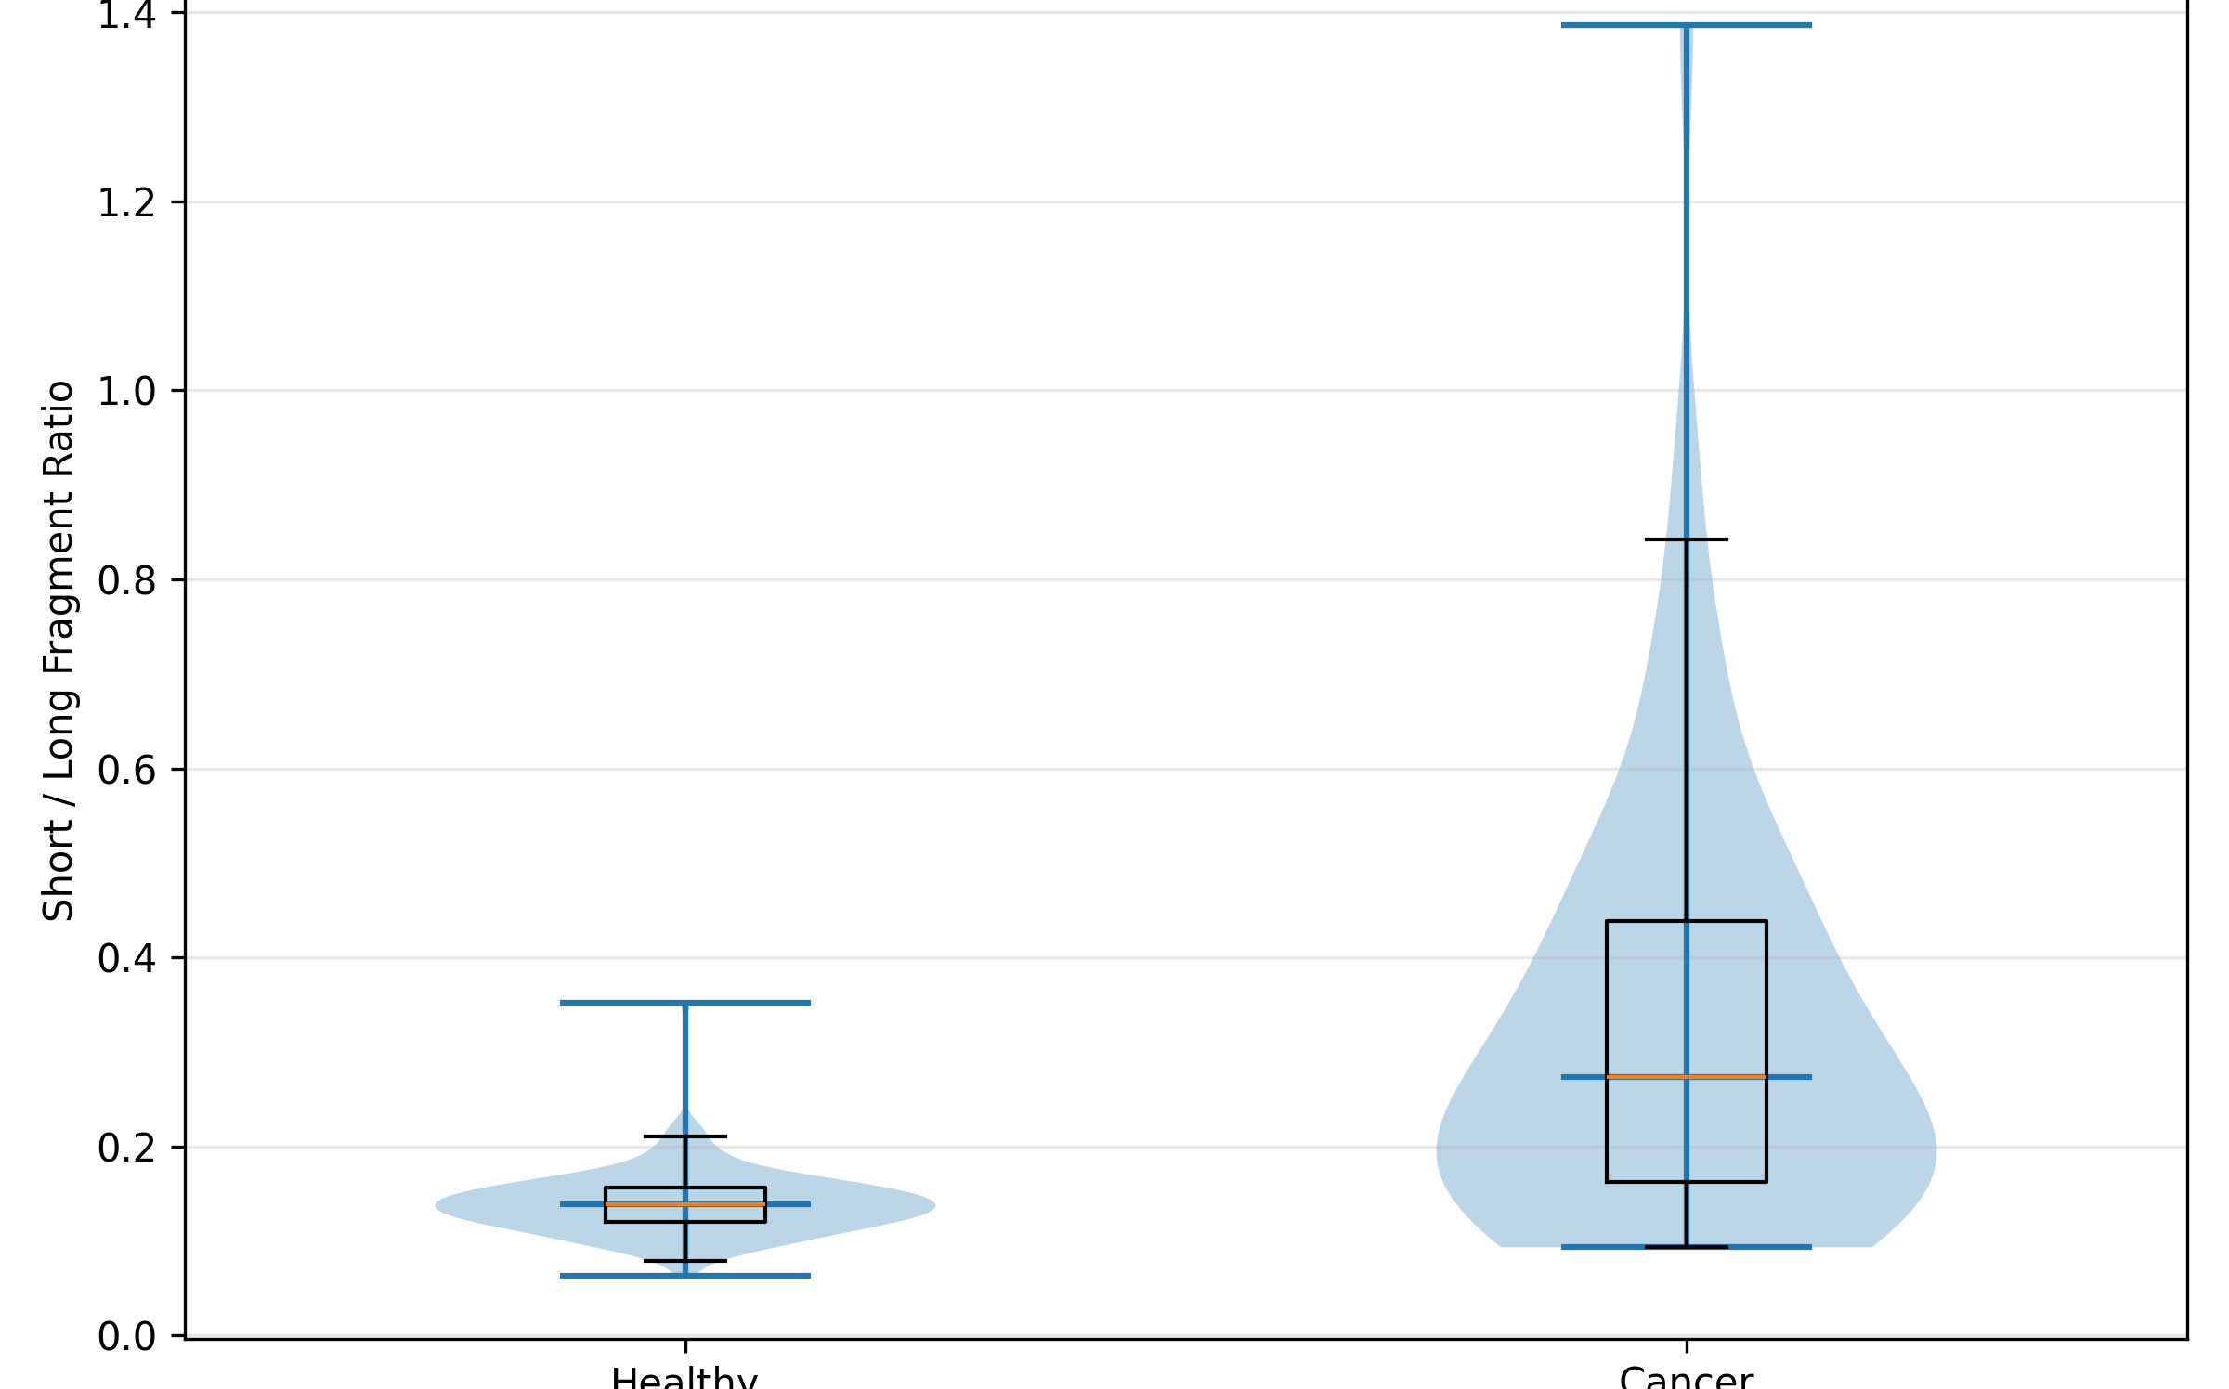
The violin plot highlights a broader and elevated distribution in cancer samples, whereas healthy samples remain tightly concentrated at lower ratios and the boxplot demonstrates that cancer samples have a significantly higher median short/long ratio (0.274) compared to healthy samples (0.139), with a wider spread

Slide 7
Overall, cancer samples exhibit approximately 2× higher short-to-long fragment ratios, along with increased variability, supporting the presence of enhanced DNA fragmentation and disrupted chromatin organization.

Slide 8
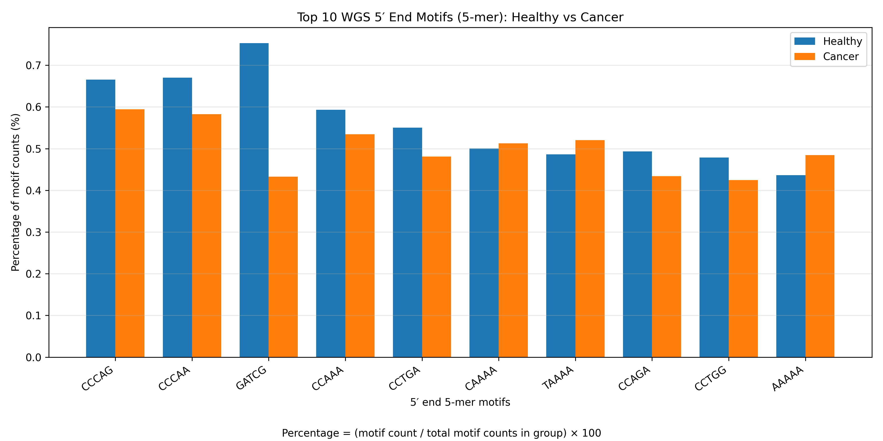
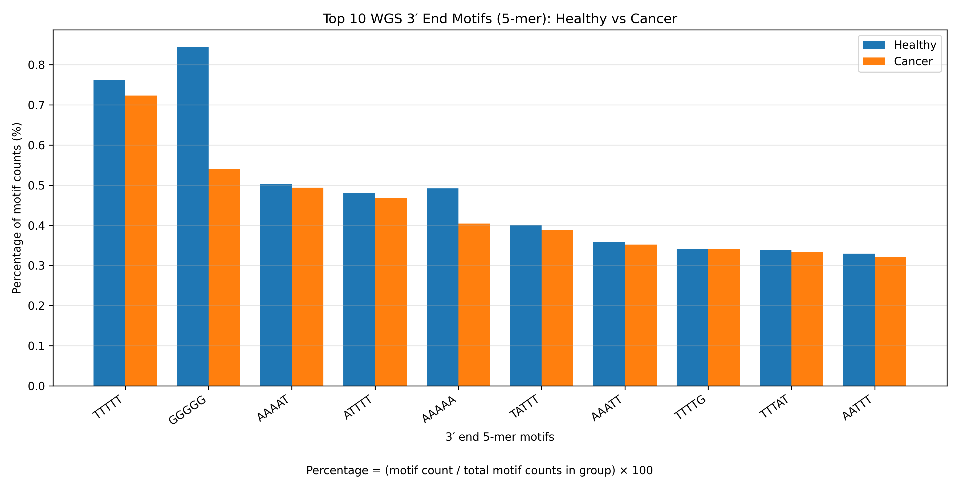
End motifs
Here we compare the top 5′ and 3′ end motifs between healthy and cancer samples. At both ends, most dominant motifs are consistently higher in healthy samples, with a noticeable reduction in cancer ,especially for motifs like GATCG at the 5′ end and GGGGG at the 3′ end. However, a few motifs such as TAAAA and AAAAA show slight enrichment in cancer.

Slide 9
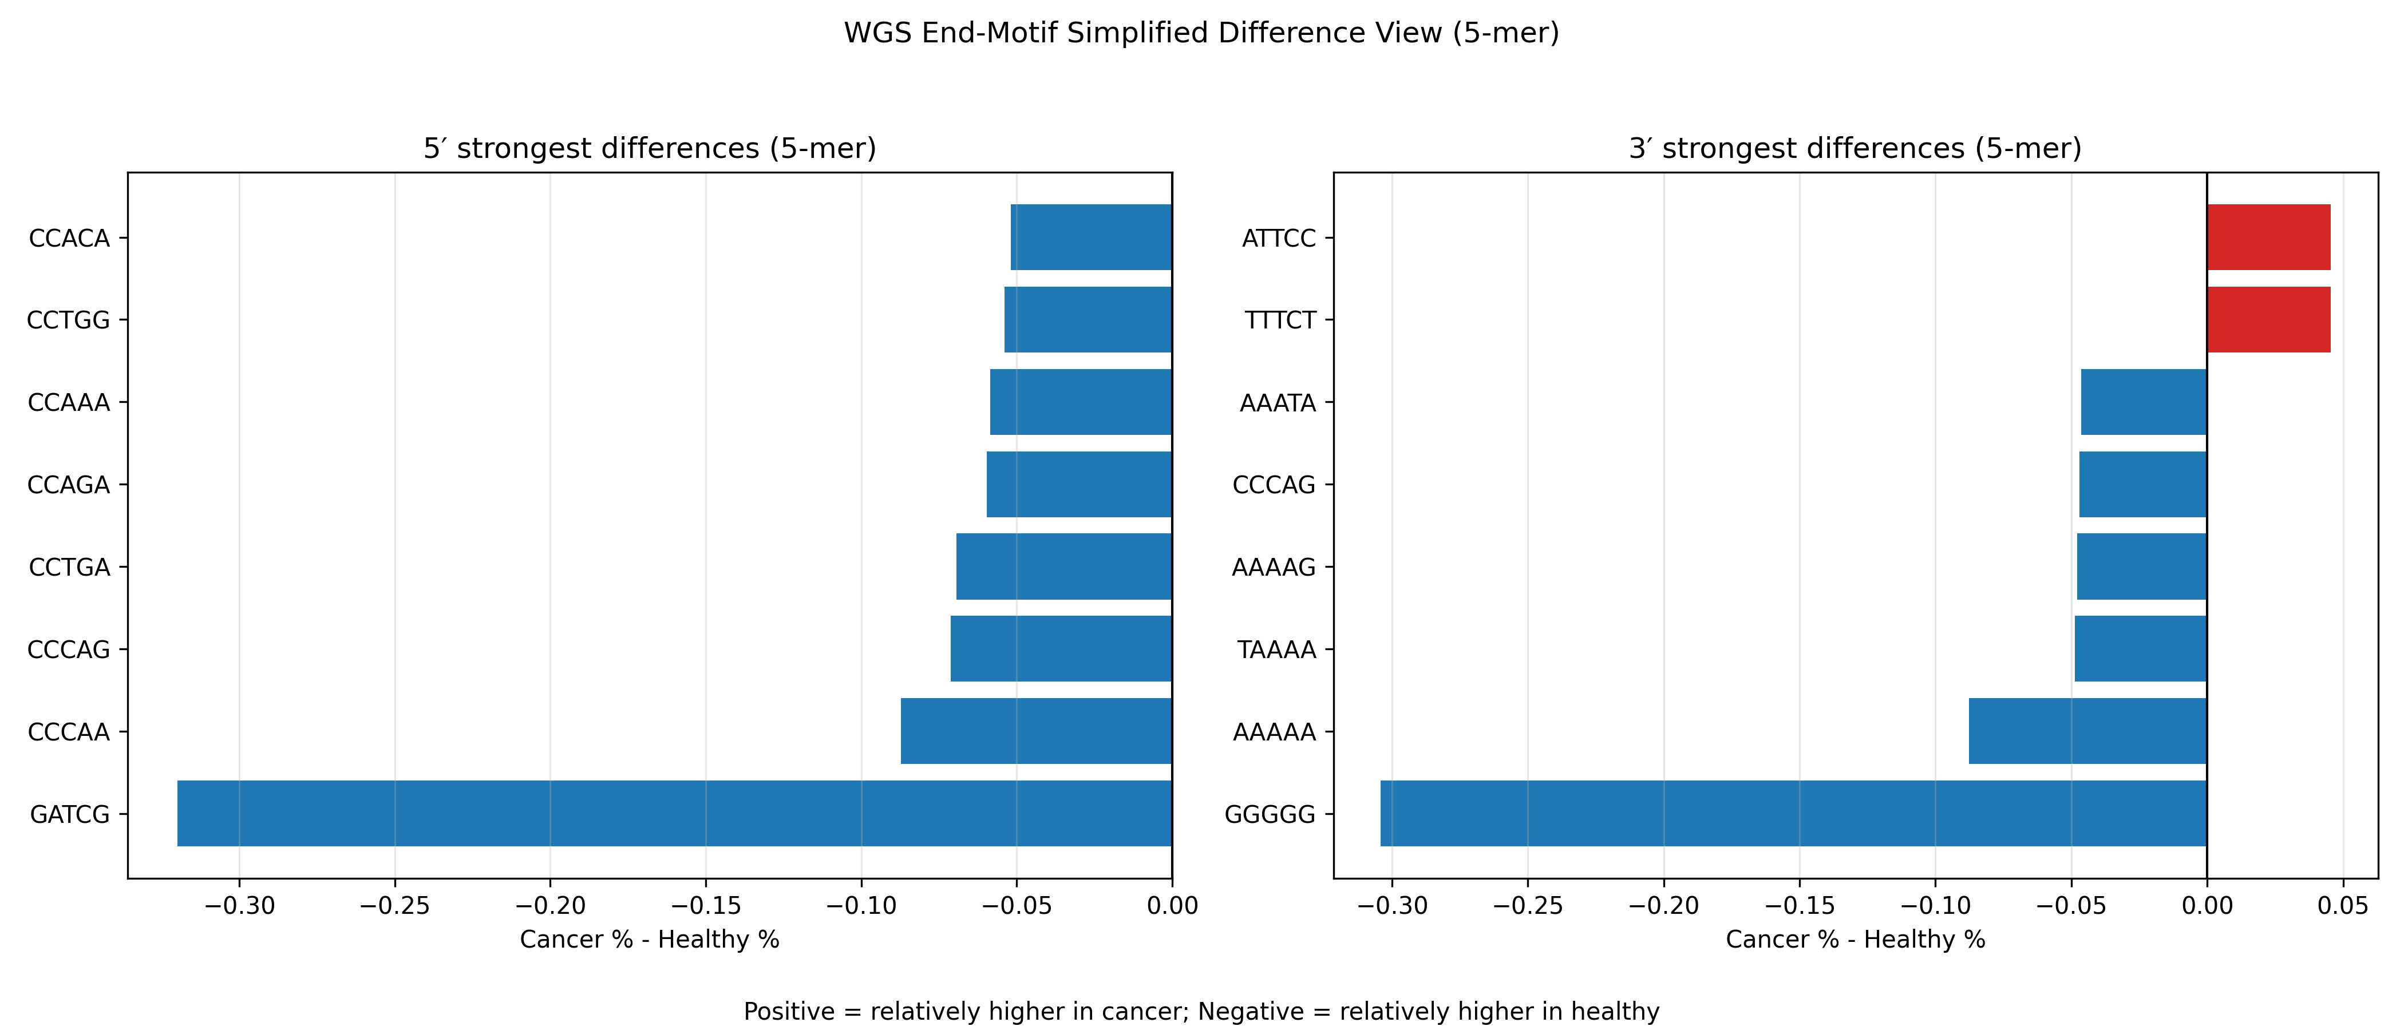
Simplifies version

Slide 10
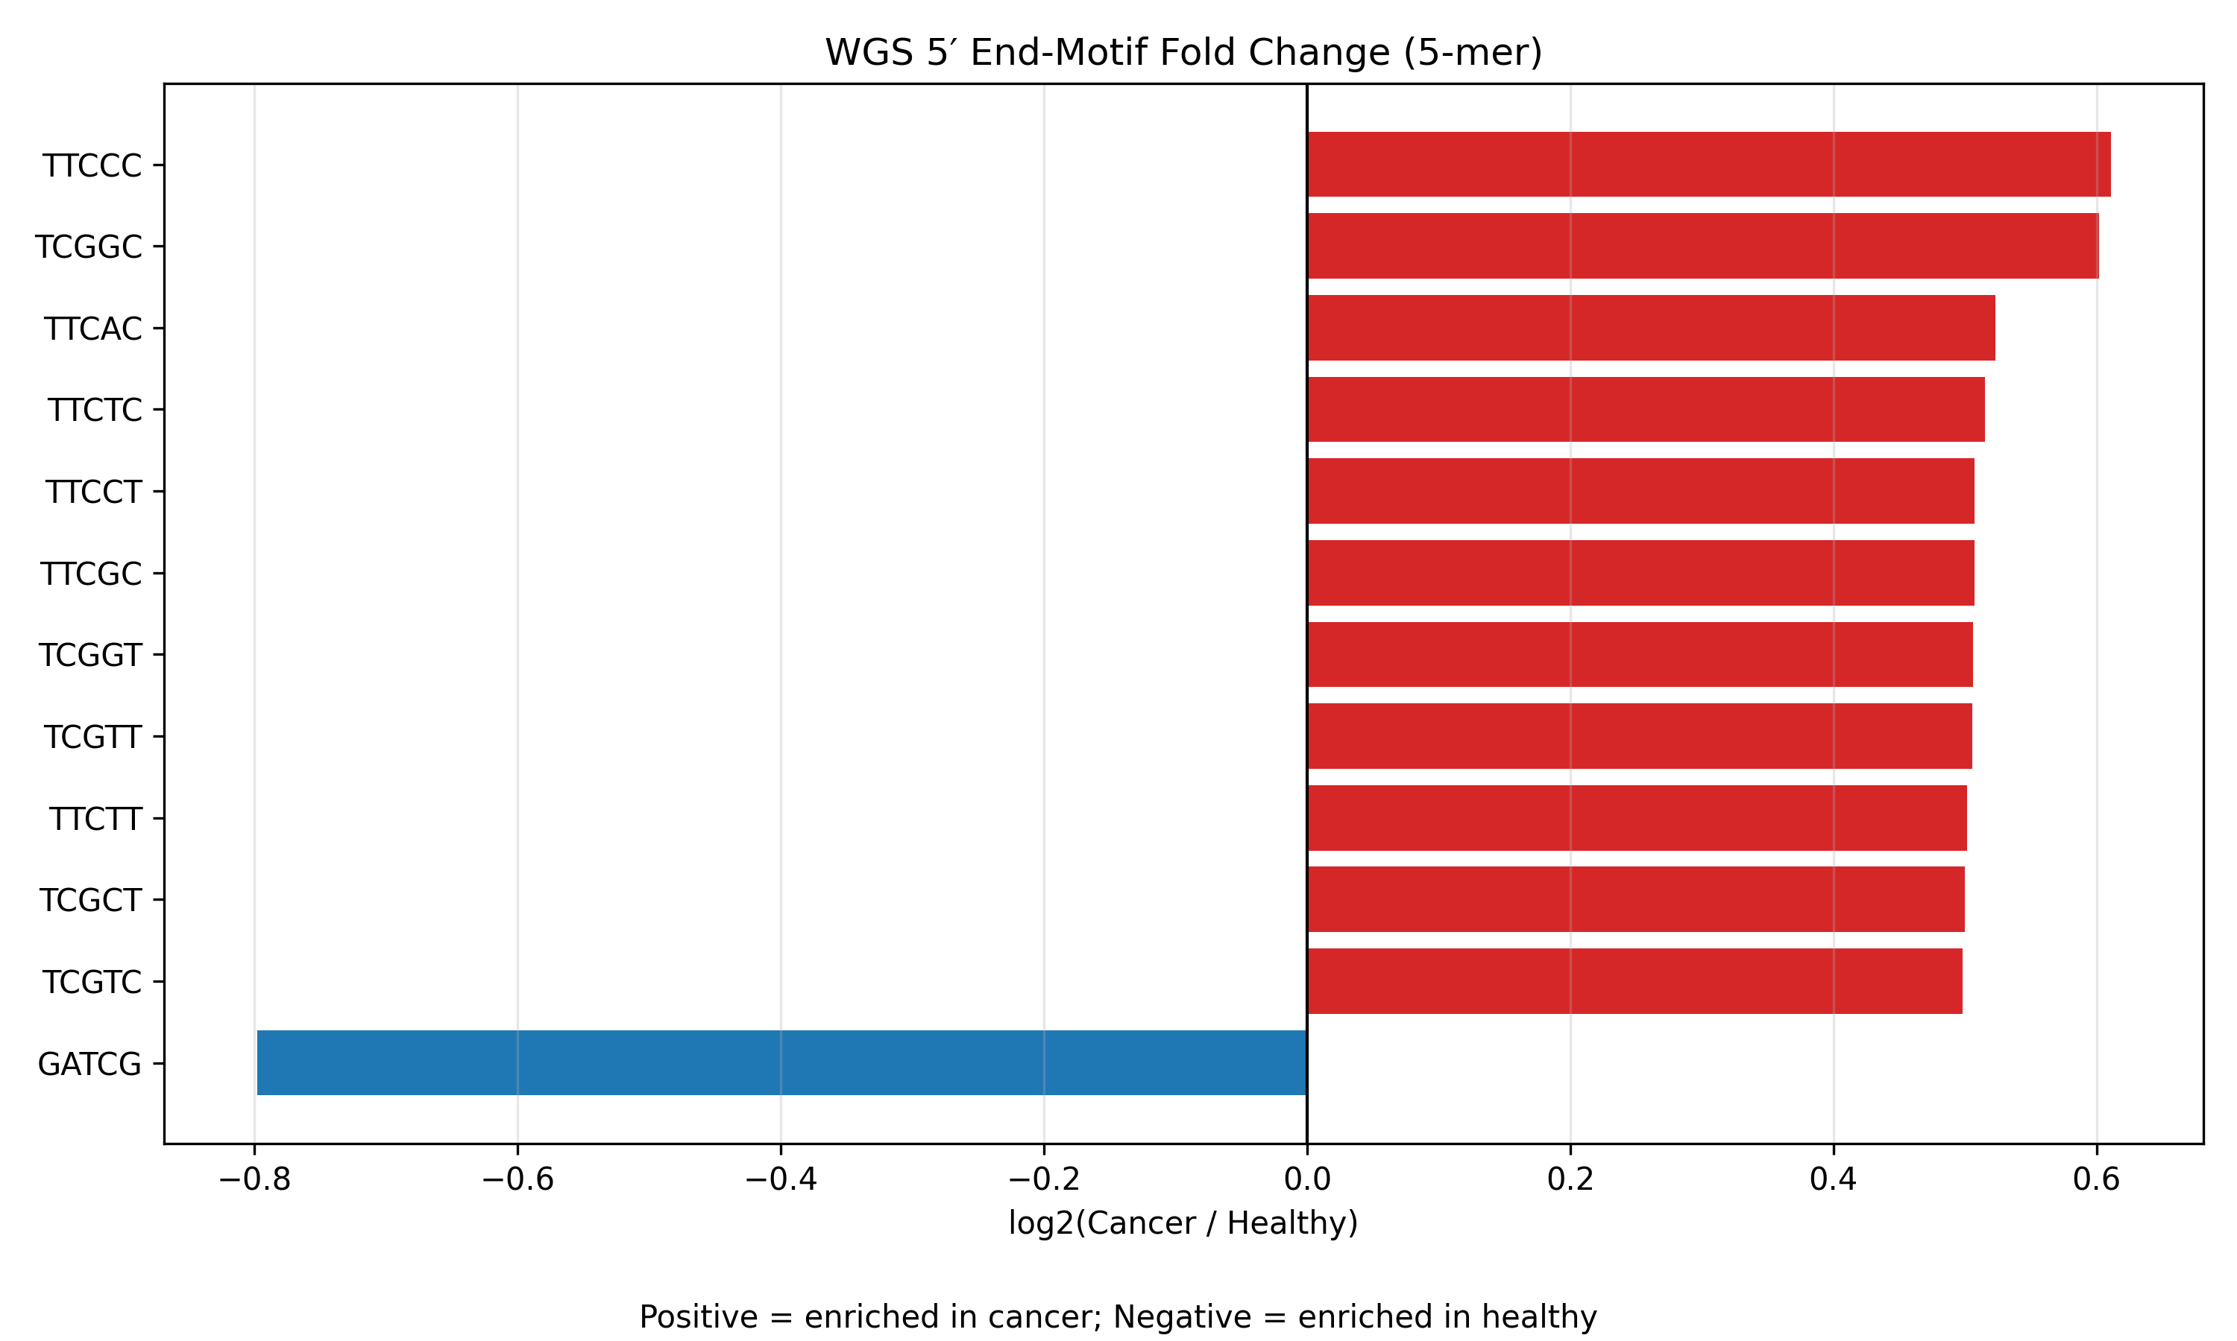
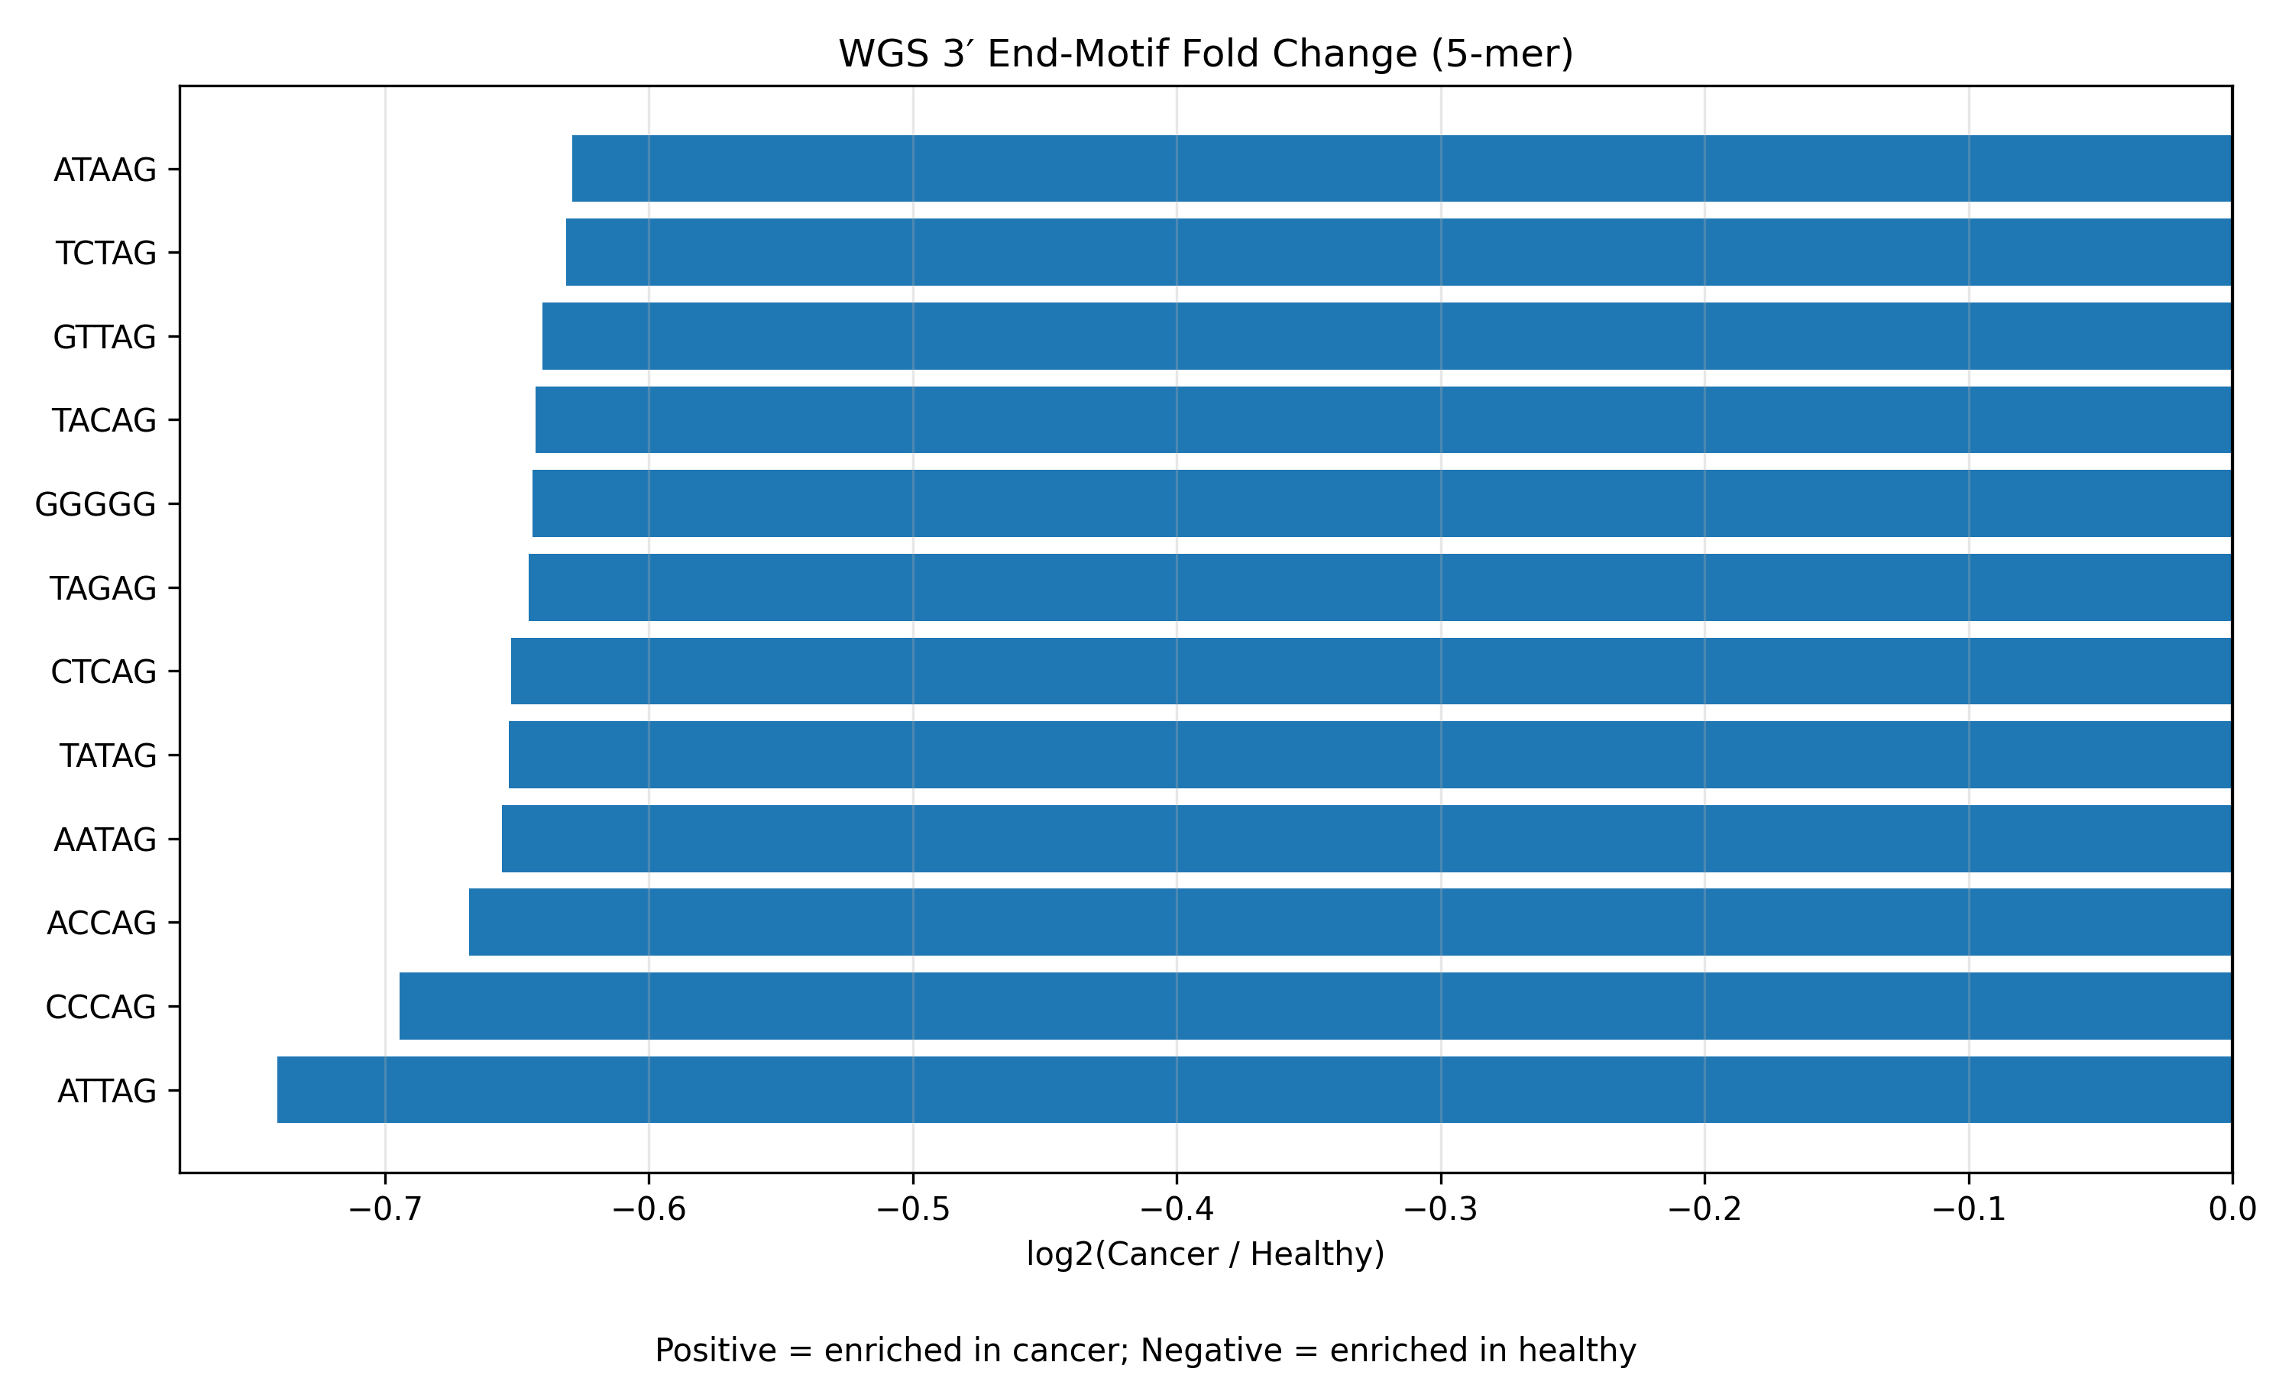
Fold Change
Fold change highlights relative increases, so even small cancer enrichments appear, while the simplified plot only shows the largest absolute differences ,this is why more cancer-enriched motifs appear in the fold change view.

Slide 11
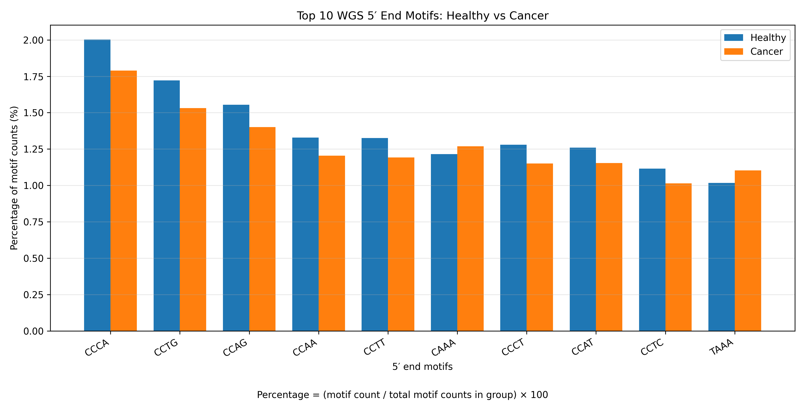
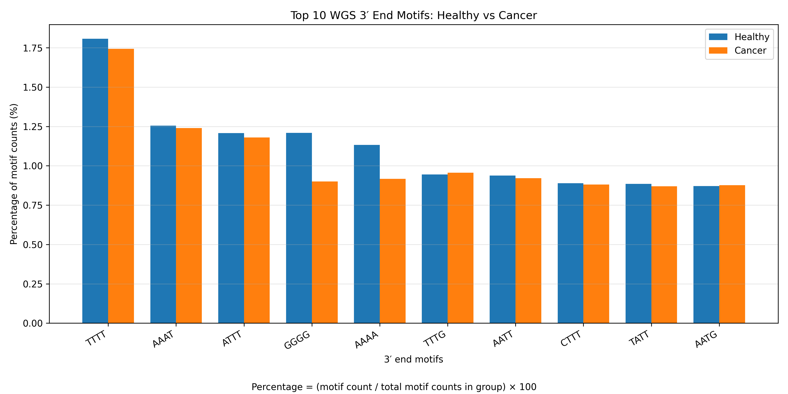
Compared with 4-mer analysis, 5-mer end-motif profiling showed clearer motif-specific differences between healthy and cancer WGS samples, particularly at the 5′ fragment end. Healthy samples were relatively enriched for motifs such as GATCG, whereas cancer samples showed relatively higher enrichment of several C/A-rich 5-mers including CCCAG, CCCAA, CCAAA, TAAAA, and AAAAA. In contrast, 3′ end differences were more modest, suggesting that the strongest discriminatory sequence signal is present at the 5′ end. 4 mers

Slide 12
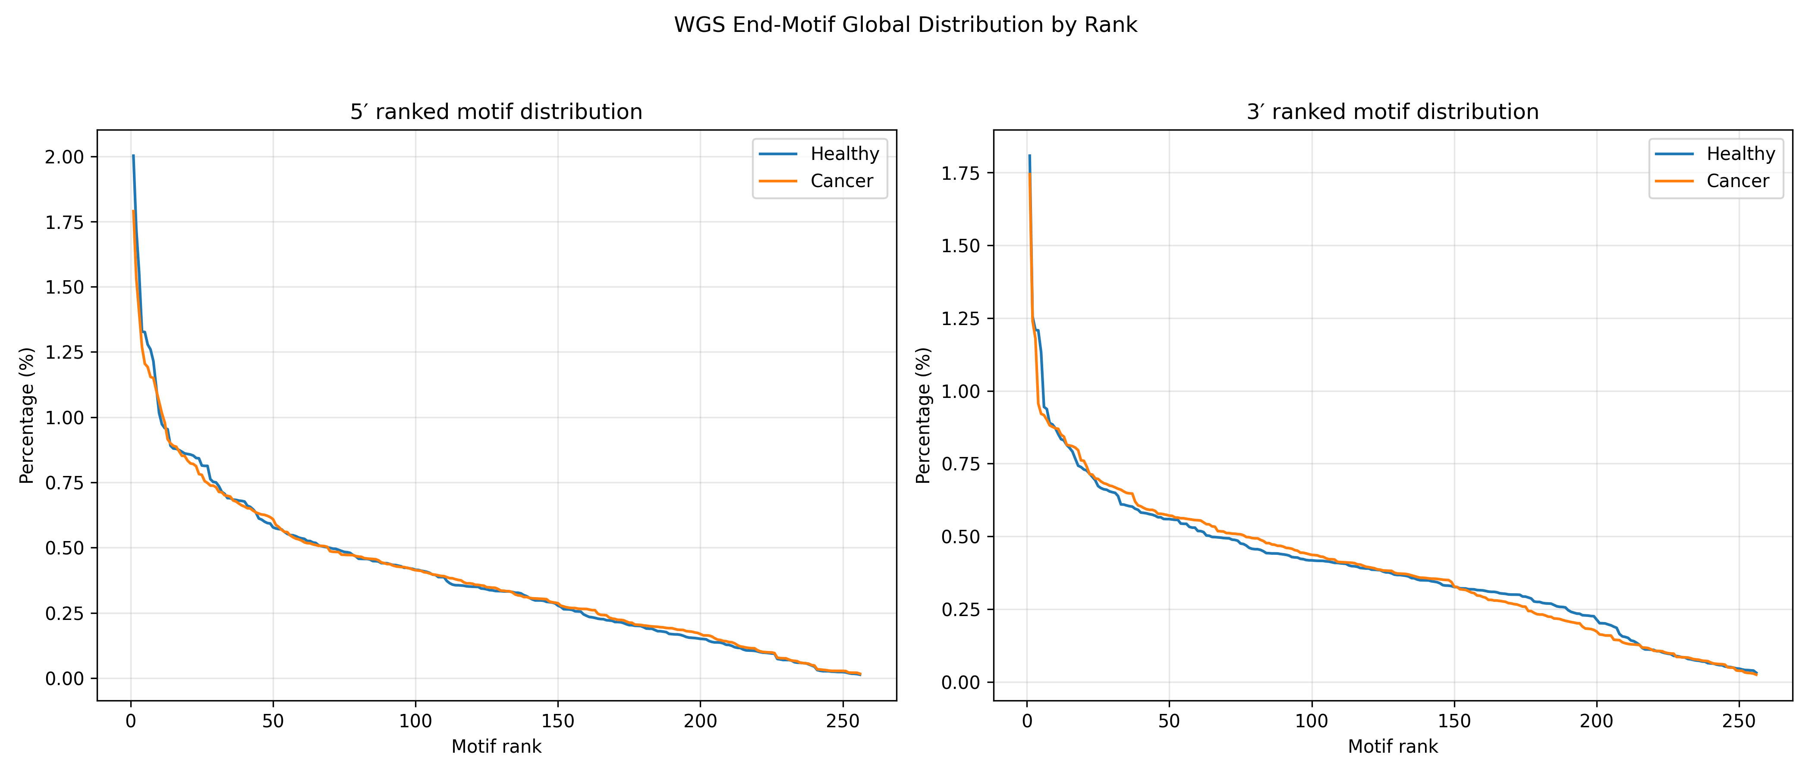

Slide 13
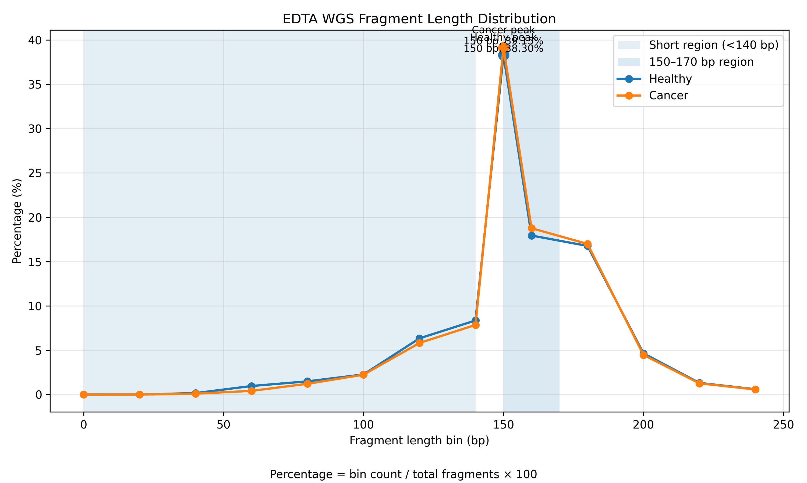
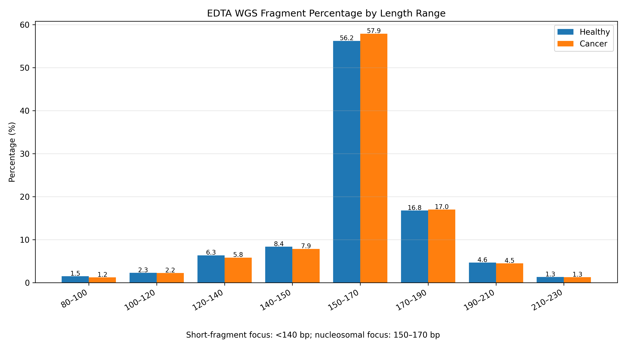
EDTA Fragment Length Distribution
Cancer samples remain tightly centered at nucleosomal length (150 bp), while healthy samples show relatively broader fragmentation with higher contribution from shorter fragments. This suggests differences in chromatin protection and fragmentation mechanisms.

Slide 14
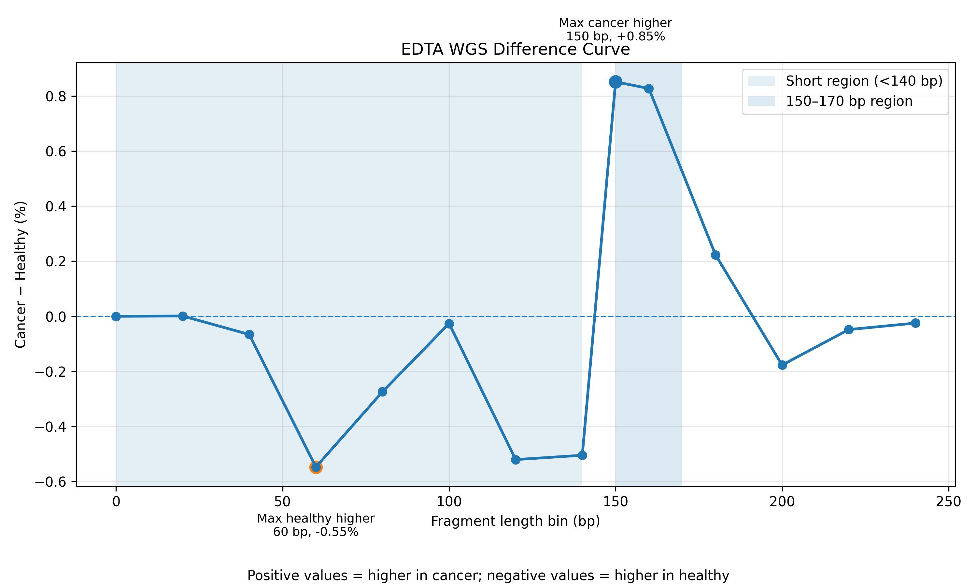
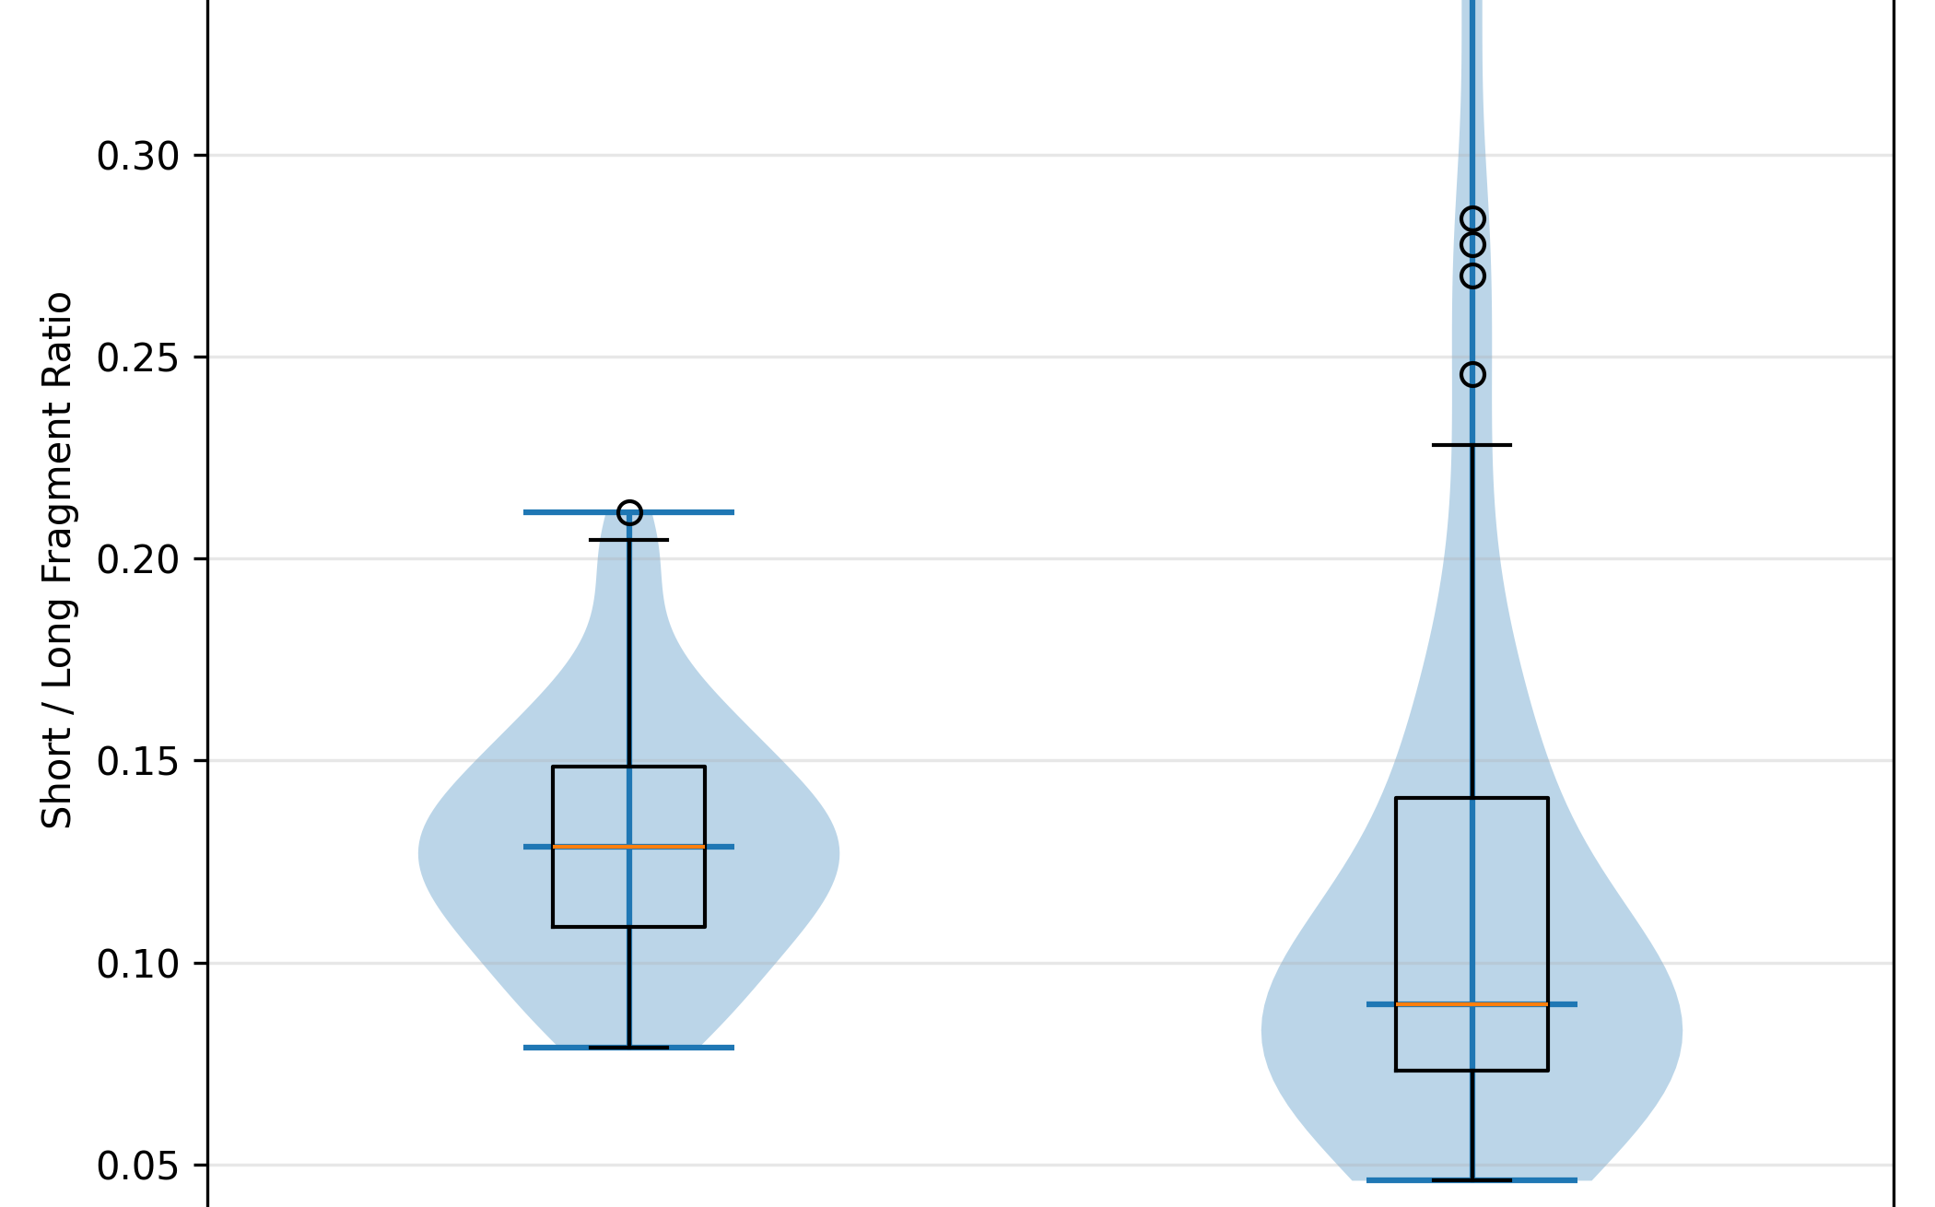
Distribution
Negative region (60–140 bp) → Healthy higher
Positive region (150–170 bp) → Cancer higher
Strongest signals:
+0.85% at 150 bp (Cancer enrichment)
−0.55% at 60 bp (Healthy enrichment)
Healthy samples show a higher median ratio (~0.13) with a relatively tight distribution, indicating consistent enrichment of short fragments across samples. In contrast, cancer samples display a lower median (~0.09) but much higher variability, with some samples extending to very high ratios (~0.35).

Slide 15
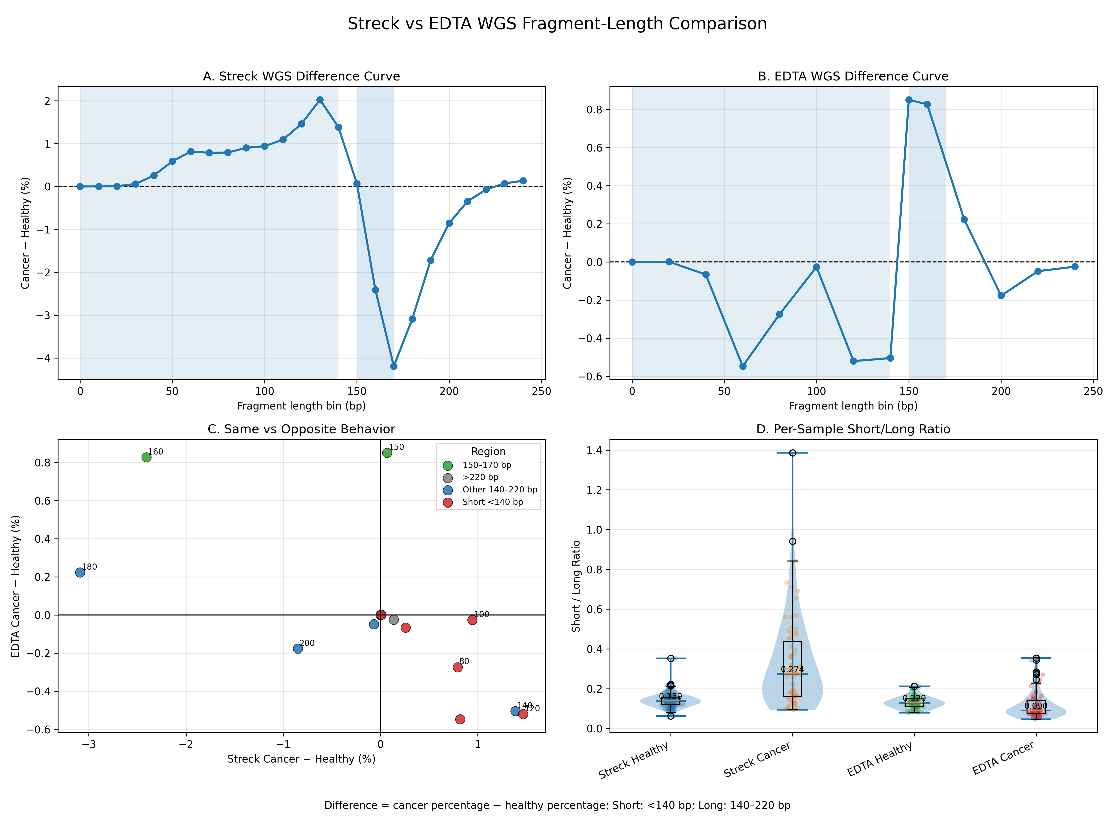

Slide 16
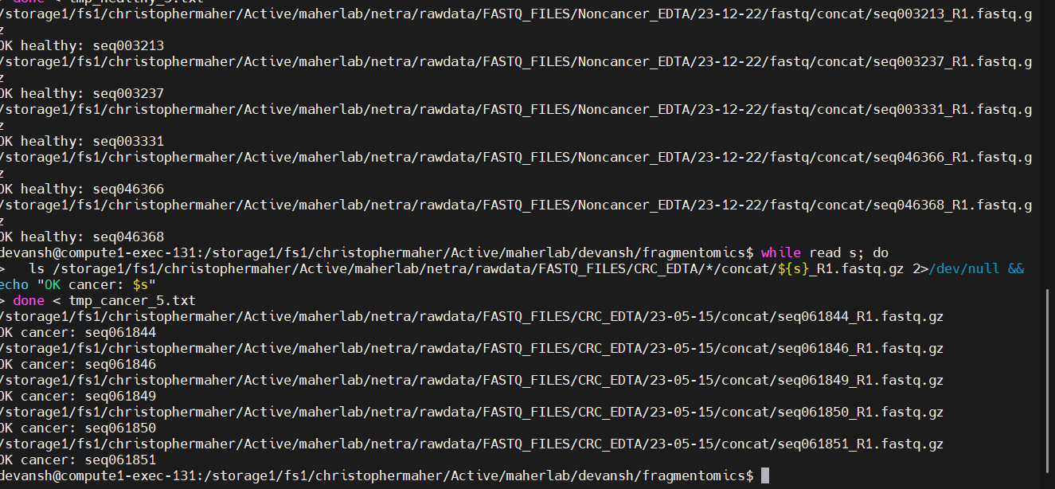
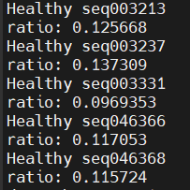
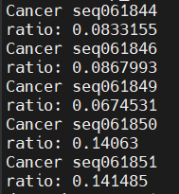
Small Sample Test
“Manual validation of individual samples confirms that healthy samples consistently show higher short-to-long fragment ratios than cancer samples in the EDTA cohort. This contrasts with the Streck cohort and reflects increased variability and potential background DNA contamination in EDTA samples rather than a labeling or pipeline error.”

Slide 17
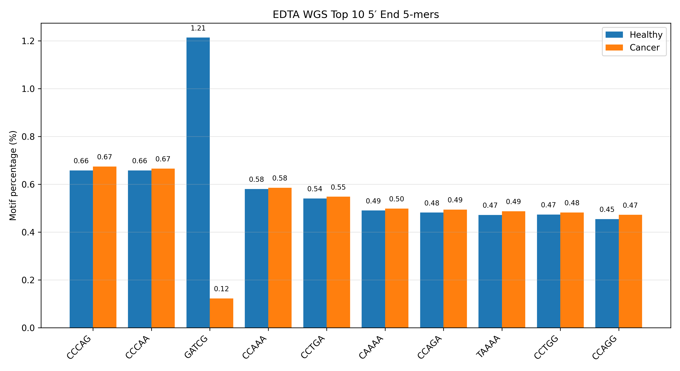
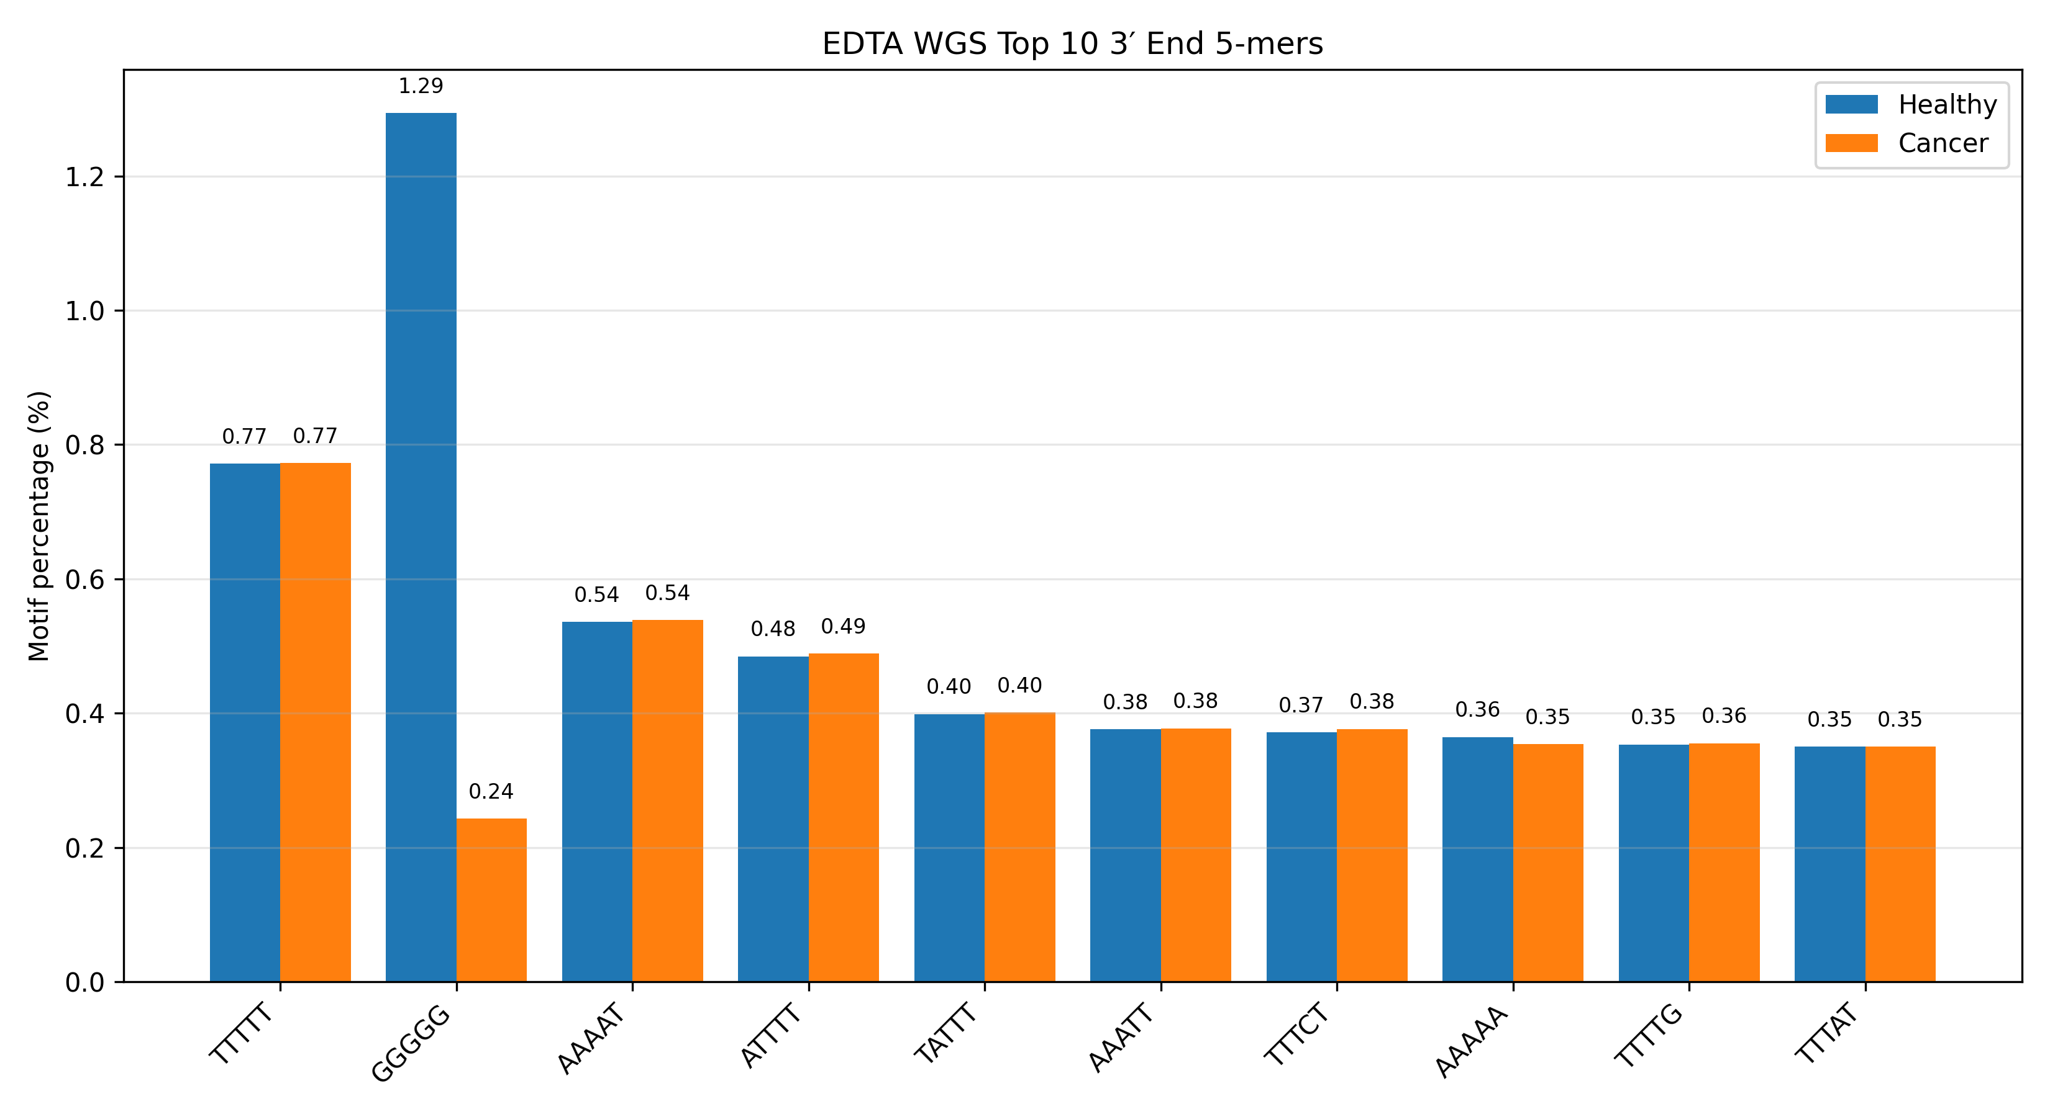
EDTA end Motifs (5-mers)

Slide 18
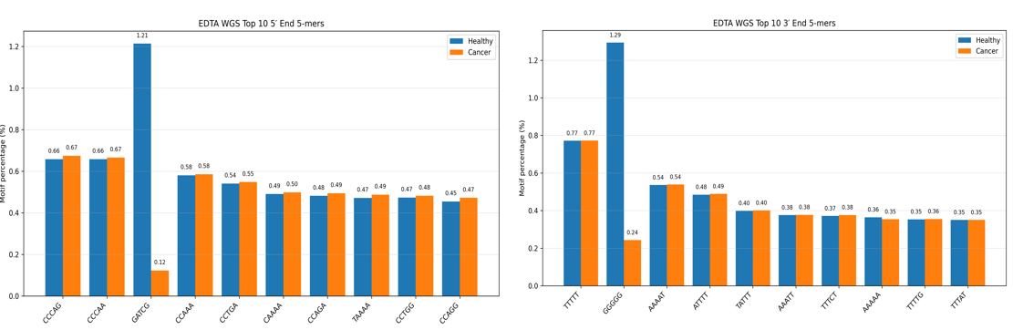
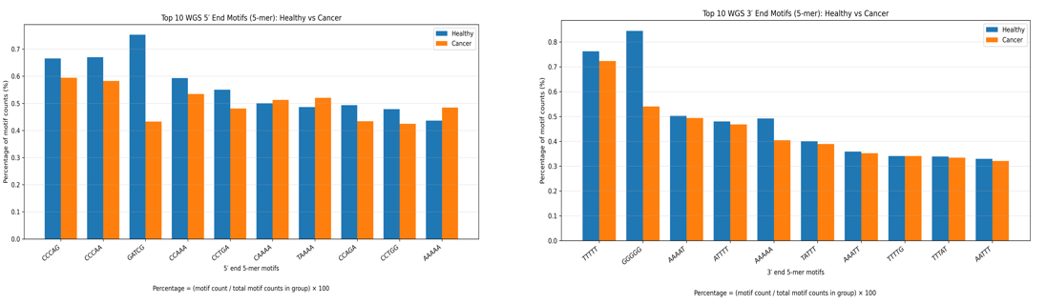
EDTA vs Streack
EDTA
Streack

Slide 19
3′ TCTCA
This motif is not dramatically more common overall, but the fragments carrying it are shifted longer in cancer by about 3–4 bp. Because fragment lengths vary widely within each group, the standardized effect size remains small, so the two groups still overlap heavily. However, published cfDNA fragmentomics studies show that shifts of only a few base pairs can still be diagnostically meaningful when they are consistent and embedded in broader fragmentation pattern

