Slide 1




Self-Supervised Few-Shot Reinforcement Learning for Scalable and Adaptive Anomaly Detection in Edge-Based Industrial IoT Systems
STUDENT: Ng Kien Loong (TP078627)
Supervisor : Assoc. Prof. Dr. Raja Rajeswari
Co-supervisor : Assoc. Prof. Dr. V. Sivakumar
September 2025

Slide 2



Industrial IoT (IIoT) and Anomaly Detection
IIoT growth
Challenges
Limitations of traditional anomaly detection
Smart factories & connected devices enable real-time monitoring & decision-making
Anomalies such as equipment failures, sensor faults, or cyber-attacks can cause downtime & high costs
Needs large labeled datasets (expensive, impractical)
Usually centralized, high latency, unsuitable for edge devices
Poor at handling dynamic and evolving anomalies

Slide 3
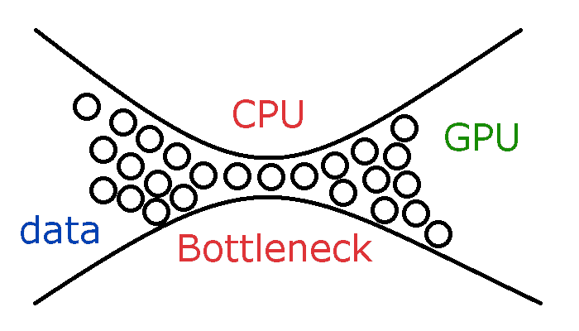
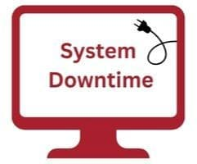
Challenges in Current IIoT Anomaly Detection
Dependence on labeled data
Industrial anomalies are rare & labeling is costly
Limits scalability in real-world IIoT
Centralized model limitations
Cloud-based approaches = high latency & poor scalability at the edge
Resource-hungry → not suitable for lightweight devices
Static models
Trained on historical data → fail to adapt to evolving industrial processes
Reduced reliability over time

Slide 4
Key Research Questions
How can the system detect new and evolving anomalies with minimal labeled data?
How can self-supervised and few-shot reinforcement learning improve anomaly detection in IIoT?
What ensures the scalability and efficiency of the framework in resource-limited edge devices?
Research Questions
How does this method compare to conventional techniques in terms of accuracy, latency, and adaptability?
Who benefits the most from this framework in real-world industrial settings?

Slide 5
Research Aim and Objectives
Enable fast adaptation to new or evolving anomalies
Ensure scalability and efficiency in edge devices with reinforcement learning
Improve anomaly detection with limited labeled data
To design a scalable, adaptive, and data-efficient anomaly detection framework for edge-based IIoT using Self-Supervised Learning (SSL), Few-Shot Learning (FSL), and Reinforcement Learning (RL)
Reduce dependence on large centralized systems
Demonstrate real-world applicability through experiments and comparisons

Slide 6

Proposed SSL + FSL + RL Framework
Self-Supervised Learning (SSL)
Few-Shot Learning (FSL)
Reinforcement Learning (RL)
Learns robust feature representations from unlabeled data
Classifies anomalies with minimal labeled samples
Handles rare or novel anomalies
Provides continuous adaptation over time
Optimizes decisions (e.g., update prototypes, request feedback, detect new classes)
Benefits
Data-efficient (uses fewer labels)
Scalable (smaller model size)
Adaptive (learns continuously at the edge)

Slide 7
Research Methodology
1. Data Acquisition
SOLDEF PCB dataset (defect detection)
Synthetic IIoT data via simulations
Preprocessing: normalization, noise filtering, semi-automated labeling
Dataset citation:
https://www.mdpi.com/2504-4494/8/3/117
2. Model Development
SSL: Contrastive learning for feature representation
FSL: Prototypical networks for few-shot classification
RL: Q-learning for continual adaptation
3. Experiment Setup
Simulated edge environments using Docker (CPU & memory limits)
Consumer-grade GPUs/CPUs for training/testing
4. Evaluation Metrics
Accuracy, Precision, Recall, F1-score
Training time & computational efficiency
Scalability & adaptability under edge constraints

Slide 8
Results – CNN vs SSL + FSL + RL
 | CNN | SSL + FSL + RL
Accuracy | 78.0% | 72.5% (~93% of CNN performance)
Labeling Efficiency | 252 labeled samples | 32 labeled samples (87% reduction)
Training Time | ~15 minutes (CPU) | <1 minute (CPU)
Model Size | 42.6 MB | 11.7 MB (3.6× smaller)
For more details:
https://github.com/Daavidng/project/blob/main/README.md

Slide 9

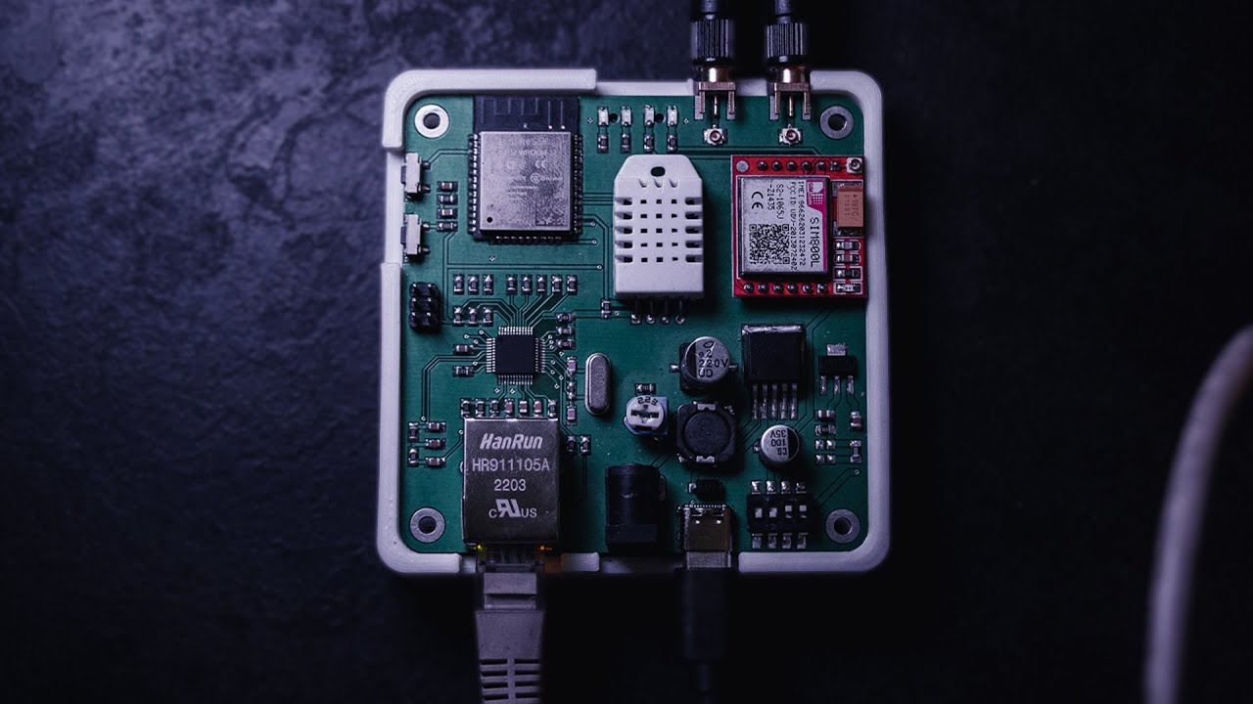
Research Limitations
Dataset Constraints
Evaluated mainly on one dataset (PCB defects)
Generalization to other IIoT domains still uncertain
Training Setup
SSL pretraining limited (short epochs)
Few-shot setup fixed (5–8 shots per class)
Evaluation Environment
Tested in CPU + Docker simulations, not real edge hardware
Quantization impacts estimated, not fully measured
Metrics & Scope
Long-term RL adaptation not yet tested under real distributional drift

Slide 10

Conclusion & Future Work
Conclusion
SSL + FSL + RL framework → 72.5% accuracy, close to CNN (78%)
Requires 87% fewer labels (32 vs 252)
3.6× smaller model, 15× faster training
RL enables continual adaptation to new anomalies
Practical for resource-constrained edge IIoT systems
Future Work
Extend SSL pretraining and explore new methods
Conduct systematic experiments
Validate on real edge hardware (Raspberry Pi, Jetson Nano)
Apply compression (quantization-aware training, pruning)
Test long-term RL adaptation with human-in-the-loop

Slide 11
Q&A

