Slide 1


Nomination for Business Excellence Award

Slide 2

Project Savings: BDT 4,690,445.00
Nomination Category: Innovation Excellence
Project Name: Tyre Retreading
Project ID: SCM-LOG-014
Project Lead: Dabajit Paul
Team Members incl. Position Title: Mohammad Khorshed Alam
(Assistant Executive-Workshop)
Notes:
© Copyright Showeet.com – Free PowerPoint Templates

Slide 3
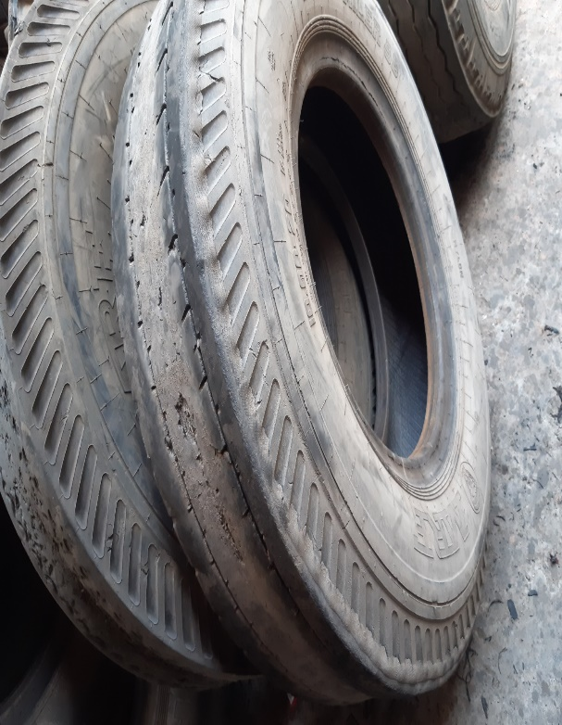
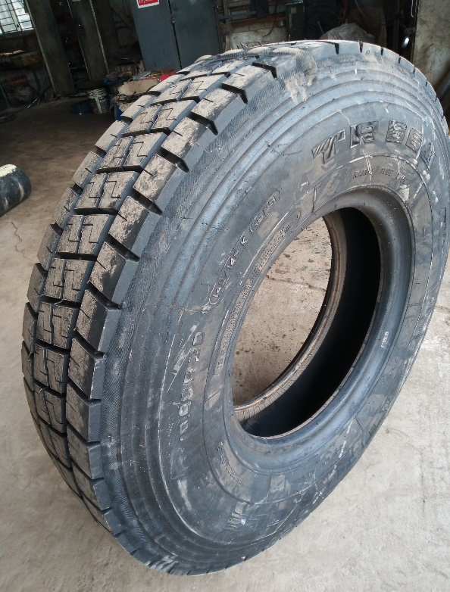
What is Tyre retreading
A worn casing of tyre that has a good structural quality is taken off the vehicle and is given a renewed tread. After that, the revamped tyre is processed forward for a curing process in which the new rubber is vulcanized to the original casing and hence the tyre gets a newly made tread pattern.
Notes:
© Copyright Showeet.com – Free PowerPoint Templates

Slide 4
Brief description of initiative
Tyre is a very essential and mostly consumed item in fleet operation. Each year we need to purchase a big volume of tyre for our own fleet to replace old and damaged tyre frequently. In earlier we only replaced new tyre while required but we didn’t consider to reuse the tyre by retreading. The initiative was taken since July 2020 to re-utilize of old tyre by retread that reduced the tyre operating costs significantly. Retread is a process of which we may optimize tyre utilization; reduce waste and savings of cost as well. Our objective is to retread minimum 15-20% tyre against total volume regularly.
Notes:
© Copyright Showeet.com – Free PowerPoint Templates

Slide 5
Tyre Retreading Process
Collection of Tyres
Initial Inspection at site
Vendor Selection
Buffing after inspection
Curing by chamber
Building-tread rubber
Cementing and filling
Section repairing
Final inspection
Notes:
© Copyright Showeet.com – Free PowerPoint Templates

Slide 6
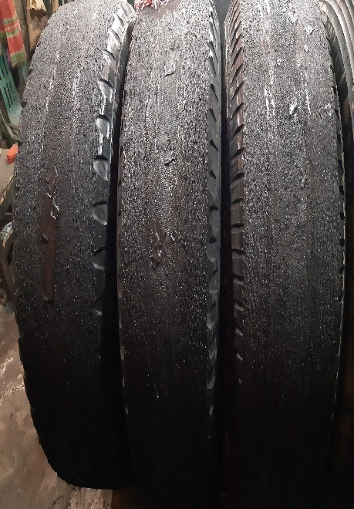
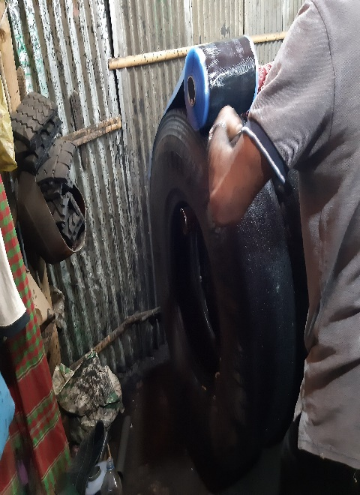
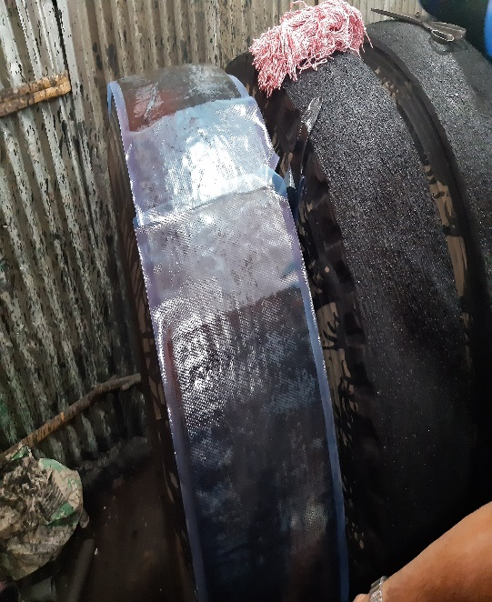
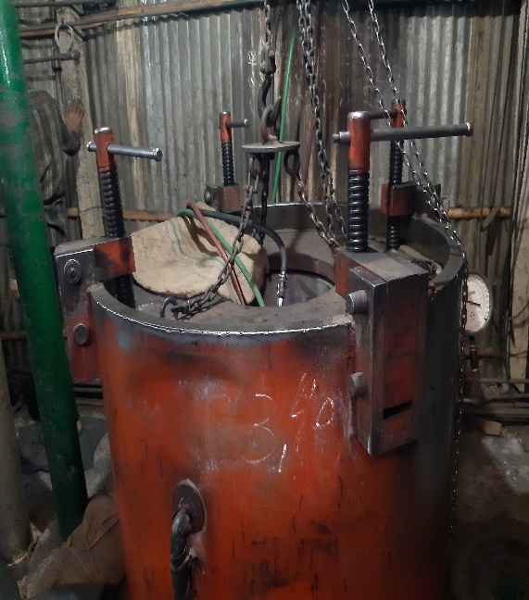
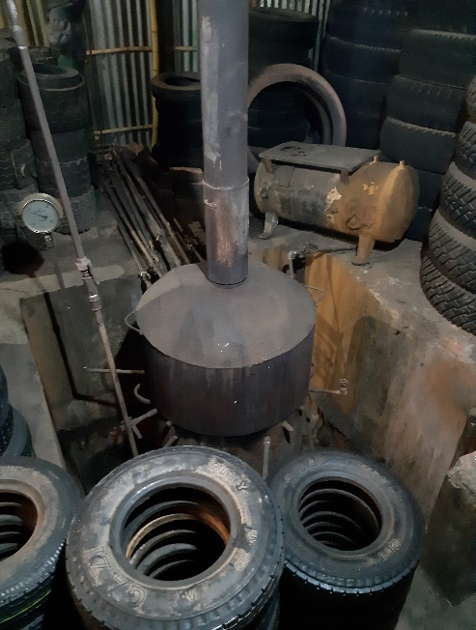
Tyre Retreading Process
Notes:
© Copyright Showeet.com – Free PowerPoint Templates

Slide 7


Tyre Retreading Process
Before Retreading
After Retreading
Notes:
© Copyright Showeet.com – Free PowerPoint Templates

Slide 8
Deliverables through this project
.
A new dimension of tyre utilization and hence reduce waste.
Cost reduction: 14%
% of tyre cost in terms of total maintenance cost (2019-2020): 53%
% of tyre cost in terms of total maintenance cost (2020-2021): 39%
iii) Consumables reduction: 18%
No. of new tyre issued (2019-2020): 1289
No. of new tyre issued (2020-2021): 1057
iV) New vendor development
Notes:
© Copyright Showeet.com – Free PowerPoint Templates

Slide 9
Future Vision
.
Our future vision is to increase tyre re-utilization by retreading process. There are scopes to reduce tyre consumption if we can manage tyre management system in more definitive way.
Notes:
© Copyright Showeet.com – Free PowerPoint Templates

Slide 10
Challenges
Vendor development
Initial selection
End user attitude
Failure issue
Notes:
© Copyright Showeet.com – Free PowerPoint Templates

Slide 11
Mitigation process
Vendor development: Meeting; visit; counseling; procurement
Initial selection: Good eye patch; Training
End users attitude: Motivation
Failure rate: discussion, findings, warranty policy
Notes:
© Copyright Showeet.com – Free PowerPoint Templates

Slide 12
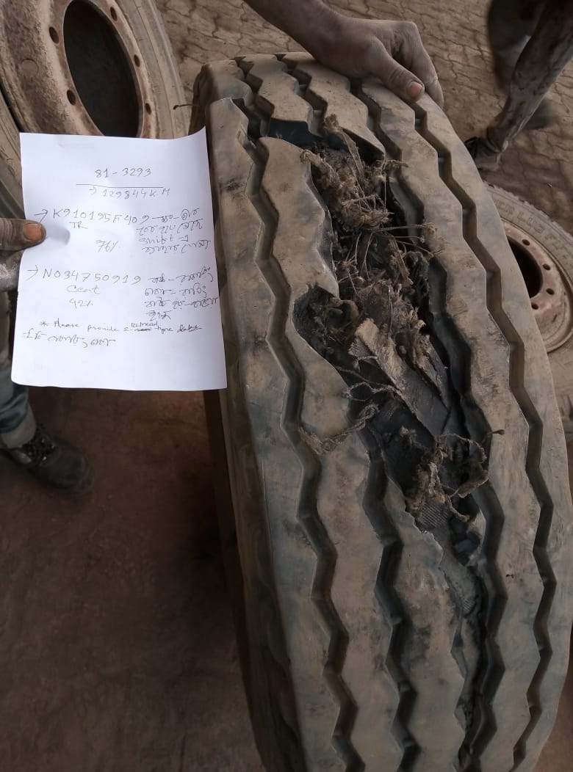
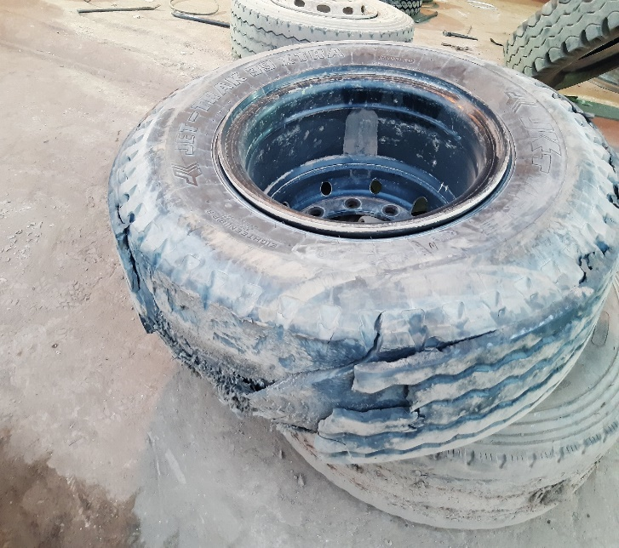
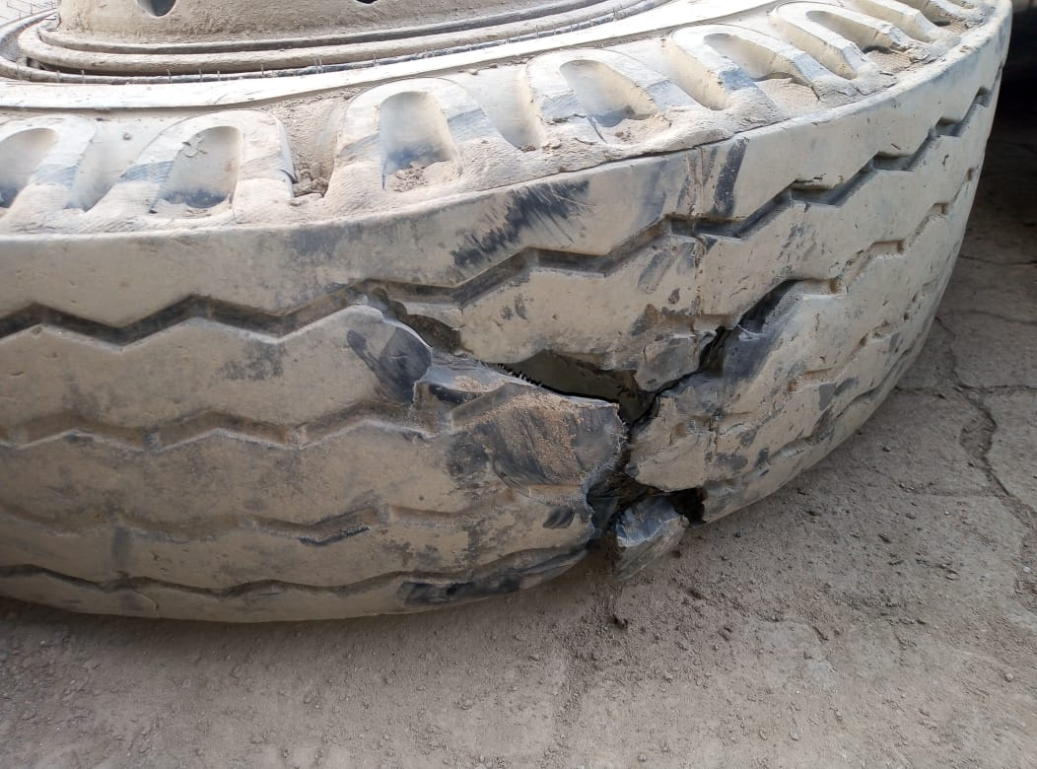
Some of the failures snapshot
Failures may occur due to unseen leak; main casing inflation, operational issue etc.
Notes:
© Copyright Showeet.com – Free PowerPoint Templates

Slide 13
Thank you
Notes:
© Copyright Showeet.com – Free PowerPoint Templates

