Slide 1
Summer Internship Project Presentation
Gaurav Dabas

Slide 2
To Analyse text documents and create a knowledge graph based querying capability on drilling documents.
Expectation from the project:
Processing raw data to structured data in the forms of entity and relations to create a semantic knowledge graph.
Creating a framework that is capable of retrieving answers from the knowledge graph when queried in natural language form.

Slide 3
Methodology
Given some data (mostly unstructured), after processing the data, we acquire useful information by using Named Entity recognition and Relation Extraction.
Using this structured data, we model our knowledge graph model and enable embedding of rich semantic data.
Finally for querying the data, natural language questions are translated into executable queries for answer retrieval.
Timeliness – 5 days ( As I had to study courses on NLP from scratch on udemy and coursera)

Slide 4
Process Flow
Extracting Entities
Extracting Relations
Creation of Knowledge Graph
Querying the graph

Slide 5
Extracting Relations and Entities
Tried various libraries such as StanfordNLP, nltk, spacy for the following task.
Finally, Extracted entities and relations from the text using Spacy library in Python.
Used the POS (parts of speech) tagging feature of the library.
Recognized subject, object and predicate (verb) from each of the sentences after tokenizing.
Created triples by combining all three of these.
Timeliness – 5 days ( As had to change the approach as first ones did not comply with the further needs even though it gave better results )

Slide 6
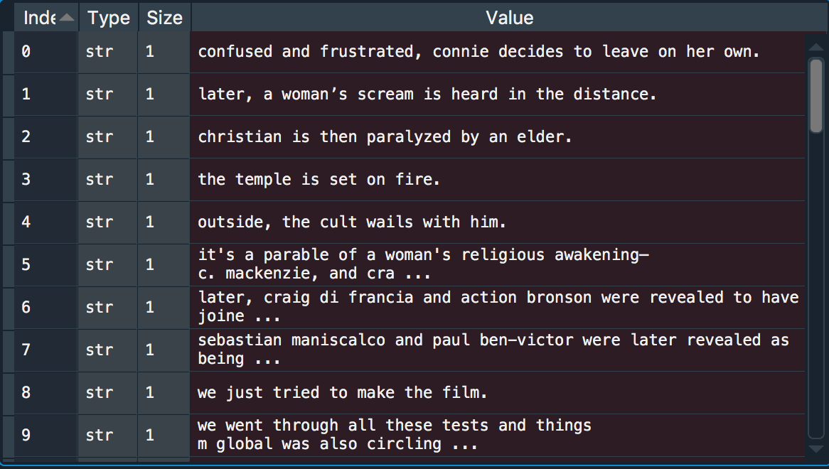
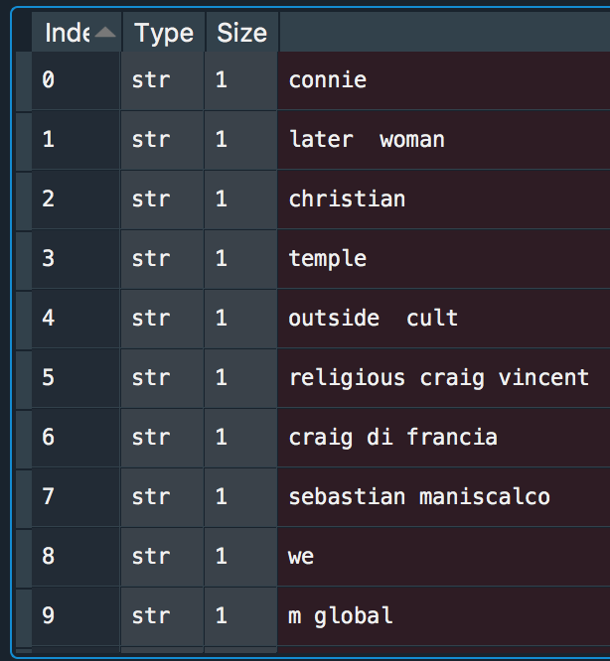
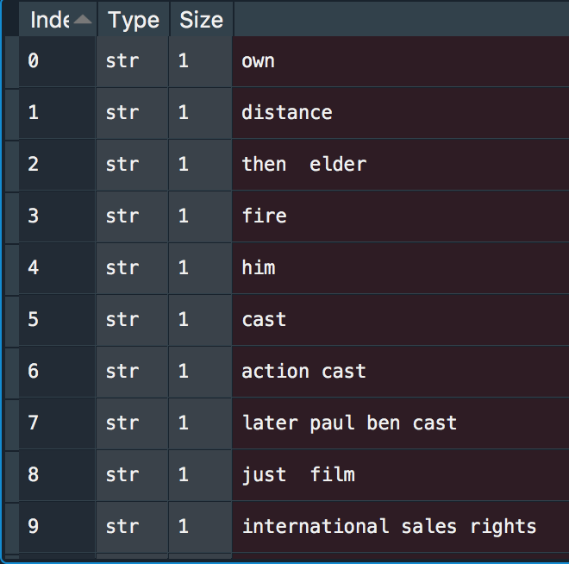
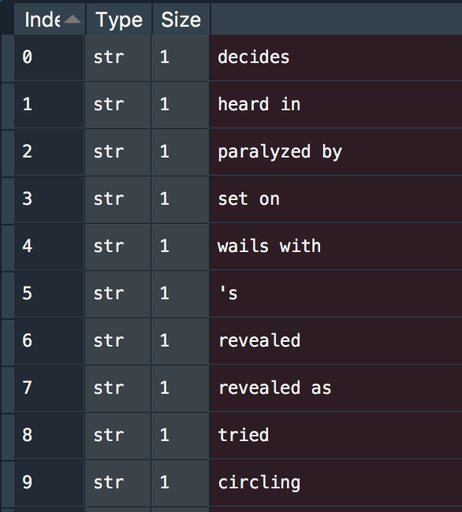

Slide 7
Creation of Knowledge Graph
Tried different libraries for this such as RDFlib, neo4j etc. But they could not comply with my preferred way of querying the graph.
Finally, Networkx library in python was used to create a knowledge graph out of the triples formed in the last slide.
The graph was a directed graph from one node (subject) to another (object) with edge representing the relation.
Matpotlib library was used to plot the graph as shown in the next slide.
Timeliness – 3 days

Slide 8
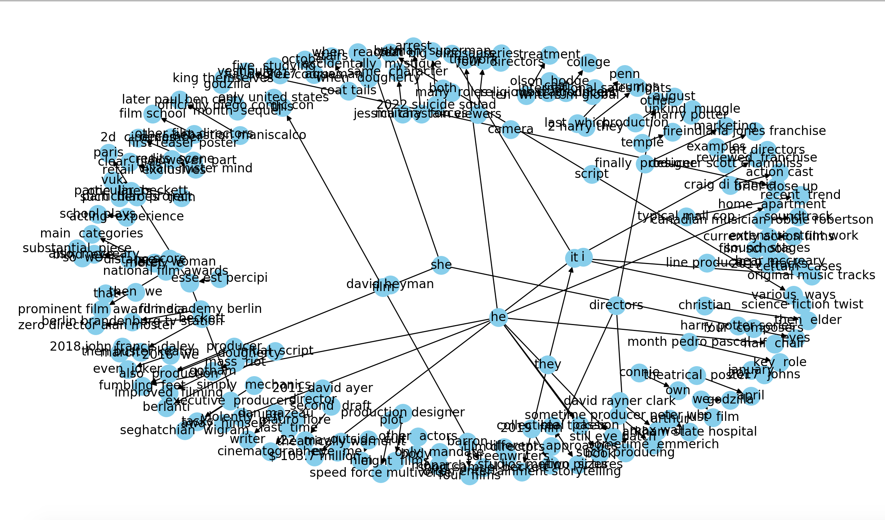

Slide 9
Querying the graph
Tried different complex frameworks to convert natural language to queries like quepy but did not work.
Finally adopted simple way . The same procedure was used to convert the question into triples as the sentences were converted.
Using this, we searched the graph for the corresponding node using which we could extract the full relation and hence reach the sentence in the initial documents.
It has many limitations which only complex frameworks can solve.
Timeliness – 2 days

Slide 10
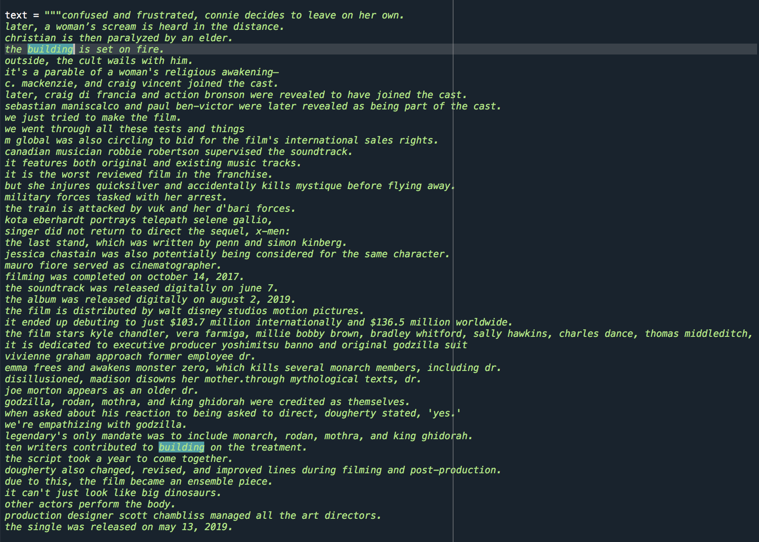


Slide 11
Scope of improvements
The Triples extracted are less rich in semantic embedding which could be enhanced by using StanfordNLP library as it has properties such as coreference etc.
The project was mainly done by concentrating on textual data and can be improved to take into account tabular and other type of data too.
The graph can be created using neo4j and RDFlib library so that there is better question answering as they support query language retrievals.

