Slide 1
Bike Rental Demand Forecasting
Person A - Dhruv Talavat (PES1UG24AM087)
Problem - Dataset - EDA - Preprocessing - Baseline
Featurization aligned to Du, He & Zhechev (reference paper)

Slide 2
Problem Statement
Bike-share operators must match hourly supply to demand.
Too few bikes at rush hour = lost rides; too many = wasted docks.
Goal: predict hourly rentals (cnt) from calendar + weather features.
Supervised regression on 2 years of hourly data (2011-2012).
Primary metric: RMSLE (log-scale) - same as the Kaggle competition
in the reference paper; also report RMSE / MAE / R2.

Slide 3
Dataset Overview
Source: UCI Bike Sharing Dataset - hourly file (17,379 rows).
Period: 2011-01-01 to 2012-12-31, Capital Bikeshare (Washington D.C.).
Target: cnt = casual + registered rentals per hour.
Calendar features: season, yr, mnth, hr, weekday, holiday, workingday.
Weather: weathersit, temp, atemp, hum, windspeed (normalized).
Note: casual + registered == cnt, so both are excluded (leakage).

Slide 4
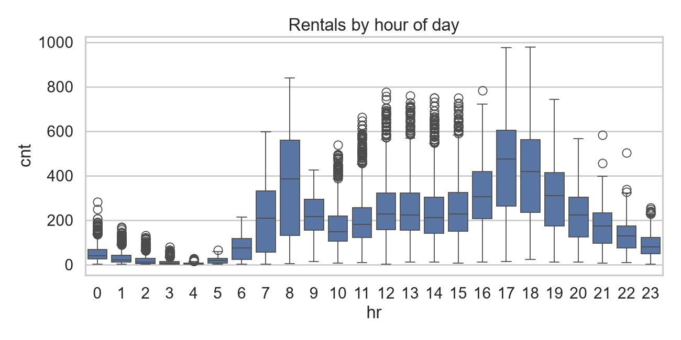
EDA - Rentals by Hour of Day
Bimodal commute pattern: peaks at 8 AM and 5-6 PM on working days.

Slide 5
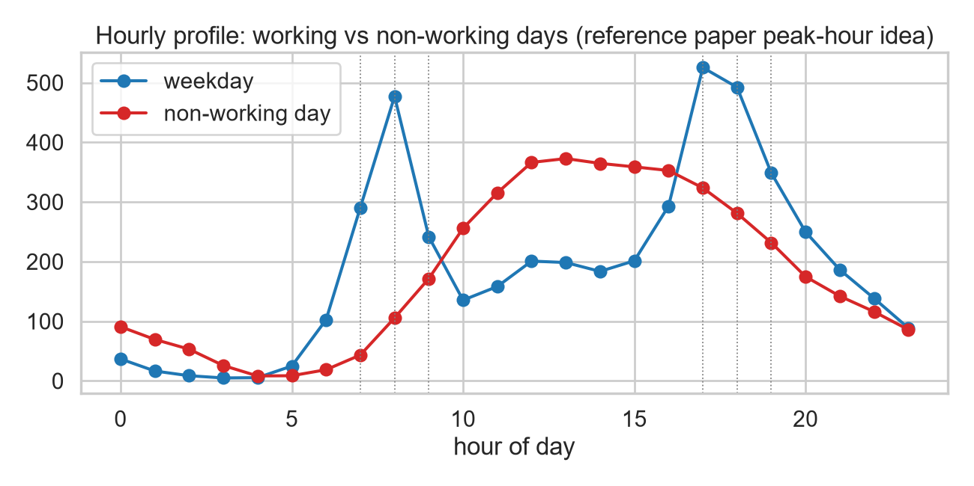
EDA - Weekday vs Weekend Peak Hours (paper-aligned)
Validates the paper's peak-hour idea: weekday 7-9 AM & 5-7 PM; weekend 10 AM-6 PM.

Slide 6
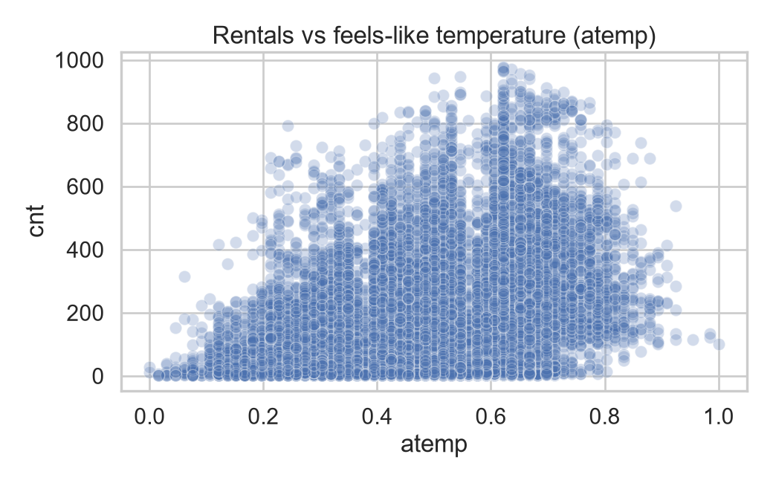
EDA - Feels-like Temperature & Humidity
Demand rises with atemp then plateaus; humidity pulls demand down.

Slide 7
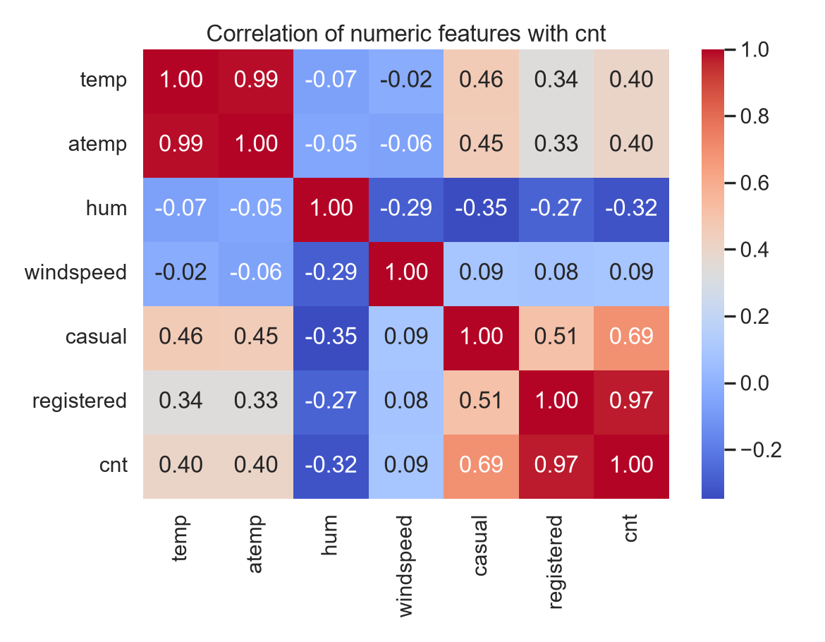
EDA - Correlation & Collinearity
temp ~ atemp are ~0.99 correlated -> drop raw temp, keep atemp (paper's choice).

Slide 8
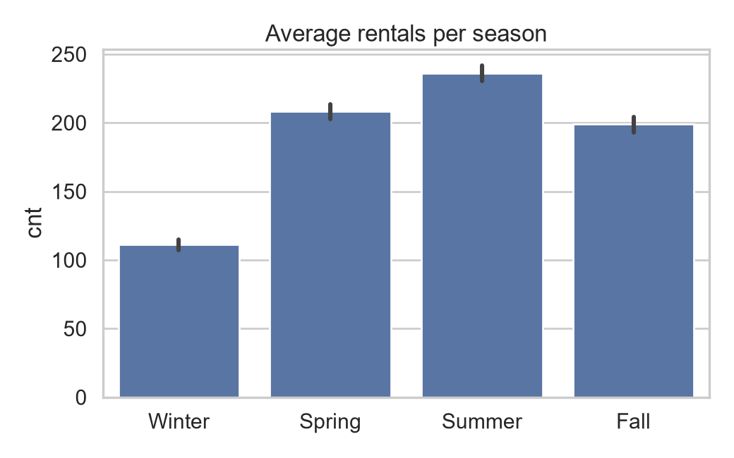
EDA - Seasonal Pattern
Peak demand in Summer and Fall; Winter is the trough.

Slide 9
Preprocessing & Feature Engineering (paper-aligned)
Discretized atemp into 4 quantile buckets: cold/mild/warm/hot.
Peak-hour buckets: weekday 7-9 AM, 5-7 PM; weekend 10 AM-6 PM.
Kept month as a feature (paper: month beats coarse season).
Dropped raw temp (collinear with atemp); kept atemp.
Cyclic sin/cos encodings for hour, weekday, month.
One-hot encoding with handle_unknown='ignore'; leakage-safe features.
Temporal split by date: train 2011-01-01 to 2012-08-07, test after.

Slide 10
Baseline Models (for Person B to beat)
Linear Regression: RMSLE 1.050 | RMSE 119.5 | R2 0.706
Random Forest: RMSLE 0.410 | RMSE 79.7 | R2 0.869
Best RF params: max_depth=None, n_estimators=400, min_samples_leaf=1
Paper's tree models: CTree CV-RMSLE 0.460, RF 0.503 - same pattern:
tree-based models dominate; plain linear models lag far behind.
Artifacts: models/baseline_model.pkl + baseline_metrics.json +
baseline_diagnostics.json (params, features, split date).

Slide 11
Summary & Handoff
Cleaned, documented, leak-free dataset with paper-aligned features.
Strong RF baseline (RMSLE 0.41) saved as the benchmark to beat.
Handoff notes: severe-weather regime is extrapolation; RF cannot
extrapolate - gradient boosting (paper's GBM) may do better on
the recent-trend drift; hour is the most important feature.
Demo input side lives in app/demo_app.py (Streamlit).

