Slide 1
Coding

Slide 2
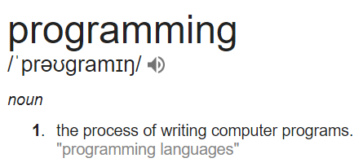
What is coding?

Slide 3
How I define programming/coding
Breaking down problems in basic sequential steps and typing it up giving the computer certain commands

Slide 4
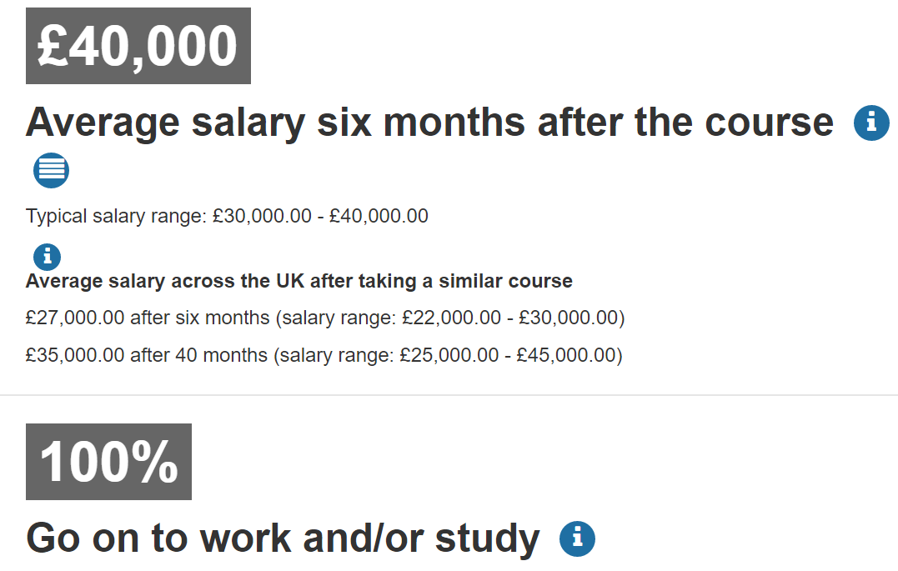
Why learn to code?
It’s used in practically all fields (Physics, Biology, Economics etc)
“I think everybody in this country should learn how to program a computer because it teaches you how to think.” – Steve Jobs
Build stuff you care about. E.g. VR games
$$$ ---------->
Source: BSc CS @ UCL via Unistats

Slide 5
Activity: Write down the steps to make a house from scratch (in English/Pseudocode)

Slide 6
“Standard” answer
Find a building plot
Arrange finance
Set a realistic budget
Find a designer
Get in touch with the planners
Get it approved by the council
Choose a building route
Get the essentials sorted
Prepare your plot
Get building

