Slide 1
Researching Serene

Slide 2
What
Serene is an application to:
Create learning plans
Monitor learning progress
Reflect on achievements

Slide 3

Why
Setting goals and planning learning is important
Many learners do not plan their learning very well
Productivity apps can motivate us to do things that we otherwise would rather not do
Serene !

Slide 4
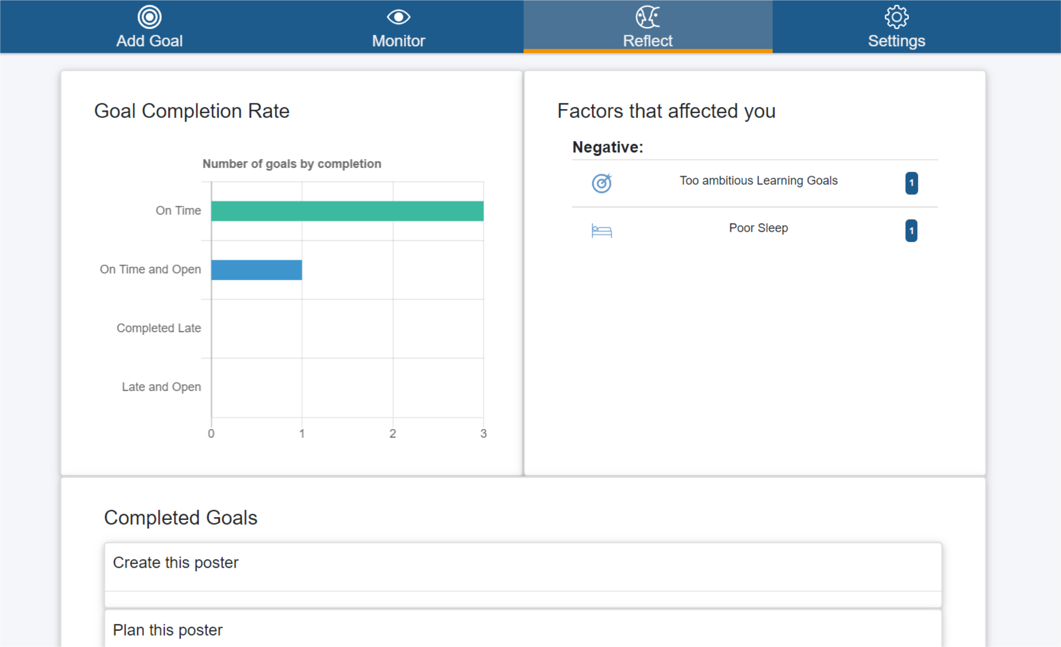
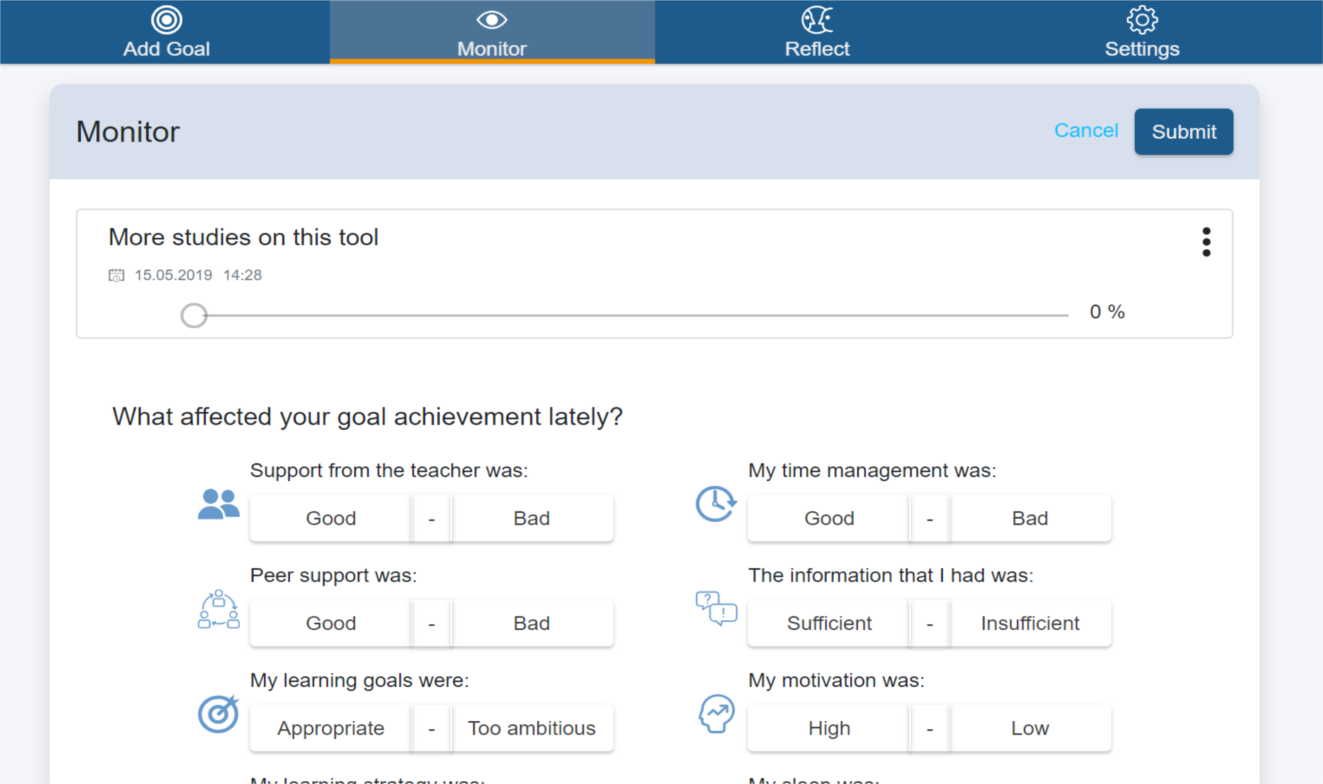
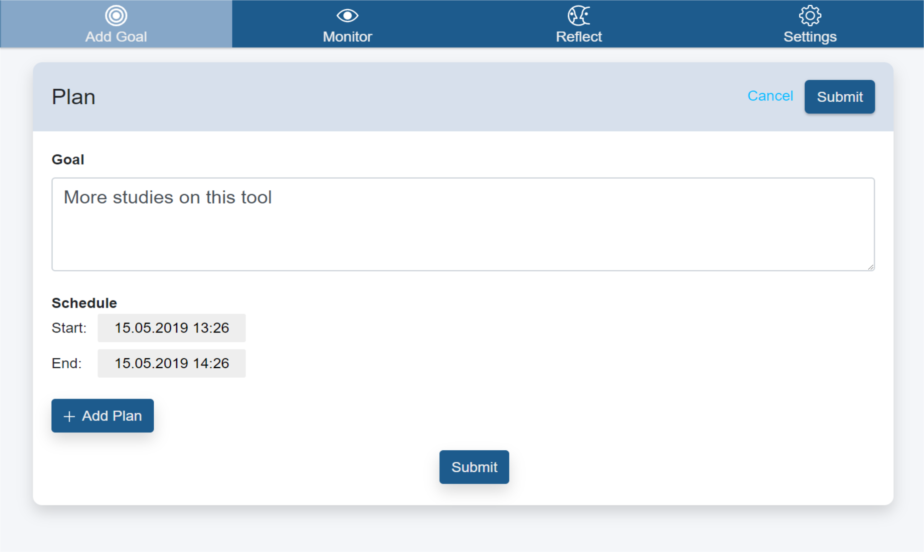
Current State
Serene is very “bare bones”
Basically a ToDo-list
Little added value

Slide 5
Motivational Design (I am not 100% about this term. I see it used with slightly different contexts)
Social features
Peer referenced visualizations
Goal ratings
Gamification elements
Points
Badges
...
Additional information
Study advice
Learning Strategies
Suggested Goals

Slide 6
Gathering Motivational Design Elements
Inspirations from:
Gamification
https://www.gamified.uk/user-types/gamification-mechanics-elements/
Mobile Health
https://www.lensesofmotivationaldesign.com/
Primarily based on Self-Determination Theory

Slide 7
Evaluating Motivational Design Elements
Create Mockups
Let Students rate them according to perceived:
Usefulness
Likeliness of use
Gather additional Comments

Slide 8
Up Next: Some Mockups
They are not mutually exclusive
Some are obviously bad ideas
Some may become better with more thought

Slide 9
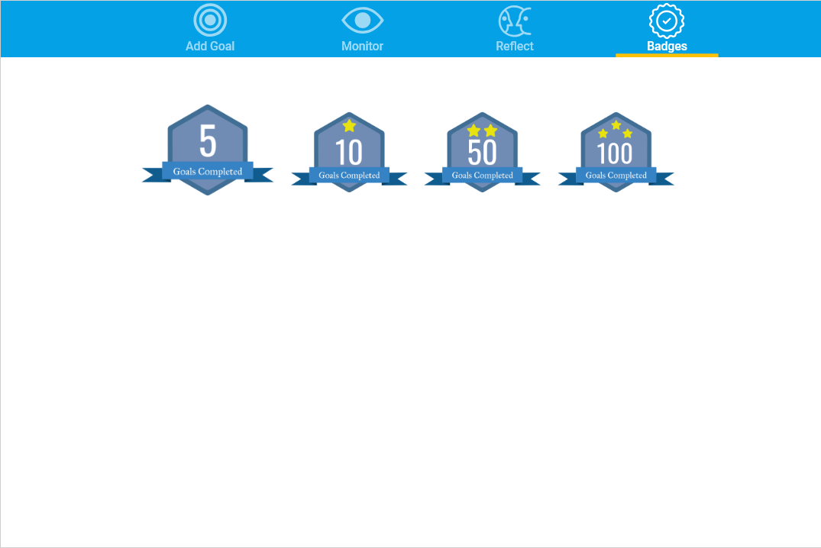
Digital Achievements
Learners can earn badges for achievements in the application

Slide 10
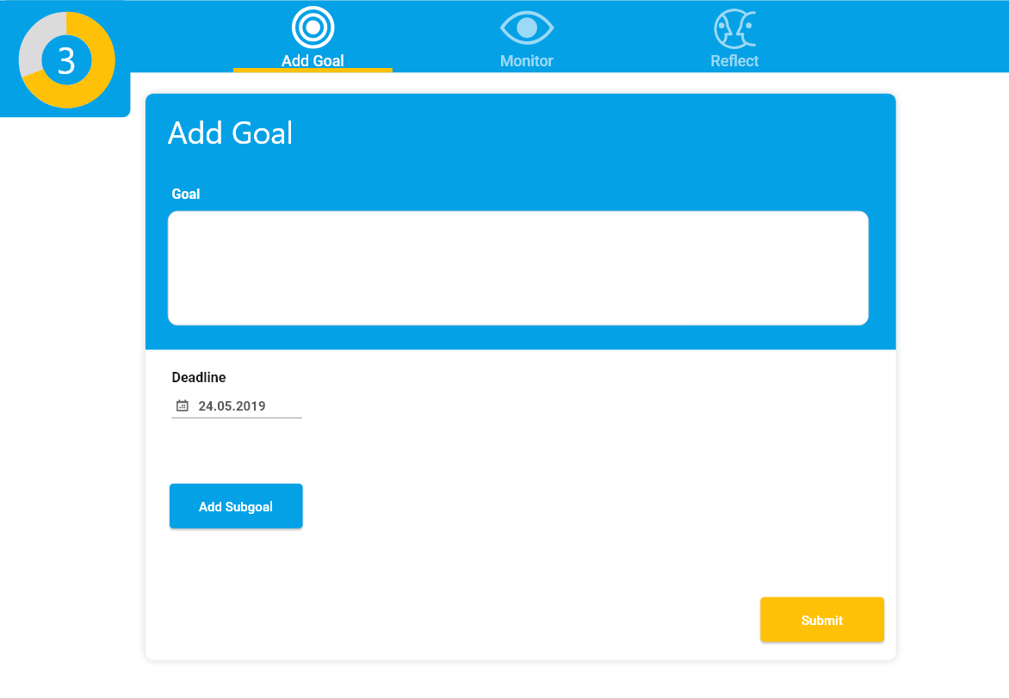
Streak
Show how many days in a row the application has been used

Slide 11
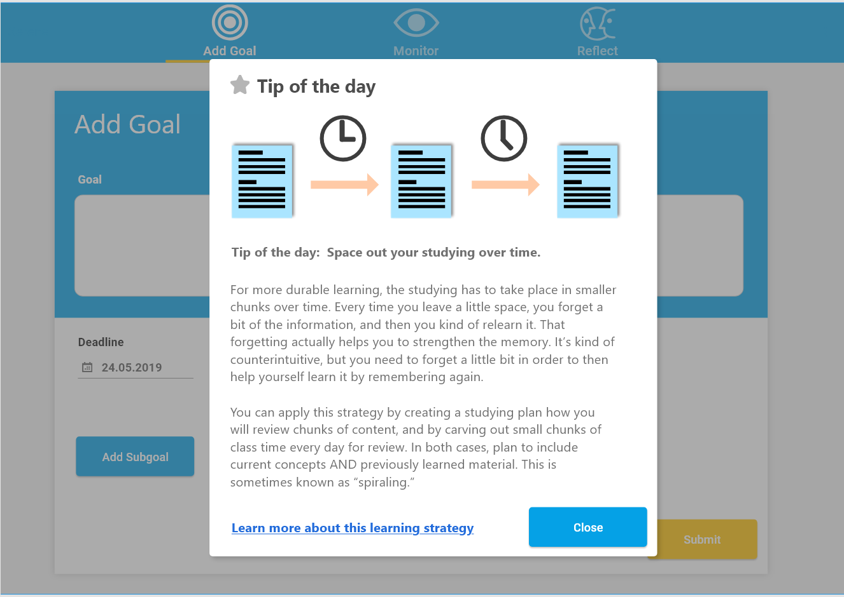
Tips
Dialogues that regularly show tips for better learning

Slide 12
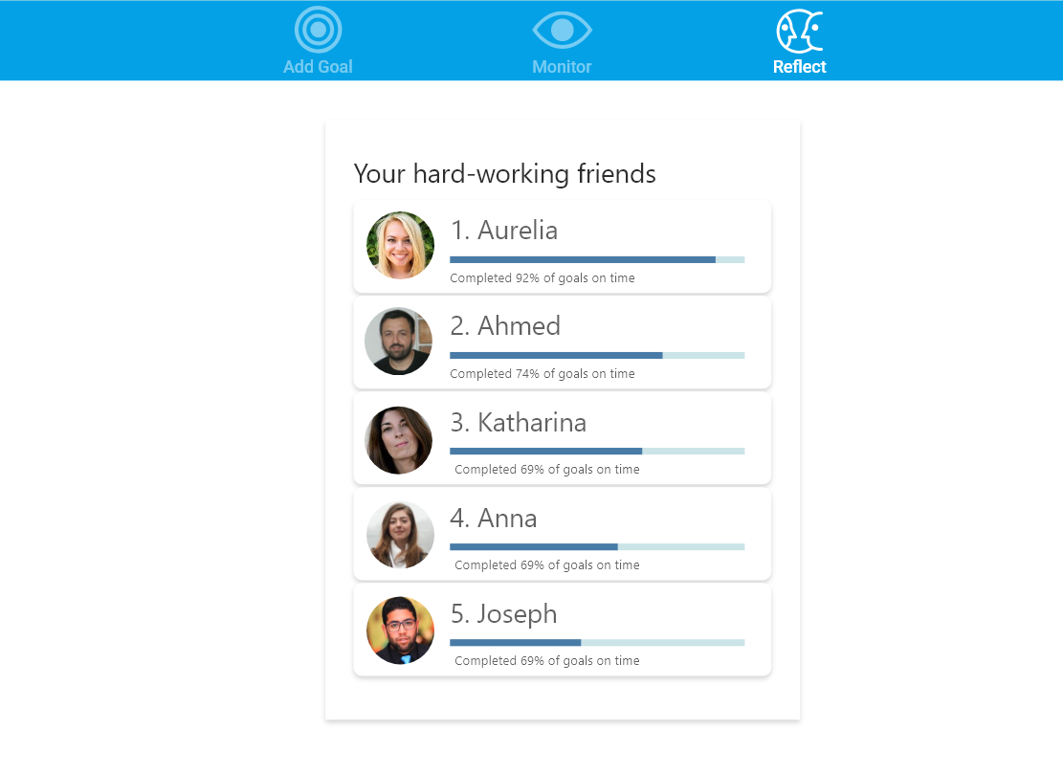
Leaderboards
Leader Board that shows how good peers are at achieving their goals

Slide 13
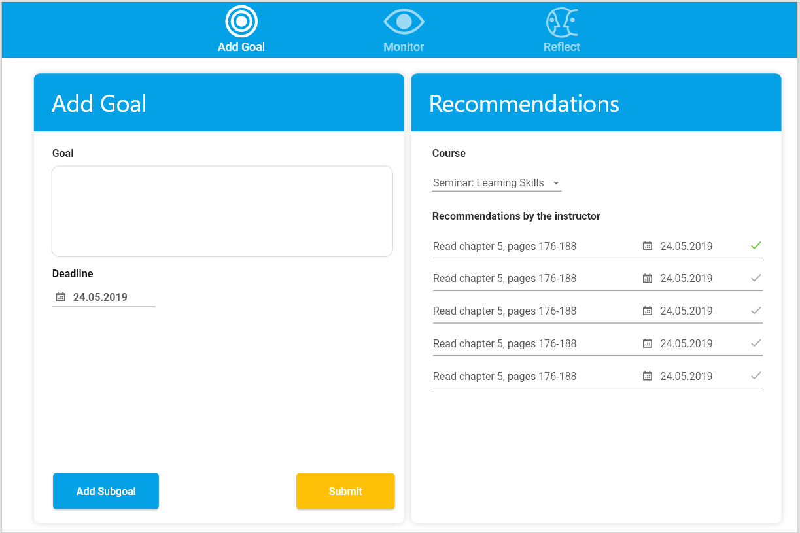
Goal Recommendations (Course)
Goal recommendations based on the tasks of a course
Defined by the instructor

Slide 14
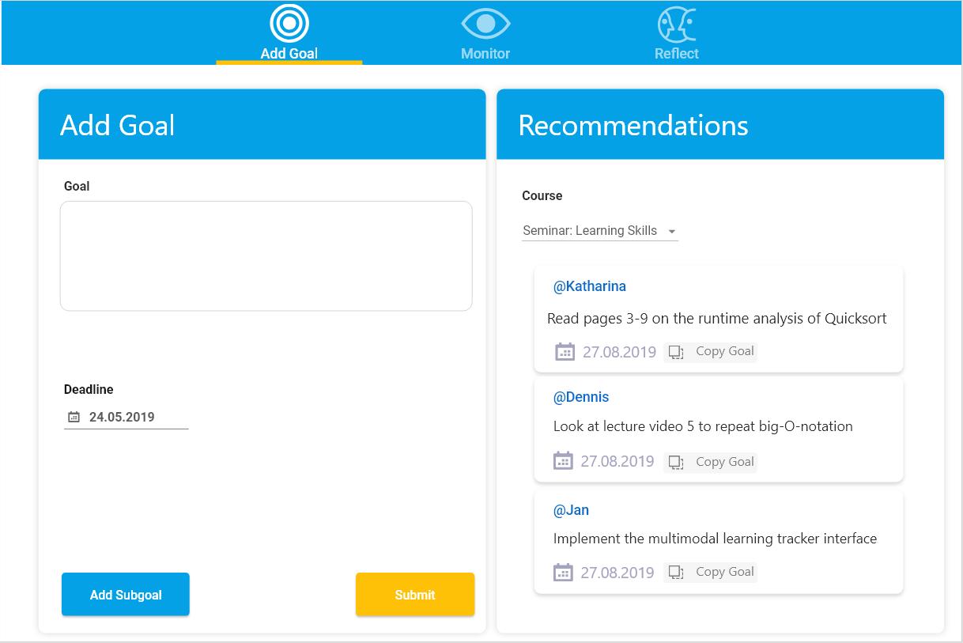
Goal Recommendations (Peers)
Goal recommendations based on the tasks of peers

Slide 15
Goal Recommendations (Peers)
Goal recommendations based on the tasks of peers
Goals can be copied

Slide 16
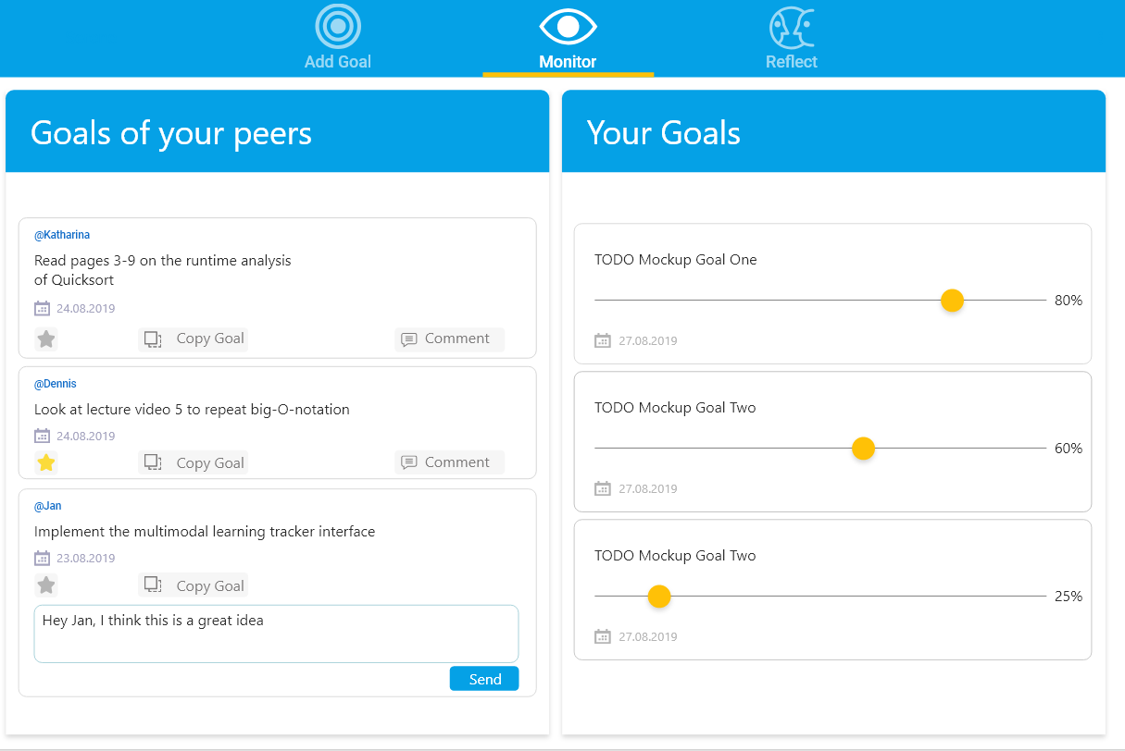
Commenting on Goals
Rate and comment on the goals of others

Slide 17
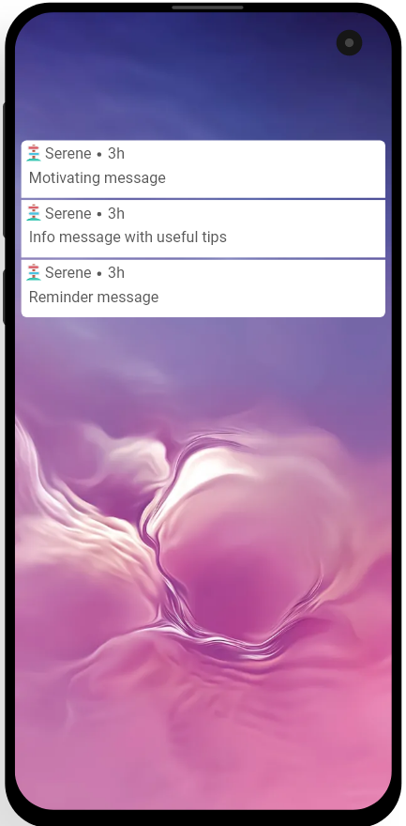
Mobile Notifications
Mobile notifications:
Motivating messages
Tips
Reminders

Slide 18
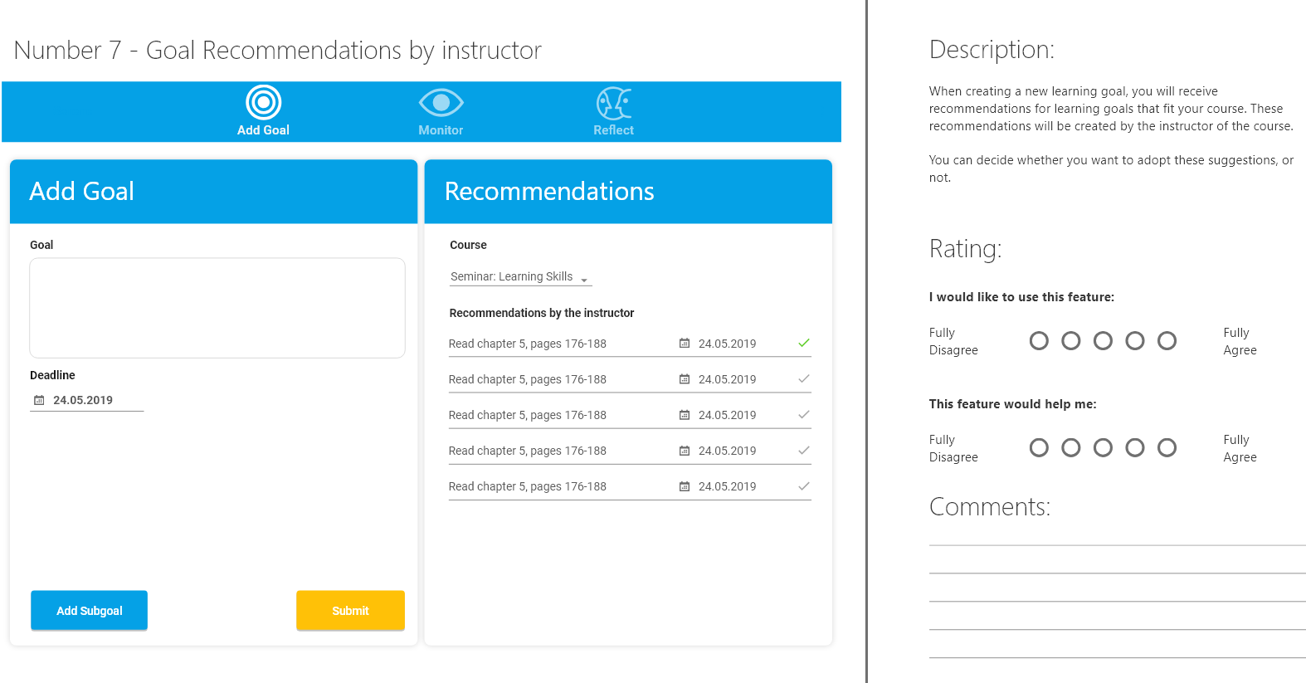
Feedback on Mockups

Slide 19
Implementing Motivational Design
Identify the favorites
Implement them
Evaluate them
Repeat until Serene is a Franken-App with dozens of weird features?

Slide 20
Open Issues
Which constructs/surveys should I evaluate?
Hexad from gamification?
MSLQ for SRL skills?
Design matters
If my mockups are already bad, features will be perceived as negative
Anyone with amazing design skills here?

Slide 21
Before Learning
Define Goal(s): allow to set multiple goals!?
How much time do you plan to allocate to learning today?
Identify obstacle to achieving the goal (have a list of suggestions, e.g. procrastination, multitasking, appointments, ... + show previous obstacles by that student)
Make a plan to overcome the obstacle
How commited/determined are you to achieve your goal today? (Do you feel like you have to do it?)
How motivated are you to pursue your goal?
Self-efficacy

Slide 22
During Learning (asked after learning?!)
Learning strategies?!
How good were you at keeping yourself focused on learning?
How good were you at motivating yourself?
How good were you at

Slide 23
After Learning
Show goal(s) again: Did you achieve them (yes, no, partly)
Show only if goals were specified
How effectively did you use your time? Did you stay within your planned time-schedule / by how much did you exceed it (show allocated time again)?
Show only if that Item was answered before learning
Quality of learning result: ??? (Understanding of learning material)
Overall, how satisfied are you with yourself today?
What could you make better next time? (open)
Write yourself a little note for next time (which will be shown
Could be refering to “what to make better“ or a motivational quote („Push yourself!“, „You can do this!“ etc.)

Slide 24
Metacognitive Strategies
Monitor Progress

Slide 25
Questionnaires
Self-regulated learning (e.g., “Fragebogen zur Erhebung des selbstregulierten Lernens an der Universität“, Bellhäuser, 2017; 26 Items)
Which features do good self-regulators use/how often etc. (therefore, all Items/features should be optional)
Goal Orientation (intrinsic vs. extrinsic): 8 Items from MSLQ

