Slide 1
Sketch Searcher used CNN
Machine learning project ( use Python )
- Kim Jinyeong
- Jeon Dabin
- Shin Jiyoung
- Lee JongHyun
- Choi Myungsun

Slide 2



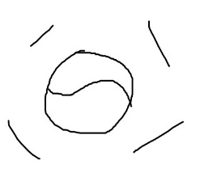



<Aim of Project>
- Find object that I want based on vaguely remembered image information

Slide 3
<Project Planning>
“ Remember Easier“
Recognize images
that are hard to remember
Window consists of Paint canvas and Output canvas.
( Working in PyCharm environment )
Prepare Data Set. ( Sketch Images )
Machine Learning.
( Working in Jupyter Notebook environment )
Apply model that is learned on the window that we previously prepared.
Show picture in which an image means.

Slide 4
Step1 : prepare 그림판
Step1 : prepare 그림판
Design Window
Draw object that you remember dimly
Program recognize drawing image and judge what this image is
With this prediction, print object photo in output canvas
Push search button, program search this object on web and print related window
Module
cv2
Tkinter
keras
Tensorflow
Selenuum

Slide 5
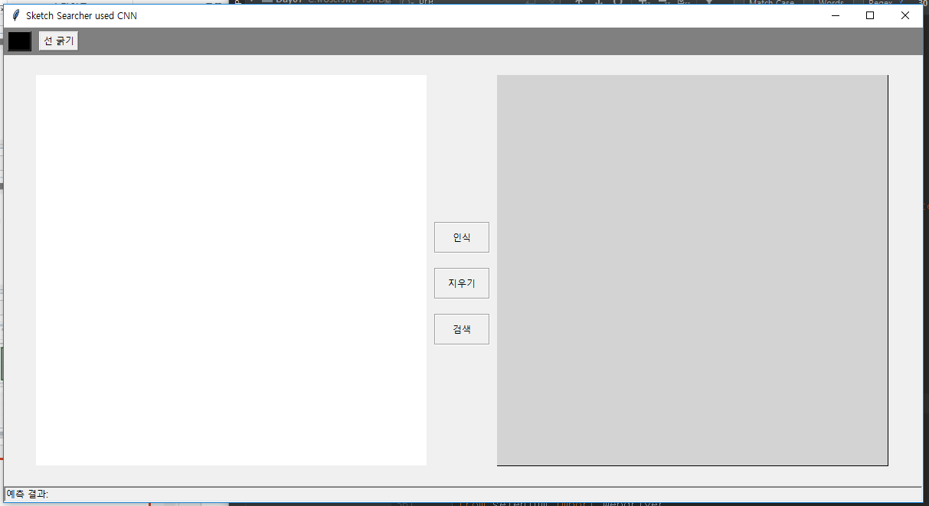
Step1 : prepare 그림판
Step1 : prepare 그림판
Execution Window
Draw Here
Output

Slide 6
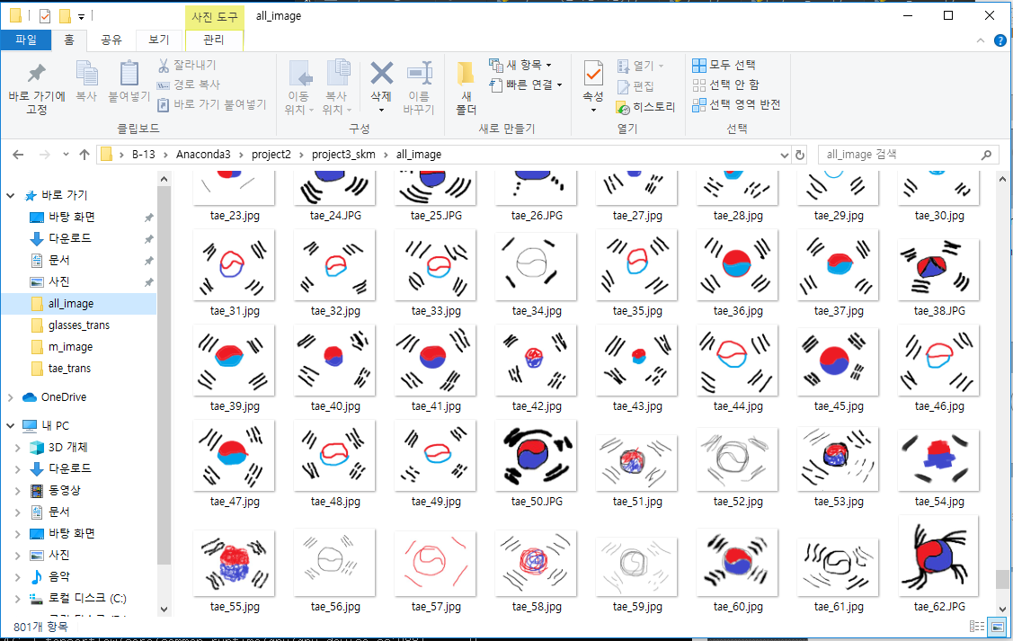
Step 2 : Machine Learning Process
Step1 : prepare 그림판
Prepared draw images

Slide 7
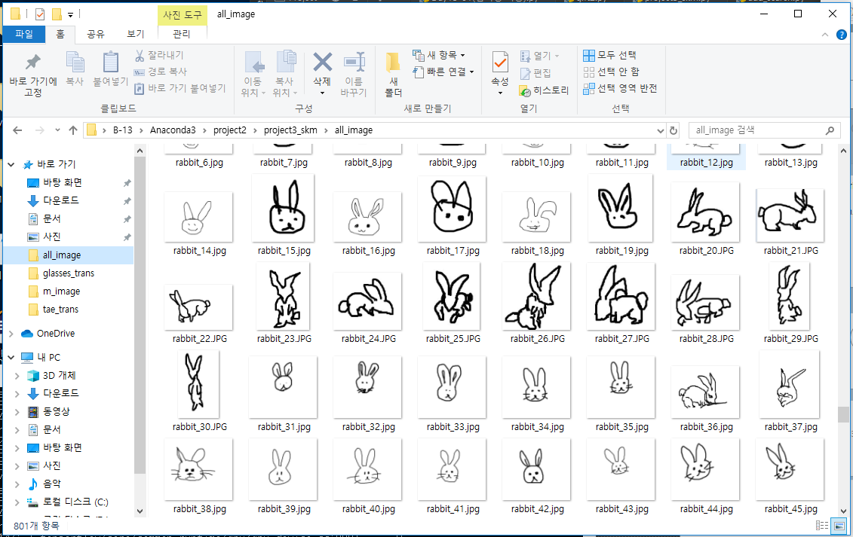
Step 2 : Machine Learning Process
Step1 : prepare 그림판
Prepared draw images

Slide 8
Step 2 : Machine Learning Process
Step1 : prepare 그림판
Setting
Install CUDA 10.1
Installing cuDNN -> Unzip cuDNN package
Pip3 install upgrade tensorflow-gpu
Conda install keras-gpu
Modeling
CNN
Module
import os, shutil
from keras.applications import VGG16
- from keras.preprocessing image import ImageDataGenerator
Notes:
<세팅>
<모델링>
<모듈>

Slide 9
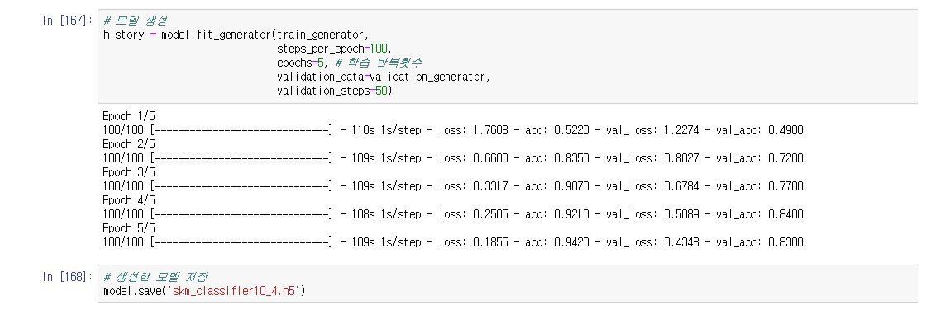
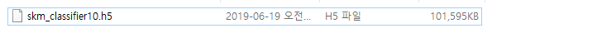
Step 2 : Machine Learning Process
Step1 : prepare 그림판
Modeling Result
Saved Model

Slide 10
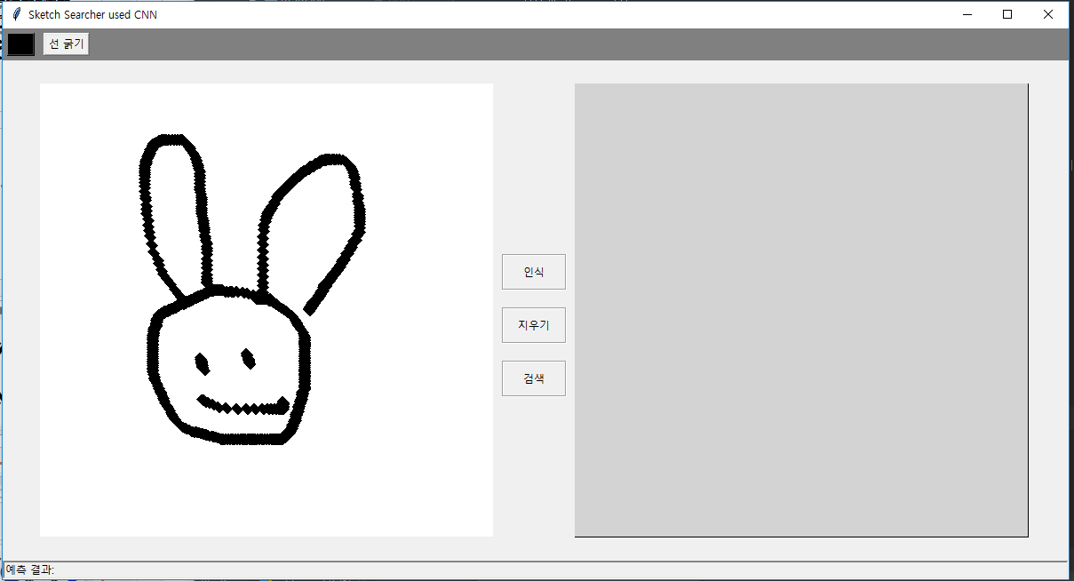
Step3 : Run Program
Step1 : prepare 그림판
Recognition
Notes:
그림판에 토끼 그리고 인식 누르면

Slide 11
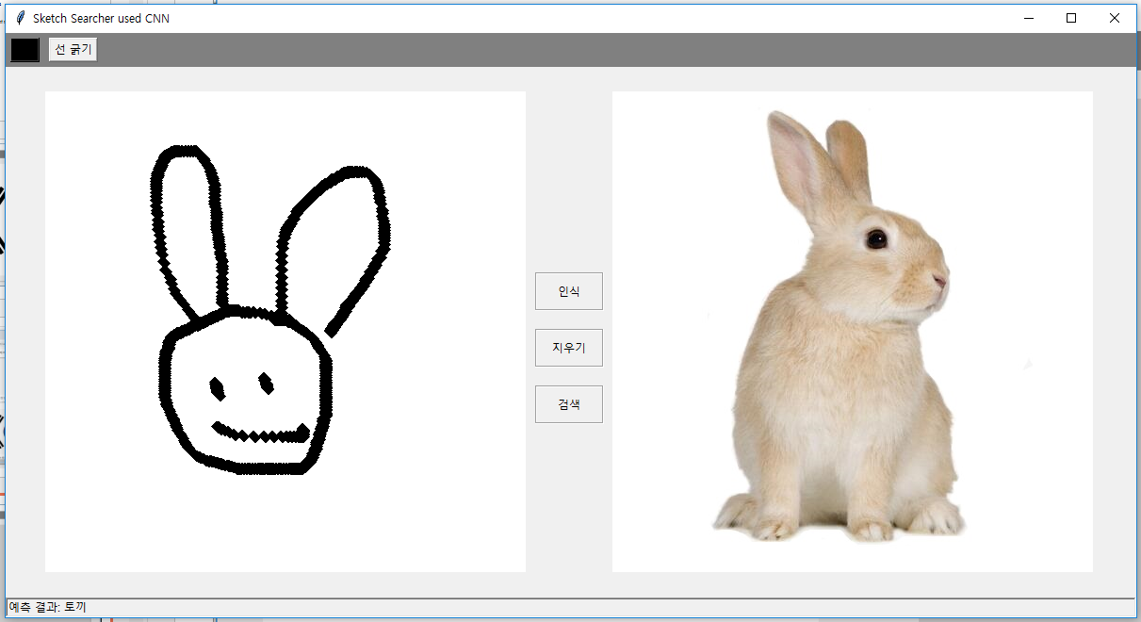
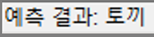
Step3 : Run Program
Step1 : prepare 그림판
predictive results
Notes:
토끼 사진이 뜨고 아래 예측결과에 토끼

Slide 12
Step3 : Run Program
Step1 : prepare 그림판
Search
After you recognize the image, press the search button
Notes:
토끼 사진이 뜨고 아래 예측결과에 토끼

Slide 13
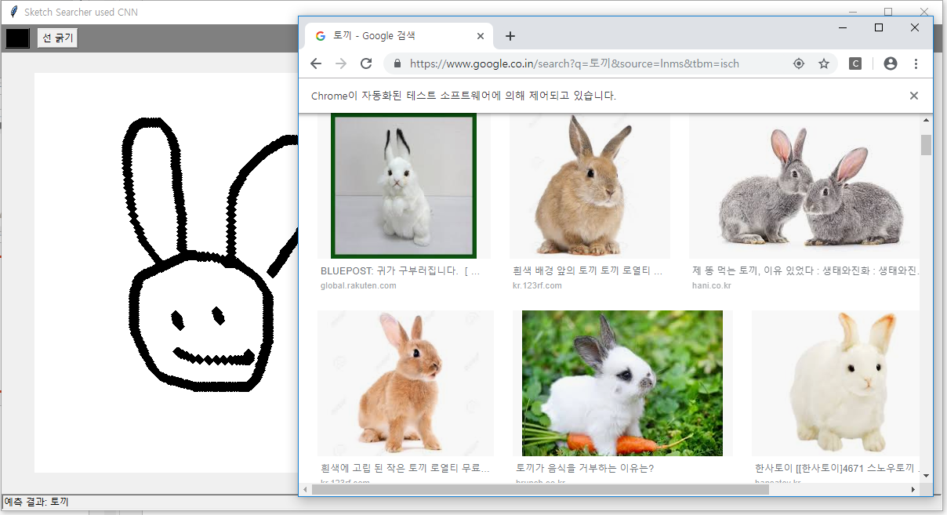
Step3 : Run Program

Slide 14
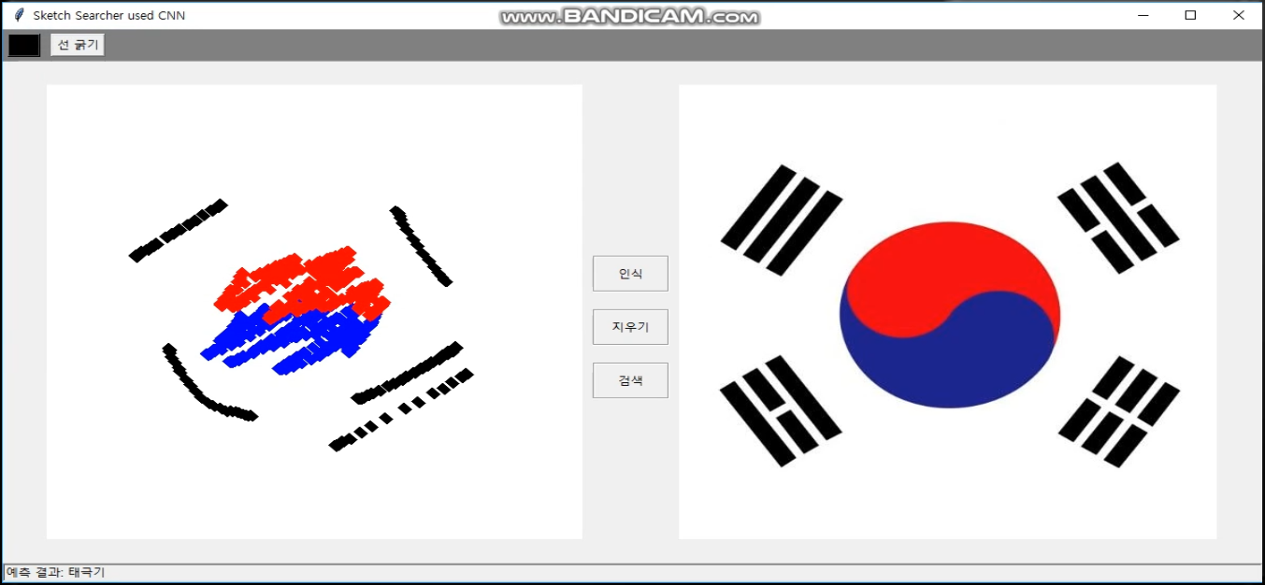
Color Image Recognition

Slide 15
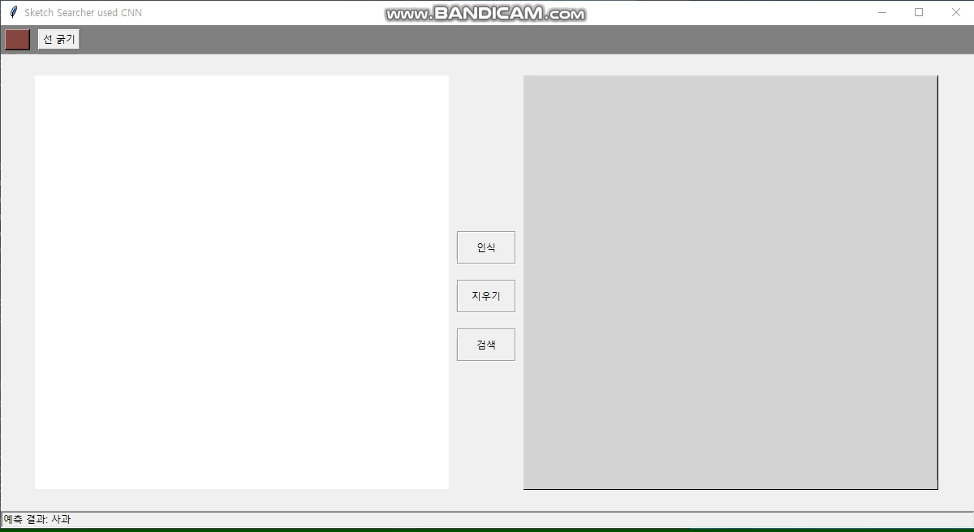
Color Image Recognition

Slide 16
Thank you

