Slide 1
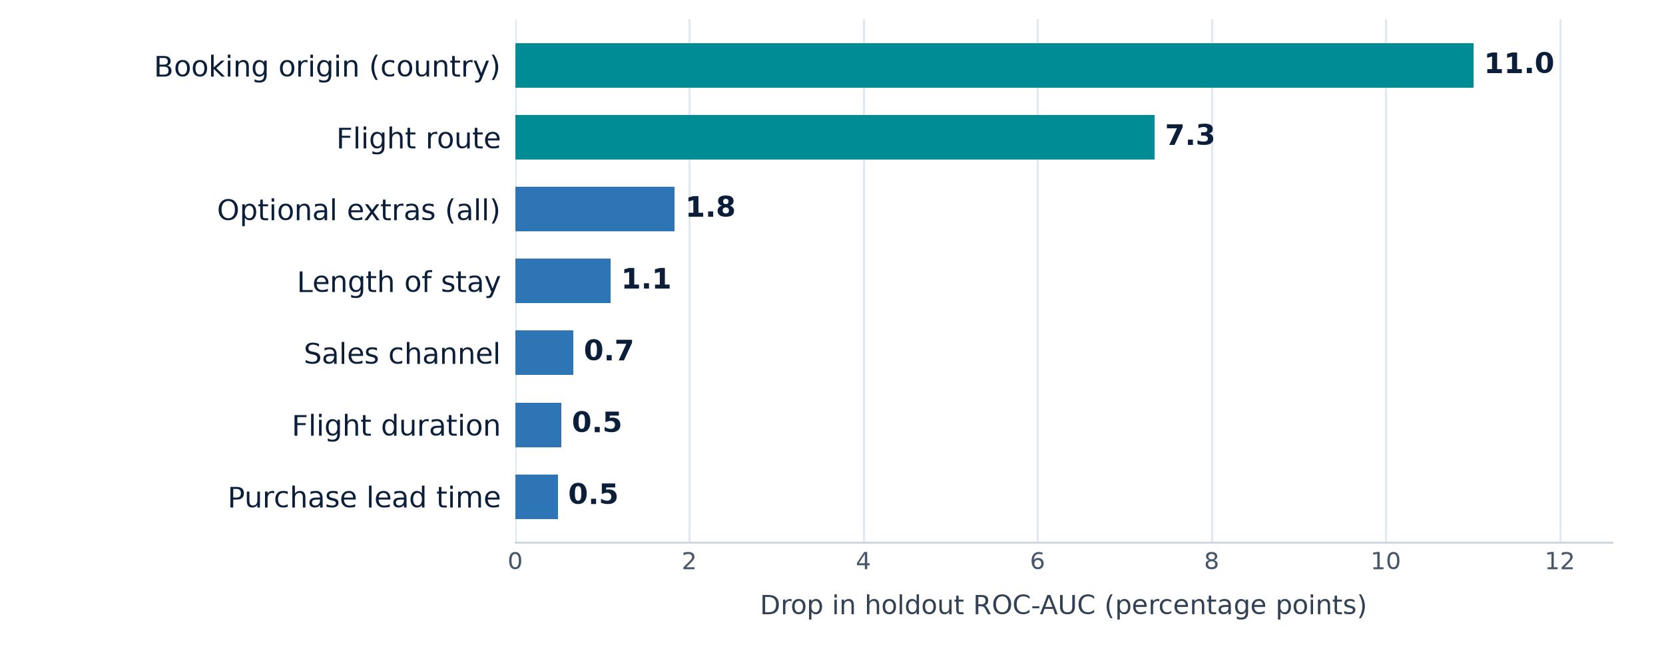
Customer booking prediction: geography is the strongest signal
CUSTOMER ANALYTICS
Random Forest model on 49,281 British Airways booking enquiries | 5-fold cross-validation + holdout evaluation
October 2026
0.79
0.37
2.9x
29%
ROC-AUC
PR-AUC
LIFT AT TOP 10%
BOOKINGS CAPTURED
Holdout | CV 0.795 ± 0.003
2.4x the 15% base rate
vs contacting a random 10%
by targeting the top 10%
What drives a booking?
WHAT THE MODEL TELLS US
Drop in holdout ROC-AUC when each driver is shuffled. Other features add <0.1 pts each.
1
Market and route drive ~80% of measured importance.
Conversion is ~5% in Australia/New Zealand vs ~35% in Malaysia. The score mostly separates markets before it separates individuals.
2
Intent signals add usable, but smaller, lift.
All three extras: 18.6% vs 10.7% with none. Short breaks (4-7 days): 19.5% vs 10.1% for 15-30 days. Internet 15.5% vs Mobile 11.0%.
3
A useful ranking, not a guarantee.
PR-AUC 0.37 vs 0.15 base rate; at the 0.5 threshold the model finds 61% of bookers with 34% precision.
Accuracy is 77% - below the 85% 'never books' baseline. Precision at the top of the ranking is the metric that matters.
RECOMMENDATION
Rank enquiries and target the top 10-20% for 2.5-2.9x lift; A/B test incremental bookings before scaling.
Localise offers by origin/route and short breaks; retrain quarterly with price and seasonality data.
Holdout (n=9,857): ROC-AUC 0.788 | PR-AUC 0.367 | recall 0.61 | precision 0.34 at 0.50. CV: ROC-AUC 0.795 ± 0.003.
1
Data: 50,000 rows, 719 exact duplicates removed. 80/20 stratified split; 5-fold CV; 600-tree Random Forest; out-of-fold target encoding for route and origin. Importance = grouped drop in ROC-AUC when a driver is shuffled.
Notes:
PURPOSE: one-slide summary of the customer-booking propensity model.
DATA: 50,000 British Airways booking enquiries, 14 columns, no missing values. 719 exact duplicate rows were removed, leaving 49,281 rows; 15.0% completed a booking. An 80/20 stratified split was used (39,424 train / 9,857 holdout).
FEATURES: num_passengers, purchase_lead, length_of_stay, flight_hour (plus sine/cosine), flight_duration, flight_day_num, is_weekend, extras_count, the three optional-extra flags, sales_channel, trip_type, route and booking_origin. Route and booking_origin were target-encoded out-of-fold inside the model pipeline.
MODEL: RandomForestClassifier, 600 trees, min_samples_leaf=10, max_features='sqrt', class_weight='balanced_subsample'. 5-fold stratified CV on the training set. CV ROC-AUC 0.795 +/- 0.003, PR-AUC 0.391 +/- 0.011, F1 0.451. Holdout ROC-AUC 0.788, PR-AUC 0.367 (vs 0.150 prevalence), accuracy 76.8%, recall 60.6%, precision 34.4% at the 0.5 threshold.
BUSINESS RESULT: the model is a ranking tool. Contacting the top 10% captures 28.6% of all bookings (2.86x lift); the top 20% captures 50.3% (2.51x lift). Top decile precision is 42.8%, so most contacted customers still will not book - it is a prioritisation aid, not a guarantee.
DRIVERS: grouped permutation importance on the holdout set. Booking origin is 11.0 percentage points of ROC-AUC, route 7.3, optional extras 1.8, length of stay 1.1, sales channel 0.7, flight duration 0.5, purchase lead time 0.5. Origin and route together are about 80% of measured importance, so the score mostly separates markets before it separates individuals.
CAVEATS: (1) The optional-extra fields may be captured late in the funnel; without them the holdout ROC-AUC is 0.781 and PR-AUC 0.352. Confirm timing before production use. (2) The analysis is predictive, not causal. (3) Price, seasonality/travel dates, repeat-customer history and abandoned-search data were not available. (4) Retrain and monitor drift before reuse.
RECOMMENDATION: deploy as a ranked marketing score, target the top 10-20%, A/B test incremental bookings against random contact, localise creative by origin/route and short breaks, and retrain quarterly with price and seasonality data.

