Slide 1
Blossom Beauty
Cosmetic Web Application

Slide 2
Project Overview
Blossom Beauty is a cosmetic web application designed to provide users with a personalized and seamless online beauty shopping experience.
The platform allows users to browse products, manage cart ,order products and receive product recommendations based on their skin or hair concerns. Implemented admin dashboard to manage products and orders.

Slide 3
Users and Use Cases
Users
User
Admin
User Use Cases
Register and login
Browse products
Search products
Receive personalized product recommendations based on user concern
Add products to cart and apply discount
Place orders and view order history

Slide 4
Admin Use Cases
Admin login
Manage products
Manage and view orders

Slide 5
Project Architecture
Blossom Beauty follows a microservices-based architecture.
The frontend is developed using React with Redux Toolkit for efficient state management.
Backend services are implemented using Java (Spring Boot) and for storing the data we have used the MySQL.
User Service
Product Service
Cart Service
Order Service

Slide 6
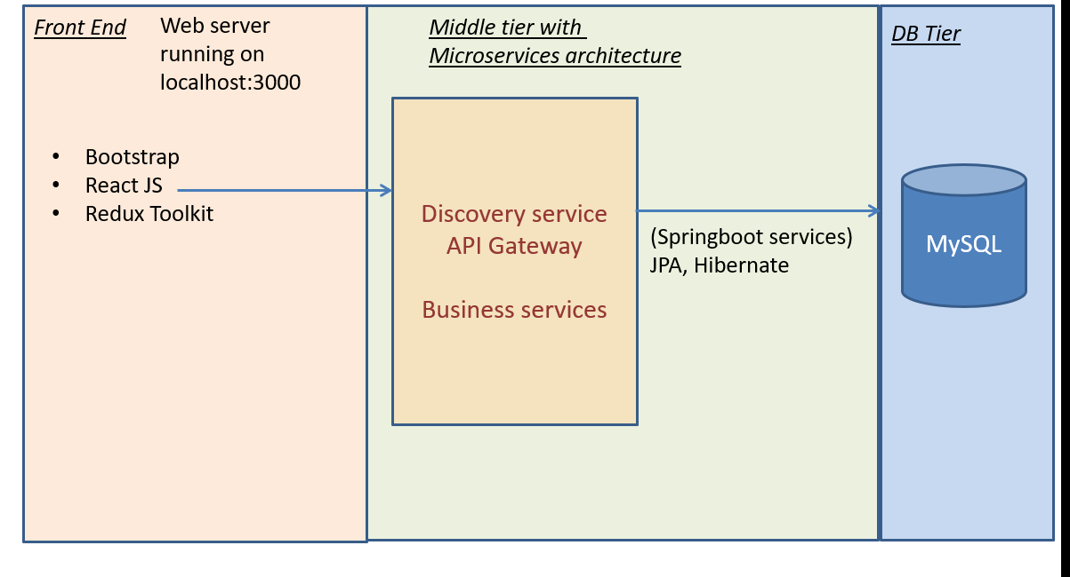
Project Architecture

Slide 7
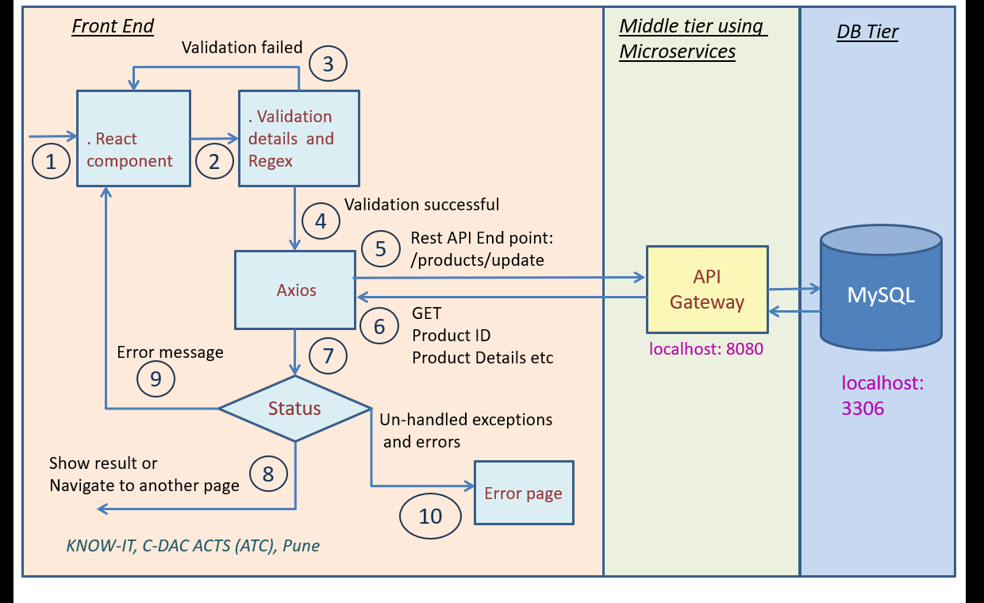
Frontend Architecture

Slide 8
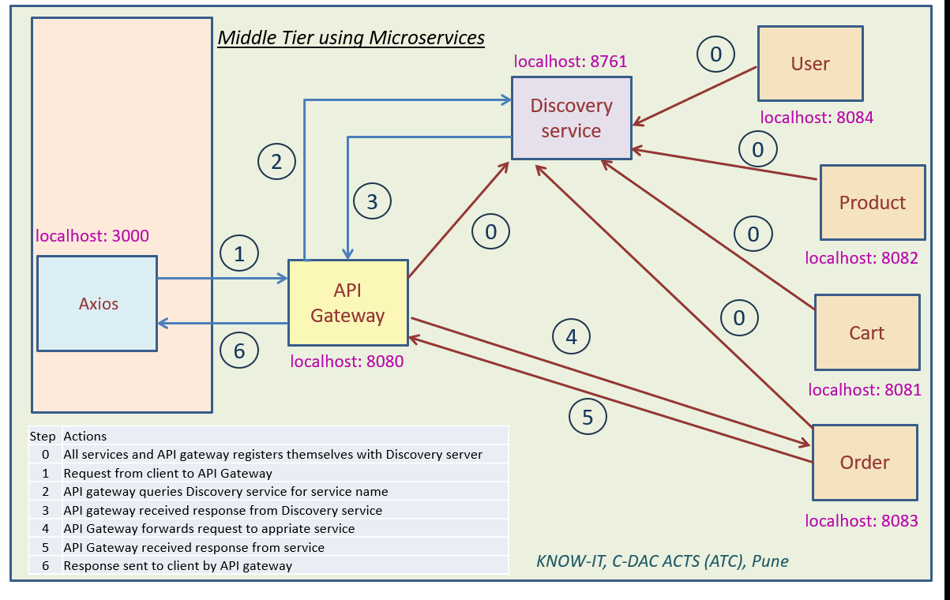
Backend Architecture

Slide 9
Role and Contribution
Worked on Database design
Worked on backend services using Java(Spring Boot)
Developed frontend UI using React and Redux Toolkit
Implemented state management and API integration
Contributed in database design and testing
Debugged and resolved integration issues

Slide 10
Project Methodology
1 .Requirement Analysis
Admin
Customers
Functional requirements were identified and documented in the Software
Requirement Specification (SRS). System scope, modules, and user roles were clearly defined.
2 . System Design
The overall system architecture was designed.
Use-case diagrams were created for:
Admin
Customer
Database design and UI flow were planned to ensure smooth interaction
between modules.

Slide 11
3. Development
We have used microservices for dividing the application into independent modules.
Layered architecture for organizing the code structure.
4. Testing
Unit testing is used to test individual components of module of each microservice.
Integration testing is used to test communication between two services.
System Testing is used to test communication between frontend ,backend services and database

Slide 12
Future Extension
Online payment gateway integration
Create Wishlists and convert to cart
Advanced AI-based recommendation system
Product reviews and ratings
Mobile application development
Cloud deployment using AWS or Azure

Slide 13
Experience / Lessons Learnt
Gained practical experience with microservices architecture
Learned how to use REST APIs
Learned real-world frontend-backend integration
Improved debugging and problem-solving skills
Enhanced teamwork, communication, and project planning skills

