Slide 1


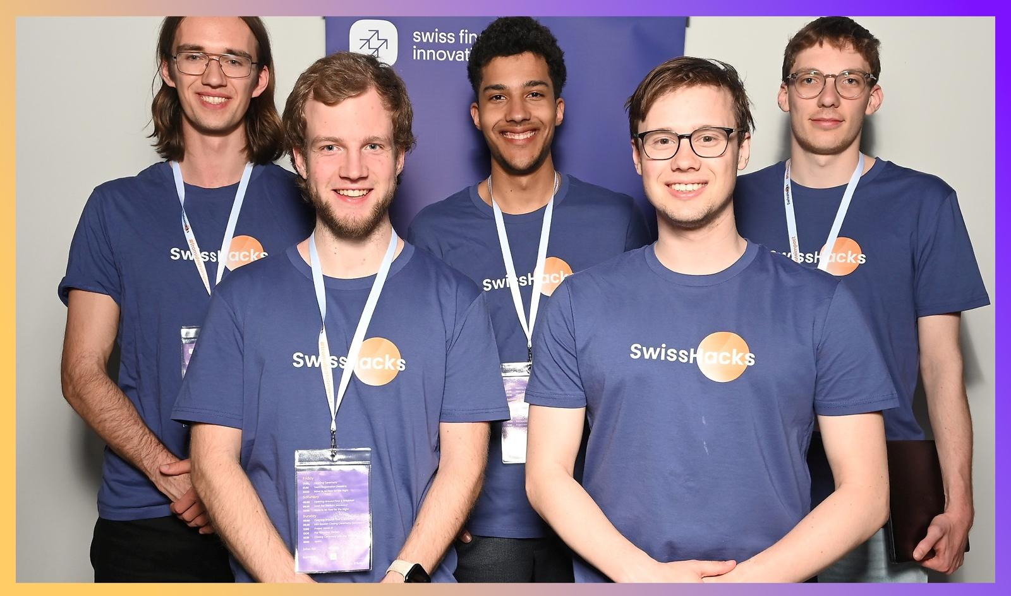
FiveNeu(t)rons
Julius Bär – Improve Client Onboarding Efficiency in Private Banking using Machine Learning and Gamification

Slide 2

Structure
API-Interface class
Data matching
Parser
Download data
start_game()
decide()
make_decision()
LLM
display(error)
rejected
accepted

Slide 3


Innovation
Precission
Rule-based consistency checks for well-structured data
Deterministic logic ensures reliable validation
→ Low error probability
Flexibility
Utilizing Large Language models
Ideal for data fields with inconsistent wording
→ Enables comparison beyond exact matches

Slide 4

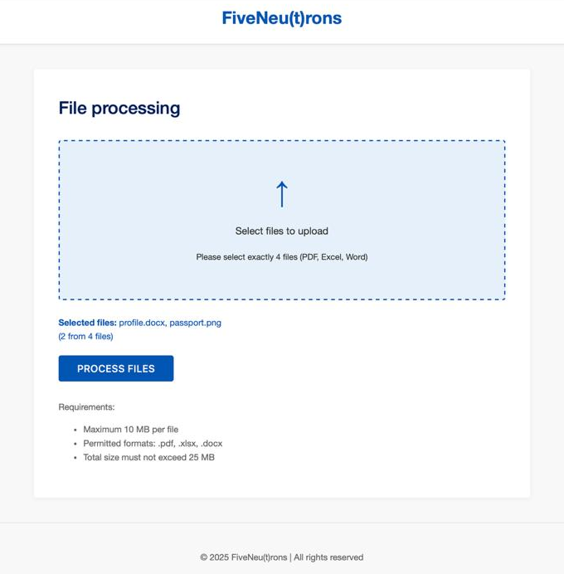
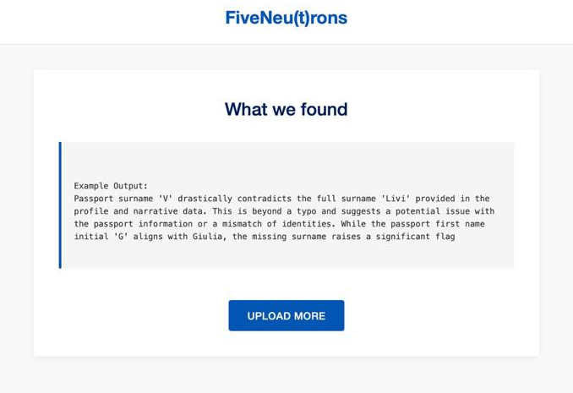
Outlook
Develop user-friendly webinterface

Slide 5
Outlook
Develop user-friendly webinterface
Deploy lightweight, on-device/server (L)LMs for secure, focused use
Add new features (e.g. signature consistency check, AI powered data extraction)
Fine-tune models on domain-specific data → higher accuracy

