Slide 1
IOT
Home
Automation
Integrated using Blynk

Slide 2

Thanks!

Slide 3




Submitted By :
Priyanka Kumari
Yash Patil
Mwaniki Grace Waigumo
Sridhar R

Slide 4
Table of contents
Learning
Requirement
01
02
03
Implementation
04
Conclusion
What I learnt in this Internship
About the project and requirements
Development Process of this Project
Final Overview of this Home Automation

Slide 5
01
Learning
What I learnt in this Internship

Slide 6
Introduction
Concepts I learnt through this Internship:
C & C++
IOT (Internet Of Things)
Embedded System
And the most important thing: How these concepts used in this project.

Slide 7

C & C++
It is a general-purpose language, even though it is applied and used effectively in various specifics domains

Slide 8
The best error message is the one that never show up
.
.
.
Data Types
Modifier &
Qualifier
Condition &
Loop
.
.
.
Operators
Arrays & Pointers
Strings
.
.
.
Function
Storage Classes
Pre-Processor

Slide 9

C++
Its is superset of C and Its support Oops (Object Oriented Programming)concepts

Slide 10
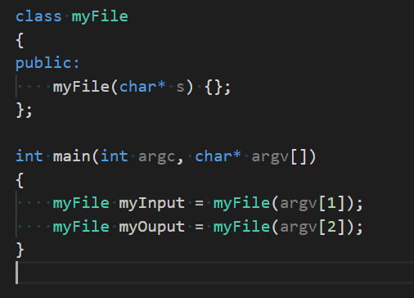
Class and Object
Function Overloading
Constructors & Destructor

Slide 11

IOT
The network of physical objects that contains Embedded Technology to communicate and interact with their internal states or the external Environment

Slide 12
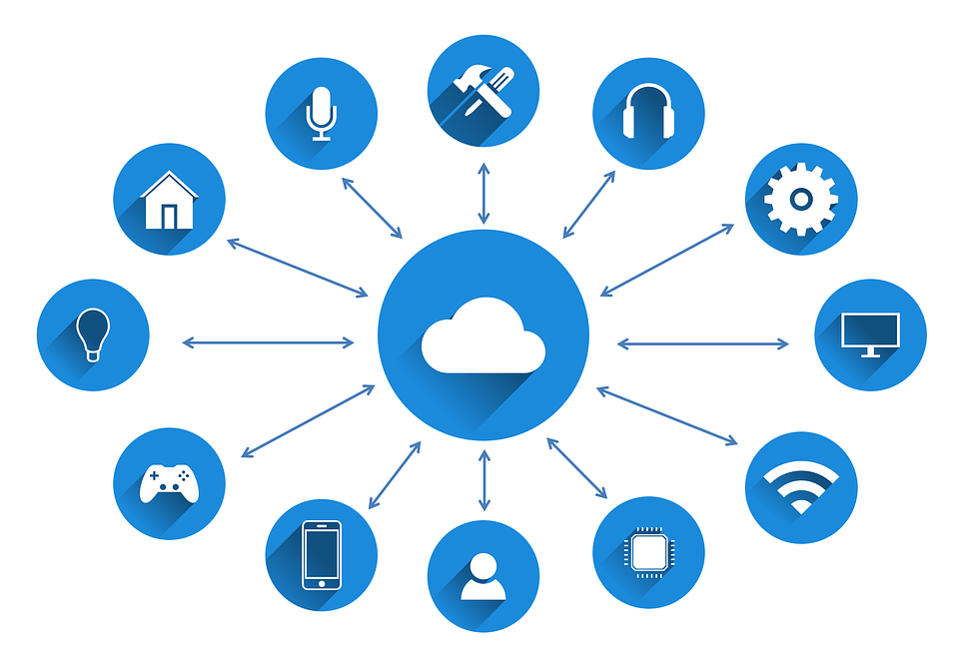
In simpler terms,
► IoT is about connecting everyday objects to the internet, enabling them to be controlled and monitored remotely.
► For example, smart home devices such as thermostats, security cameras, and lighting systems are all part of the IoT.
► Similarly, connected cars, industrial machines, and medical devices are also part of the IoT ecosystem.

Slide 13
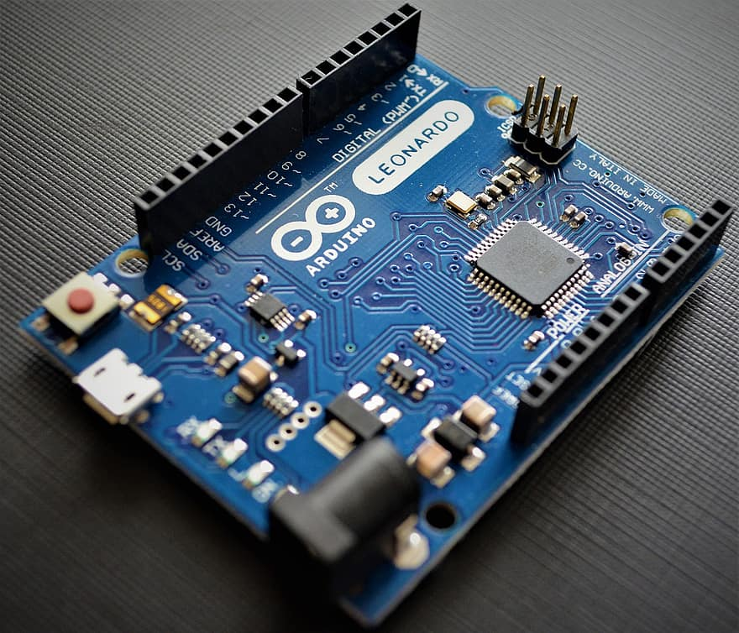
Embedded
System
It is a combination of hardware and software that is specifically designed to perform a dedicated function, typically with real-time computing constraints.

Slide 14
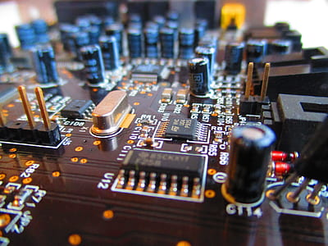
In simpler terms,
► Some examples of embedded systems include microcontrollers,
Digital Signal Processors (DSPs),
Field Programmable Gate Arrays (FPGAs), and Application Specific Integrated Circuits (ASICs).
► These systems can be programmed using a variety of programming languages, including C, C++, Java, and assembly language.

Slide 15
02
Project
Requirements
About the project and its Requirements

Slide 16
Project Requirement
Garden Light Control
Temperature System
Water Tank Control
Control the garden Lights based on the Sunlight intensity. Brighter the lights in less Sunlight.
Remotely switch ON/OFF the heater & cooler, and turn OFF the heater automatically if indoor temperature is exceeds 35°C
Remotely switch ON/OFF inlet & outlet valves, Turn OFF inlet valve automatically if the tank fills up, and turn ON the inlet valve automatically if the tank volume drops below 2000L

Slide 17

Hardware
Requirements
Arduino UNO
ETH-W5500
PCF-8574
Temperature Sensor
LCD HD44780
LDR Sensor
LED

Slide 18
Software
Requirements
Arduino IDE
PICSIMLAB
NULL Modem Emulator
Blynk IOT App

Slide 19
03
Project
Implementation
About the implementation Process

Slide 20
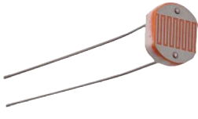
Garden Light Implementation
Light Dependent Resistor(LDR)
It used to sense the sunlight and send the analog signals to microcontroller
Analog to Digital Conversion (ADC)
Used to read analog inputs. Only analog pins A0 to A5 connected to ADC block.
ADC has three steps
Sampling: Breaking continuous signals into discrete signals. (discretizing X axis)
Quantization: Discretizing Y axis
Encoding: Assign digital value to each signal level

Slide 21
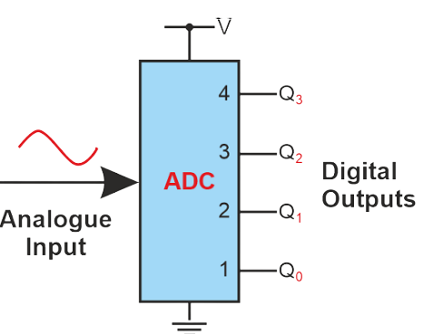
Garden Light Implementation
Resolution of ADC
Number of encoded signal levels available. Depends on the width of ADC register. In case of Arduino UNO, 10 bit register, corresponds to 1024.
Example
Microcontroller adjusts brightness of garden light (simulated as LED) with respect to analog signal sent by LDR using ADC.
Step Size: 5/1024 = 4.88 mV
Actual voltage = analog value * step size
Successive Approximation (SAR) ADC architecture used in Arduino UNO.

Slide 22
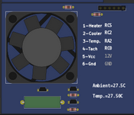
Temperature System Implementation
LM35 sensor
It provides analog voltage Output which is directly proportional to the temperature of the room.
Temperature Conversion
Analog voltage input is divided by 0.01 to obtain the temperature of the room, which is then displayed on CLCD.
ETH W5500
Arduino UNO is connected to the Internet using ETH W5500 ethernet shield
Heater and cooler can be remotely controlled using the Blynk mobile IOT App.
Datastreams, acting as virtual pins, are created on Blynk dashboard templates for exchange of data between mobile app and microcontroller.

Slide 23
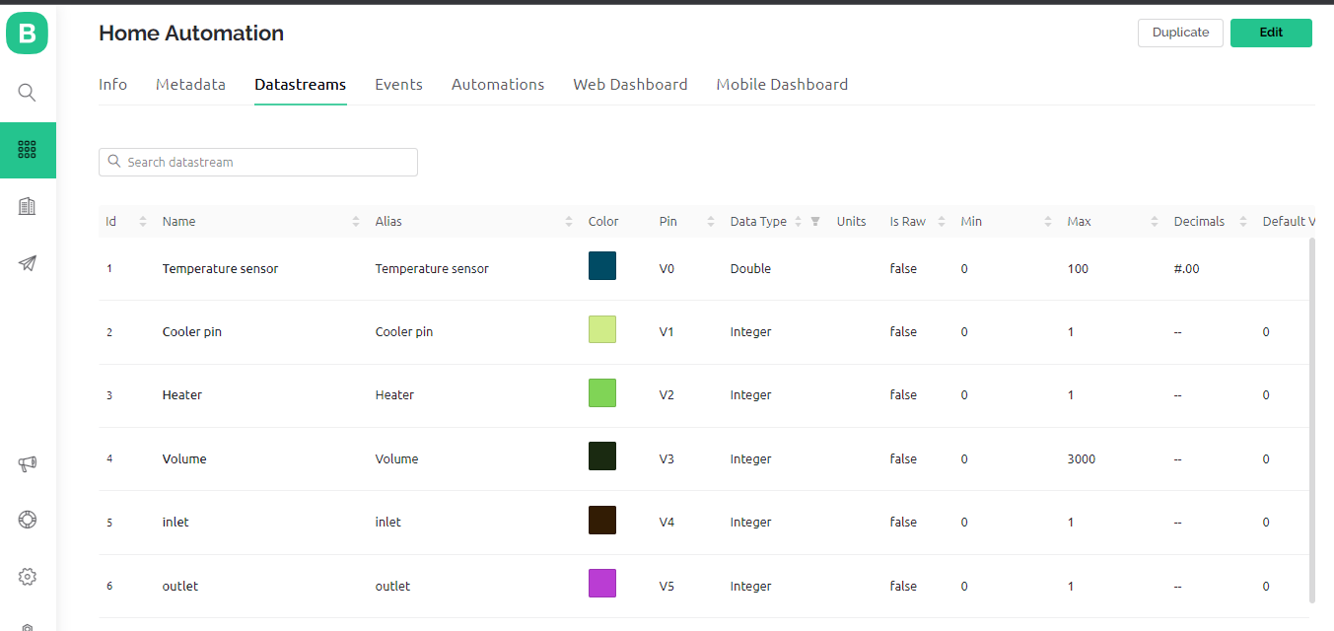
Temperature System Implementation

Slide 24
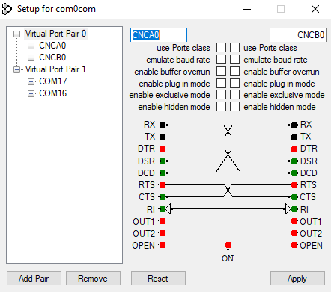
Water Tank Control Implementation
Serial Remote Tank
Serial remote tank simulator used here
To control inlet valve or outlet valve, send a byte (0x00 or 0x01) followed by another byte (0x01 to enable, 0x00 to disable) using Serial.write(0xXX).
0x30 byte is sent to request data from volume sensor
Serial.read() is used to read the volume in 8 bits
Null Emulator
Null emulator used to set up serial communication between PICSimLab and Serial Tank (COM1 <> COM2)

Slide 25
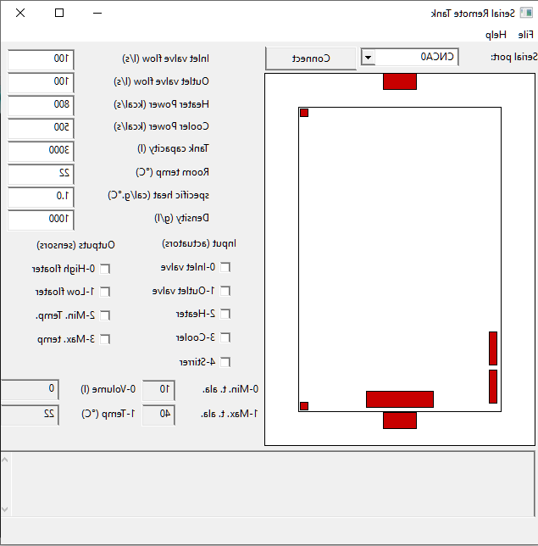
Water Tank Control Implementation

Slide 26
04
Conclusion
Came to the end of story

Slide 27
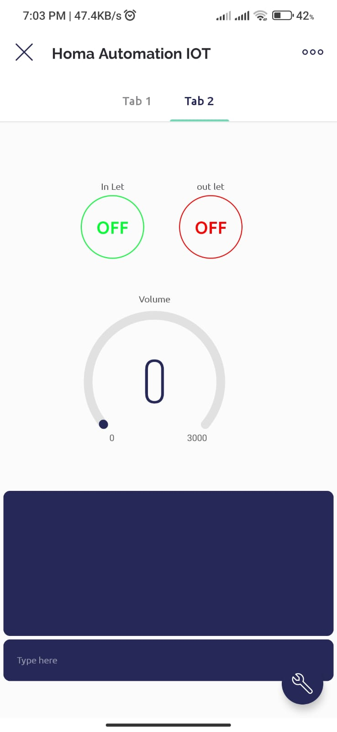
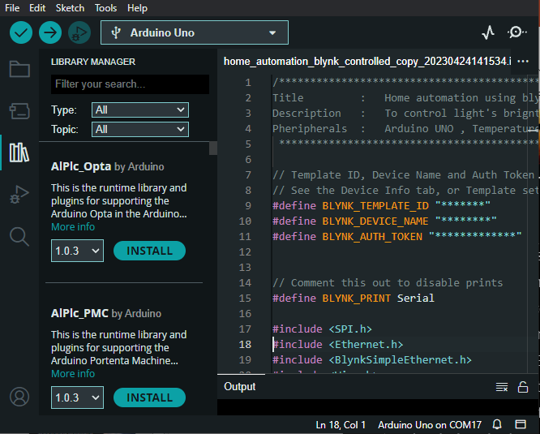
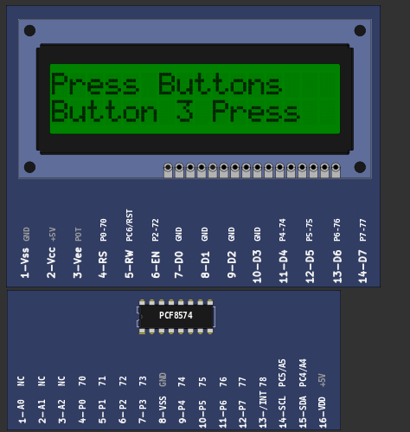
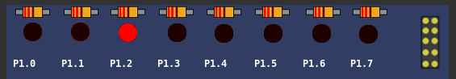
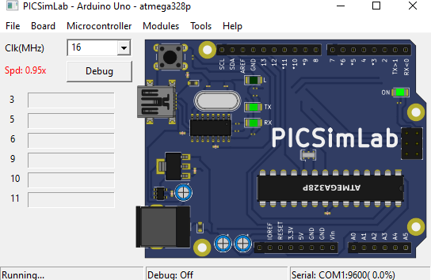
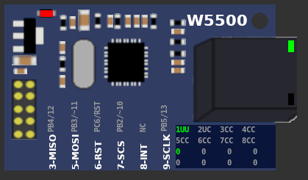

Slide 28
Thank You!

Slide 29
Project Demo !

