Slide 1
Image processing - Geometric transformations

Slide 2
Objectives
What is Geometric transformations in image domain?
Why using Geometric transformations ?
Applications in image, video
Notes:
Application:
Extract feature of image base on frequency
Filtering noise
Determining frequencies in an image

Slide 3
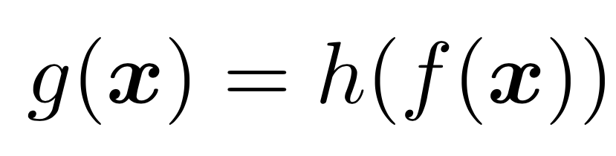
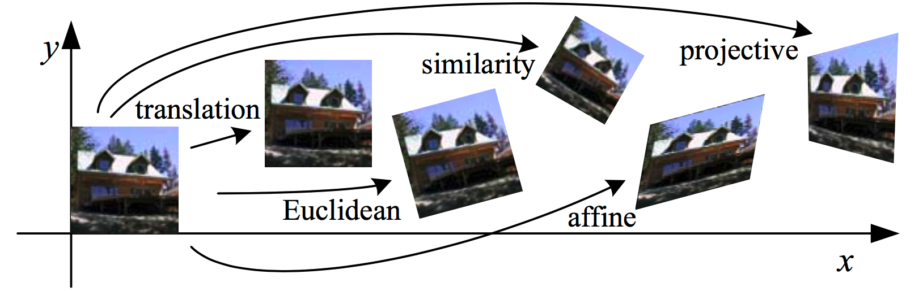
Geometric Transformations
Image transforms the range of the image

Slide 4
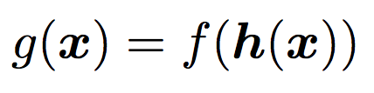
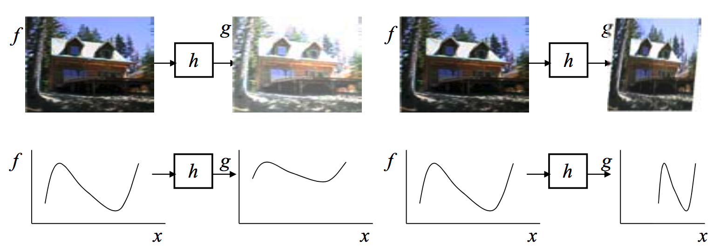
Geometric Transformations
Transform the domain
Notes:
1. Parametric transformations
2. local general deformations
3. cross-dissolves to create interesting morphs

Slide 5
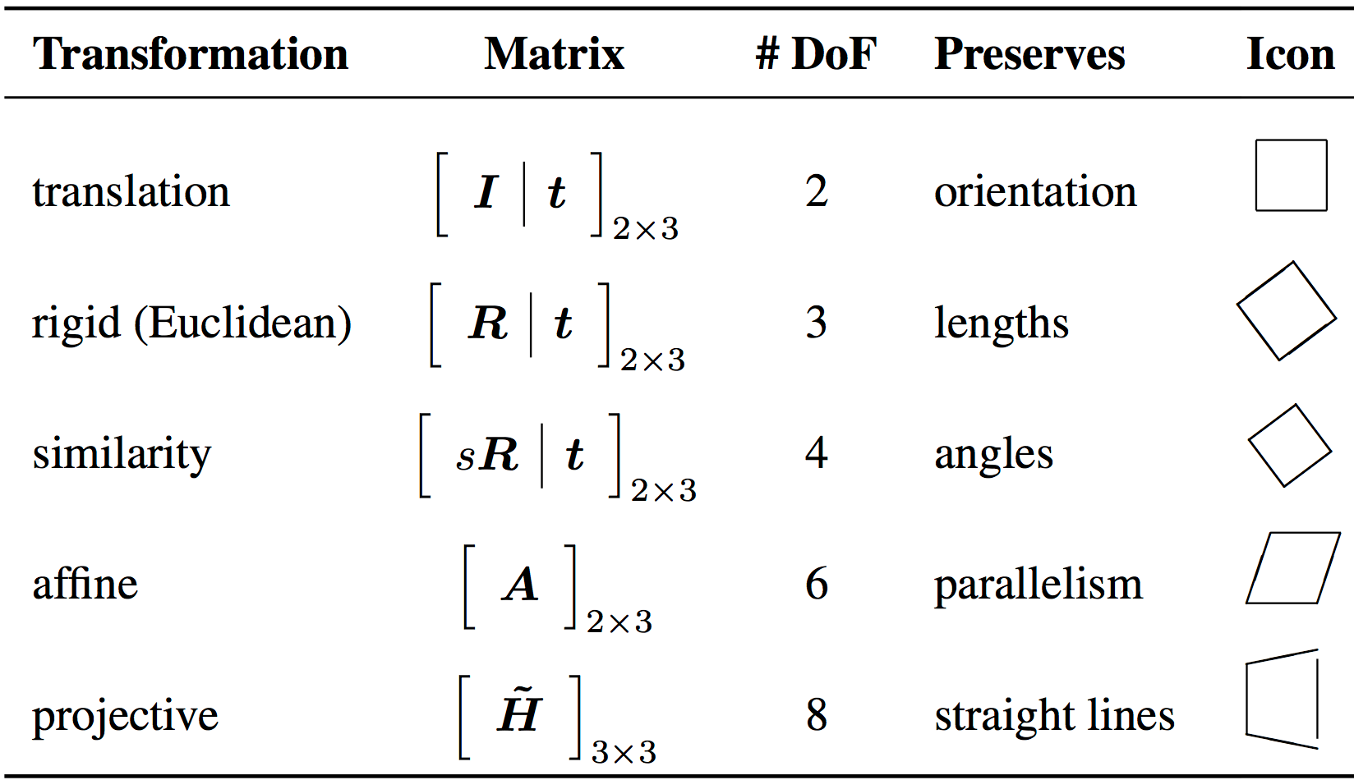
Parametric transformations
Why name is parametric transformation?
The behavior of the transformation is controlled by a small number of parameters
Notes:
Hierarchy of 2D coordinate transformations. Each transformation also preserves the properties listed in the rows below it, i.e., similarity preserves not only angles but also parallelismandstraightlines.The2×3matricesareextendedwithathird[0T 1]rowtoform a full 3 × 3 matrix for homogeneous coordinate transformations.

Slide 6
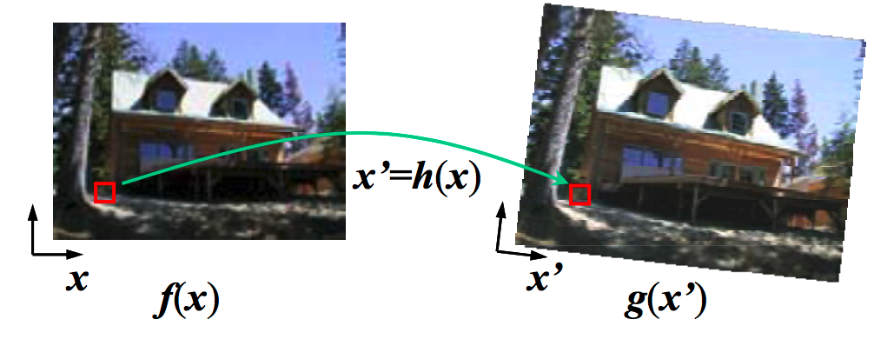
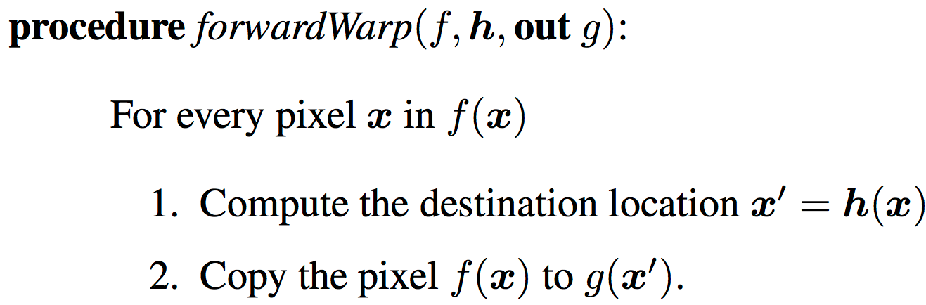
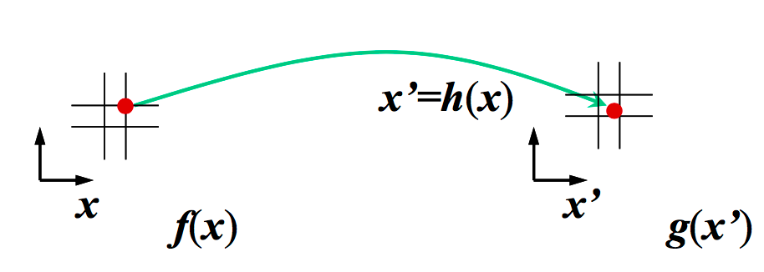
Parametric transformations
We have source image f(x) and transformation formula x’= h(x). How to compute the values of the pixels in the new image g(x)?
forward warping
Is that good ?
Notes:
Hierarchy of 2D coordinate transformations. Each transformation also preserves the properties listed in the rows below it, i.e., similarity preserves not only angles but also parallelismandstraightlines.The2×3matricesareextendedwithathird[0T 1]rowtoform a full 3 × 3 matrix for homogeneous coordinate transformations.
The process of copying a pixel f(x) to a location x′ in g is not well defined when x′ has a non-integer value. What do we do in such a case? What would you do?

Slide 7
Parametric transformations
Forward warping:
The process of copying a pixel f(x) to a location x′ in g is not well defined when x′ has a non-integer value
forward warping is the appearance of cracks and holes, especially when magnifying an image.
Any idea for this problems?
Each pixel in the destination image g(x′) is sampled from the original image f(x)
How does this differ from ?
since hˆ(x′) is (presumably) defined for all pixels in g(x′)→ we no longer have holes.
Resampling an image at non-integer locations is a well-studied problem
High-quality filters that control aliasing can be used.
Notes:
A preferable solution is to use inverse warping (Algorithm 3.2), where each pixel in the destination image g(x′) is sampled from the original image f(x)

Slide 8
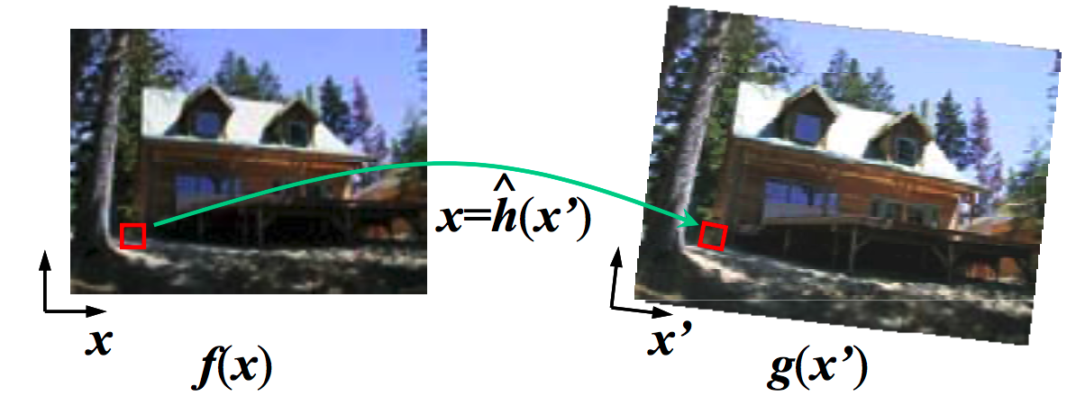
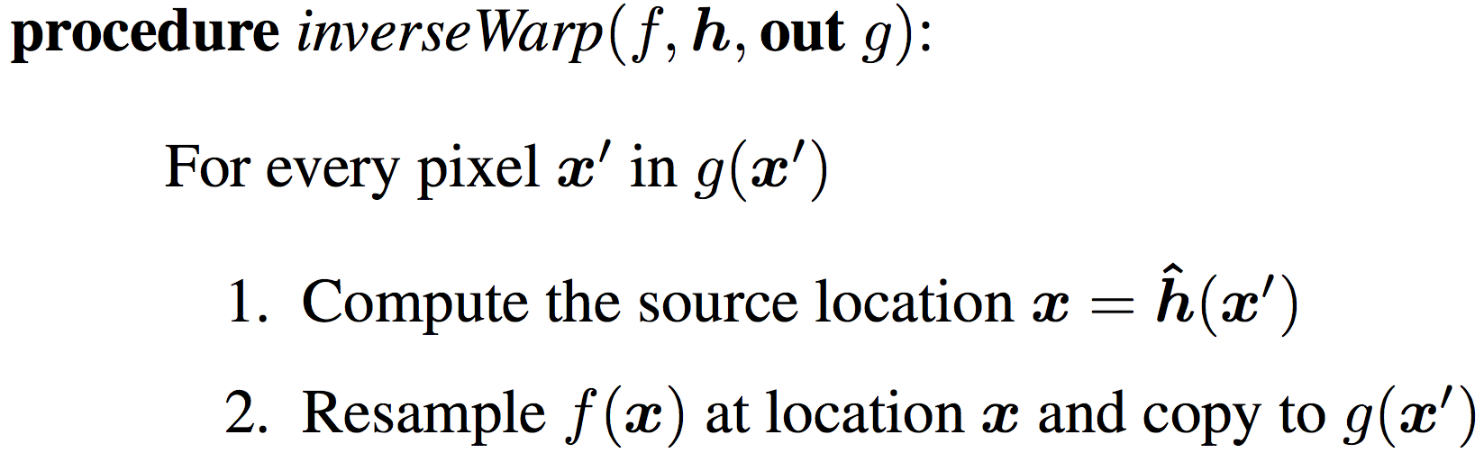
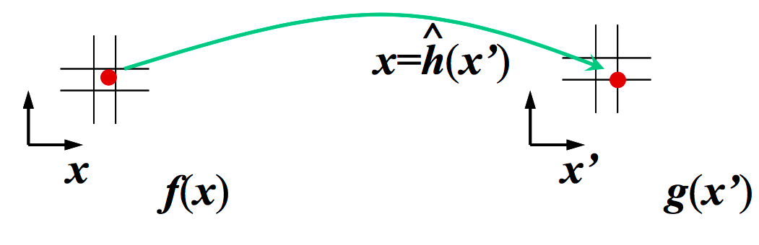
Parametric transformations
Inverse warping:
Notes:
Inverse warping algorithm: (a) a pixel g(x′) is sampled from its corresponding
(a)
(b)
location x = hˆ(x′) in image f(x); (b) detail of the source and destination pixel locations.

Slide 9
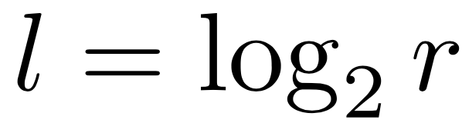
MIP-mapping
To prevent aliasing → we need to pre-filter the image.
rapidly pre-filter images being used for texture mapping in computer graphics.
A MIP-map is a standard image pyramid where each level is pre-filtered with a high-quality filter rather than a poorer quality approximation.
To resample an image from a MIP-map, a scalar estimate of the resampling rate r is first computed( OpenGL and Direct3D)
Once a resampling rate has been specified, a fractional pyramid level is computed using the base 2 logarithm

Slide 10
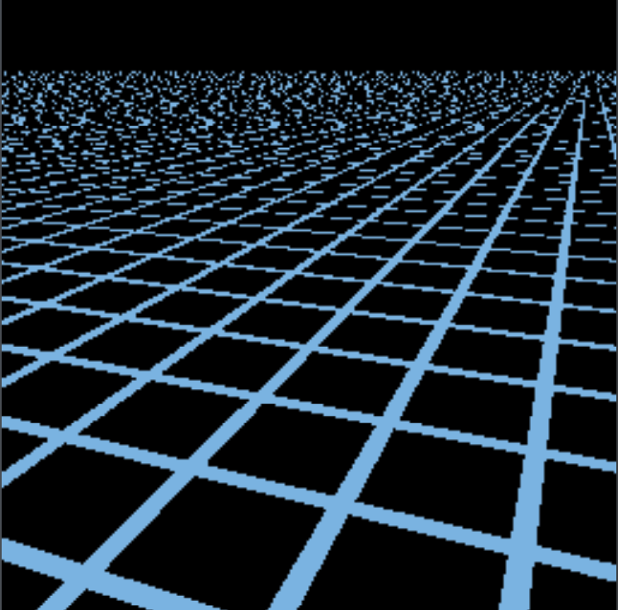
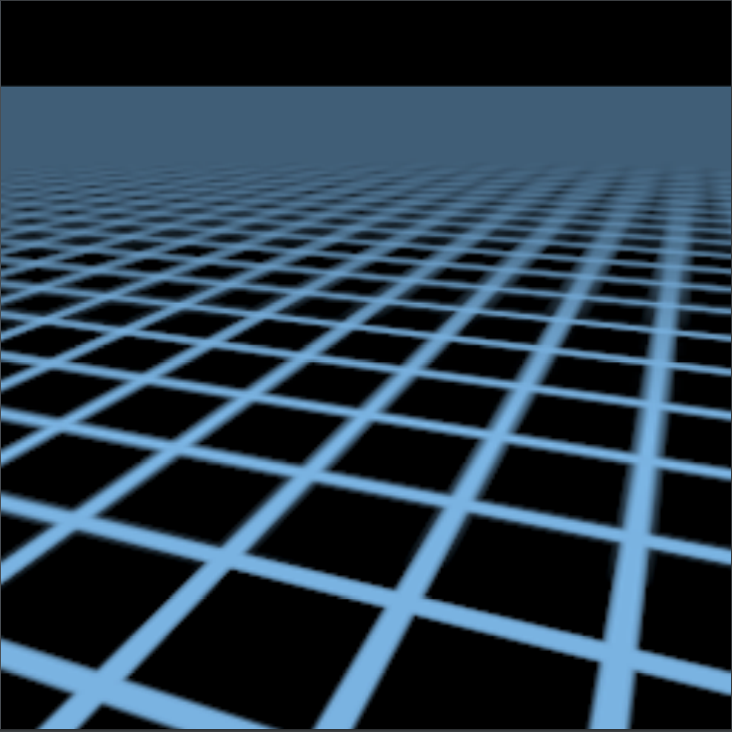
MIP-mapping
Notes:
Consider having a high resolution texture on a mesh plane. When this texture is viewed from a close distance, everything is visually in place however, when viewed from a distance, the texture becomes distorted and out of place→ apply MIP- Mapping to solve this problem
Illustrates the difference in quality when using mip-mapping, left image represents before mip-mapping is applied while right shows after mip-mapping is applied.

Slide 11
Elliptical Weighted Average
The Elliptical Weighted Average (EWA) filter invented by Greene and Heckbert (1986) is based on the observation that the affine mapping x = Ax′ defines a skewed two-dimensional coordinate system in the vicinity of each source pixel x.
For every destination pixel x′, the ellipsoidal projection of a small pixel grid in x′ onto x is computed.
Using to filter the source image g(x) with a Gaussian whose inverse covariance matrix is this ellipsoid.
The EWA is also quite slow

Slide 12
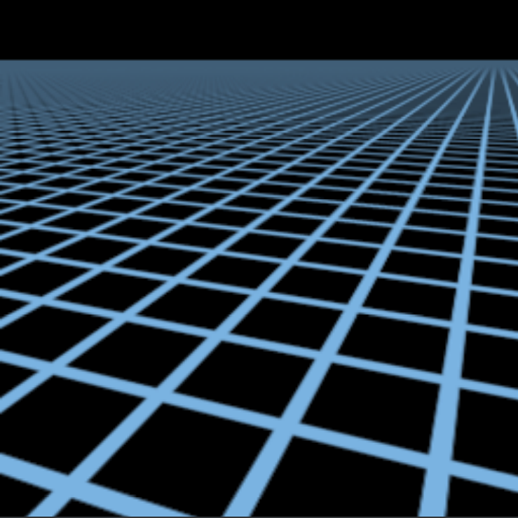
Elliptical Weighted Average
Notes:
Illustrates the difference in quality when using EWA, left image represents before EWA is applied while right shows afterEWA is applied.

Slide 13
Anisotropic filtering
Anisotropic filtering is a method of enhancing the image quality of textures on surfaces of computer graphics that are at oblique viewing angles with respect to the camera where the projection of the texture.
Anisotropic filtering eliminates aliasing effects but improves on these other techniques by reducing blur and preserving detail at extreme viewing angles.
Anisotropic filtering is now common in modern graphics hardware and is enabled either by users through driver settings or by graphics applications and video games through programming interfaces.

Slide 14
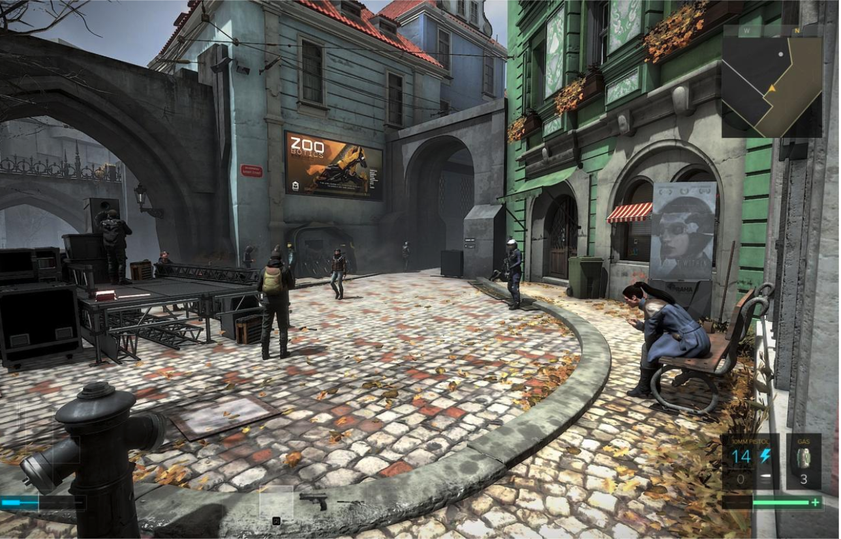
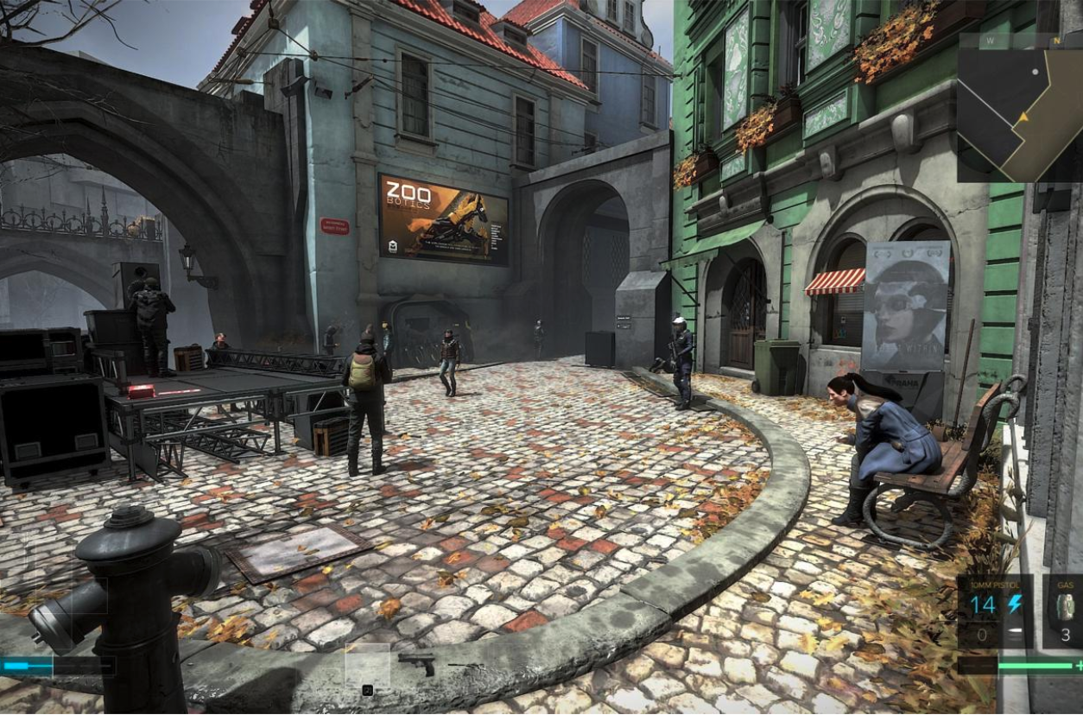
Anisotropic filtering
Notes:
Left: the cobbled street, the textures get blurrier and blurrier
Right: the cobbled stones around you and in the distance look much clearer.

Slide 15
Multi-pass transforms
For parametric transforms, the oriented two-dimensional filtering and resampling operations can be approximated using a series of one-dimensional resampling and shearing trans- forms
The advantage of using a series of one- dimensional transforms is that they are much more efficient than large, non-separable, two-dimensional filter kernels.
In order to prevent aliasing, however, it may be necessary to upsample in the opposite direction before applying a shearing transformation

Slide 16
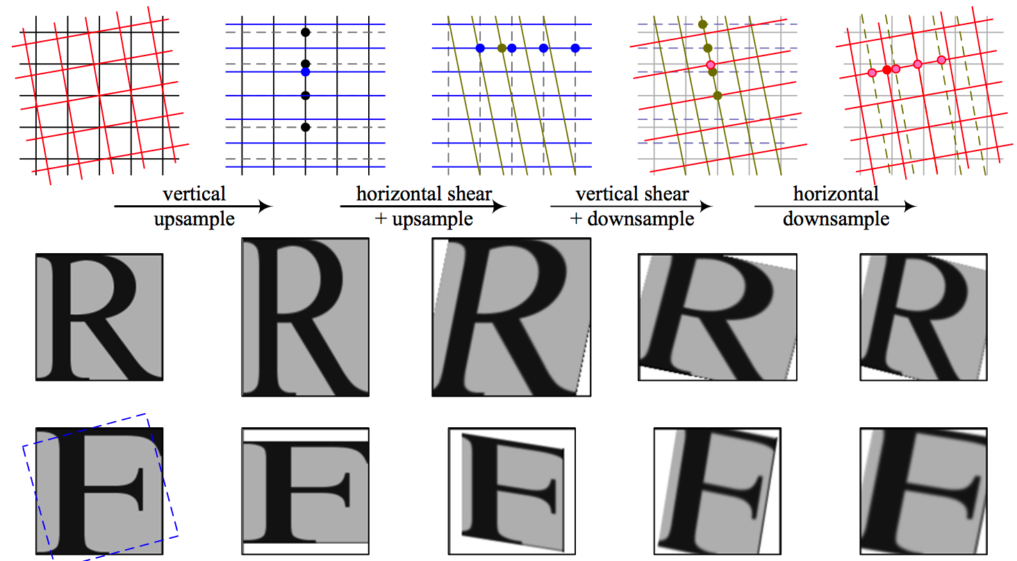
Multi-pass transforms
Notes:
Four-pass rotation (Szeliski, Winder, and Uyttendaele 2010): (a) original pixel grid, image, and its Fourier transform; (b) vertical upsampling; (c) horizontal shear and up- sampling; (d) vertical shear and downsampling; (e) horizontal downsampling. The general affine case looks similar except that the first two stages perform general resampling.

Slide 17
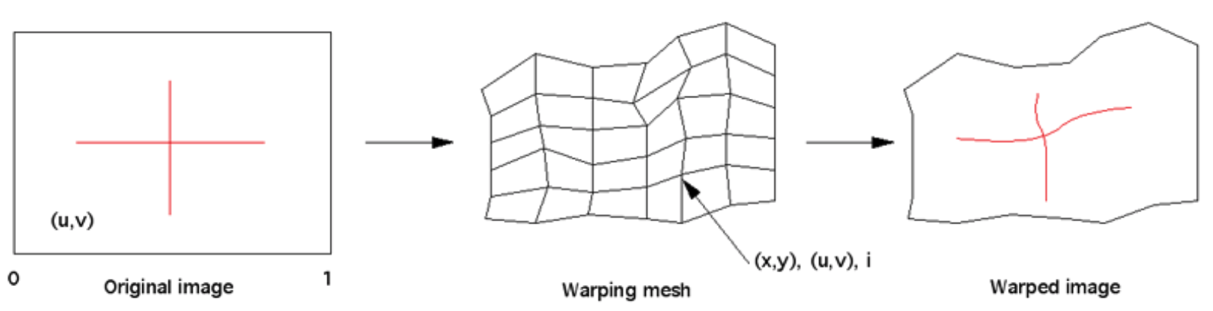
Mesh-based warping
Images that are not simple perspective projections that are the norm for flat screen displays
The image in a format that contains all the required visual information and distort it to compensate for the non planar nature of the surface.
Notes:
Image applied as a texture to a mesh, each node is defined by a position (x,y) and texture coordinate (u,v).

Slide 18
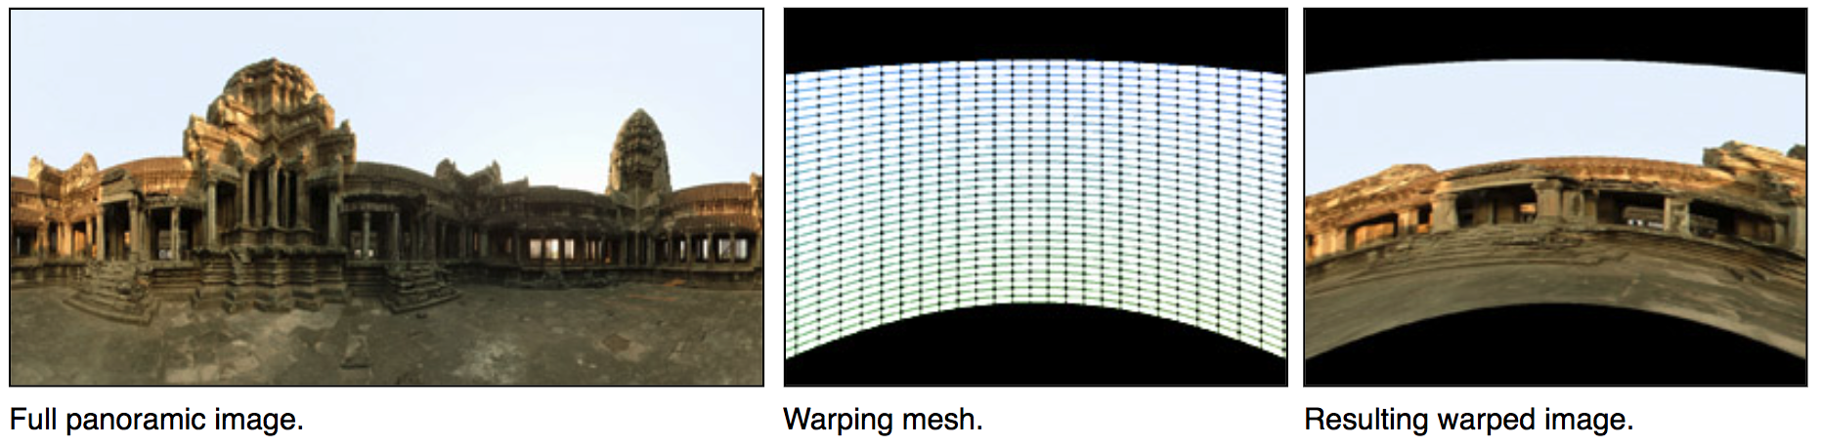
Mesh-based warping
Notes:
Example warping a panoramic image for a cylindrical display. The warping is encoded in the x,y node positions, the u,v coordinates are a regular grid.

Slide 19
Summary
Learn about Geometric transformations in image domain.
Learn and implement the Geometric transformations
MIP-mapping
Elliptical Weighted Average
Anisotropic filtering
Multi-pass transforms
Mesh-based warping

