Slide 1
Feature detection and matching - Points and patches

Slide 2
Objectives
Learn about keypoint features or interest points
Learn how to handle patches of pixels surrounding the point location
The techniques is used in Feature detectors
The techniques is used in Feature descriptors
The techniques is used in Feature matching
The techniques is used in Feature tracking
Notes:
Application:
Extract feature of image base on frequency
Filtering noise
Determining frequencies in an image

Slide 3
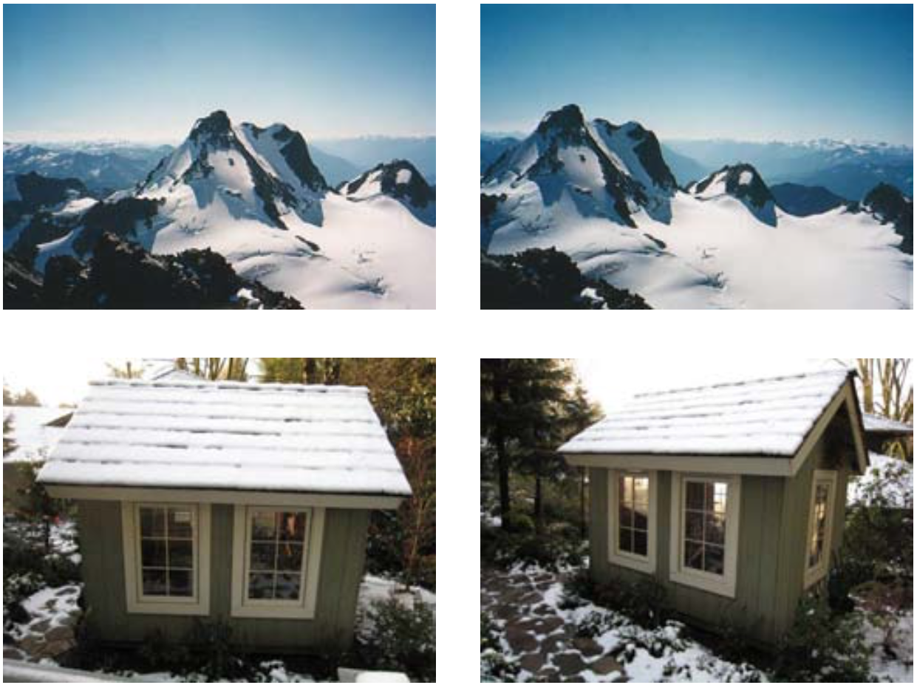
How to determine matched images?
Notes:
- For the first pair, we may wish to align the two images so that they can be seamlessly stitched into a composite mosaic
- For the second pair, we may wish to establish a dense set of correspondences so that a 3D model can be constructed or an in-between view can be generated

Slide 4
Points, Patches and Feature
Image patch as the name suggests is a group of pixels in an image( correspondence points)
Feature is a piece of information about the content of an image.
Features may be specific structures in the image such as points, edges, or objects.
Point features can be used to find a sparse set of corresponding locations in different images
Feature extraction involves reducing the number of resources required to describe a large set of data

Slide 5
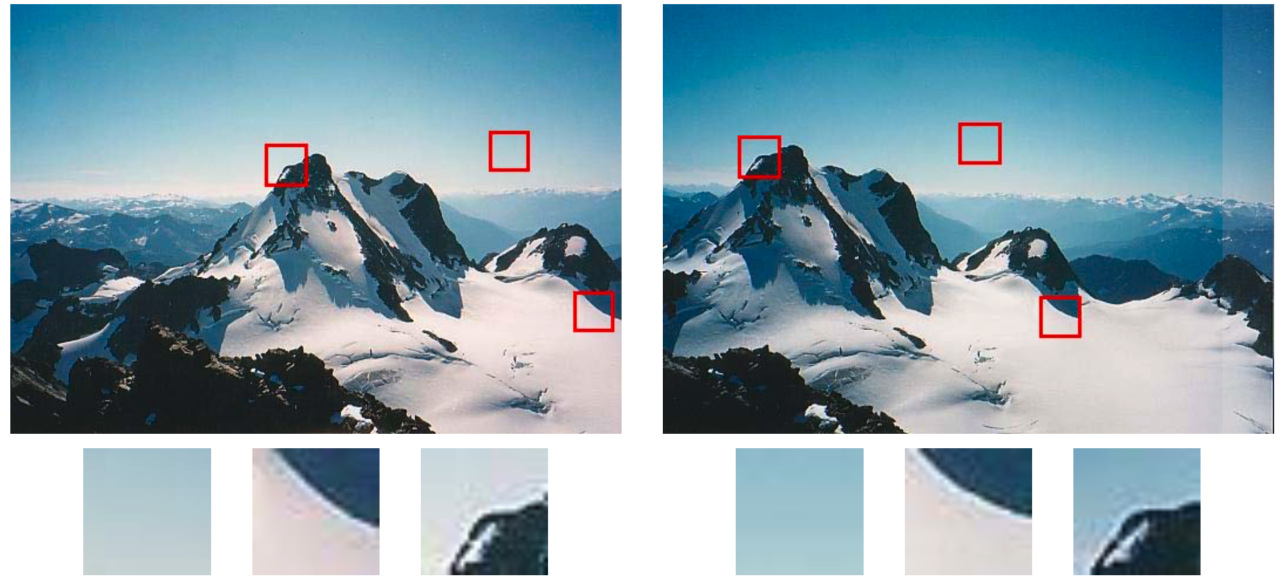
Feature detectors
How can we find image locations where we can reliably find correspondences with other images?
What are good features to track?
Notes:
feature detection (extraction)
the three sample patches to see how well they might be matched or tracked. Image pairs with extracted patches below. Notice how some patches can be localized or matched with higher accuracy than others.

Slide 6
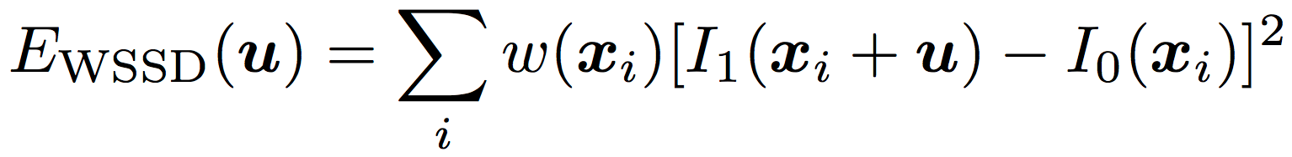
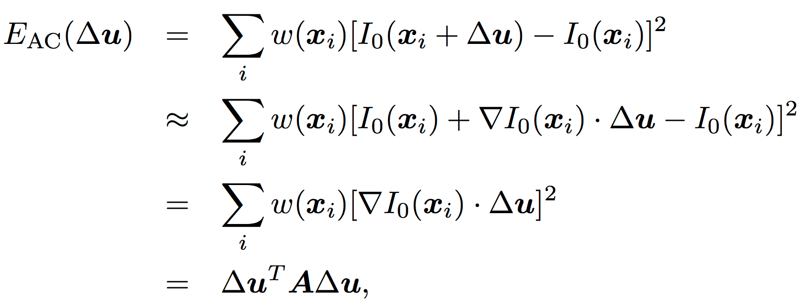
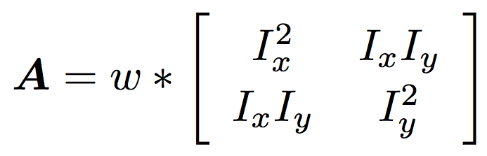
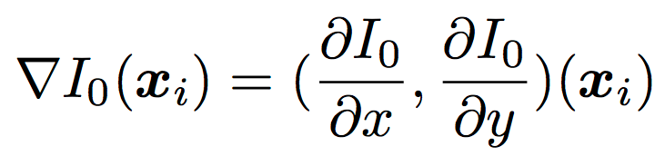
Feature detectors
Matching criterion for comparing two image patches:
where I0 and I1 are the two images being compared, u = (u, v) is the displacement vector, w(x) is a spatially varying weighting function, and the summation i is over all the pixels in the patch.
Auto-correlation function
Where image gradient at xi
Auto-correlation matrix
Notes:
Therefore, we can only compute how stable this metric is with respect to small variations in position ∆u by comparing an image patch against itself, which is known as an auto-correlation function or surface

Slide 7
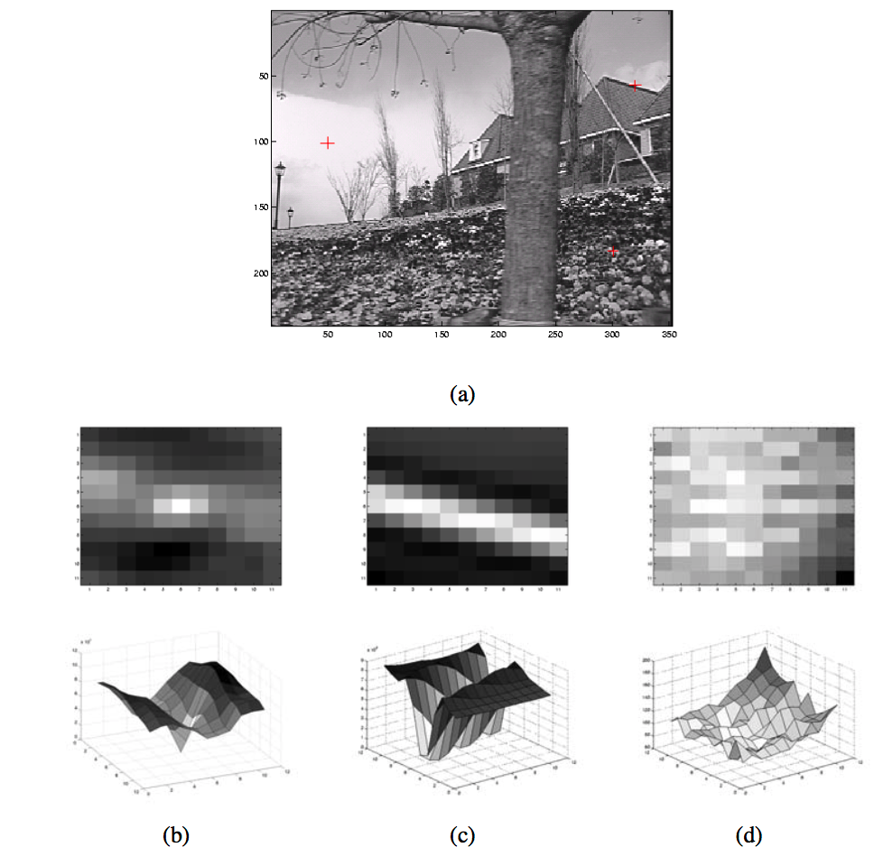
Feature detectors
Notes:
Three auto-correlation surfaces EAC(∆u) shown as both grayscale images and surface plots: (a) The original image is marked with three red crosses to denote where the auto-correlation surfaces were computed; (b) this patch is from the flower bed (good unique minimum); (c) this patch is from the roof edge (one-dimensional aperture problem); and (d) this patch is from the cloud (no good peak). Each grid point in figures b–d is one value of ∆u.

Slide 8
Feature detectors
The basic auto-correlation-based keypoint detector algorithm
Compute the horizontal and vertical derivatives of the image Ix and Iy by convolving the original image with derivatives of Gaussians
Compute the three images corresponding to the outer products of these gradients
Convolve each of these images with a larger Gaussian.
Compute a scalar interest measure using one of the formulas discussed above
Find local maxima above a certain threshold and report them as detected feature point locations.

Slide 9
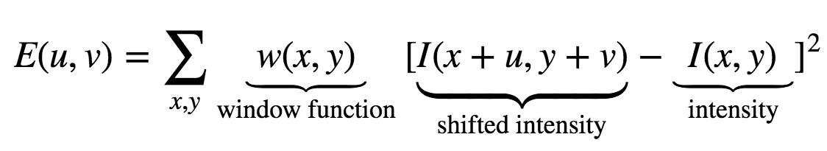
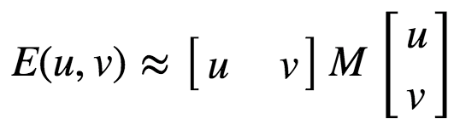
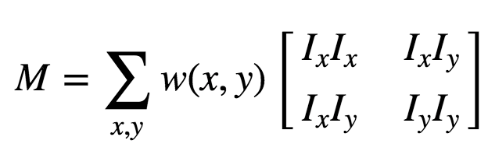

Feature detectors - Harris Corner Detector
It basically finds the difference in intensity for a displacement of (u,v) in all directions
We have to maximize this function E(u,v) for corner detection
Where and Ix and Iy are image derivatives in x and y directions respectively.
Compute score which determines if a window can contain a corner or not.
Where det(M)=λ1λ2, trace(M)=λ1+λ2, λ1 and λ2 are the eigenvalues of M
Notes:
Harris Corner Detection — Uses a Gaussian window function to detect corners

Slide 10
Feature detectors - Harris Corner Detector
The magnitudes of these eigenvalues decide whether a region is a corner, an edge, or flat
When |R| is small, which happens when λ1 and λ2 are small, the region is flat.
When R<0, which happens when λ1>>λ2 or vice versa, the region is edge.
When R is large, which happens when λ1 and λ2 are large and λ1∼λ2, the region is a corner.

Slide 11
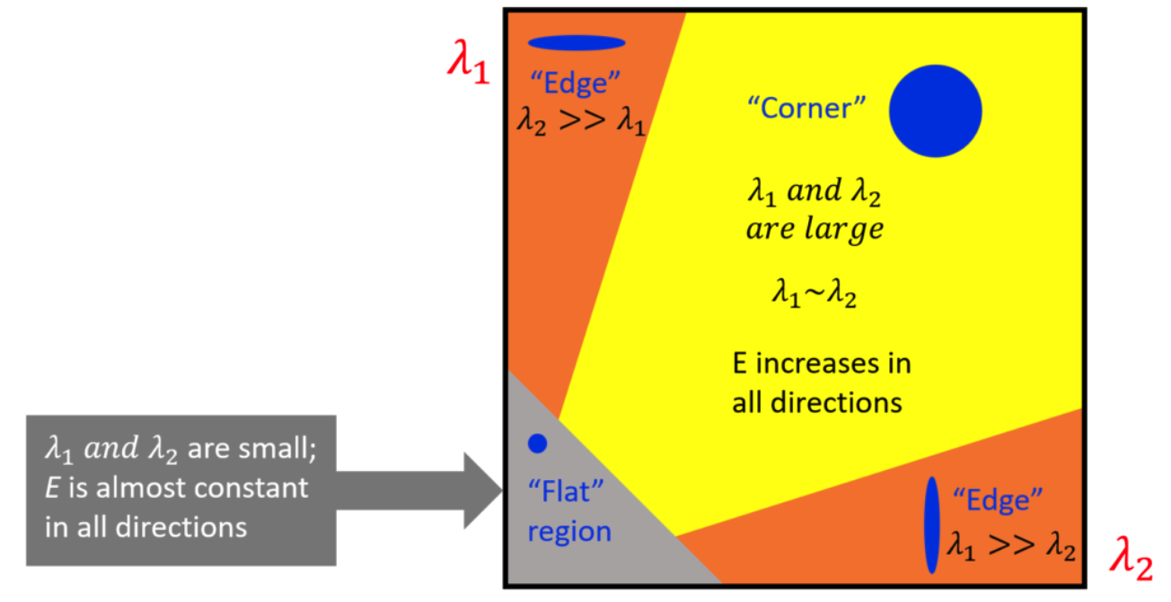
Feature detectors - Harris Corner Detector

Slide 12
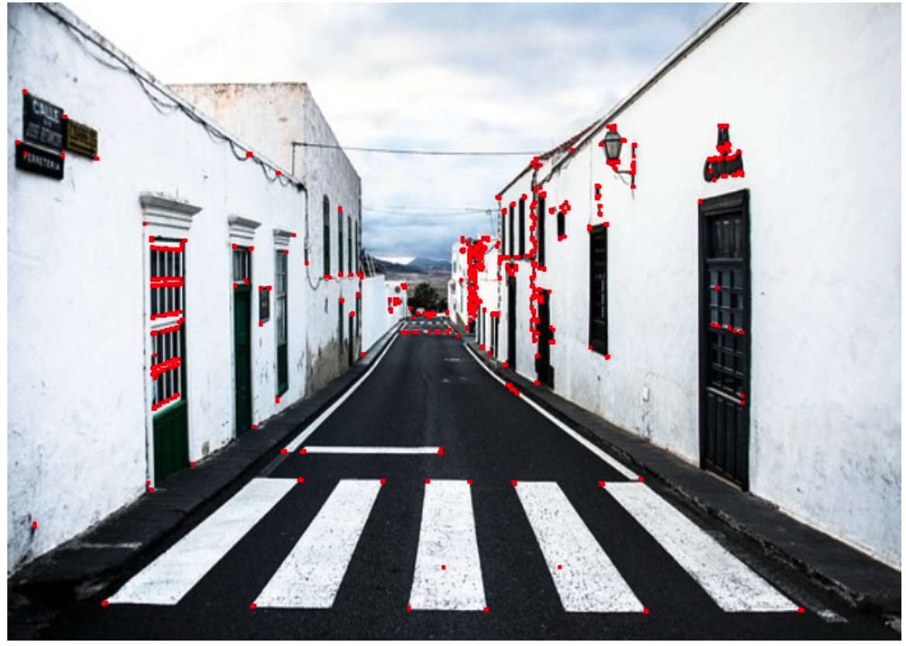
Feature detectors - Harris Corner Detector

Slide 13
Feature detectors - Scale-Invariant Feature Transform
It is a feature detection algorithm in computer vision to detect and describe local features in images
SIFT Algorithm :
Scale-space peak selection: Potential location for finding features.
Keypoint Localization: Accurately locating the feature keypoints.
Orientation Assignment: Assigning orientation to keypoints.
Keypoint descriptor: Describing the keypoints as a high dimensional vector.
Keypoint Matching
Notes:
Scale-Invariant Feature Transform (SIFT) — This technique is scale invariant unlike the previous two
In last couple of chapters, we saw some corner detectors like Harris etc. They are rotation-invariant, which means, even if the image is rotated, we can find the same corners. It is obvious because corners remain corners in rotated image also. But what about scaling? A corner may not be a corner if the image is scaled. For example, check a simple image below. A corner in is a feature detection algorithm in computer vision to detect and describe local features in imagesScale-space peak selection: Potential location for finding features.Keypoint Localization: Accurately locating the feature keypoints.Orientation Assignment: Assigning orientation to keypoints.Keypoint descriptor: Describing the keypoints as a high dimensional vector.Keypoint Matchinga small image within a small window is flat when it is zoomed in the same window. So Harris corner is not scale invariant.

Slide 14
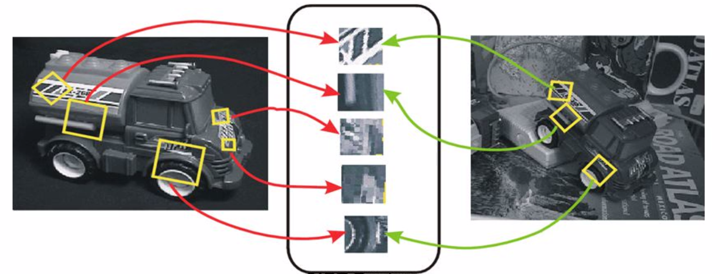
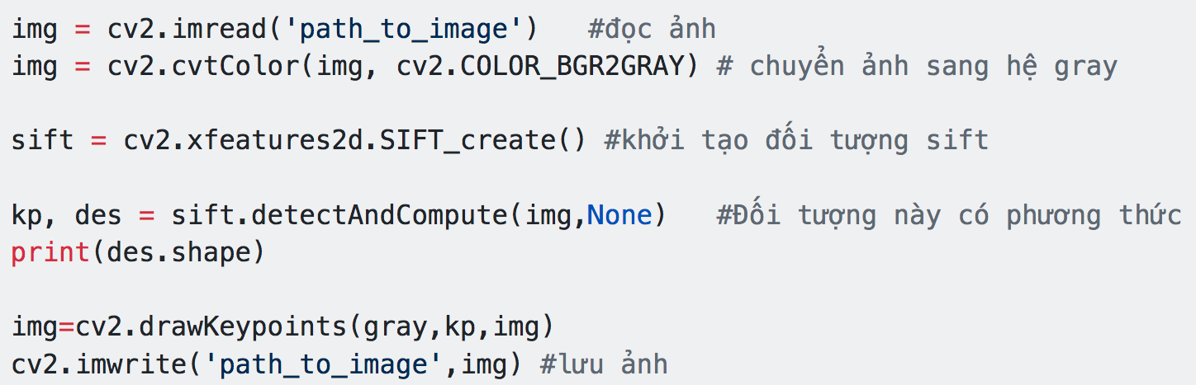
Feature detectors - Scale-Invariant Feature Transform
Notes:
Scale-Invariant Feature Transform (SIFT) — This technique is scale invariant unlike the previous two

Slide 15
Feature detectors - Others
Speeded-Up Robust Features (SURF) — This is a faster version of SIFT as the name says.
Features from Accelerated Segment Test (FAST) — This is a much more faster corner detection technique compared to SURF.
Binary Robust Independent Elementary Features (BRIEF) —This technique reduces the memory usage by converting descriptors in floating point numbers to binary strings.
Oriented FAST and Rotated BRIEF (ORB) — uses FAST keypoint detector and BRIEF descriptor.

Slide 16
Feature descriptors
After detecting features (keypoints), you must determine which features come from corresponding locations in different images.
A feature descriptor is an algorithm that takes an image and outputs feature descriptors/feature vectors.
Feature descriptors encode interesting information into a series of numbers and act as a sort of numerical "fingerprint" that can be used to differentiate one feature from another.
Ideally, this information would be invariant under image transformation, so we can find the feature again even if the image is transformed in some way

Slide 17
Feature descriptors - Scale-Invariant Feature Transform
It is a feature detection algorithm in computer vision to detect and describe local features in images
SIFT Algorithm :
Scale-space peak selection: Potential location for finding features.
Keypoint Localization: Accurately locating the feature keypoints.
Orientation Assignment: Assigning orientation to keypoints.
Keypoint descriptor: Describing the keypoints as a high dimensional vector.
Keypoint Matching
Notes:
Scale-Invariant Feature Transform (SIFT) — This technique is scale invariant unlike the previous two
In last couple of chapters, we saw some corner detectors like Harris etc. They are rotation-invariant, which means, even if the image is rotated, we can find the same corners. It is obvious because corners remain corners in rotated image also. But what about scaling? A corner may not be a corner if the image is scaled. For example, check a simple image below. A corner in is a feature detection algorithm in computer vision to detect and describe local features in imagesScale-space peak selection: Potential location for finding features.Keypoint Localization: Accurately locating the feature keypoints.Orientation Assignment: Assigning orientation to keypoints.Keypoint descriptor: Describing the keypoints as a high dimensional vector.Keypoint Matchinga small image within a small window is flat when it is zoomed in the same window. So Harris corner is not scale invariant.

Slide 18
Feature descriptors - Scale-Invariant Feature Transform
Notes:
Scale-Invariant Feature Transform (SIFT) — This technique is scale invariant unlike the previous two

Slide 19
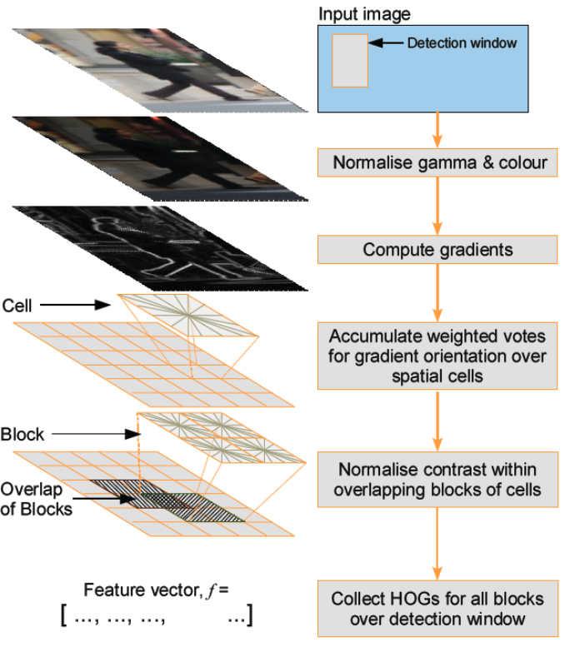
Feature descriptors - Histogram of Oriented Gradients
Notes:
HOG is a histogram of orientations of the image gradients within a patch
the Histogram of Oriented Gradients method (or HOG for short) is used for object detection and image recognition.
HOG is based off of feature descriptors, which extract the useful information and discard the unnecessary parts.
HOG calculates the horizontal and vertical component of the gradient’s magnitude and direction of each individual pixel and then organizes the information into a 9-bin histogram to determine shifts in the data.
Block normalization can be further utilized to make the model more optimal and less biased.

Slide 20
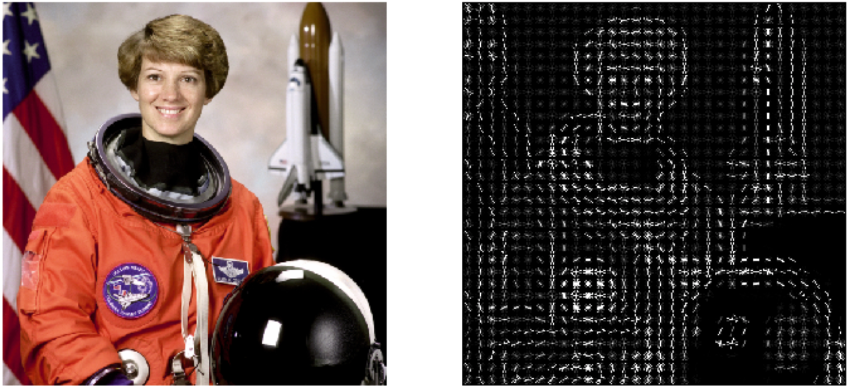
Feature descriptors - Histogram of Oriented Gradients
Notes:
HOG is a histogram of orientations of the image gradients within a patch

Slide 21
Feature descriptors - Others
Steerable filters: is an orientation-selective convolution kernel used for image enhancement and feature extraction that can be expressed via a linear combination of a small set of rotated versions of itself
Shape context and geometric blur: Geometric blur is simply an average over geometric transformations of a signal. This turns out to be a useful operation for comparing two signals when some geometric distortion is expected.

Slide 22
Feature matching
After extracted features and their descriptors from two or more images→ establish some preliminary feature matches between these images.
The algorithm is based on comparing and analyzing point correspondences between the reference image and the target image
Feature matching steps:
Select a matching strategy, which determines which correspondences are passed on to the next stage for further processing.
Devise efficient data structures and algorithms to perform this matching as quickly as possible.

Slide 23
Feature matching - Matching strategy and error rates
Determining which feature matches are reasonable to process further depends on the context in which the matching is being performed.
Euclidean (vector magnitude) distances in feature space can be directly used for ranking potential matches.
The simplest matching strategy is to set a threshold (maximum distance) and to return all matches from other images within this threshold.
Threshold too high results in too many false positives--> incorrect matches being returned.
Threshold too low results in too many false negatives--> too many correct matches being missed

Slide 24
Feature matching - Efficient matching
Once we have decided on a matching strategy, you still need to search efficiently for potential candidates.
The simplest way to find all corresponding feature points is to compare all features against all other features in each pair of potentially matching images
Multi-dimensional search tree: k-d trees,
Multi-dimensional hashing: Haar wavelets, Locality sensitive hashing

Slide 25
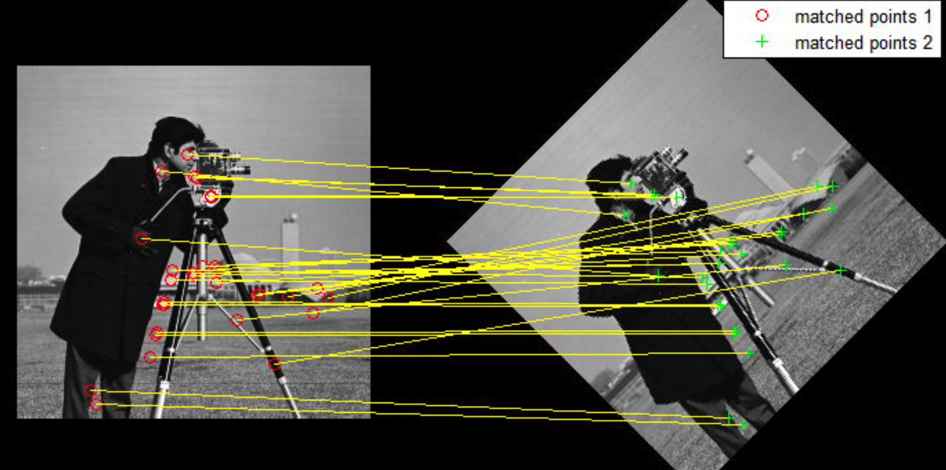
Feature matching

Slide 26
Feature tracking
The feature point tracking problem consists of detecting images of particles in a digital video sequence and linking these detections over time to follow the traces of individual particles.
The feature tracking problem: considering two consecutive frames from a video sequence, visual features are extracted within the first frame. Then, it is tried to find the same features back in the next frame.
The expected amount of motion and appearance deformation between adjacent frames is expected to be small.
Searching for locations where the corresponding patch has low squared difference often works well enough.

Slide 27
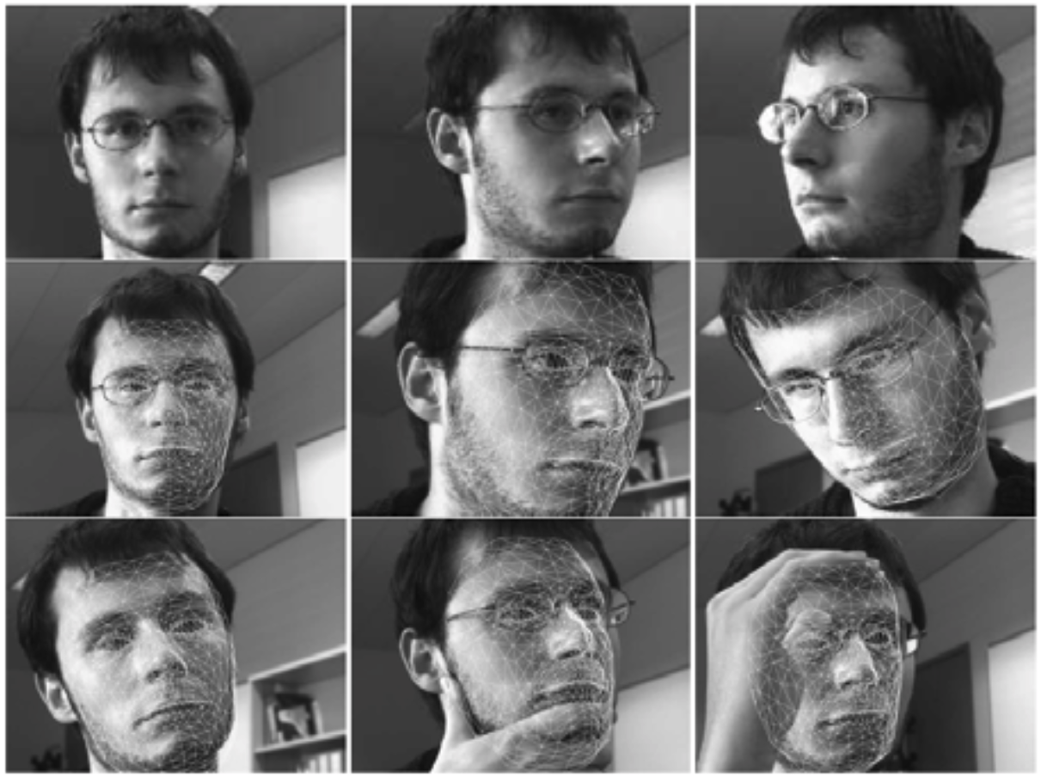
Feature tracking
Notes:
Real-time head tracking using the fast trained classifiers of Lepetit, Pilet, and Fua (2004) ⃝c 2004 IEEE.

Slide 28
Summary
Learn about keypoint features or interest points
Learn how to handle patches of pixels surrounding the point location
The techniques is used in Feature detectors
The techniques is used in Feature descriptors
The techniques is used in Feature matching
The techniques is used in Feature tracking

