Slide 1
Segmentation - Active contours

Slide 2
Objectives
What is Segmentation?
What are the effect of Segmentation in image processing and computer vision?
What is the active contour technique?
The techniques of active contours
Specific applications of active contours

Slide 3
What is Segmentation?
It is the process of dividing an image into different regions based on the characteristics of pixels to identify objects or boundaries to simplify an image and more efficiently analyze it
The goal of segmentation is to simplify and change the representation of an image into something that is more meaningful and easier to analyze.
Image segmentation is the process of assigning a label to every pixel in an image such that pixels with the same label share certain characteristics.

Slide 4
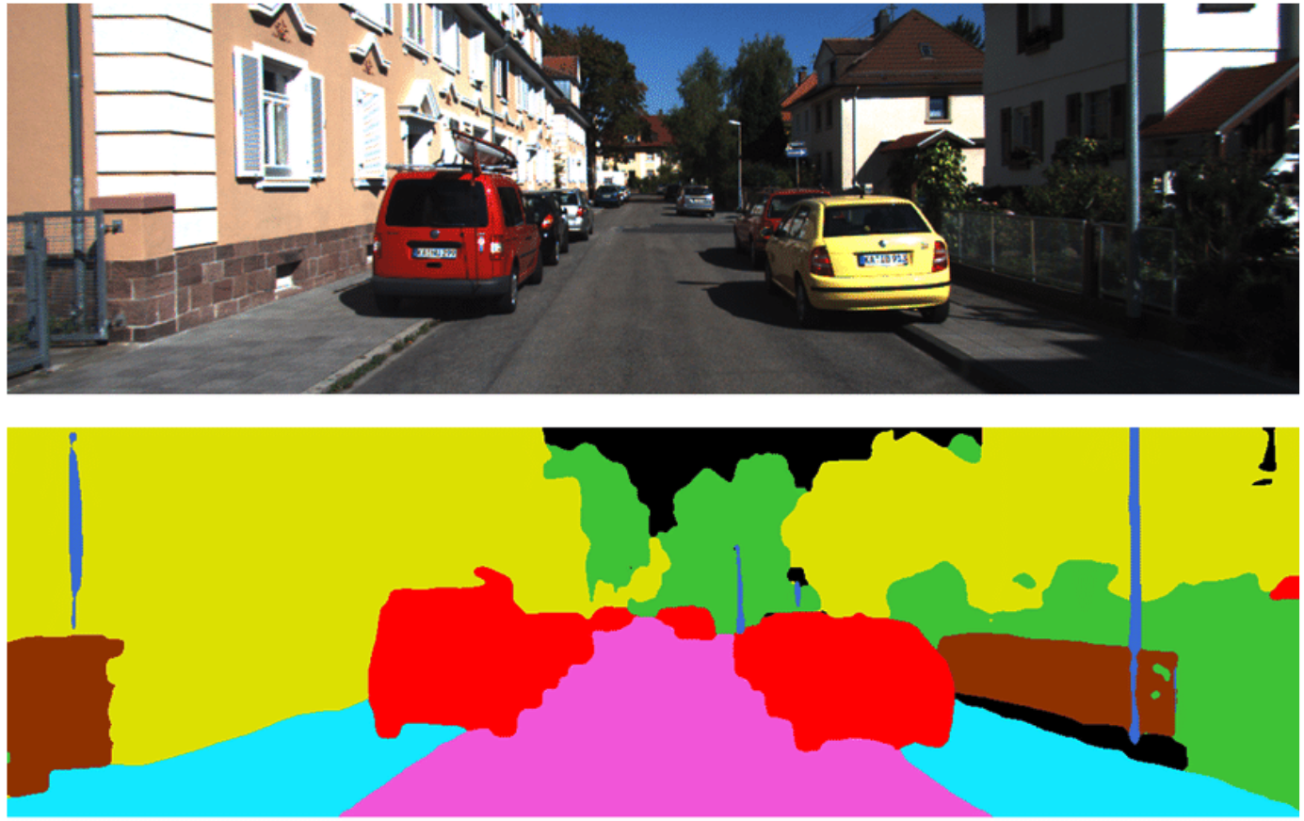
What is Image Segmentation?
The result of image segmentation is a set of segments that collectively cover the entire image or a set of contours extracted from the image

Slide 5
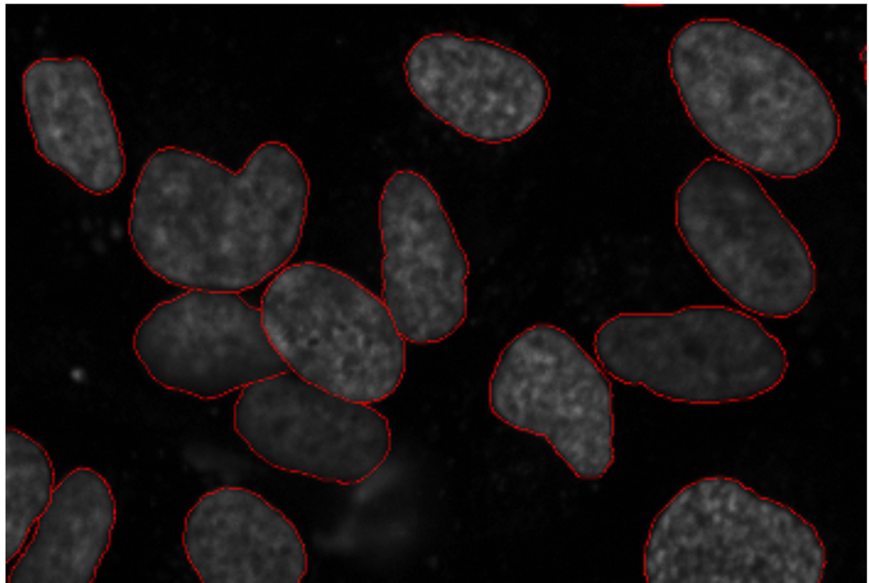
Why Image Segmentation?
Detecting cancerous cell(s) as quickly as possible can potentially save millions of lives.
The shape of the cancerous cells plays a vital role in determining the severity of the cancer. Object detection will not be very useful here. We will only generate bounding boxes which will not help us in identifying the shape of the cells.
Notes:
Image Segmentation techniques make a MASSIVE impact here. They help us approach this problem in a more granular manner and get more meaningful results.

Slide 6
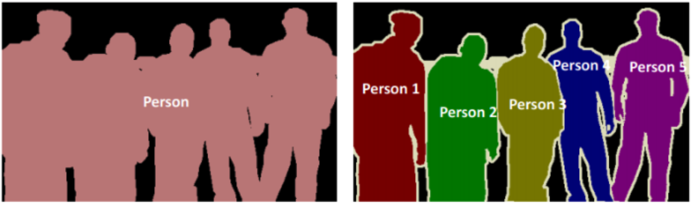
Image Segmentation Types
Semantic segmentation is an approach detecting, for every pixel, belonging class of the object.
Instance segmentation is an approach that identifies, for every pixel, a belonging instance of the object. It detects each distinct object of interest in the image.
Notes:
Semantic segmentation : (when all people in a figure are segmented as one object and background as one object)
Instance segmentation :(when each person in a figure is segmented as an individual object)

Slide 7
Application Image Segmentation?
Content-based image retrieval
Medical imaging: Locate tumors and other pathologies, Measure tissue volumes
Object detection: Pedestrian detection, Face detection
Recognition Tasks: Face recognition, Fingerprint recognition
Traffic control systems
Video surveillance
…
Notes:
Image Segmentation techniques make a MASSIVE impact here. They help us approach this problem in a more granular manner and get more meaningful results.

Slide 8
Image Segmentation - Active Contours
Contours are boundaries designed for the area of interest required in an image. Contour is a collection of points that undergoes interpolation process.
Active contour is a type of segmentation technique which can be defined as use of energy forces and constraints for segregation of the pixels of interest from the image.
Active contour defines a separate boundary or curvature for the regions of target object for segmentation.

Slide 9
Image Segmentation - Active Contours
Active contour is described as an active model for the process of segmentation.
Types:
Snakes model
Dynamic snakes and CONDENSATION model
Scissors model Level
Sets model

Slide 10
Snakes model
Snakes algorithm we try to move snake in a direction where energy is minimum.
Snake model is designed to vary its shape and position while tending to search through the minimal energy state.
Snake propagates through the domain of the image to reduce the energy function, and intends to dynamically move to the local minimum.

Slide 11
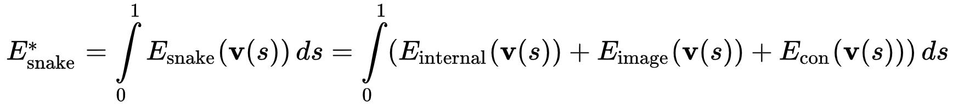

Snakes model
The energy function of the snake is the sum of its external energy and internal energy:
Internal energy :
Image energy

Slide 12
Snakes model
Snakes model steps:
Initialize the boundary curve (the active contour)➔ important
The contour moves: “Active” contour, looks like a wiggling “snake”
The contour stops moving: when many/most points on the contour line up with edge pixels
Advantage:
Autonomously and adaptively search for the minimum state.
Track dynamic objects.
Disadvantages:
Sensitive to local minima states
Dependent: contour initialization points( Number and Location)
Not works perfectly even for binary images

Slide 13
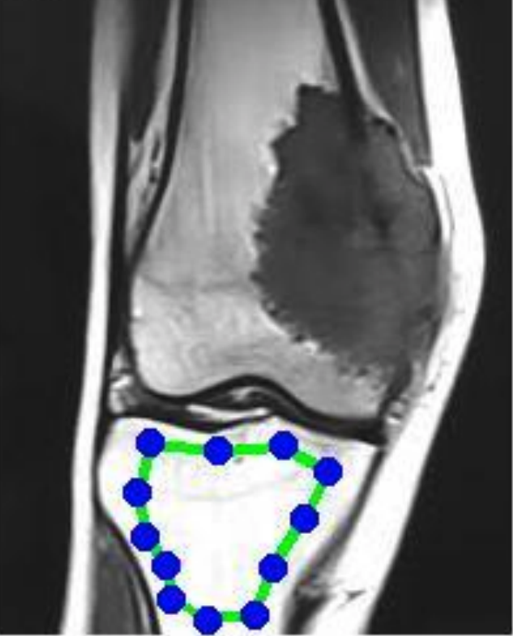
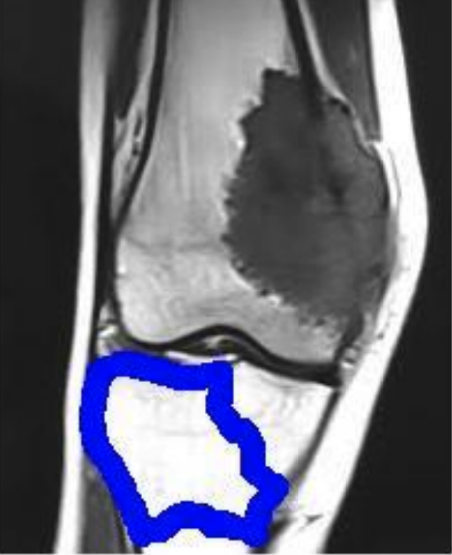
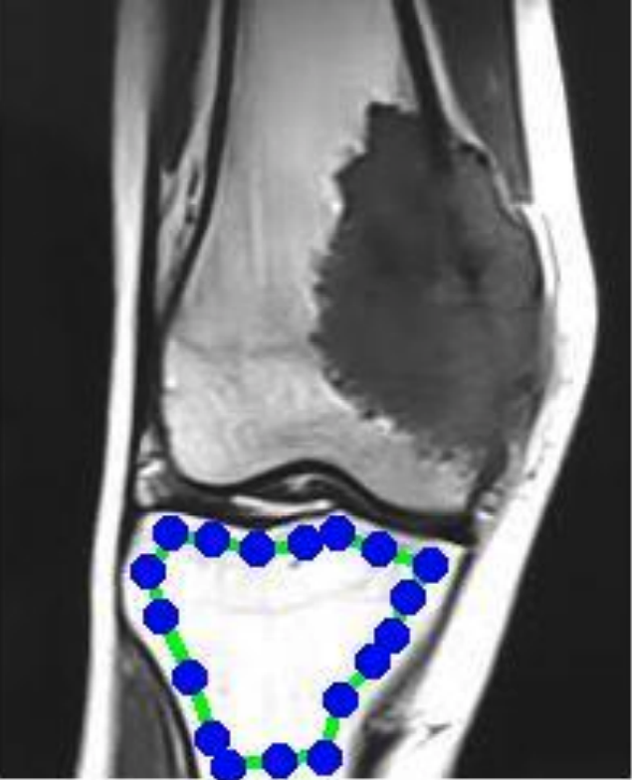
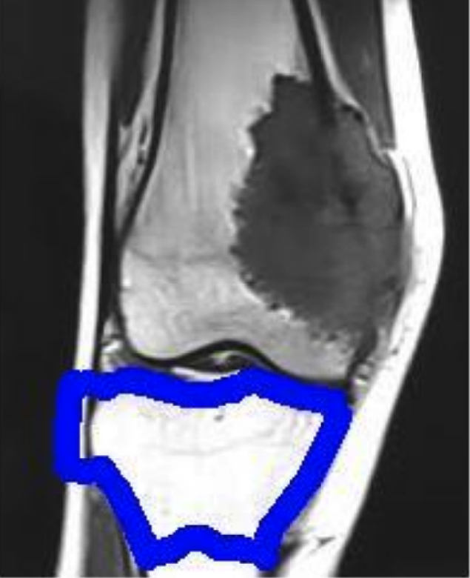
Snakes model
Initial snake
and Iteration number= 1000
Initial snake
and Iteration number= 1000

Slide 14
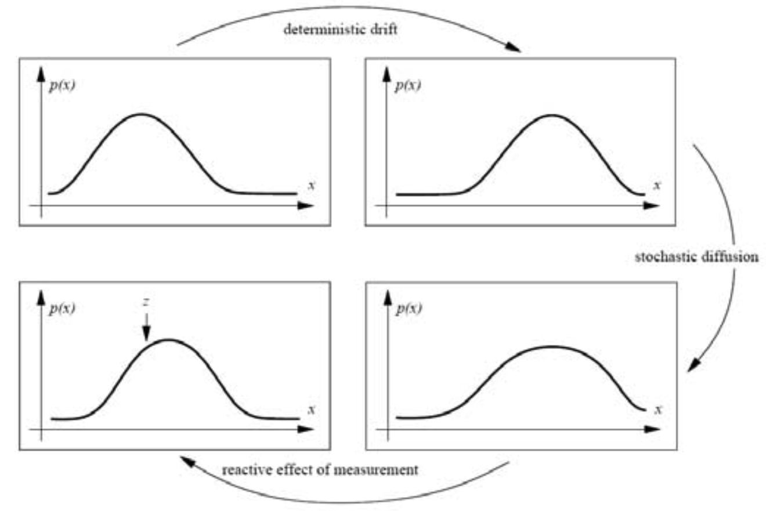
Dynamic snakes and CONDENSATION
Kalman Filter
Notes:
The Kalman filter models the distributions as uni-modal, i.e., using a mean and covariance

Slide 15
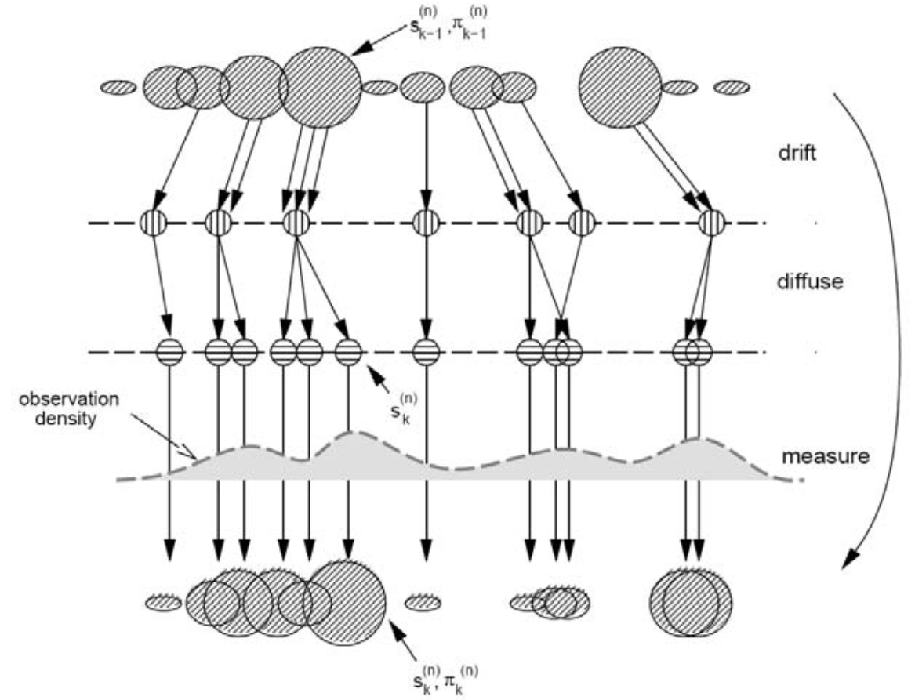
Dynamic snakes and CONDENSATION
The Condensation algorithm is based on factored sampling but extended to apply iteratively to successive images in a sequence
Notes:
CONditional DENSity propagATION: CONDENSATION

Slide 16
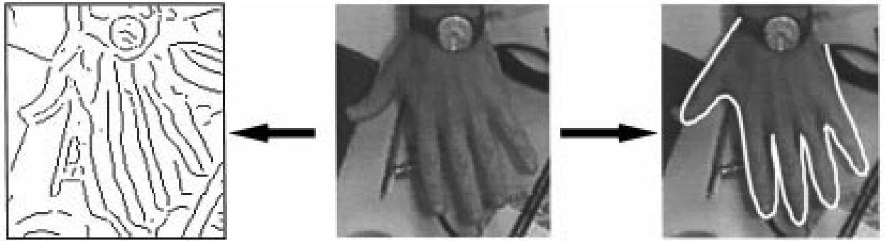
Dynamic snakes and CONDENSATION
Edge detector
Original
CONDENSATION
Notes:
A hand moving over a cluttered desk: Field 0 of a 500 field (10 s) sequence in which the hand translates, rotates, and the fingers and thumb flex independently→ Severe clutter: detail of one field (Fig. 14) from the test-sequence shows the high level of potential ambiguity. Output from a directional Gaussian edge detector shows that there are many clutter edges present as potential distractors.

Slide 17
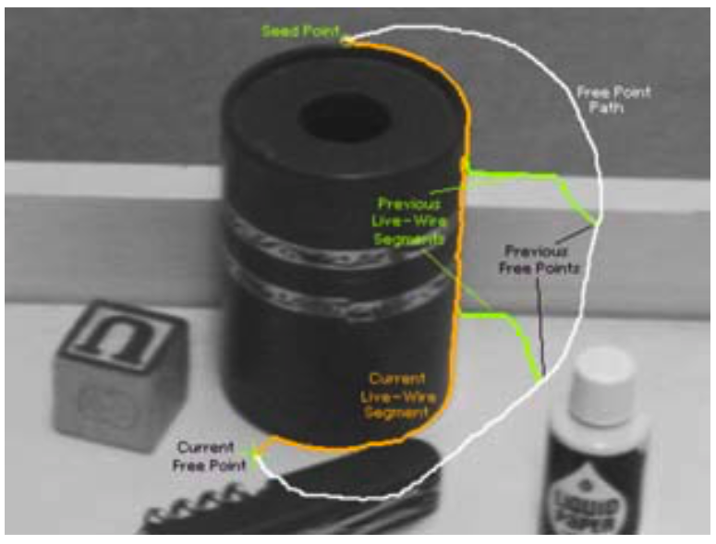
Scissors
The intelligent scissors system optimizes the contour in real-time as the user is drawing
As the user draws a rough outline (the white curve ), the system computes and draws a better curve that clings to high-contrast edges (the orange curve).

Slide 18
Level Sets
Level set is one of active contour models, which is good at handling complex topologies and capturing boundary.
The basic idea is to represent the curves or surfaces as the zero level set of a higher dimensional hyper-surface.
The level set methods are specially used in image with intensity inhomogeneity, such as medical image, SAR image, etc.

Slide 19
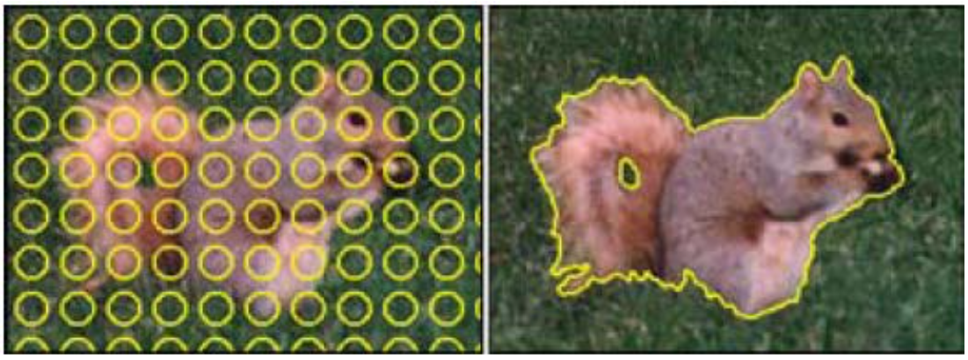
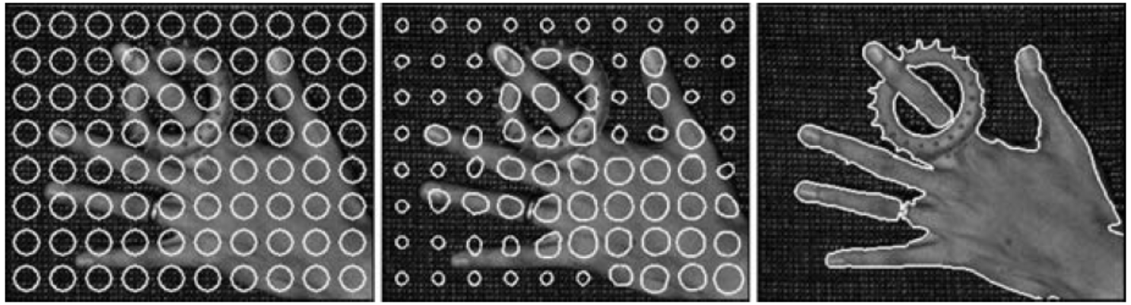
Level Sets
Notes:
Level set segmentation (Cremers, Rousson, and Deriche 2007) ⃝c 2007 Springer: (a) grayscale image segmentation and (b) color image segmentation. Uni-variate and multi-variate Gaussians are used to model the foreground and background pixel dis- tributions. The initial circles evolve towards an accurate segmentation of foreground and background, adapting their topology as they evolve.

Slide 20
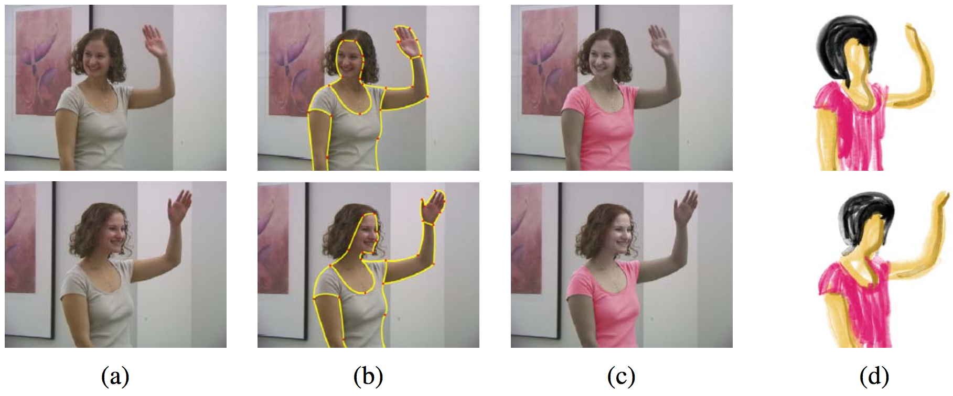
Application: Contour tracking and rotoscoping
Notes:
Keyframe-based rotoscoping (Agarwala, Hertzmann, Seitz et al. 2004) ⃝c 2004 ACM: (a) original frames; (b) rotoscoped contours; (c) re-colored blouse; (d) rotoscoped hand-drawn animation.

Slide 21
Summary
What is Segmentation?
What are the effect of Segmentation in image processing and computer vision?
What is the active contour technique?
The techniques of active contours
Specific applications of active contours

