Slide 1
Image processing - Point Operators

Slide 2
Objectives
Learn Image processing
Image Arithmetic
Understand Pixel transforms
Color transforms
Histogram based image operations

Slide 3
Image processing
Digital image processing is the use of a digital computer to process digital images through an algorithm. The generation and development of digital image processing are mainly affected by three factors:
The development of computers.
The development of mathematics.
The demand for a wide range of applications in environment, agriculture, military, industry and medical science has increased.
Image processing is a method to perform some operations on an image, in order to get an enhanced image or to extract some useful information from it.
It is a type of signal processing in which input is an image and output may be image or characteristics/features associated with that image.

Slide 4
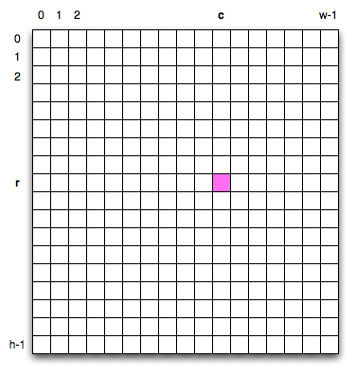
Image processing
Image processing to preprocess the image and convert it into a form suitable for further analysis
Digital image is a two dimensional array of pixel
Each pixel:
Intensity value- represented by a digital number
Position address- its row and column numbers
How to calculate intensity value of pixel in RGB space?

Slide 5
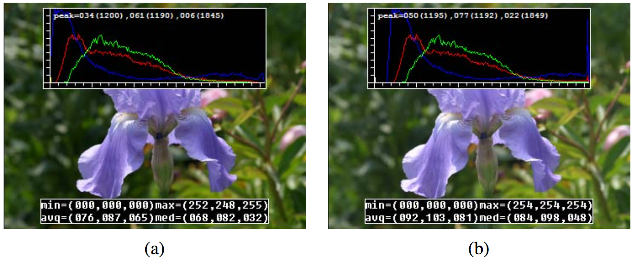
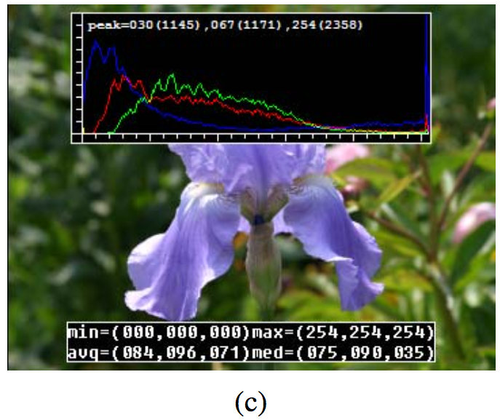
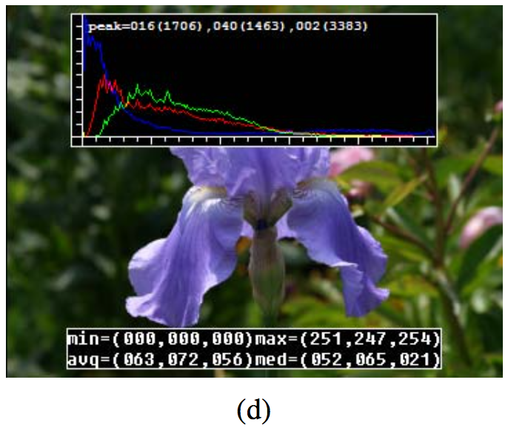
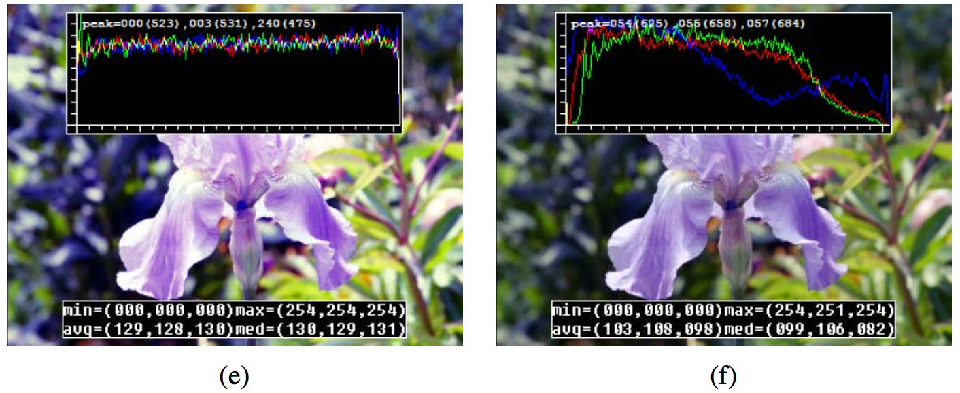
Image processing
Notes:
Some local image processing operations: (a) original image along with its three color (per-channel) histograms; (b) brightness increased (additive offset, b = 16); (c) contrast increased (multiplicative gain, a = 1.1); (d) gamma (partially) linearized (γ = 1.2); (e) full histogram equalization; (f) partial histogram equalization.

Slide 6
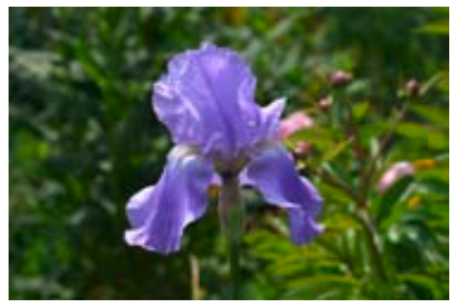
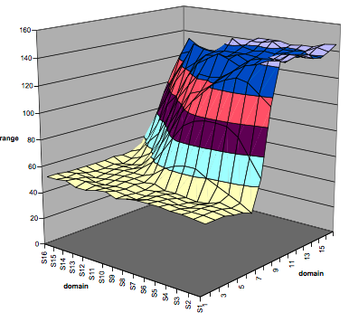
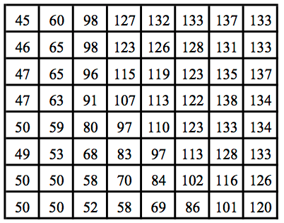
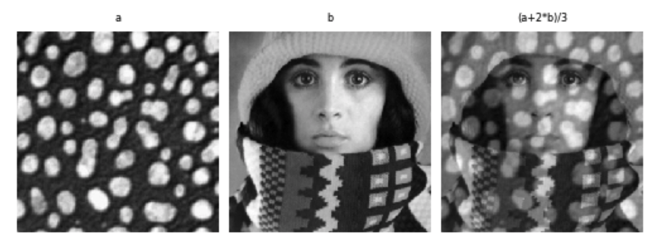
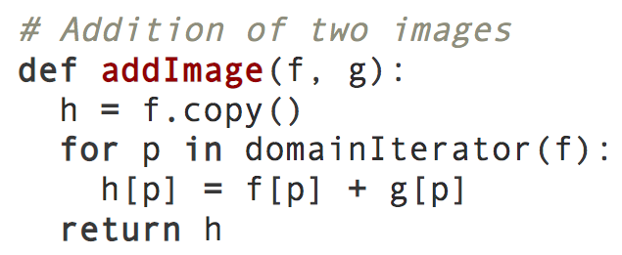
Pixel transforms
Pixel-by-pixel processing
Notes:
a) original image; (c) grid of numbers; (d) surface plot. For figures (c)–(d), the image was first converted to grayscale.
Hình dưới là 1 dạng của operator. Thực ra code by python có thể viết đơn giản là f*g

Slide 7
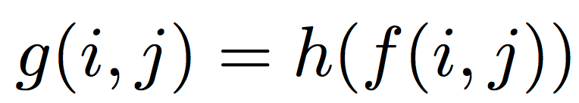
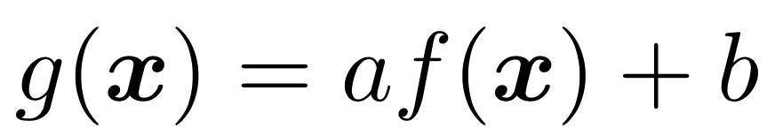
Pixel Operators
Operator is a function that takes one or more input images and produces an output image:
Discrete (sampled) images, pixel locations, x = (i, j)
Multiplication and addition with a constant
The parameters a > 0 and b are often called the gain and bias parameters
Control contrast and brightness
Notes:
a) original image; (c) grid of numbers; (d) surface plot. For figures (c)–(d), the image was first converted to grayscale.

Slide 8
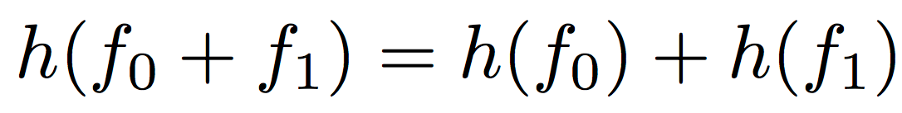
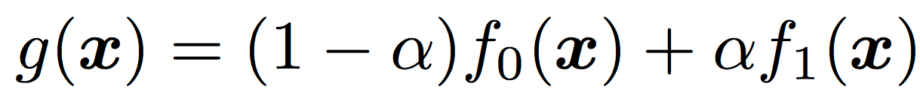
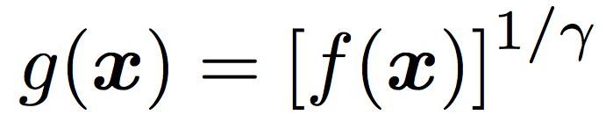
Pixel Operators
Multiplicative gain -Superposition principle:
Dyadic (two-input) operator is the linear blend operator
Invert the gamma mapping applied by the sensor
Notes:
gamma value of γ ≈ 2.2 is a reasonable fit for most digital cameras.

Slide 9
Color transforms
brightness increased (additive offset, b = 16)
Notes:
gamma value of γ ≈ 2.2 is a reasonable fit for most digital cameras.

Slide 10
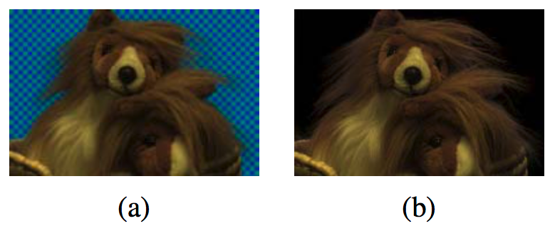
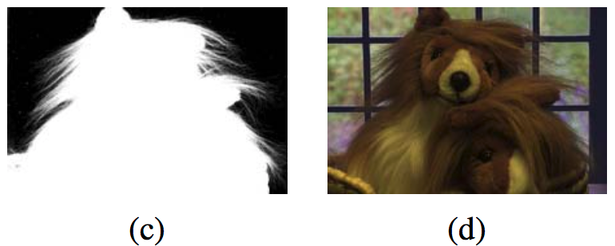
Compositing and matting
Notes:
Image matting and compositing (Chuang, Curless, Salesin et al. 2001) ⃝c 2001 IEEE: (a) source image; (b) extracted foreground object F; (c) alpha matte α shown in grayscale; (d) new composite C.

Slide 11
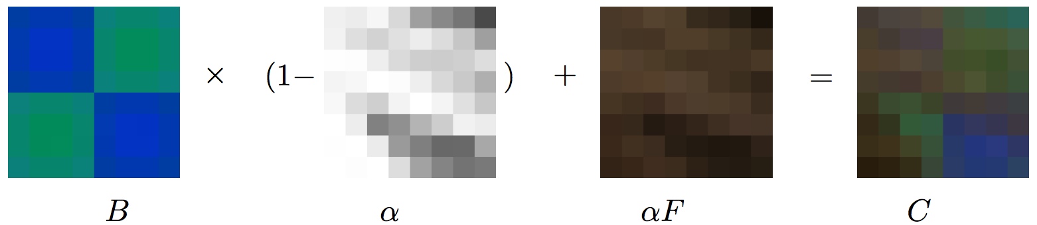

Compositing Equation
Notes:
Image matting and compositing (Chuang, Curless, Salesin et al. 2001) ⃝c 2001 IEEE: (a) source image; (b) extracted foreground object F; (c) alpha matte α shown in grayscale; (d) new composite C.

Slide 12
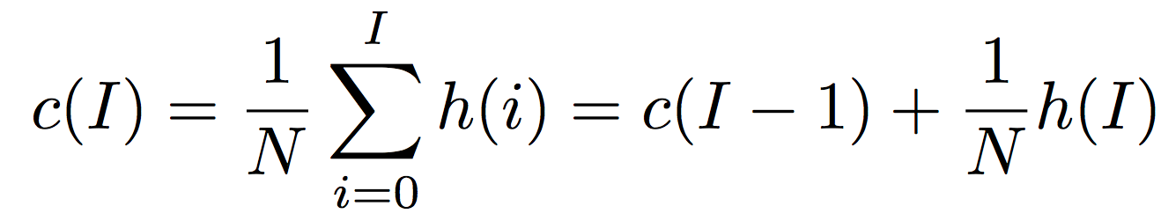
Histogram equalization
Increases the global contrast of many image (especially when the image is represented by a narrow range of intensity values)
Equalization is often used to normalize the gray values (or luminance in color images) to be invariant to changes in illumination conditions.
The cumulative distribution c(I)

Slide 13
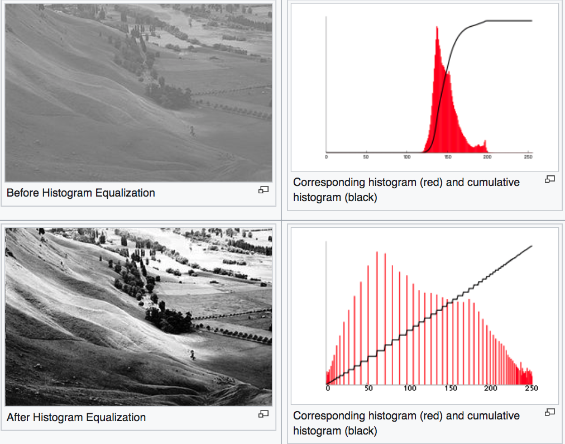
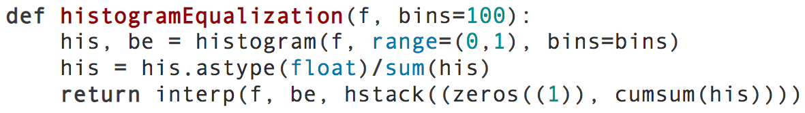
Histogram equalization
Notes:
gamma value of γ ≈ 2.2 is a reasonable fit for most digital cameras.

Slide 14
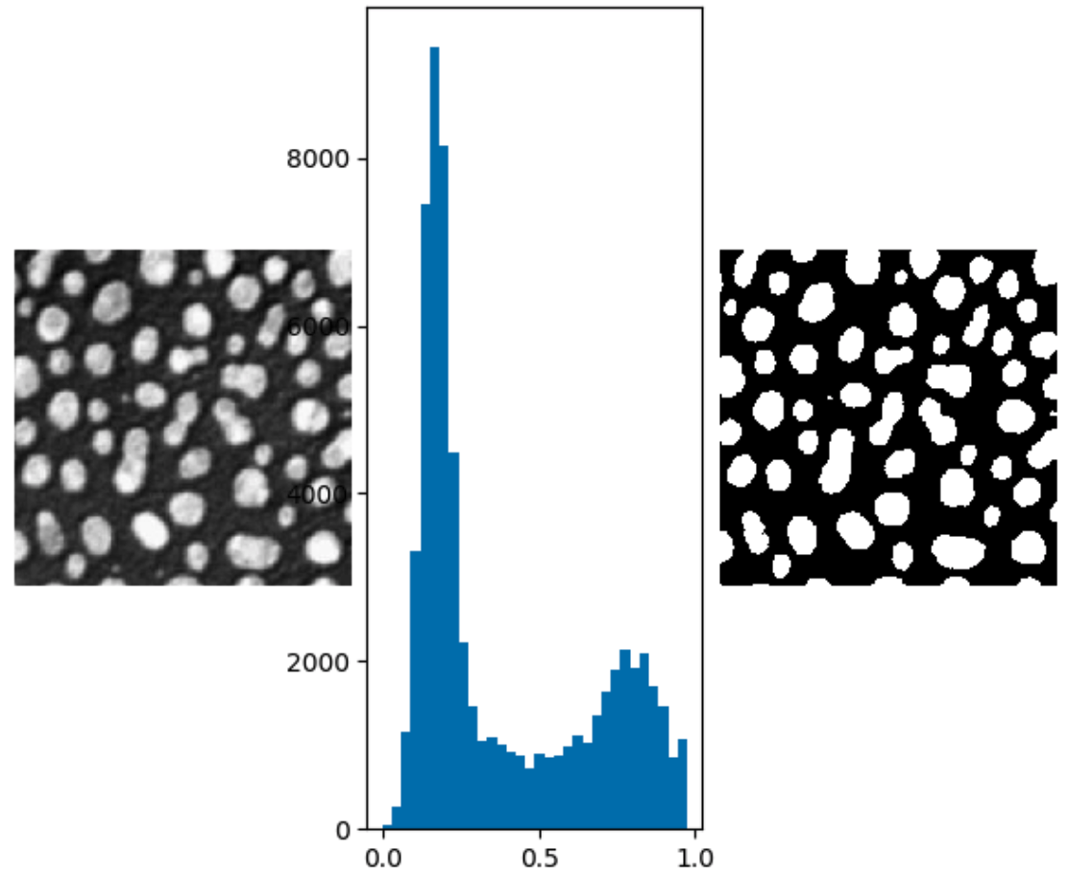
Thresholding
Thresholding methods replace each pixel in an image with a black pixel if the image intensity I(i,j) is less than some fixed constant T or a white pixel if the image intensity is greater than that constant.

Slide 15
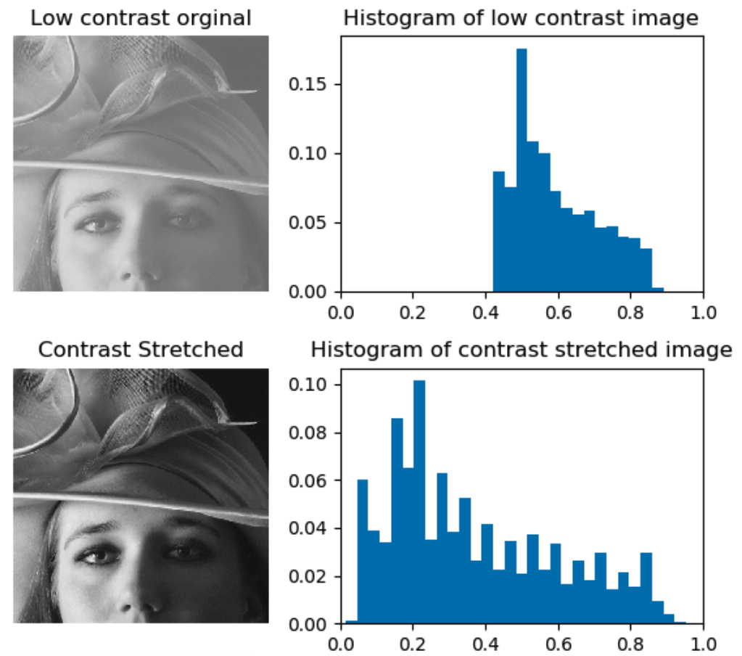
Contrast stretching
Contrast stretching (also called Normalization) attempts to improve an image by stretching the range of intensity values it contains to make full use of possible values

Slide 16
Summary
Learn Image processing
Image Arithmetic
Understand Pixel transforms
Color transforms
Histogram based image operations

