Slide 1
Image processing - Linear filtering

Slide 2
Objectives
What is image filtering
The difference between linear and nonlinear filters
Correlation and Convolution
Learn how linear filters work and their implementation
Learn how nonlinear filters work and their implementation
Notes:
What Is Image Filtering
the difference between linear and nonlinear filters
Learn how linear filters work and their implementation.
- Summed area table: MeanFilter ▪ GradientFilter ▪ LaplacianFilter ▪ WienerFilter ▪ MovingAverage
- Band-pass and steerable filters: LowpassFilter ▪ HighpassFilter ▪ BandpassFilter ▪ BandstopFilter
Recursive filtering: GaussianFilter and edge filters
Learn how linear filters work and their implementation.
MedianFilter ▪ MinFilter ▪ MaxFilter ▪ MeanShiftFilter ▪ EntropyFilter

Slide 3
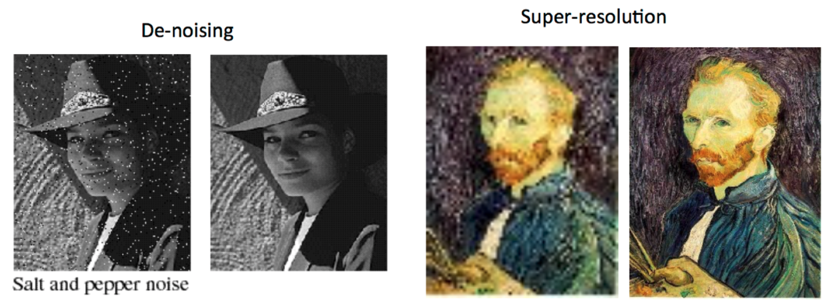
What is image filter
Filtering is a technique for modifying or enhancing an image.
Filters are just systems that form a new, and preferably enhanced, image from a combination of the original image's pixel values.
Filtering is a neighborhood operation, in which the value of any given pixel in the output image is determined by applying some algorithm to the values of the pixels in the neighborhood of the corresponding input pixel.
Notes:
Remove noise
Sharpen contrast
Highlight contours
Dêtct edges

Slide 4
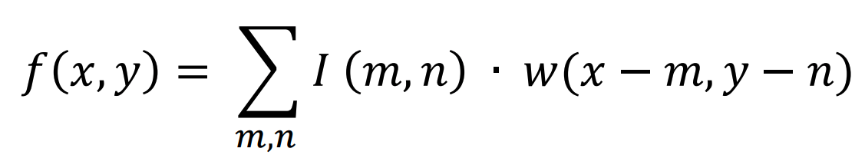
Linear and Nonlinear filters
Linear filtering is filtering in which the value of an output pixel is a linear combination of the values of the pixels in the input pixel's neighborhood.
I is represents the original image, f is represents the filtered pixels value, and w is represents the filter coefficients
The general idea in non-linear image filtering is that instead of using the spatial mask in a convolution process, the mask is used to obtain the neighboring pixel values, and then ordering mechanisms produce the output pixel.

Slide 5
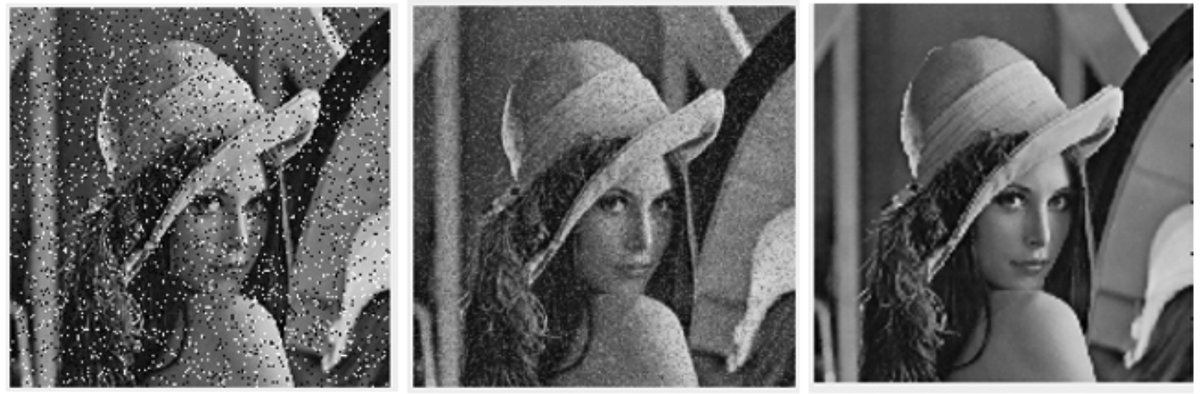
Linear and Nonlinear filters
Noisy Image-
Salt and pepper noise
Linear filtering - Mean filter
Nonliner filter- Median filter

Slide 6
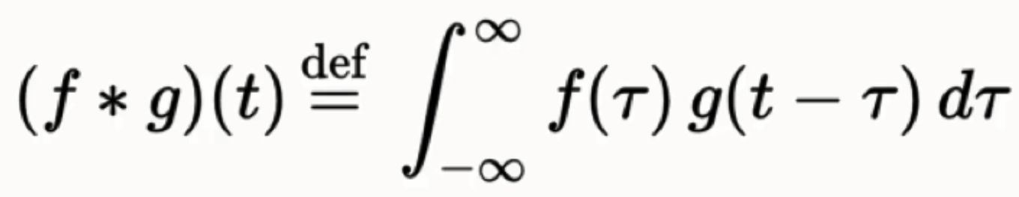
Convolution
Linear filtering of an image is accomplished through an operation called convolution.
In convolution, the value of an output pixel is computed as a weighted sum of neighboring pixels. The matrix of weights is called the convolution kernel, also known as the filter.
Convolution uses the kernel to highlight a particular feature of an image.

Slide 7
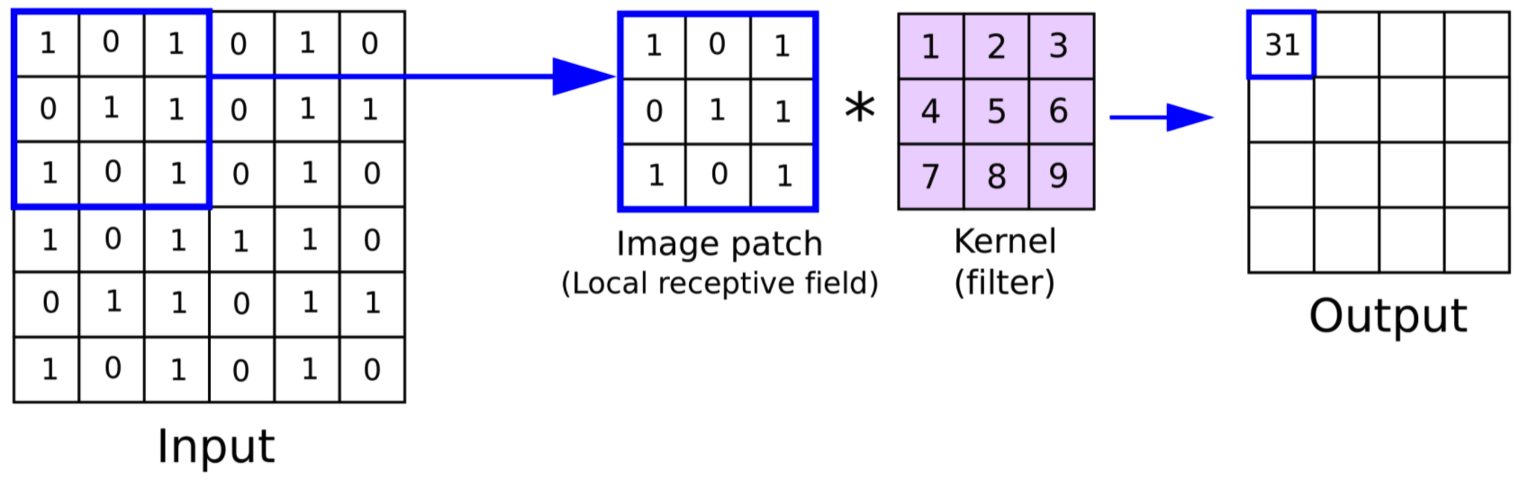
Convolution Steps
You place it over the input image beginning from the top-left corner.
Multiply each weight in the rotated convolution kernel by the pixel.
Sum up the individual products from step 2.
You then move the feature detector one cell to the right and do the same thing.
After you have gone through the whole first row, you can then move it over to the next row and go through the same process.

Slide 8
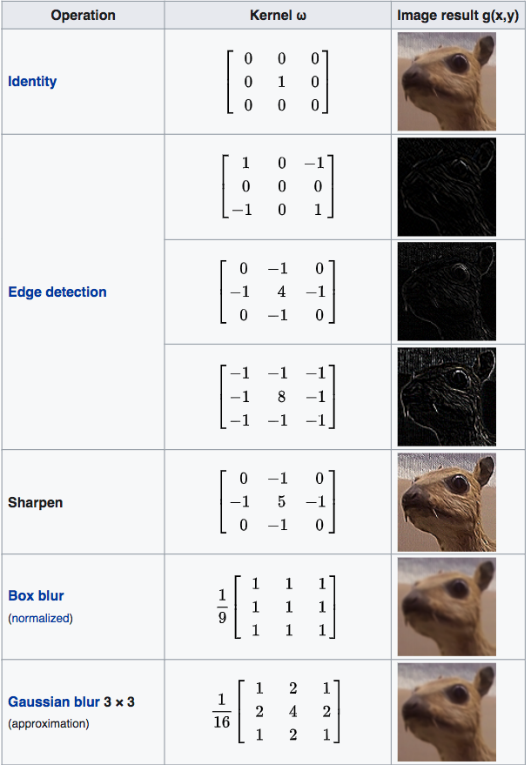
Convolution- Kernel
Notes:
Convolution is the process of adding each element of the image to its local neighbors, weighted by the kernel. This is related to a form of mathematical convolution. The matrix operation being performed—convolution—is not traditional matrix multiplication, despite being similarly denoted by *.

Slide 9
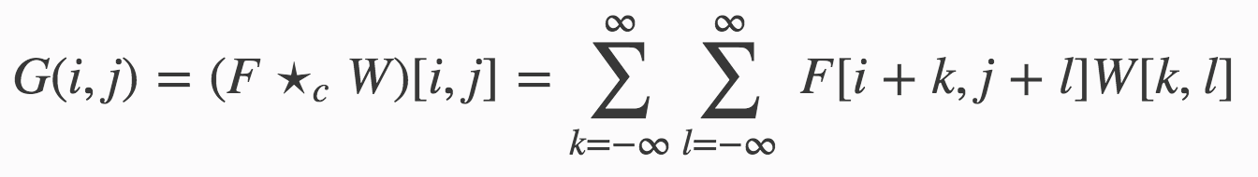
Correlation
Correlation is a local operator and is a simple local image operator.
A correlation takes an image F, a weight function W and it results in a new image G.
The weight function W is often defined on a small subset of the sample points of F.

Slide 10
Correlation
In correlation, the value of an output pixel is also computed as a weighted sum of neighboring pixels.
A correlation takes an image F, a weight function W and it results in a new image G.
The weight function W is often defined on a small subset of the sample points of F.

Slide 11
Correlation- Convolution
What are the differences between correlation and convolution?
Correlation is measurement of the similarity between two image.
Convolution is measurement of effect of one image on the other image.
The mathematical calculation of Correlation is same as convolution in time domain, except that the image is not reversed, before the multiplication process. If the filter is symmetric then the output of both the expression would be same.
Notes:
While a convolution is a filtering operation, correlation measures the similarity of two signals, comparing them as they are shifted by one another. When two signals match, the correlation result is maximized.
One application is is a vision system for using a hand to remotely control a TV. Template matching, based on correlation, is used to determine the hand position of the user to switch channels, increase or decrease volume, etc.

Slide 12
Mean Filter
It is often used to reduce noise in images.
The idea of mean filtering is simply to replace each pixel value in an image with the mean (“average”) value of its neighbors, including itself.

Slide 13
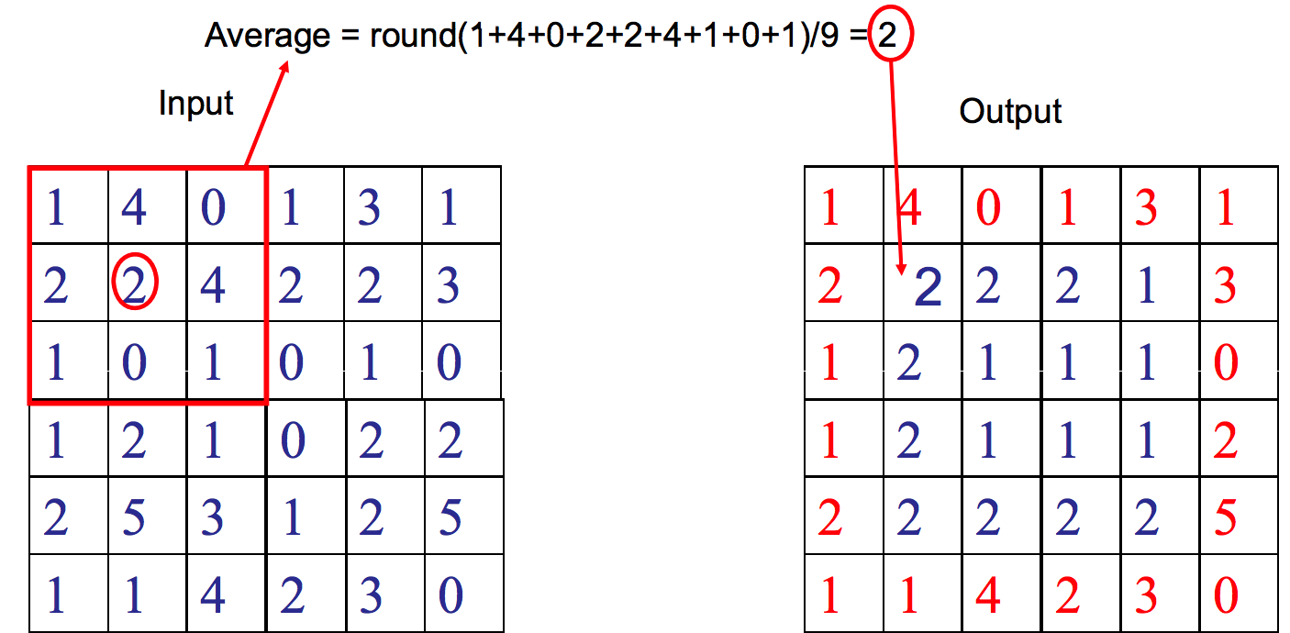
MeanFilter
Keeping border values unchanged

Slide 14
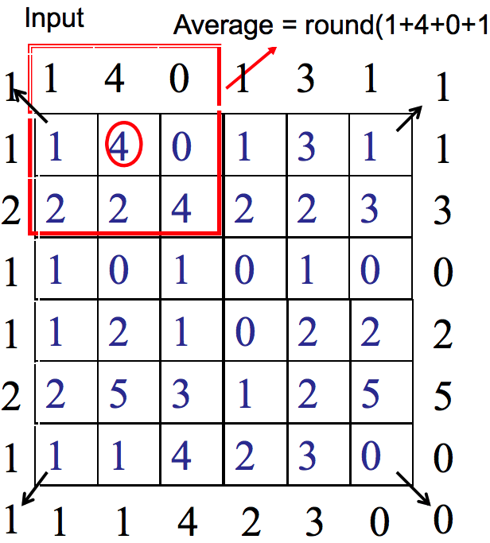
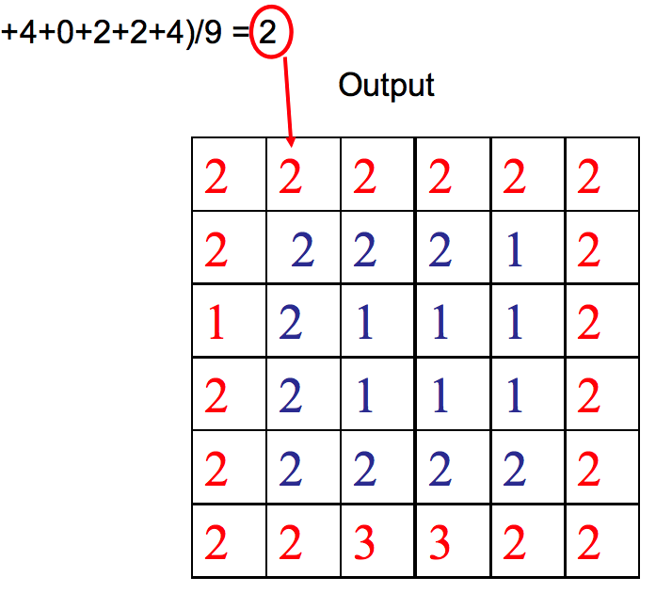
Mean Filter
Extending border values outside with values at boundary

Slide 15
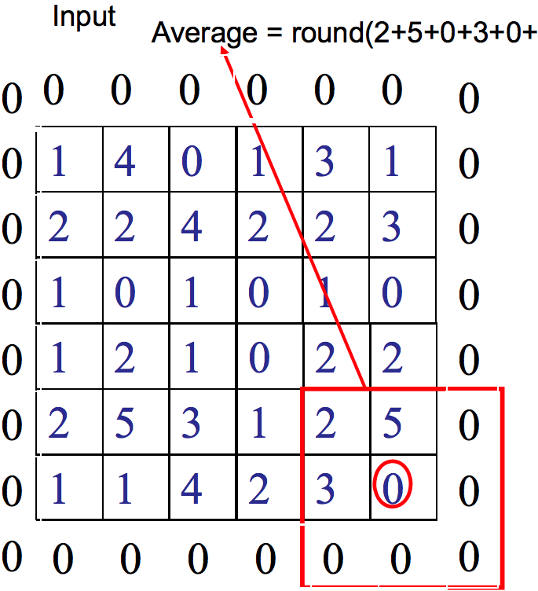
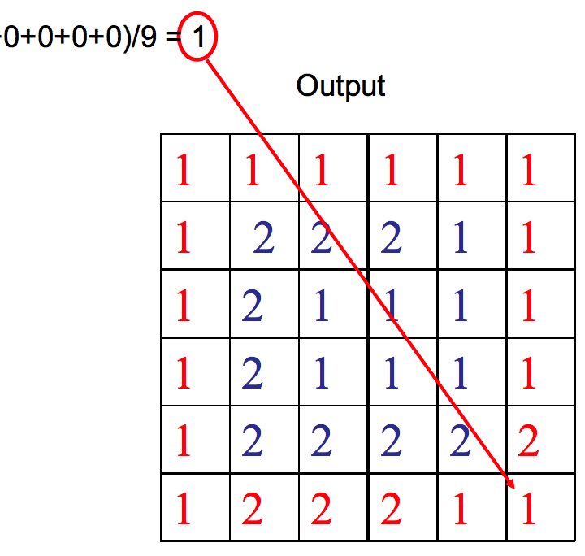
Mean Filter
Extending border values outside with 0s (Zero-padding)

Slide 16
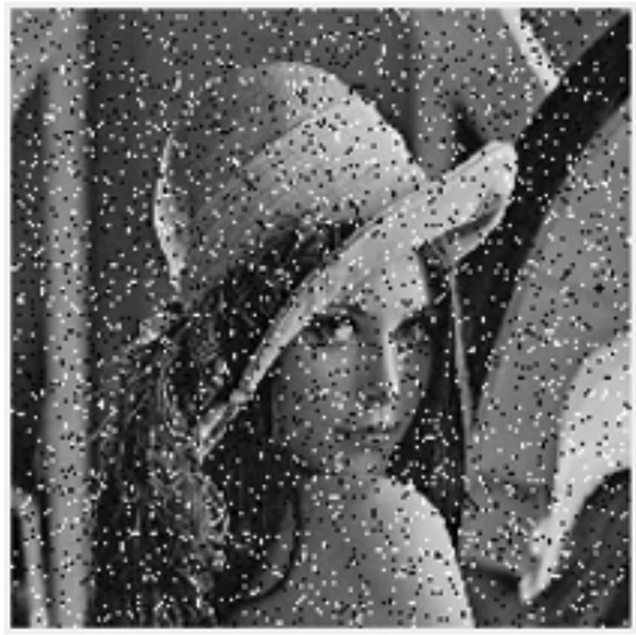
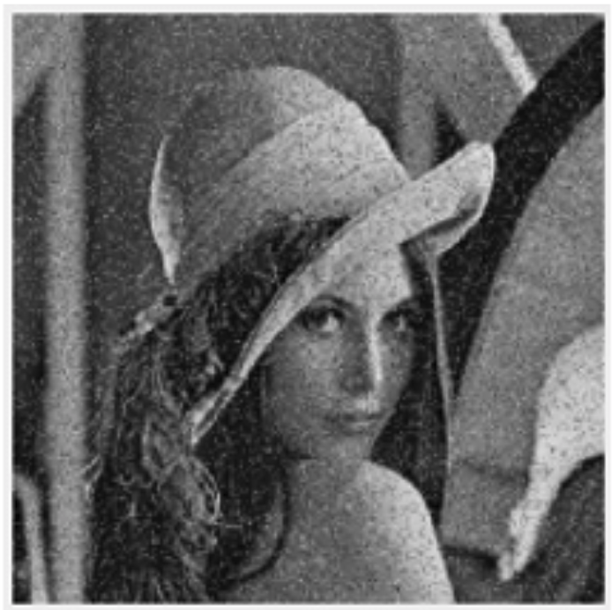
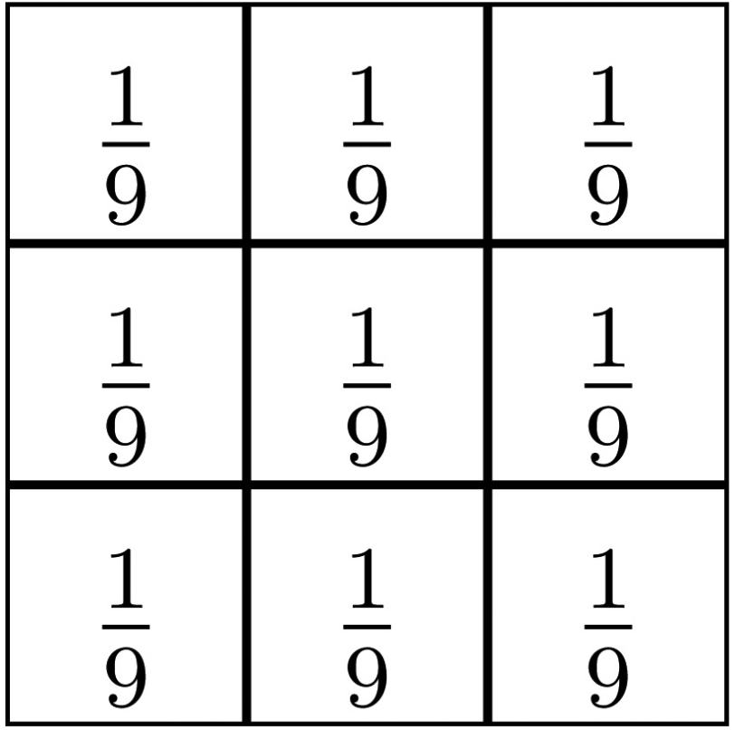
Mean Filter

Slide 17
Median Filter
Median filtering is a nonlinear method used to remove noise from images.
It is widely used as it is very effective at removing noise while preserving edges.
It is particularly effective at removing ‘salt and pepper’ type noise.
The median filter works by moving through the image pixel by pixel, replacing each value with the median value of neighbouring pixels.
The median is calculated by first sorting all the pixel values from the window into numerical order, and then replacing the pixel being considered with the middle (median) pixel value.

Slide 18
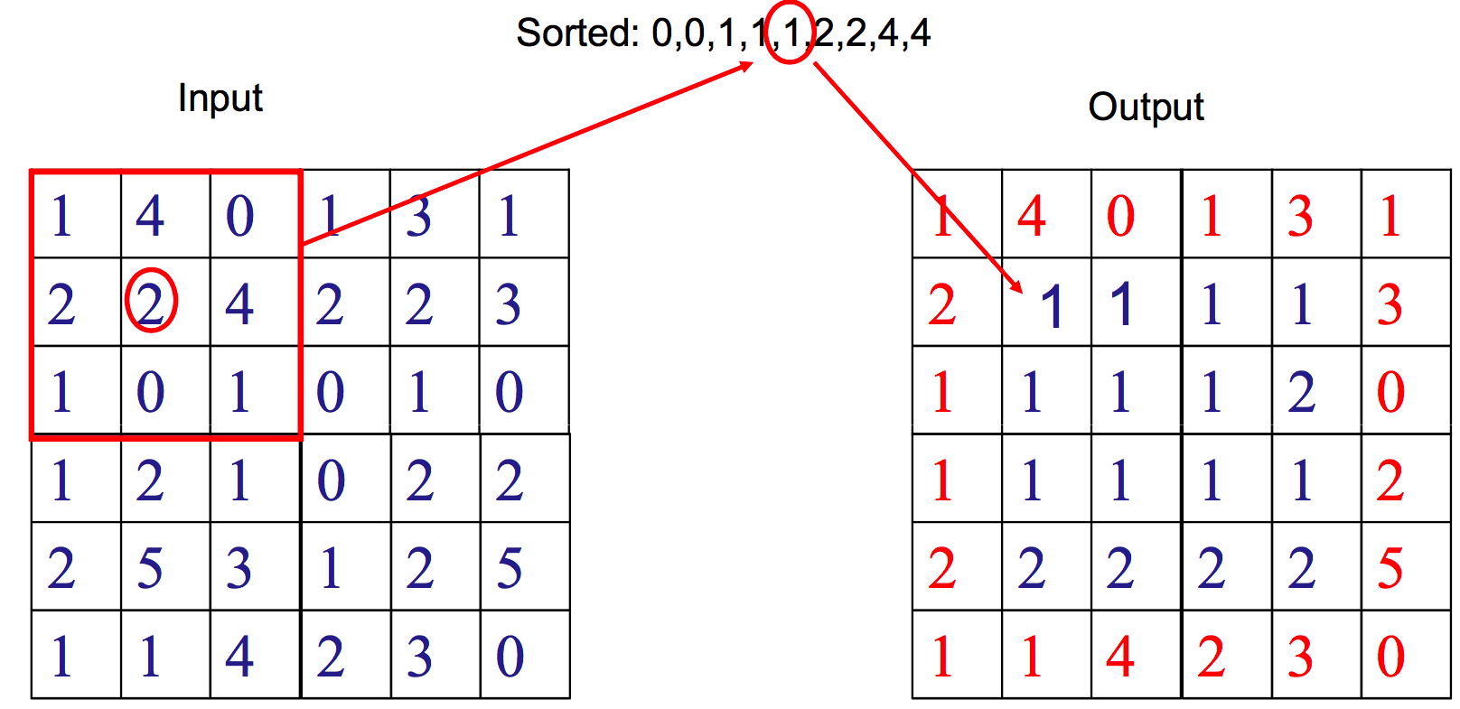
Median Filter
Keeping border values unchanged

Slide 19
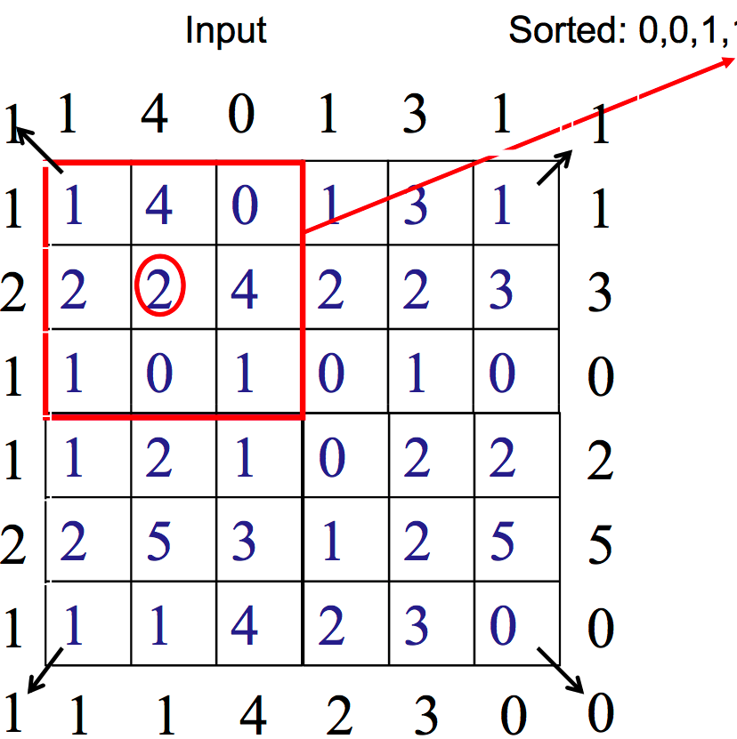
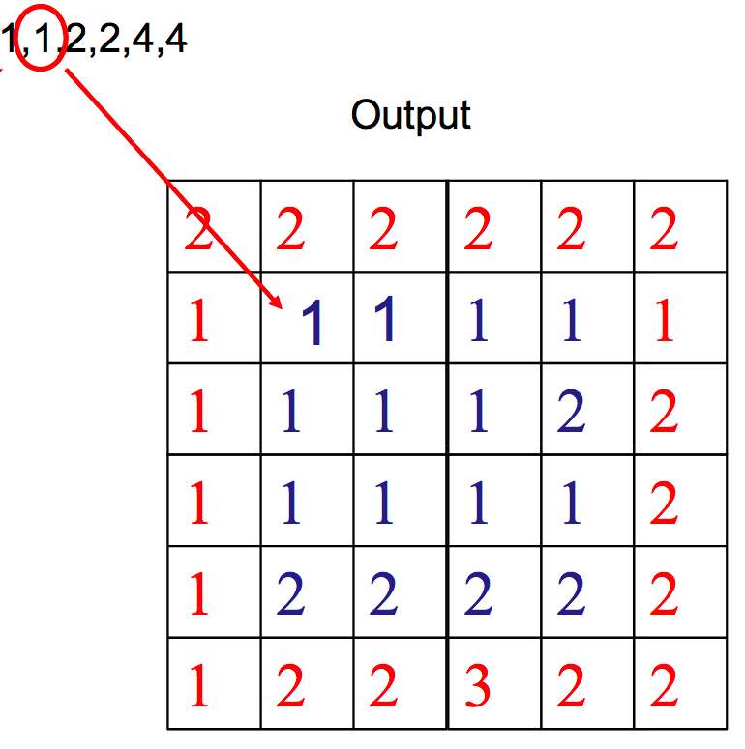
Median Filter
Extending border values outside with values at boundary

Slide 20
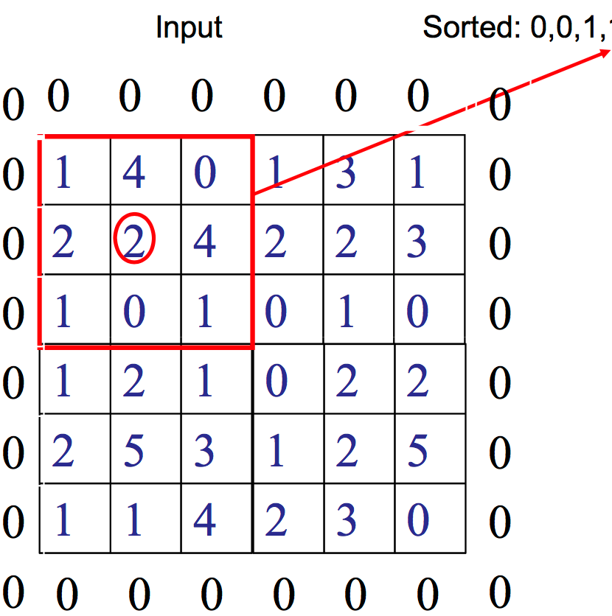
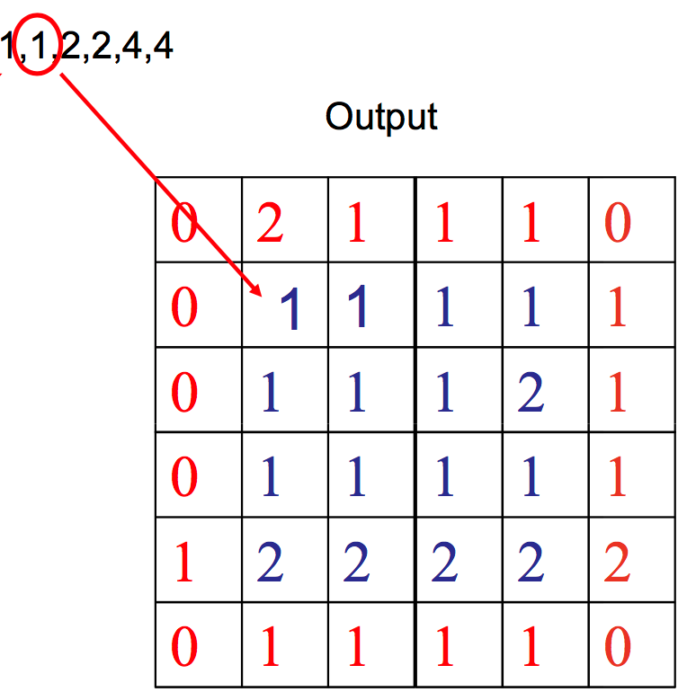
Median Filter
Extending border values outside with 0s

Slide 21
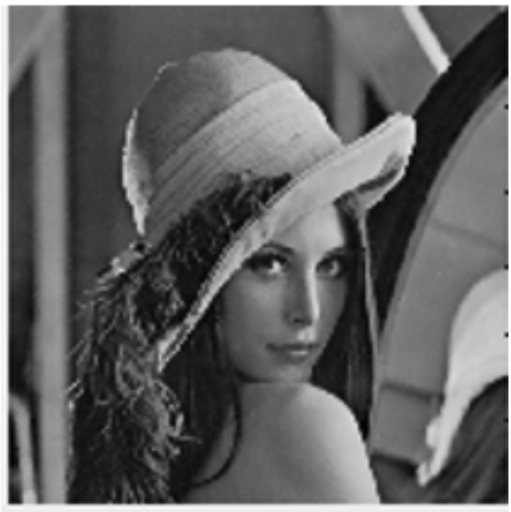
Median Filter

Slide 22
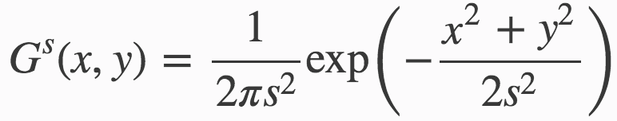
Gaussian Smoothing
Gaussian smoothing is the result of blurring an image by a Gaussian function.
Enhance image structures at different scales.
Smooth blur resembling that of viewing the image through a translucent screen
A smoothed function is the convolution of the original function f with the Gaussian weight function G

Slide 23
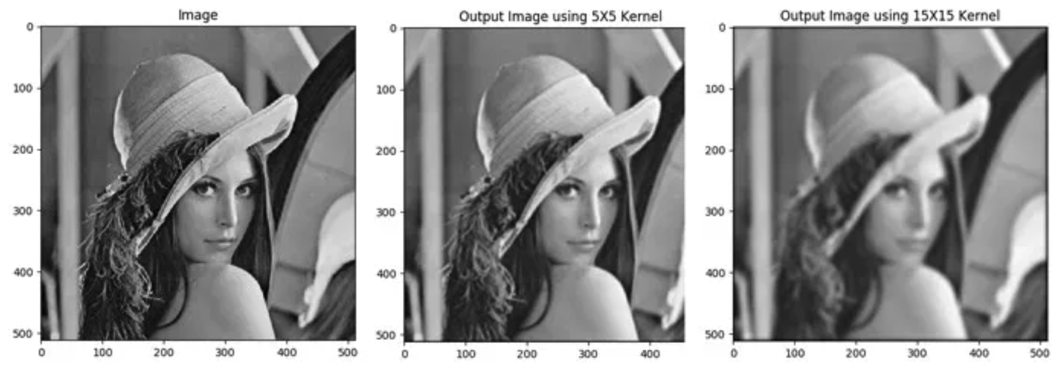
Gaussian Smoothing

Slide 24
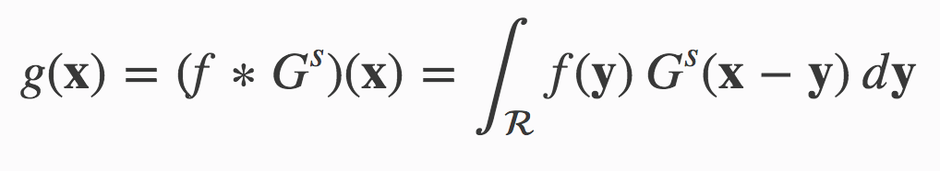
Bilateral filtering
The bilateral filter adds a tonal weight such that pixel values that are close to the pixel value in the center are weighted more than pixel values that are more different
This tonal weighting makes that the bilateral filter is capable of preserving edges (large differences in tonal value) while smoothing in the more flat regions (small tonal differences).
The bilateral filter starts with linear Gaussian smoothing:

Slide 25
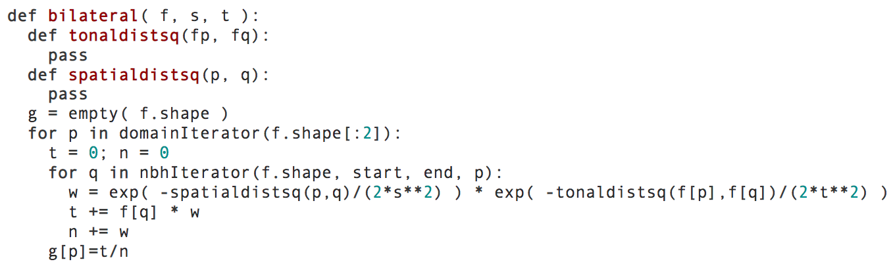
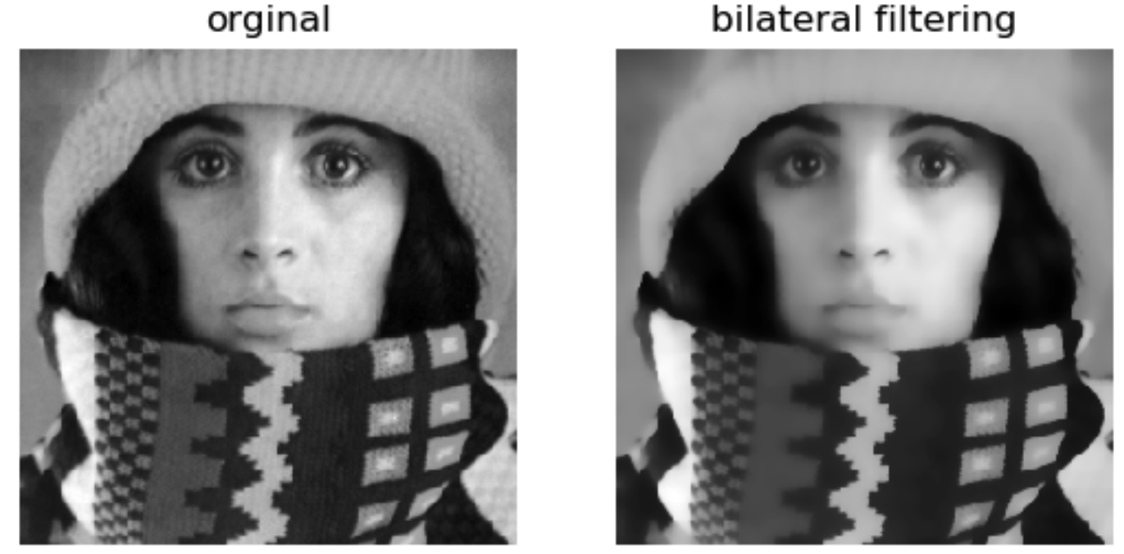
Bilateral filtering

Slide 26
Summary
What is image filtering
The difference between linear and nonlinear filters
Correlation and Convolution
Learn how linear filters work and their implementation
Learn how nonlinear filters work and their implementation

