Slide 1
Image processing - Fourier transforms

Slide 2
Objectives
What is Fourier transform?
Fourier transform of two- dimentional
Properties of Discrete Fourier transform
How using the Fast Fourier Transform
Learn how linear filters work and their implementation
Applications
Notes:
Application:
Extract feature of image base on frequency
Filtering noise
Determining frequencies in an image

Slide 3
Fourier Transform
The Fourier Transform is a tool that breaks a waveform into an alternate representation, characterized by sine and cosines.
The Fourier Transform shows that any waveform can be re-written as the sum of sinusoidal functions.
The Fourier Transform gives us a unique and powerful way of viewing these waveforms.
All waveforms, no matter what you scribble or observe in the universe, are actually just the sum of simple sinusoids of different frequencies.
Notes:
Sinusoids: The Sine and Cosine Functions
Fourier Transform PairsFourier Transform (Home)Fourier Transform Applications

Slide 4
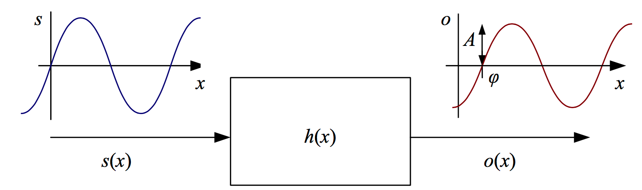
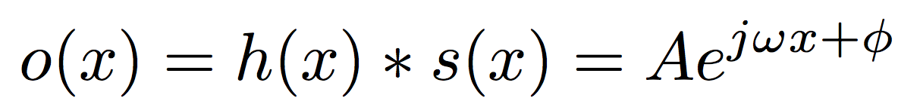
Fourier Transform
The Fourier transform is simply a tabulation of the magnitude and phase response at each frequency
Notes:
Sinusoids: The Sine and Cosine Functions

Slide 5
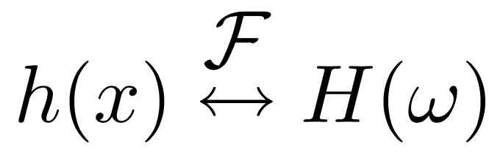
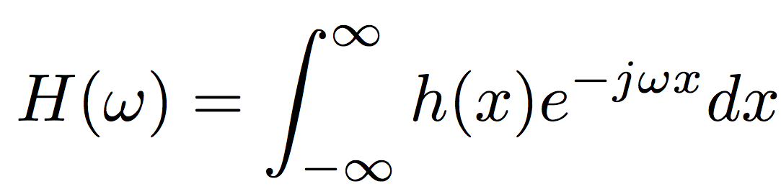
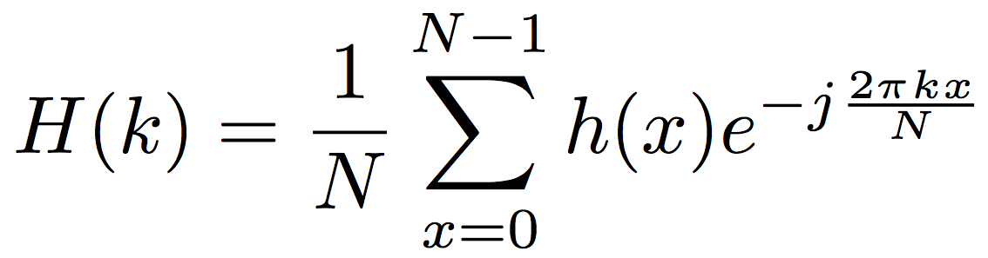
Fourier Transform
The Fourier transform pair
In the continuous domain
In the discrete domain
Notes:
where N is the length of the signal or region of analysis. These formulas apply both to filters, such as h(x), and to signals or images, such as s(x) or g(x).

Slide 6
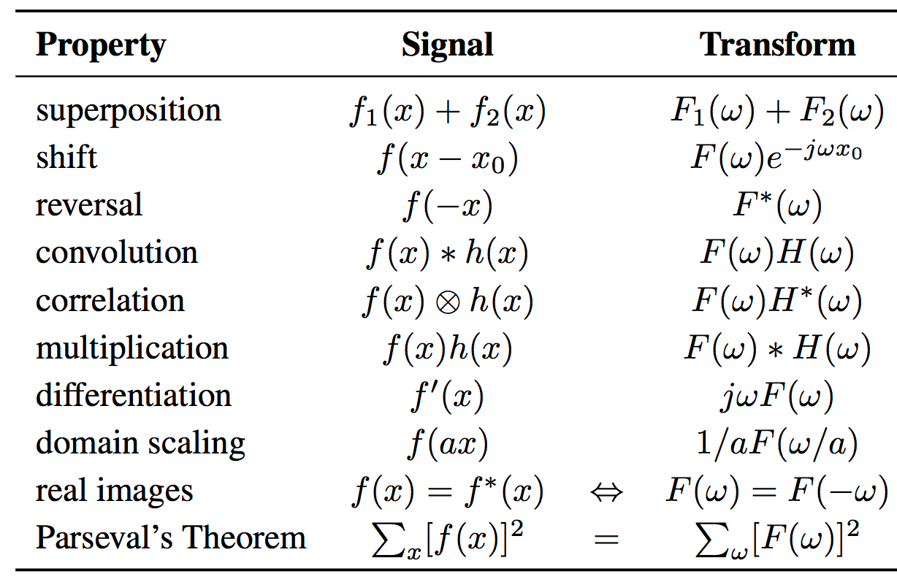
Fourier Transform’s Properties
Notes:
where N is the length of the signal or region of analysis. These formulas apply both to filters, such as h(x), and to signals or images, such as s(x) or g(x).

Slide 7
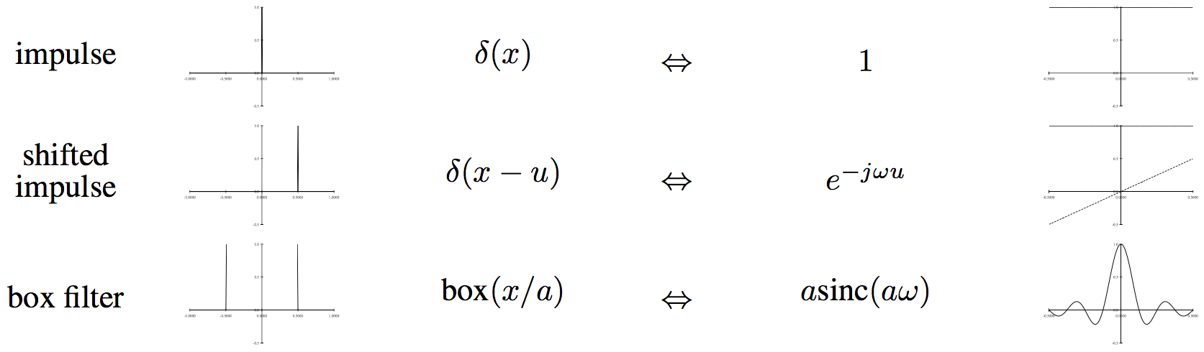
Fourier Transform pairs
Impulse: The impulse response has a constant (all frequency) transform.
Shifted impulse: The shifted impulse has unit magnitude and linear phase.
Box filter: The box (moving average) filter

Slide 8
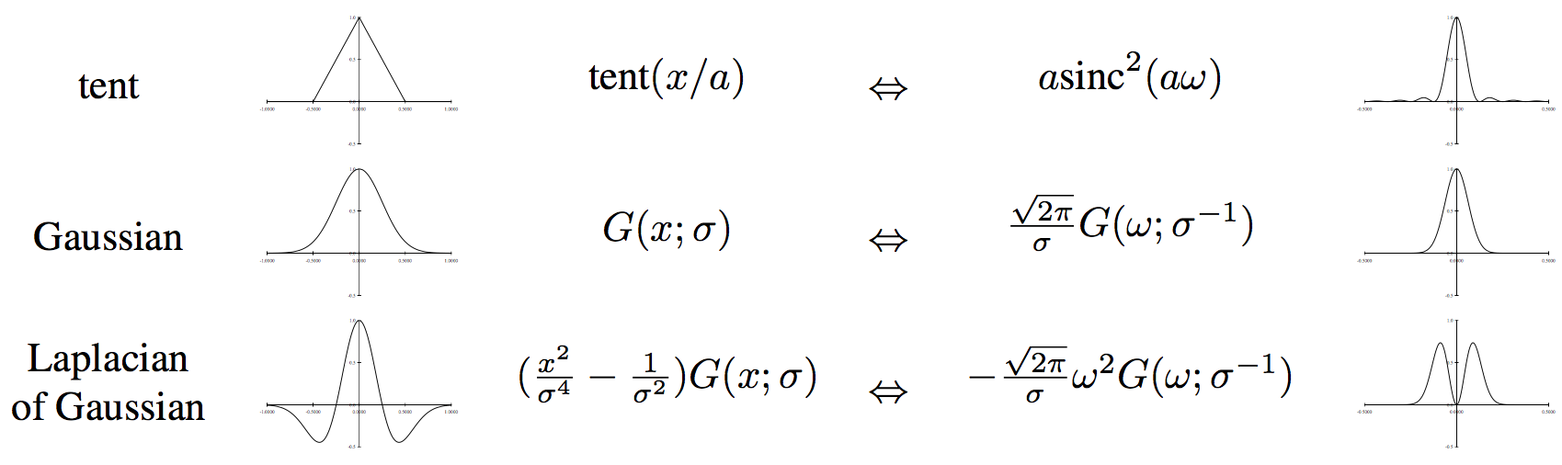
Fourier Transform pairs
Tent: The piecewise linear tent function
Gaussian: The (unit area) Gaussian of width σ
Laplacian of Gaussian: The second derivative of a Gaussian of width σ

Slide 9
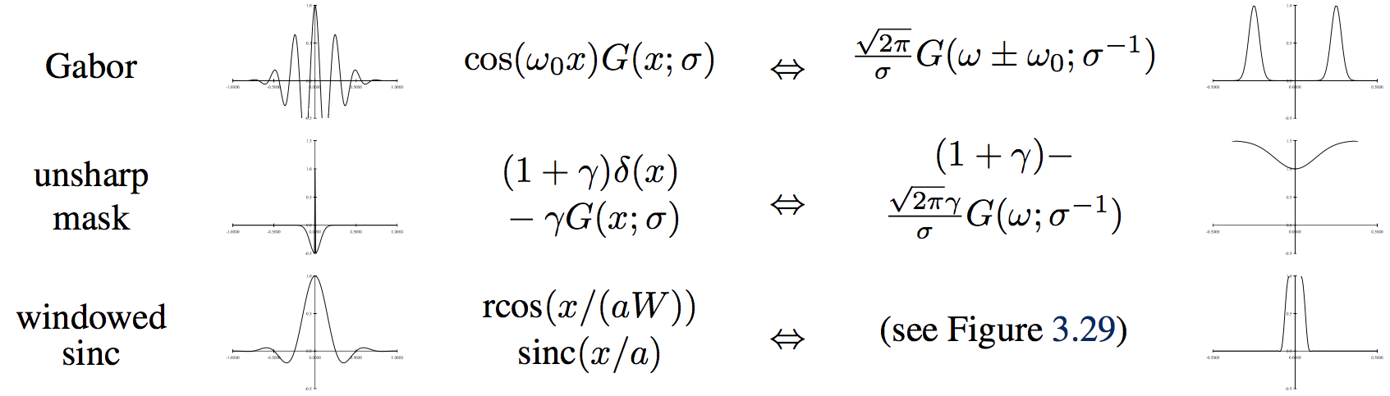
Fourier Transform pairs
Gabor: The even Gabor function
Unsharp mask: The unsharp mask
Windowed sinc: The windowed (masked) sinc function

Slide 10
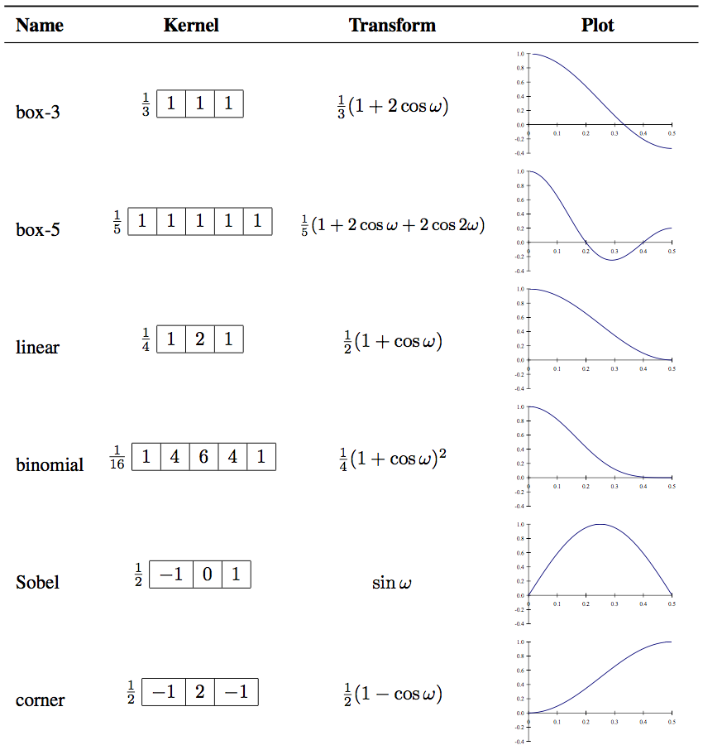
The small discrete kernels
Notes:
Fourier transforms of the separable kernels shown

Slide 11
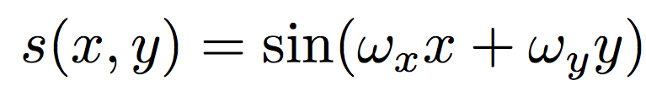
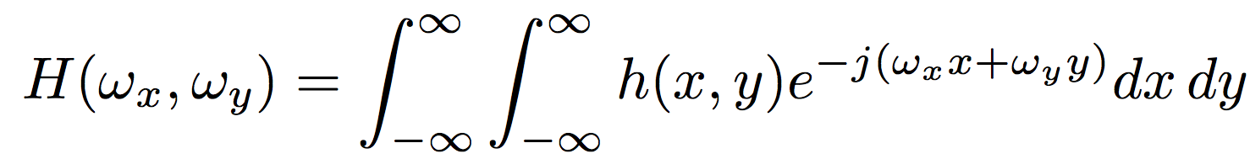
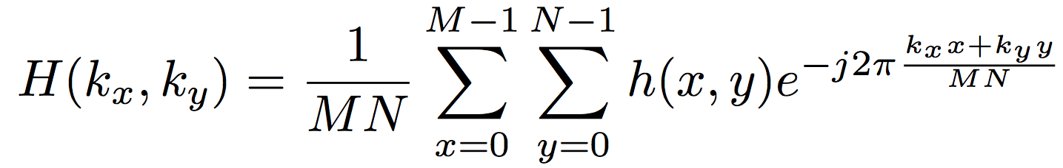
2D Fourier Transform
Oriented sinusoid :
Two-dimensional Fourier transforms continuous domain
In the discrete domain
where M and N are the width and height of the image

Slide 12
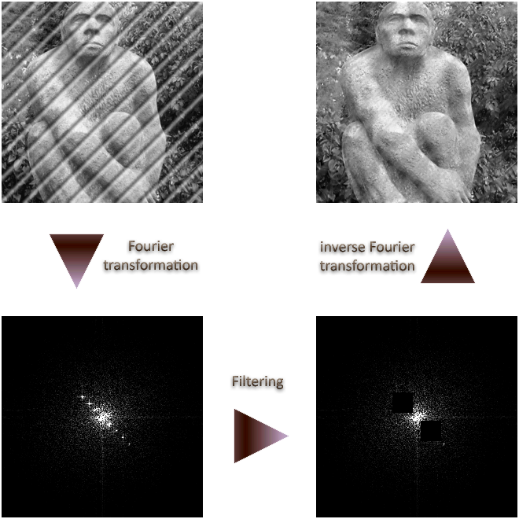
Application: image filtering

Slide 13
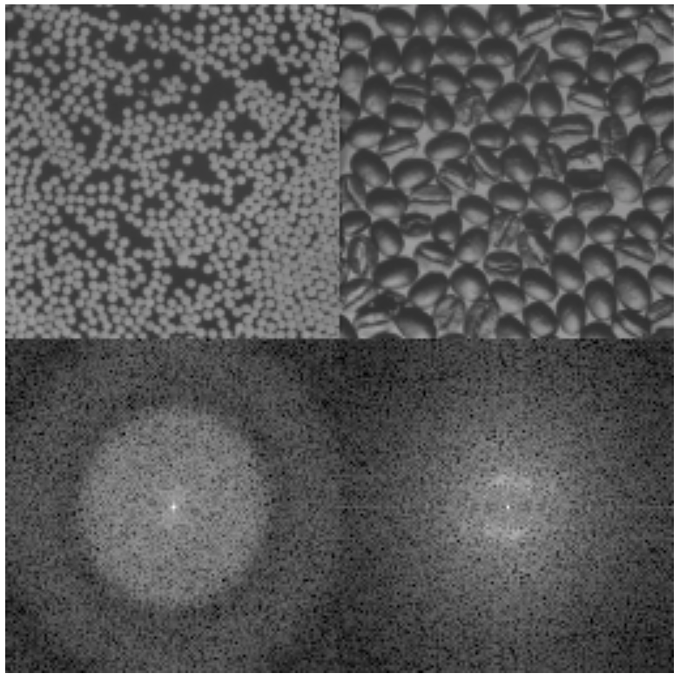
Application: image analysis
Notes:
similar objects:: Notice the concentric ring structure in the FT of the white pellets image. It is due to each individual pellet. That is, if we took the FT of just one pellet, we would still get this pattern. Remember, we are looking only at the magnitude spectrum. The fact that there are many pellets and information about exactly where each one is is contained mostly in the phase. The coffee beans have less symmetry and are more variably colored so they do not show the same ring structure. You may be able to detect a faint "halo" in the coffee FT. What do you think this is from?

Slide 14
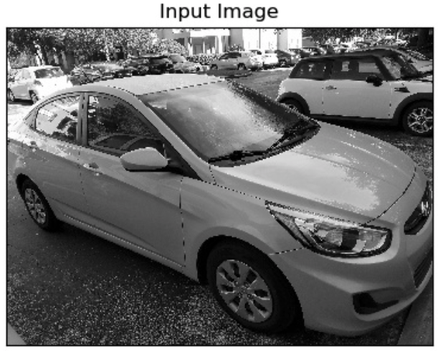
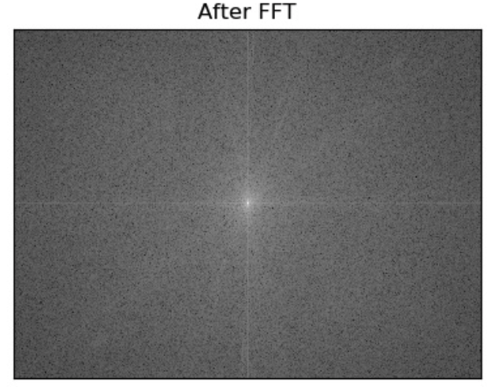
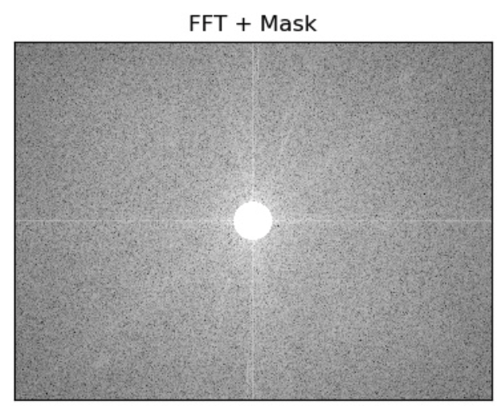
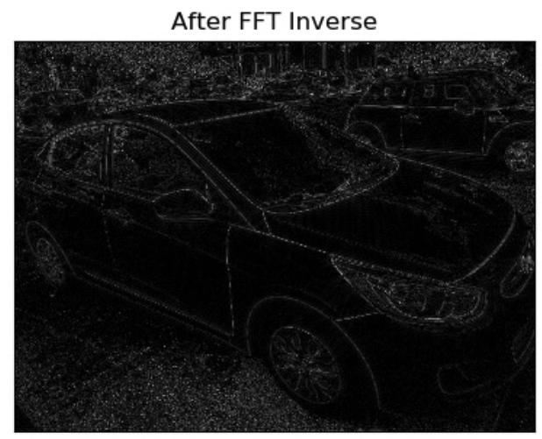
Application: Edge detection
Notes:
As can be seen, application of high pass filter, blocked all the low frequencies in the center and allowed only the high frequencies to pass through. Now since edges are usually made of low frequencies, that's we see in the resultant image.

Slide 15
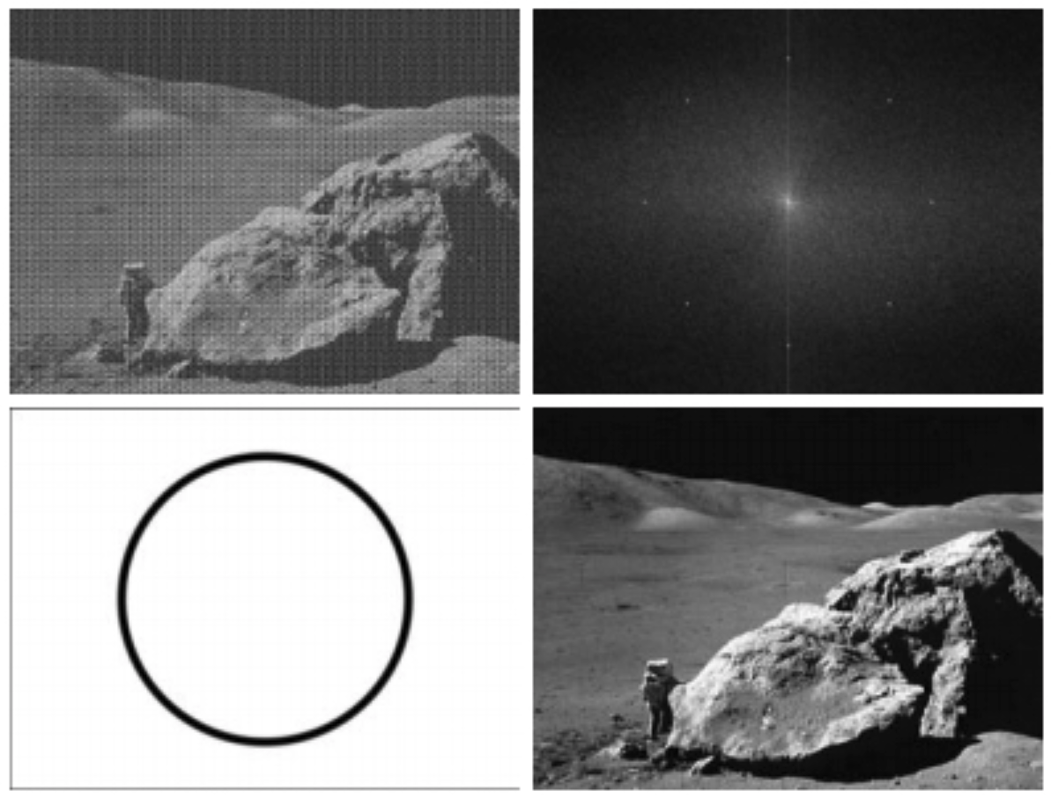
Application: image reconstruction
Notes:
A: image corrupted by sinusoidal interference
B: magnitude of the FT showing the bursts of energy responsible for the interference
C: mask used to eliminate the energy bursts
D: result of computing the inverse of the modified FT

Slide 16
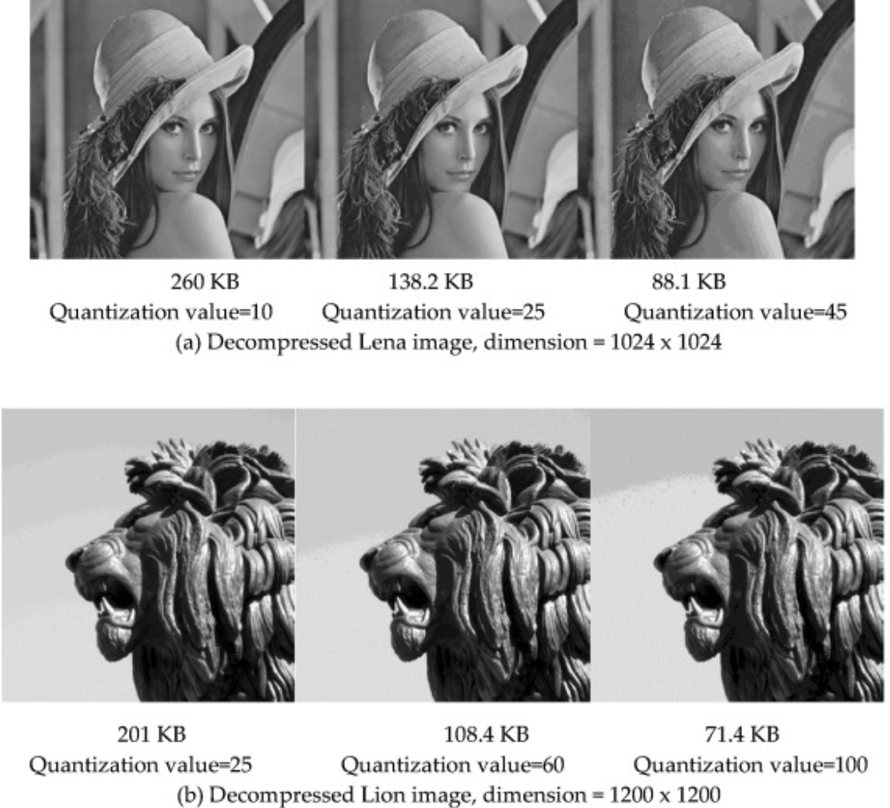
Application: image compression
Image compression based on 2D Discrete Fourier Transform and matrix minimization algorithm
Notes:
Image compression based on 2D Discrete Fourier Transform and matrix minimization algorithm. https://www.sciencedirect.com/science/article/pii/S2590005620300096

Slide 17
Summary
Learn about Fourier transform
Learn how Fourier transform is applied in image
Understand and implement applications of Fourier transform such as: image filtering, image analysis, edge detection, image reconstruction, image compression

