Slide 1

SMART INDIA HACKATHON 2026
Problem Statement ID – SIH26188
Problem Statement Title- Al-Based Fake Identity & Document Screening System
Theme- Blockchain & Cybersecurity
PS Category- Software
Team ID- TID162
Team Name- Team TRINETRA

Slide 2

Al-Based Fake Identity & Document Screening System
Team TRINETRA
Team TRINETRA

Slide 3
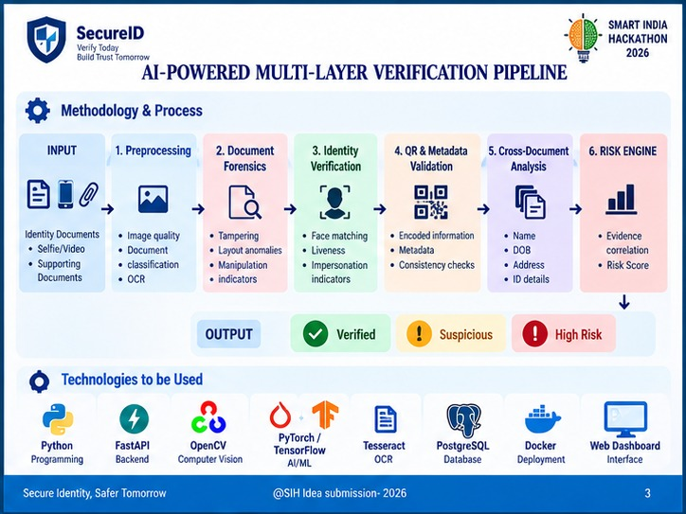
TECHNICAL APPROACH
Team TRINETRA

Slide 4
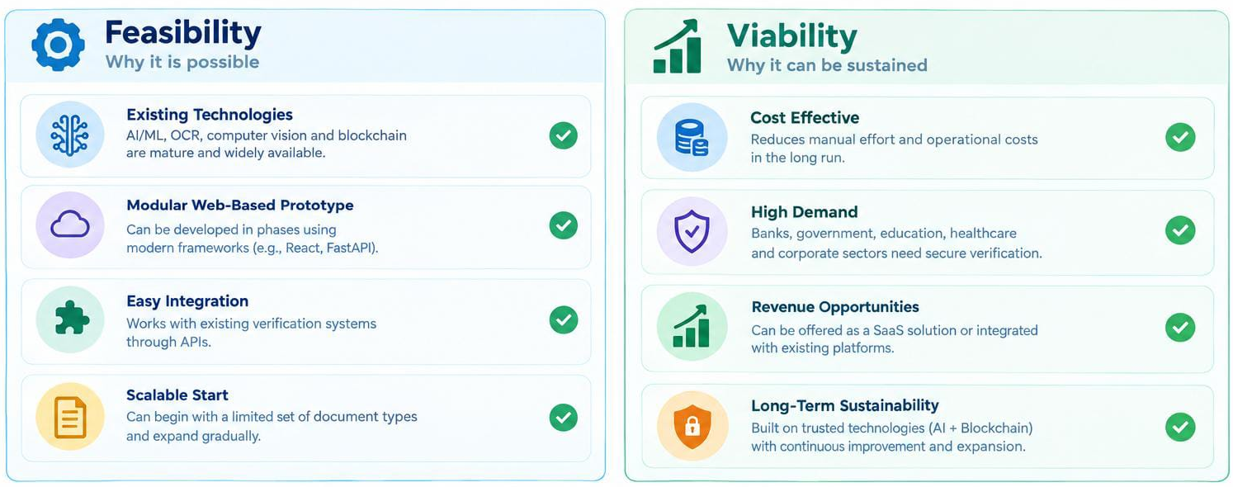
FEASIBILITY AND VIABILITY
Team TRINETRA

Slide 5

IMPACT AND BENEFITS
Team TRINETRA
Team TRINETRA

Slide 6
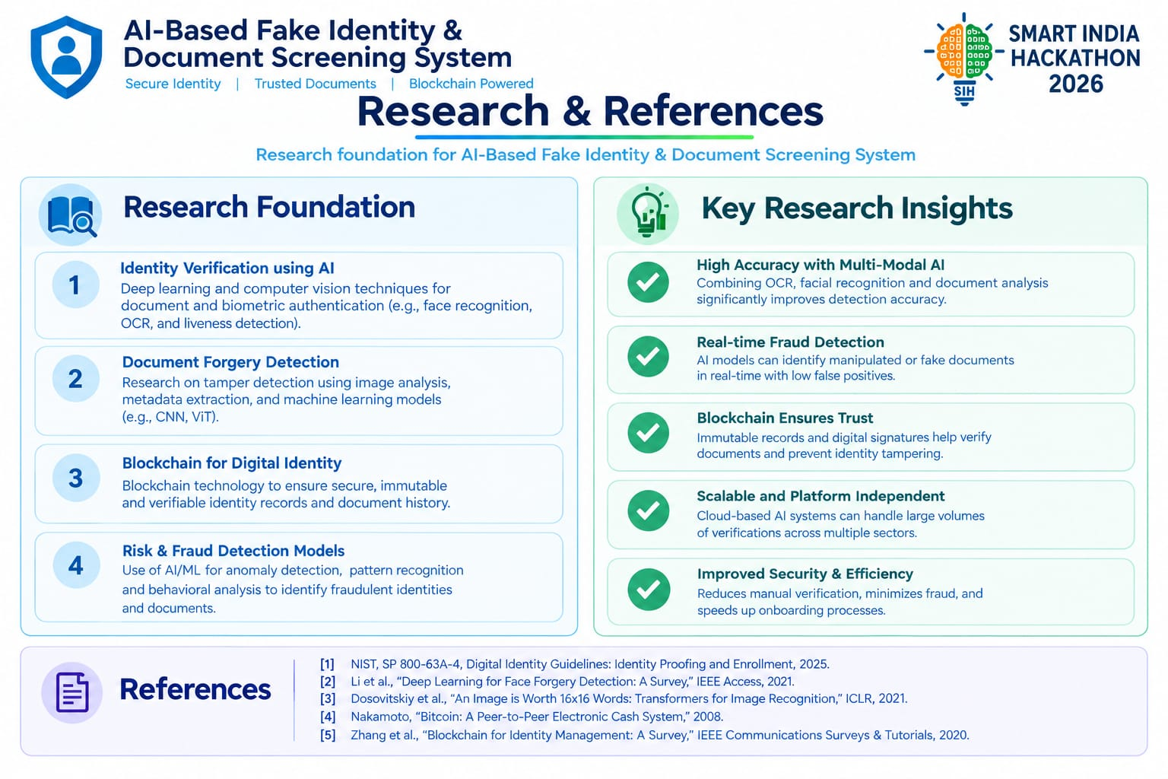
RESEARCH AND REFERENCES
Team TRINETRA

