Slide 1
CSC465 Final Project Group 9 Visualizations
Group member:
Zhaolong Lu
Peigeng Li
Harold Martin Sydney Nathan Legrand
Dachi Xu

Slide 2
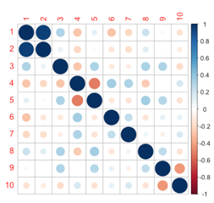
Visualization 1 basic data distributions
Census Stat Variables Box Plots
Histogram
Correlation Plot
1: Change in Population
2: Change in House Units
3: Change 5 to 7+ per house
4: Change built 1939 or less
5: Change built 1940 to 1959
6: Change Vacant Units
7: Change Income 25k to 50k
8: Change Income 50k to 75k
9: Change edu High School
10: Change eduCollege
Notes:
The Cook county project is a study of the social changes that occured in cook county over the past 13 years. As we can see from the histogram on the left, the distribution is skewed on the left due to very high increase of population and house units. Four of the ten variables have mostly decreased while the six others have sligtly increased, especially change in Incomes. The correlation matrix shows some strong relationships between population and house units but also a negative correlation betweenchange in buildings and in education.

Slide 3
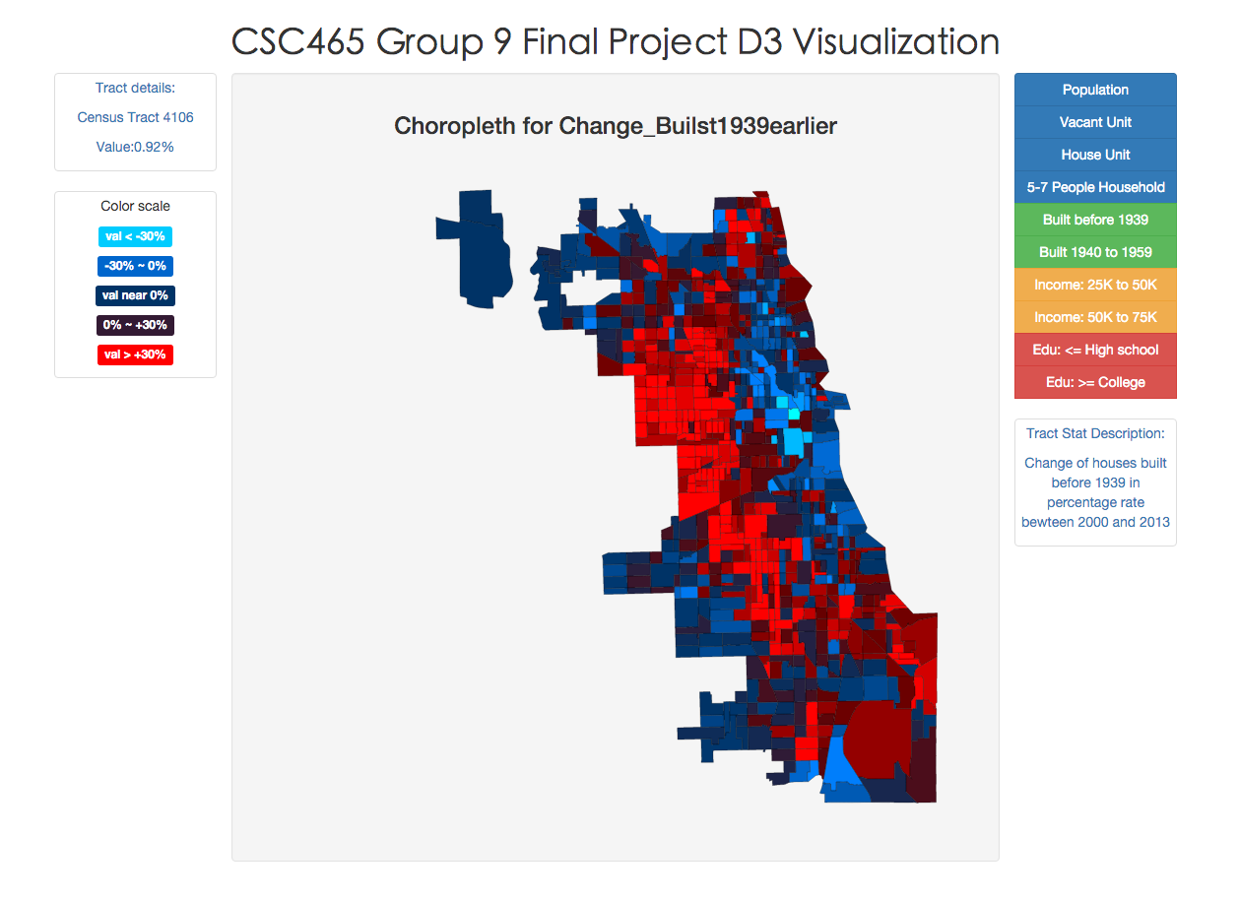
Visualization 2 Census Tract Choropleth
Webpage URL: http://dachicj.com/ChicagoCensusVisualization/
Census Detail
Statistic
options
Color
legend
Statistic
description
Choropleth

Slide 4
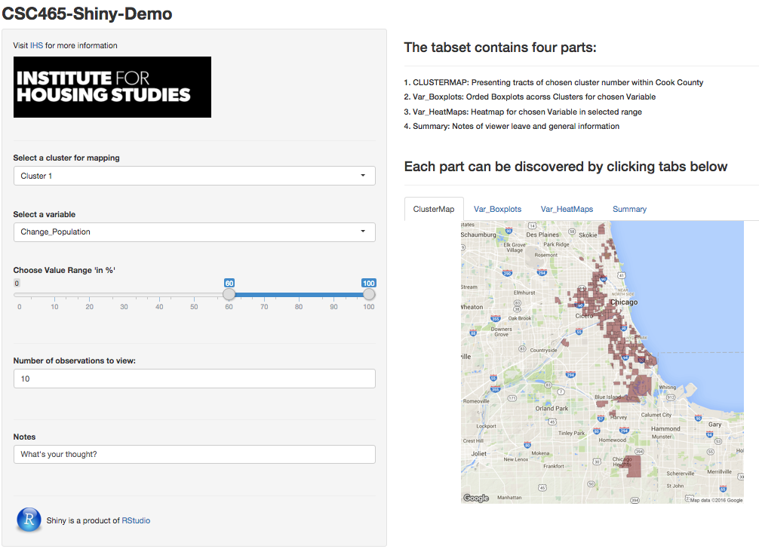
Visualization 3 Census Tract SHINY APPLICATION
Github_version:
library(shiny)
runUrl(“https://github.com/DachiCoding/ChicagoCensusVisualization/raw/master/scripts/census.zip”, display.mode = “showcase”)
ShinyIO_Version:
https://lzhaolon.shinyapps.io/census/
Notes:
As mentioned in the data description, k-means cluster method is used to find similar tracts and help us find unique communities. Using divided clusters index indicating each tracts’ categories. Combining tracts’ geographic information together with cluster indexes, the visualization can present a more intuitive view of the clusters among the Cook County area.
The boxplot is simply a general view of the distribution for each variable and discover whether there is uniqueness.
For each variable, the heat map is offered in the Shiny application enabling the user to select a specific range of the value to observe selected variable.
The ANOVA test is also used to make sure there is at least one variable is significant among all the clusters though it is not add into the interactive Shiny.
Notes: What do you think about each cluster and each variables. While observing the visualizations, you can put notes. And it will return to the summary.

Slide 5
Summary
Cluster 1,2,3(Urbanities):
increasing income in 25-50k
well educated
lincoln park, hyde park, lake view, west loop.
Cluster 4(Middle Class):
similar to Clustering 1,2,3
increasing income in 50-75k
Suburban area
Cluster 5,6,7,8(Wealth):
Stable communities
low change in income
low change in vacant unit
Coast or suburban area

