Slide 1
CSC465 Final Project Group 9 Visualizations
Group member:
Zhaolong Lu
Peigeng Li
Harold Martin Sydney Nathan Legrand
Dachi Xu

Slide 2
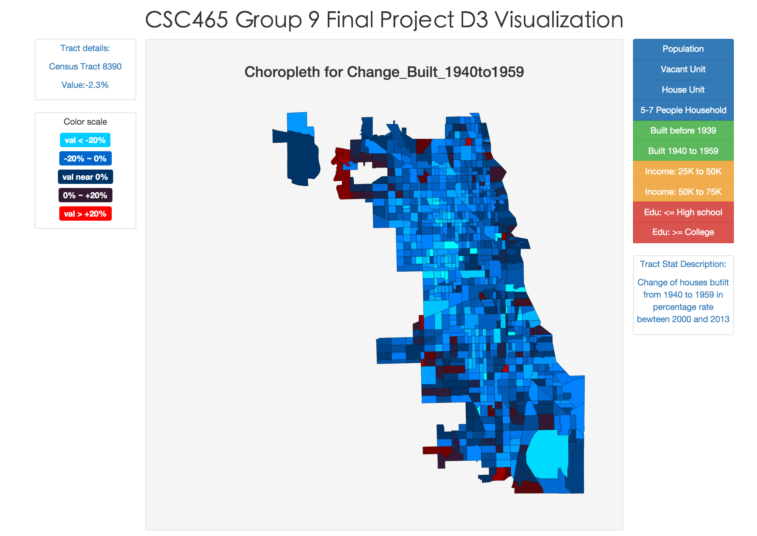
Visualization 2 Census Tract Choropleth
Webpage URL: http://dachicj.com/ChicagoCensusVisualization/
Census Detail
Statistic
options
Color
legend
Statistic
description
Choropleth

