Slide 1
Local community detection in a graph generated created by Preferntial deletion
-Prithika Vijayakumar

Slide 2
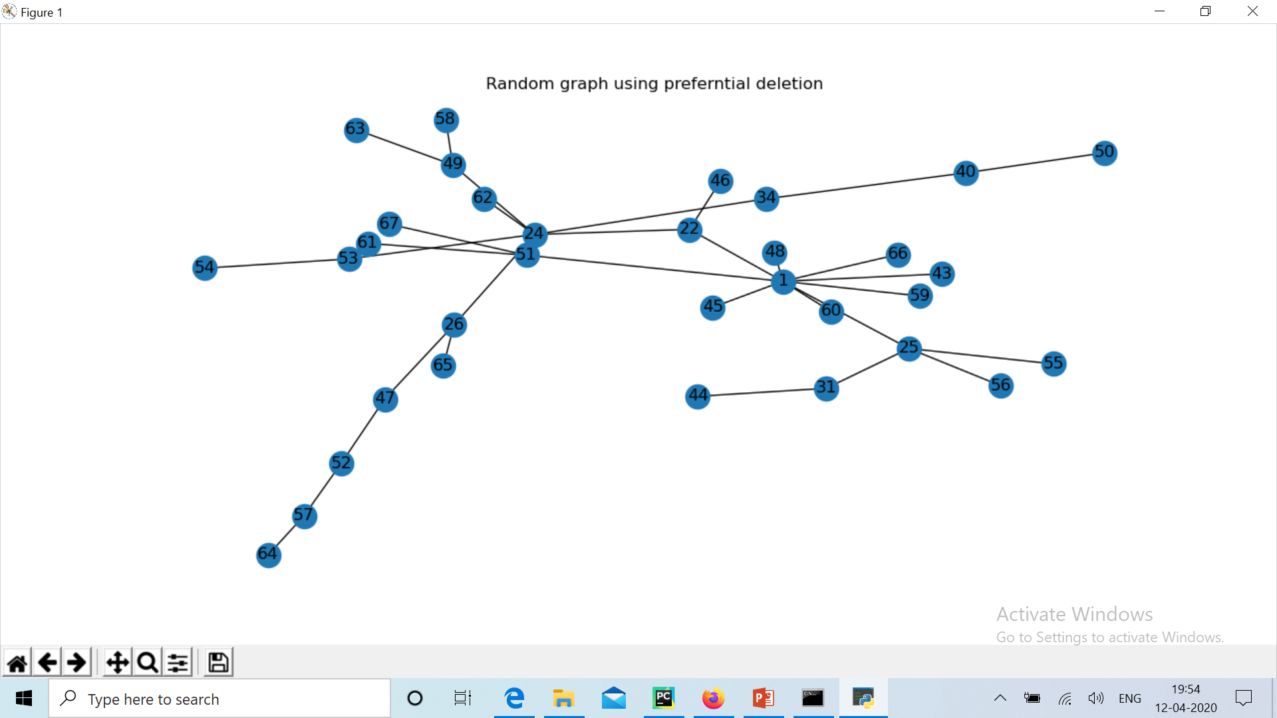
Random graph generated by preferential deletion
And linear attachment

Slide 3
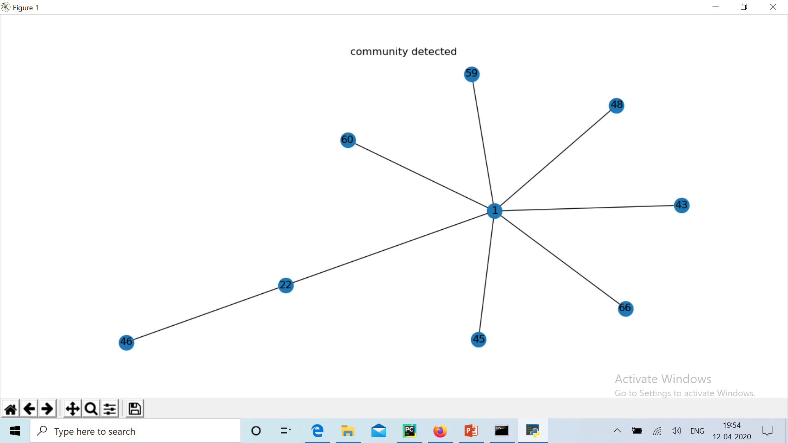
Community detected for seed nodes 1 and 22 using cluster coefficient

Slide 4
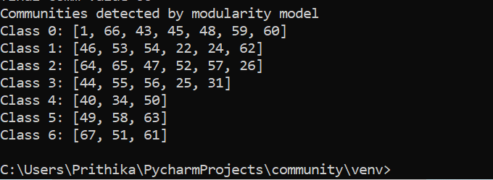
All Community detected by modularity model

Slide 5
Result for another simulation.

Slide 6
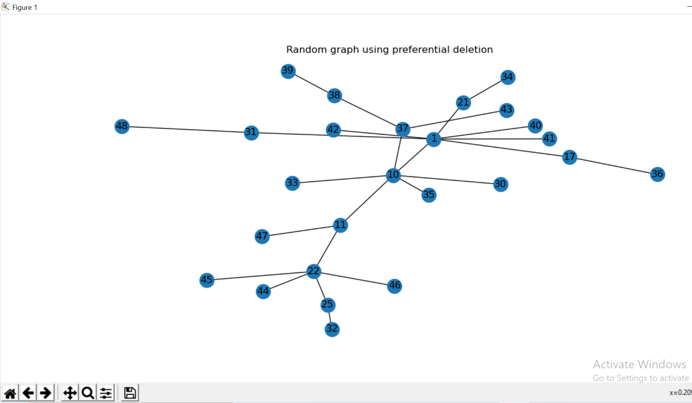
Random graph generated by preferential deletion
And linear attachment

Slide 7
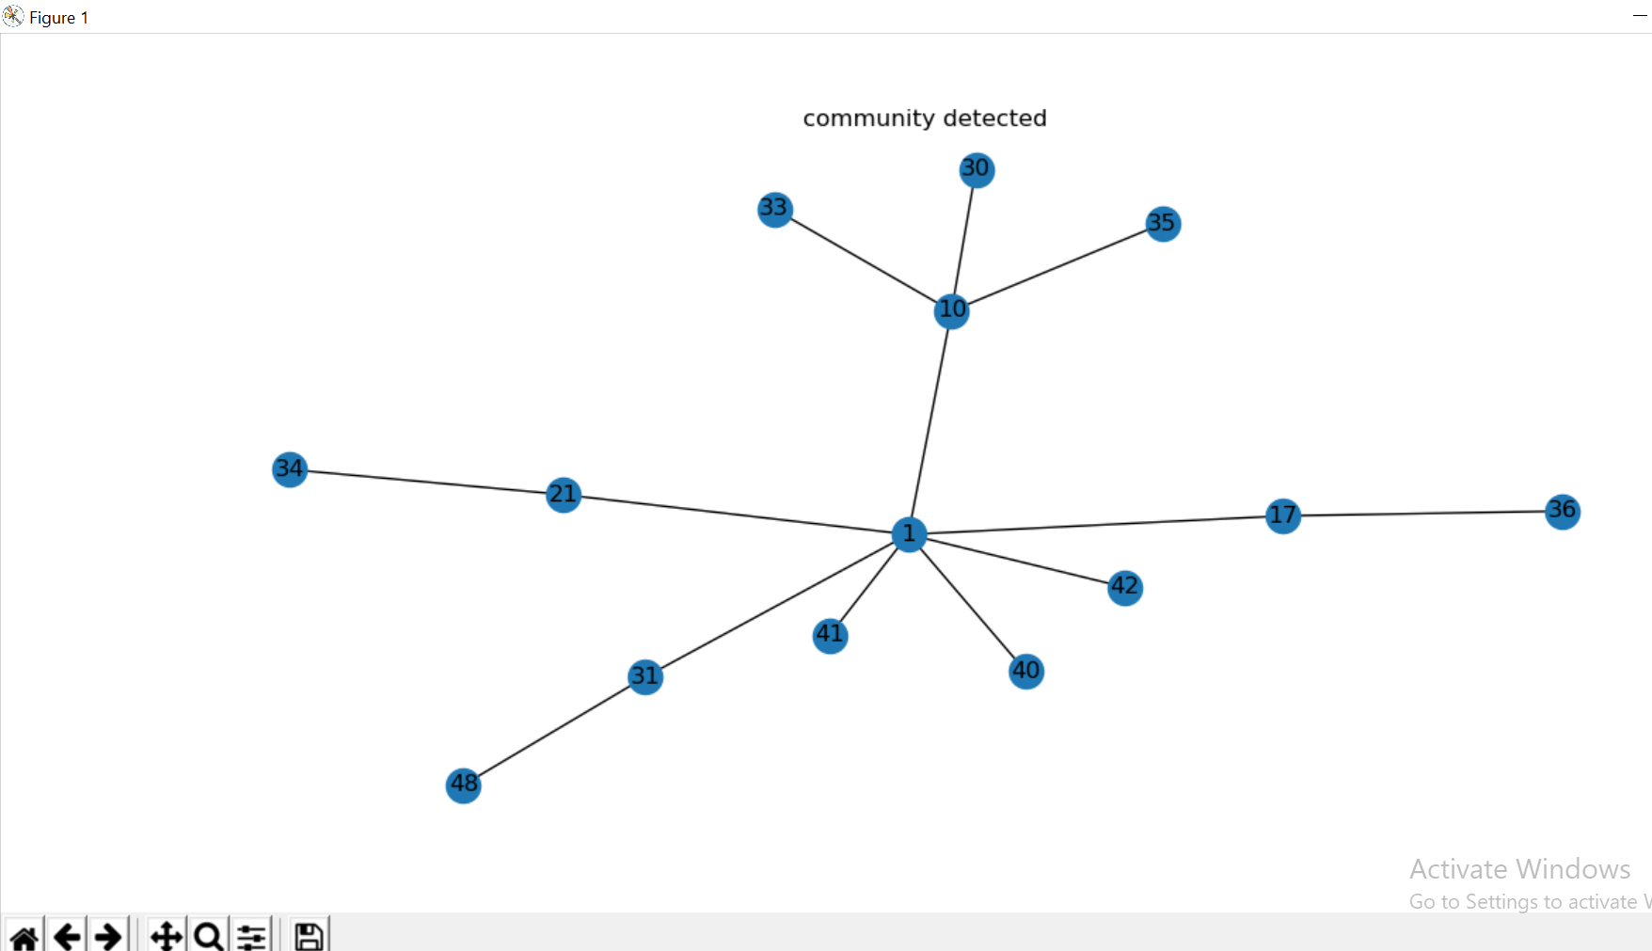
Community detected for seed nodes 1 and 10 using cluster coefficient

Slide 8
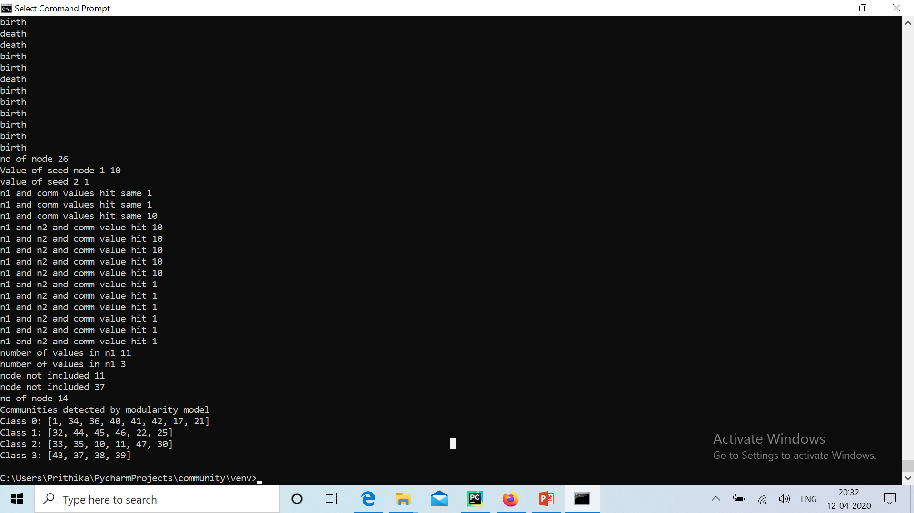
All Community detected by modularity model

